Slide 1

時間序列分析中的因果推斷： 概述、學界和業界概況 Causal Inference in Time Series Analysis:
Overview, Academic and Industry Landscape
presented by Steven Ho (何思賢)
2024/05/27

Slide 2
Outline
Why Causal Inference
Causal Inference in Academia
Causal Inference in Industry
Case Study: causaLens
Vizuro’s Strategy for Developing Causal AI
Q&A

Slide 3
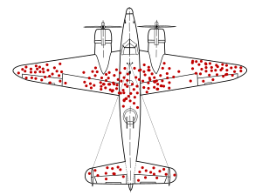
Why Causal Inference
Everyone knows, “Correlation does not imply causation.”
Without a model, it's easy to make erroneous judgments. Example: survivorship bias.

Slide 4
Why Causal Inference (Cont’d)
In traditional econometrics:
central theme: understanding the causes of bias in estimated coefficients
various methods to obtain (asymptotically) unbiased- estimators for coefficients
In traditional machine learning:
We essentially do not see these discussions how to obtain unbiased-estimators.
Why?

Slide 5
Why Causal Inference (Cont’d)
My personal view:
If the data is sufficient and representative, and no policy decisions are involved, but only predictions based on the data, causal analysis may not be crucial.
predictions vs explanation (+ policy recommendations): When it comes to explanation and policy recommendations, causal analysis is essential.
reduce reliance on data representativeness and lower costs: Additionally, when data is insufficient or unrepresentative, a correct causal model can save substantial costs from erroneous inferences.

Slide 6
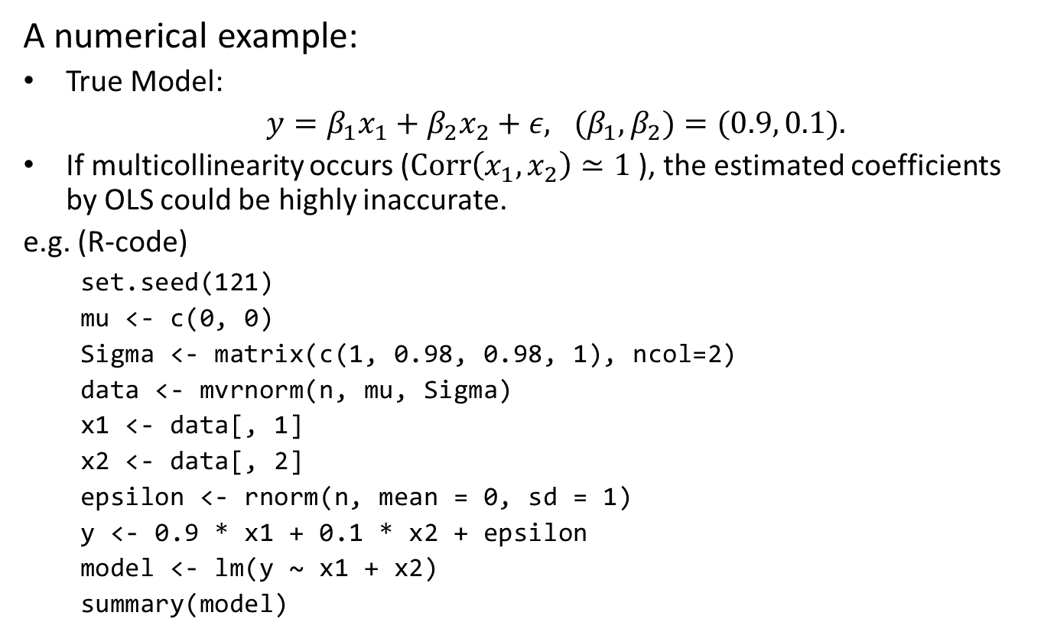
Why Causal Inference: An Example
A numerical example:
True Model:
$y=β_{1}x_{1}+β_{2}x_{2}+ε, {(β}_{1},β_{2})=(0.9, 0.1).$
If multicollinearity occurs ($Corr\left(x_{1},x_{2}\right)≃1$ ), the estimated coefficients by OLS could be highly inaccurate.
e.g. (R-code)
set.seed(121)
mu <- c(0, 0)
Sigma <- matrix(c(1, 0.98, 0.98, 1), ncol=2)
data <- mvrnorm(n, mu, Sigma)
x1 <- data[, 1]
x2 <- data[, 2]
epsilon <- rnorm(n, mean = 0, sd = 1)
y <- 0.9 * x1 + 0.1 * x2 + epsilon
model <- lm(y ~ x1 + x2)
summary(model)

Slide 7
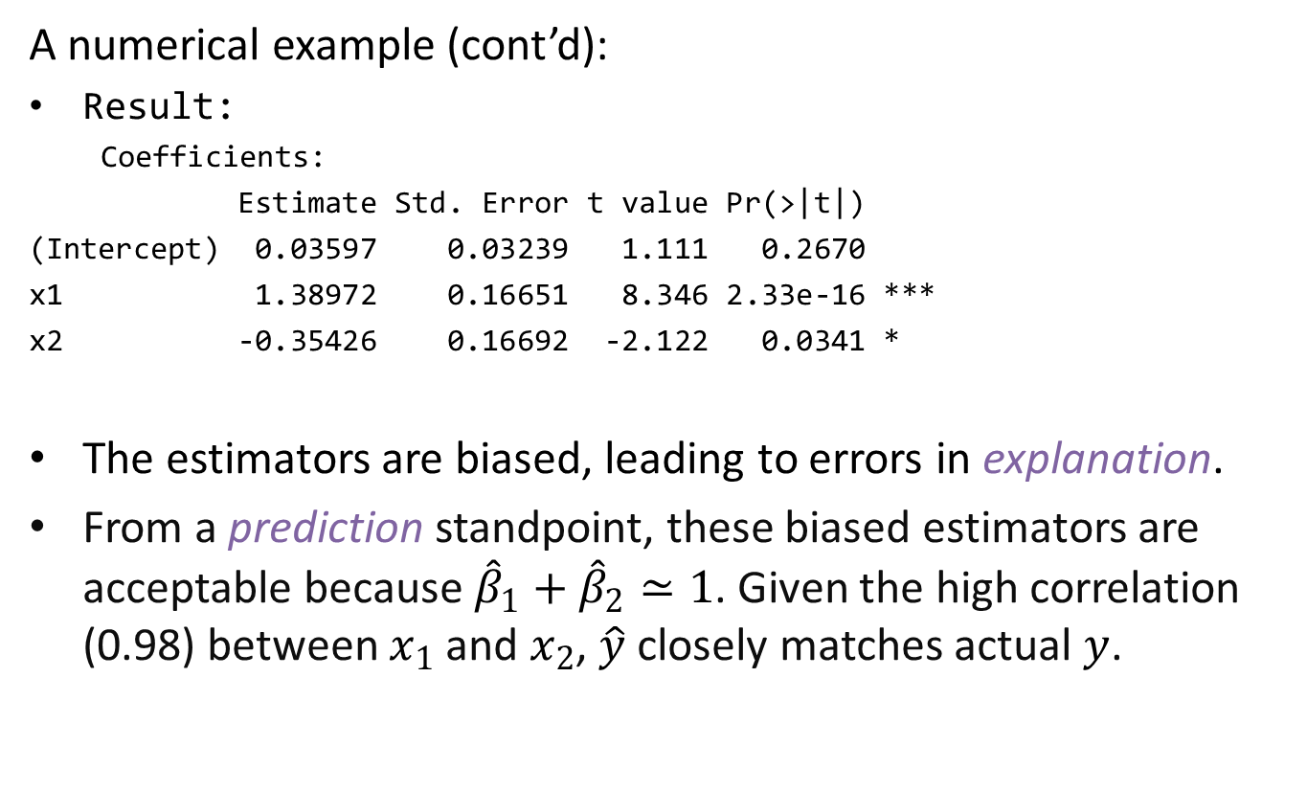
Why Causal Inference: An Example (Cont’d)
A numerical example (cont’d):
Result:
Coefficients:
Estimate Std. Error t value Pr(>|t|)
(Intercept) 0.03597 0.03239 1.111 0.2670
x1 1.38972 0.16651 8.346 2.33e-16 ***
x2 -0.35426 0.16692 -2.122 0.0341 *
The estimators are biased, leading to errors in explanation.
From a prediction standpoint, these biased estimators are acceptable because ${\hat{β}}_{1}+{\hat{β}}_{2}≃1$. Given the high correlation (0.98) between $x_{1}$ ​and $x_{2}$​, $\hat{y}$​ closely matches actual $y$.

Slide 8
Causal Inference in Academia: Overview
1980s: Foundations and Early Developments
Key Figures:
Donald Rubin, Paul Rosenbaum
Methods: Potential Outcomes Framework, Propensity Score Matching
Characteristics:
Emphasis on randomized controlled trials (RCTs)
Introduction of propensity score matching to handle confounding in observational studies​ (ar5iv)​​ (Harvard Scholars)

Slide 9
Causal Inference in Academia: Overview (Cont’d)
1980-2000s: Expansion and Formalization
Key Figures: Judea Pearl
Methods: Causal Diagrams, Structural Causal Models (SCM)
Characteristics:
Use of graphical models to represent causal relationships
Development of do-calculus for formal causal inference
Increased focus on counterfactual reasoning and interventions​ (ar5iv)

Slide 10
Causal Inference in Academia: Overview (Cont’d)
1990-2000s: Applied Methods and Policy Impact
Key Figures: James Heckman, Guido Imbens
Methods: Instrumental Variables, Natural Experiments, Difference-in-Differences (mainly in Economics)
Characteristics:
Addressing endogeneity and selection bias
Emphasis on quasi-experimental designs for policy evaluation and impact assessment
Expansion of econometric techniques for causal inference​ (ar5iv)​​ (Harvard Scholars)

Slide 11
Causal Inference in Academia: Overview (Cont’d)
2010s: Integration with Big Data and Machine Learning
Key Figures: Susan Athey, Stefan Wager
Methods: Causal Trees, Double Machine Learning, Synthetic Control Methods
Characteristics:
Integration of ML techniques to enhance causal inference accuracy
Development of scalable methods for high-dimensional data, such as causal forests and ensemble learning
Emphasis on robustness and generalizability of causal estimates​ (Oxford University Press)​​ (ar5iv)

Slide 12
Causal Inference in Academia: Overview (Cont’d)
2020s: Current Trends and Future Directions
Methods: Deep Learning for Causal Inference, Causal Discovery Algorithms
Characteristics:
Cross-disciplinary approaches integrating AI and causal inference
Advanced techniques for causal discovery in complex systems
Focus on improving transparency and interpretability of causal models

Slide 13
Causal Inference in Academia: GitHub Projects
Institution | Project Name | Description
PyWhy (Carnegie Mellon University) | causal-learn | A Python package for causal discovery implementing various causal discovery algorithms. (Discovery)
University of Hamburg | DoubleML | An R and Python package for double machine learning for causal inference. (Inference)
Stanford University | GRF | A package for generalized random forests for estimating heterogeneous treatment effects. (Inference)

Slide 14
Causal Inference in Industry: Overview (2010s to now)
Marketing and Customer Analytics: Analysis of the impact of marketing strategies on customer behavior and sales
Healthcare: Analysis of treatment effects and healthcare policies
Finance: Risk assessment and investment strategy optimization
Real-Time Personalization: Personalized recommendations and advertisements in real-time
Supply Chain Optimization: Improving supply chain efficiency by understanding the causal impact of various factors on logistics and inventory management

Slide 15
Causal Inference in Industry: GitHub Projects
Company | Project Name | Description
Google | CausalImpact | An R package for causal inference using Bayesian structural time-series models. (Inference)
 | TFP CausalImpact | Python version of above (Inference)
Uber | CausalML | A Python package for uplift modeling and causal inference with ML. (Inference)
Microsoft | DoWhy | A Python library supports explicit modeling and validation of causal assumptions, combining causal graphical models and the potential outcomes framework. (Discovery)
 | EconML | A Python package for interpretable machine learning methods to estimate heterogeneous treatment effects. (Inference)

