Slide 1

Road Safety App “B.Safe”
By Team ‘Hustler Dudes’

Slide 2
Introduction to B.Safe
In view to the problem statement given, we have come up with an app which helps citizens of all ages to prevent accidents or get help while facing any problem immediately.
The following project is based on the ideology of road accidents occurring in the state and lack of communication between the authorities.
The project is up to date with the software requirements and functioning given in the next slide.

Slide 3
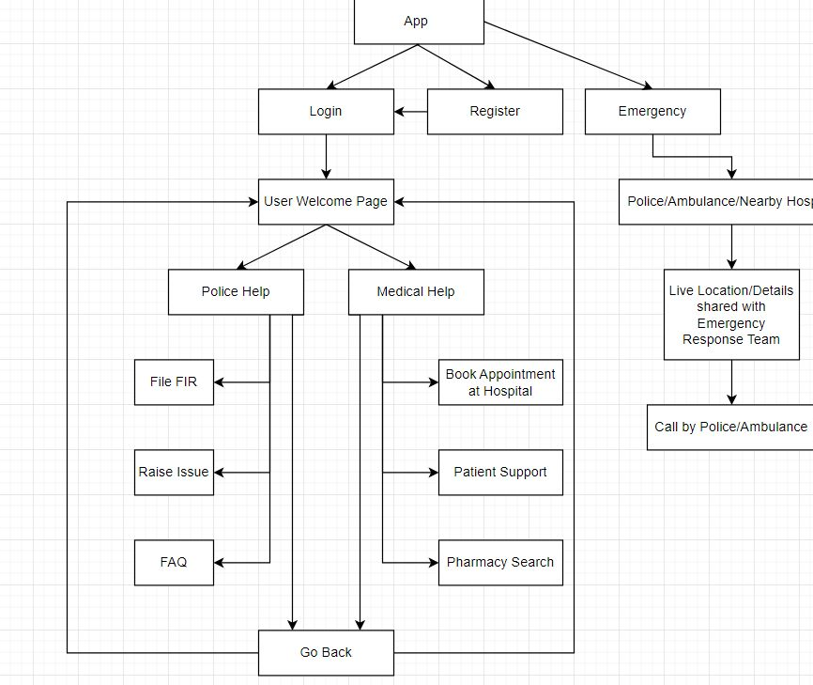
Flowchart of the Application “B.Safe”

Slide 4

GUI of the App “B.Safe”
Login Page

Slide 5
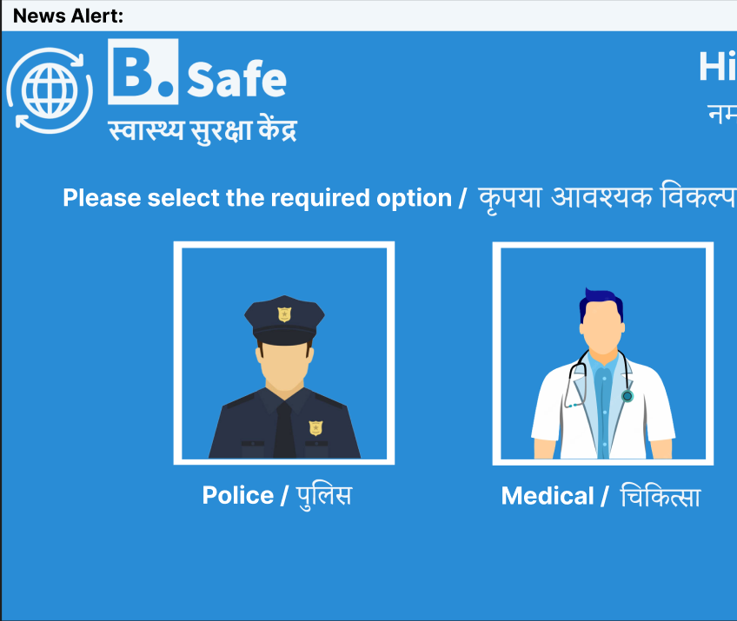
User Interface
User Intro Page

Slide 6
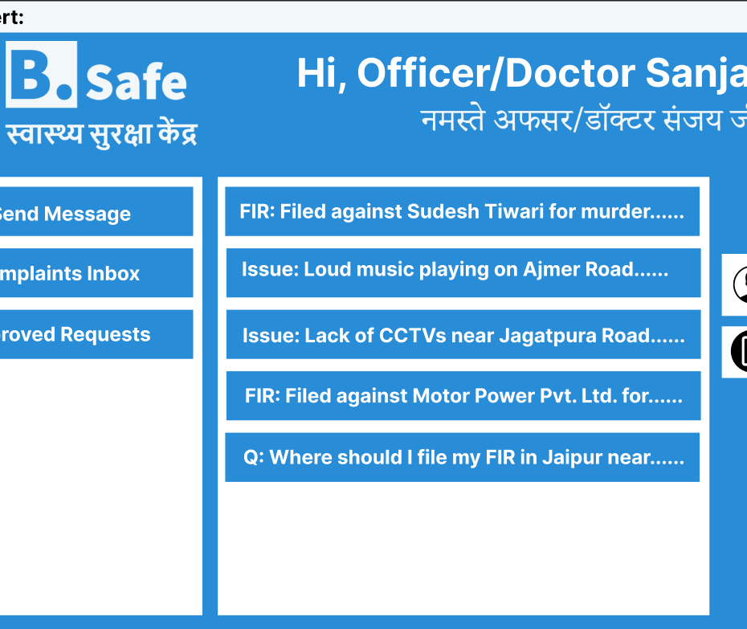
User Interface
Officer/Doctor Intro Page

Slide 7
Links to the Project App “B.Safe”
https://github.com/raidin2k3/Road-Safety-App-B.Safe-

Slide 8
Thank You

