Slide 1


RAHGIR (राहगीर)
A Multi-Agent AI Travel Assistant for Indian Road Trips
Mini Project / 5ᵗʰ Sem / BCS554
STUDENT NAME :
1. Raj Porwl 2400320100875
2. Rameshwar Tripathi 2400320100888
3. Shashank Kumar 2400320101027
4. Rahul Singh 2400320100872
SUPERVISOR NAME:
Mr.Praveen Kumar Rai
(Assistant Professor)

Slide 2
ABSTRACT
• RAHGIR (राहगीर) is a multi-agent AI travel assistant that plans complete road trips across India from a single natural-language request.
• Existing map apps give the shortest route, but not the experience - they cannot tell a traveller what a place is famous for, or what is worth stopping for on the way.
• RAHGIR uses a LangGraph-orchestrated team of specialised AI agents (route, discovery, "famous-for", and itinerary agents) built on a FastAPI backend.
• Routing data comes from OpenRouteService and points of interest from the Google Places API (with OpenTripMap as fallback); an LLM layer enriches each stop with local context, food, and culture.
• Output is a day-wise, drive-time-aware itinerary with detours, halts, and local highlights - tailored to Indian highway travel.

Slide 3
OBJECTIVE
• To build an AI travel assistant that converts a plain-language request (e.g. “Delhi to Jaipur in 2 days”) into a complete, day-wise road-trip itinerary.
• To design a multi-agent architecture using LangGraph, where each agent handles one responsibility - routing, discovery, enrichment, and planning.
• To integrate real routing and POI data (OpenRouteService for routing, Google Places for POIs) instead of relying only on LLM memory, reducing hallucinated places.
• To implement a “famous-for” agent that explains why each stop matters - its food, heritage, or local speciality.
• To expose the system through a FastAPI backend with a clean web interface, keeping response time practical for real use.
• To focus specifically on Indian highway travel, including tier-2 and tier-3 towns that mainstream travel apps ignore.

Slide 4
SCOPE of the Problem Statement
Problem: Planning an Indian road trip today means juggling maps, blogs, YouTube videos and WhatsApp advice. Map apps optimise for distance, not for what is worth seeing.
Scope of RAHGIR:
• Covers road-based domestic travel between any two Indian cities, including intermediate towns along the highway.
• Generates a multi-day itinerary with realistic driving hours, halt suggestions, and cultural or culinary highlights per stop.
• Works from a single conversational input - source, destination, duration, and interests.
• Out of scope (current version): flight and train booking, hotel reservation, live traffic prediction, and payment integration.

Slide 5
RELATED WORK
• Google Maps / MapmyIndia - excellent routing and navigation, but purely distance and time optimised; no narrative or cultural context for stops.
• MakeMyTrip / Yatra / TripAdvisor - strong for booking and reviews, but oriented to destinations and hotels rather than the journey between them.
• ChatGPT and similar LLM assistants - can draft itineraries, but rely on model memory alone, which causes outdated or hallucinated places and unrealistic drive times.
• Research on LLM agents (ReAct, Toolformer) shows tool-augmented reasoning reduces hallucination - the basis for our grounded, API-backed design.
• Gap identified: no existing system combines real routing APIs, POI data, and LLM reasoning specifically for Indian road-trip planning.

Slide 6
Applications
• Personal road-trip planning - families, students and weekend travellers get a ready day-wise plan with halts, food stops and sightseeing.
• Tourism promotion for smaller towns - surfaces tier-2 and tier-3 destinations that rarely appear in commercial travel listings.
• Travel agencies and tour operators - can auto-draft custom itineraries for clients in seconds instead of hours of manual research.
• Highway hospitality and local businesses - dhabas, homestays and heritage sites gain visibility as recommended stops.
• Educational and cultural travel - school or college trips planned around heritage, craft and food clusters along a route.
• Reusable architecture - the multi-agent pattern can be extended to logistics routing, pilgrimage circuits, or state tourism portals.

Slide 7
Limitations
• No live traffic or road-condition data - travel times are estimates and may differ during monsoon, festivals or roadwork.
• Latency and cost - multiple agent calls per request increase response time and API usage compared with a single query.
• No booking, payment or real-time availability for hotels and restaurants in the present version.

Slide 8
Conclusion and Future Scope
Conclusion:
• RAHGIR demonstrates that a multi-agent LLM system grounded in real routing and POI APIs can produce practical, context-rich road-trip itineraries for Indian travellers.
• Splitting the work across specialised LangGraph agents kept each component simple, testable and easy to extend.
• The “famous-for” layer is the key differentiator - it turns a route into a journey with meaning.
Future Scope:
• Add user-contributed and state tourism-board POI data for towns thin on commercial listings.
• Add live traffic, weather and fuel-stop awareness for more accurate timing.
• Hindi and regional-language support, plus a voice interface for drivers.
• Mobile application with offline itinerary access and hotel/dhaba booking integration.
• Personalisation from past trips and user feedback.
• Integration into cars as a Tour Mode.

Slide 9
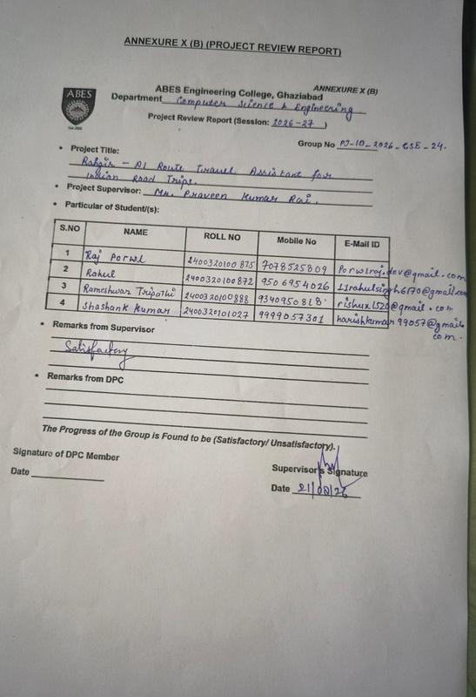
Annexure 10 B (Screenshot :Duly Signed by Supervisor)

Slide 10
References
[1] LangChain Inc., “LangGraph documentation,” LangGraph, 2024. [Online]. Available: https://langchain-ai.github.io/langgraph/
[2] S. Ramírez, “FastAPI documentation,” FastAPI, 2024. [Online]. Available: https://fastapi.tiangolo.com/
[3] HeiGIT, “OpenRouteService API documentation,” Heidelberg Institute for Geoinformation Technology. [Online]. Available: https://openrouteservice.org/dev/
[4] Google LLC, “Places API documentation,” Google Maps Platform, 2024. [Online]. Available: https://developers.google.com/maps/documentation/places/web-service
[5] OpenTripMap, “OpenTripMap API documentation,” OpenTripMap. [Online]. Available: https://opentripmap.io/docs
[6] S. Yao et al., “ReAct: Synergizing reasoning and acting in language models,” in Proc. Int. Conf. Learn. Represent. (ICLR), 2023.
[7] T. Schick et al., “Toolformer: Language models can teach themselves to use tools,” in Adv. Neural Inf. Process. Syst. (NeurIPS), vol. 36, 2023.
[8] P. Lewis et al., “Retrieval-augmented generation for knowledge-intensive NLP tasks,” in Adv. Neural Inf. Process. Syst. (NeurIPS), vol. 33, 2020, pp. 9459–9474.
[9] Ministry of Tourism, Government of India, “India tourism statistics 2024,” New Delhi, India, Rep., 2024.

