Slide 1
Password Preservation
Prepared By:
Mohd. Raihan Uddin
Software Engineer
Ultra-X BD

Slide 2
Introduction
This presentation is offered how we can store our essential password in windows application. This application name is password reservation. Sometimes we forget our very essential password like facebook, twitter, gmail, yahoo etc. To reservation these password this application is very useful.
Basically this application has 5 forms
1) Sign in form
2) Registration form
3) Homepage form
4) Add new items form and
5) View forms
In the next step I will explain UI design of this application

Slide 3
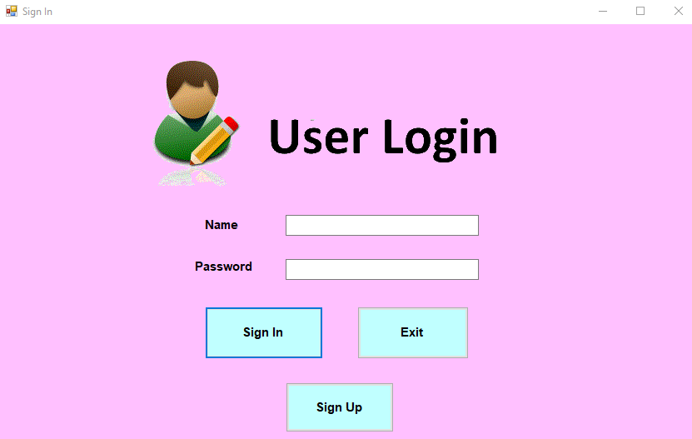
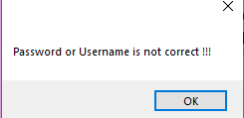
Login Page
Here is my User Login page.
→ There has two text field. One for entry the name and another for entry the password
→ There has two button. If we click exit button then the window will close.
If the entire name and password is not correct then it provide
“incorrect username and Password”.
If It successfully done then it go to home Page.
→ Another button has named as Sign up. Here the user can register for authenticate.

Slide 4
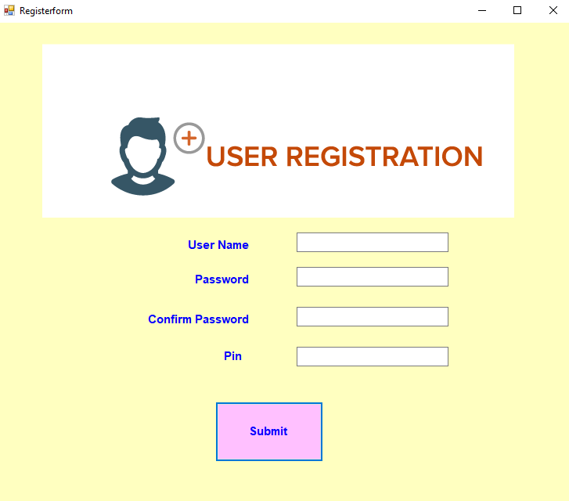
User Registration Page
Here is my User registration page.
If we click “Sign Up” button in
→ There has 4 text box.
* Name
* Password
* Confirm Password
* Pin
If the entire password and confirm password are not match the a red label is create which is show “Password Mismatch”
Here is the very important text field name as “Pin”.
If any authorized person access password, he won’t be access get information because of this pin.
Only authorized person know the pin , and only he will get the information

Slide 5
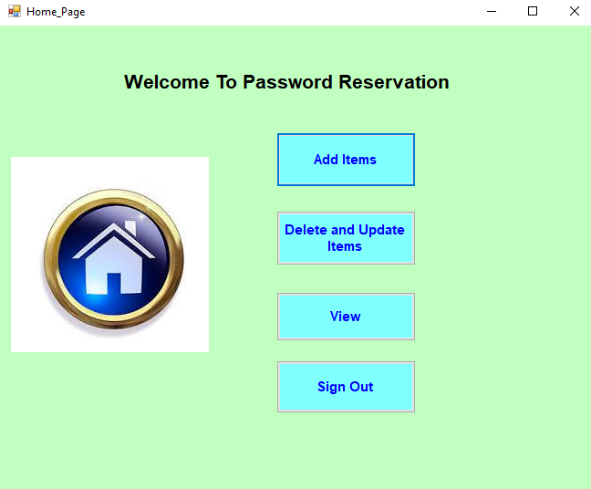
Home Page
Here is my User Home page.
→ There has four option
1. Add Items.
If we want to add more item and password to store database, then we need to click add items.
2. Delete and update items.
If we want to delete any item and want to update any password then we need to click delete and update items.
3. View option is for showing the items and there password.
4. If we click to Sign Out then we go to the user login page.

Slide 6
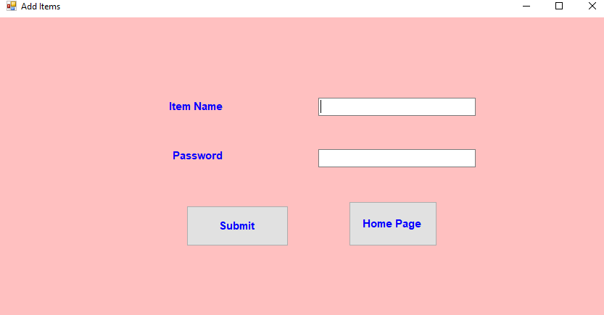
Add Items
The the item add page. Here we can add item and their password then it store in database.
Here is two text box. One is for entry the item name and another one is for entry the password then it submitted successfully.
Here I include a Home page button to go for home page.

Slide 7
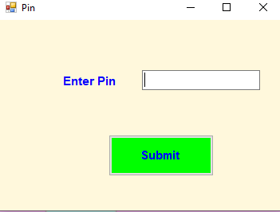
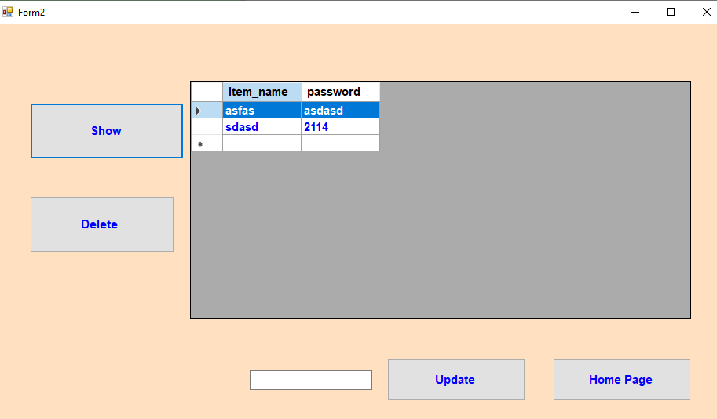
Delete and update item
Here is my delete and update item page . If we want to delete any data or update any password the we select
this button. After clicking this button it will show the pin information of user.
After successfully submitted the pin. It will show show the main page of delete and update.
There has 4 button and one text box
The text box is used for updating the password.
Show button show the result of the items .
Delete button delete the selected result.
Update button update the information from the text box.
And home page button is used for go to home page.

Slide 8
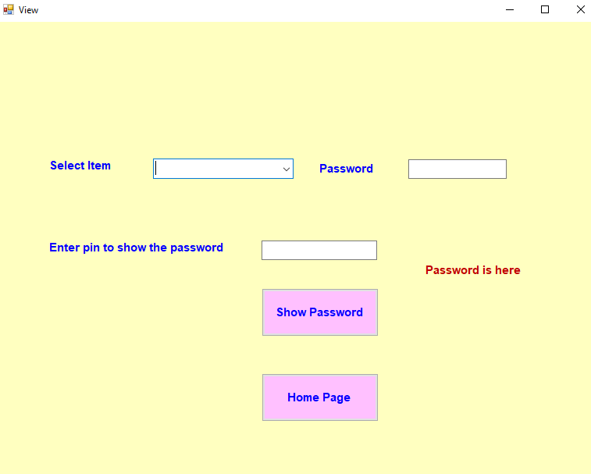

View Page.
Here is my view page.
There has three text box and two button box.
View box is mainly used for select and show the password of the item.
Select item is used for select the item.
After select item, the password is show all character as a star that means it is hide
If we enter the valid pin then the user show the password of the item.
If enter the wrong pin it will not work.

