Slide 1
Cross Traffic Intersection
Presented by:
Abu Sayem
Bodrul Amin Murad
Ismail Hossain
Raihan Uddin

Slide 2
Motivation
Urban intersections are major congestion points, causing delays, higher fuel use, and safety risks
Traditional traffic lights and stop signs lack adaptability for dynamic traffic and autonomous vehicles
Autonomous fleets demand real-time, fairness-driven control to maximize throughput and minimize wait times
Integrated software-hardware solutions can deliver low-latency, verifiable performance

Slide 3
Introduction
Project: Cross Traffic Management for autonomous vehicles at a four-way junction
Core concept: Max Dynamic Weight Scheduling—prioritizes directions by real-time queue metrics
Development stages:
C implementation of core queuing logic
FreeRTOS integration for real-time task management
UPPAAL verification of timing and safety properties
VHDL hardware design and ModelSim simulation

Slide 4
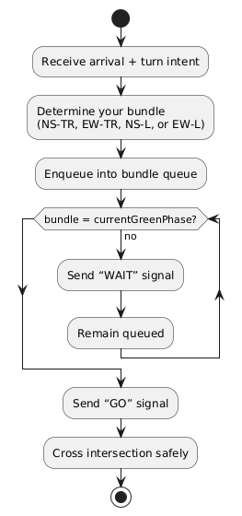
SysML diagrams
Activity Diagram
Models per-vehicle flow: arrive → bundle classification (NS-TR, EW-TR, NS-L, EW-L) → enqueue → WAIT/GO signals → safe crossing
Visualizes gating by current green phase and request buffering

Slide 5
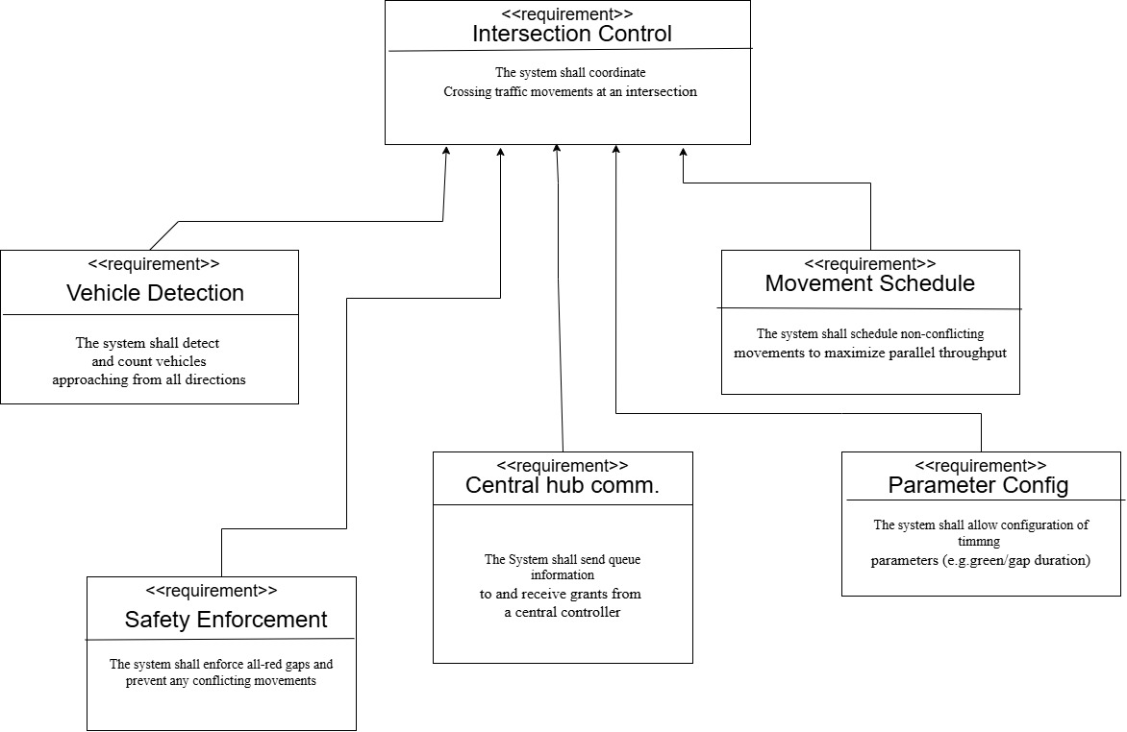
SysML diagrams
Requirements Diagram
Top-level :
    Vehicle Detection
    Movement Scheduling
    Central Hub Communication
    Parameter Configuration
    Safety Enforcement
Ensures traceability from system objectives to specific features

Slide 6
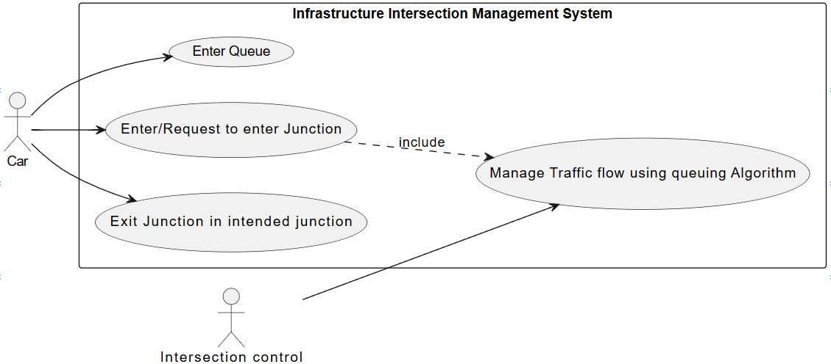
SysML diagrams
Use Case Diagram
Actors : Car (enter queue, request entry, exit junction), Intersection Control (scheduling service)
Use case: “Manage Traffic Flow using Queuing Algorithm” binds vehicle requests to scheduler

Slide 7
Why Dynamic Weight Scheduling Algorithm
Dynamic Prioritization: Continuously adapts to real-time traffic conditions, giving higher priority to directions with heavier demand.
Throughput Optimization: Balances competing flows to maximize the number of vehicles served per cycle.
Fairness Guarantee: Ensures no direction is perpetually delayed by periodically boosting weights for long-waiting queues.
Responsive to Surges: Quickly reacts to sudden spikes in arrivals (e.g., platoons of autonomous cars) without manual retiming.

Slide 8
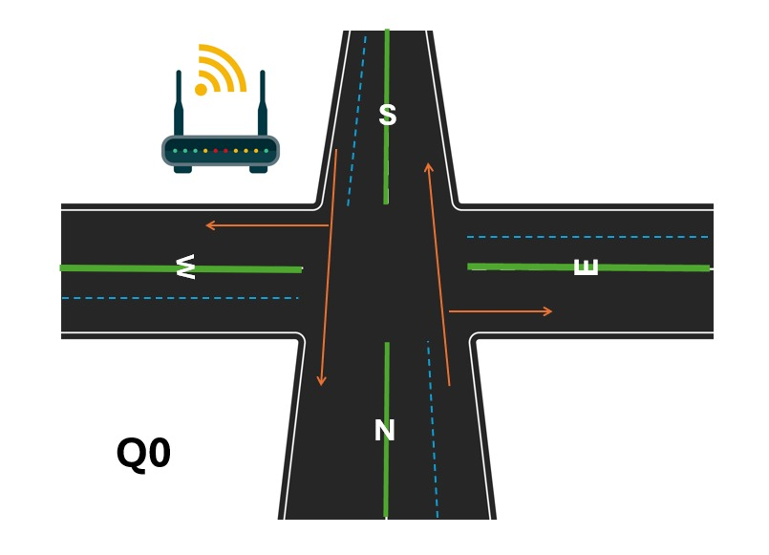
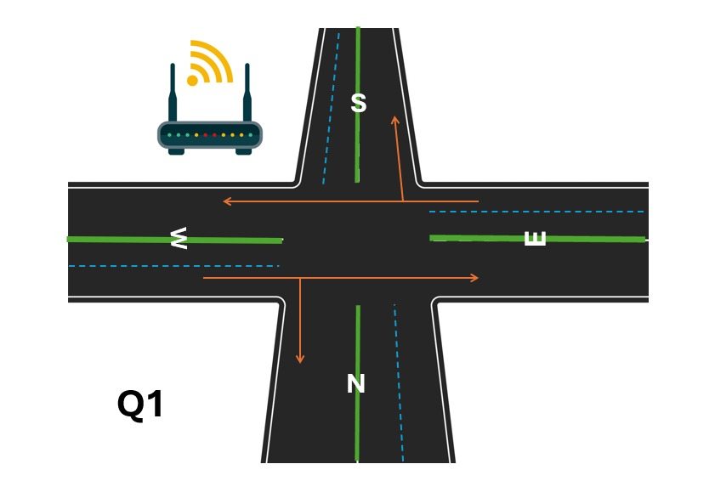
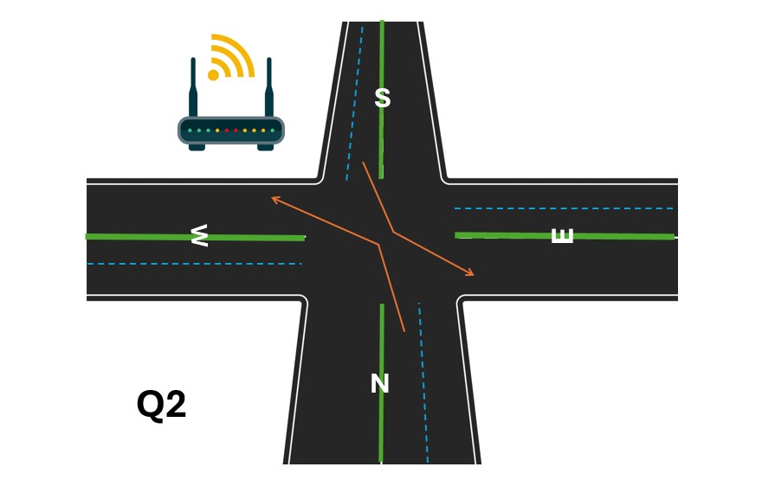
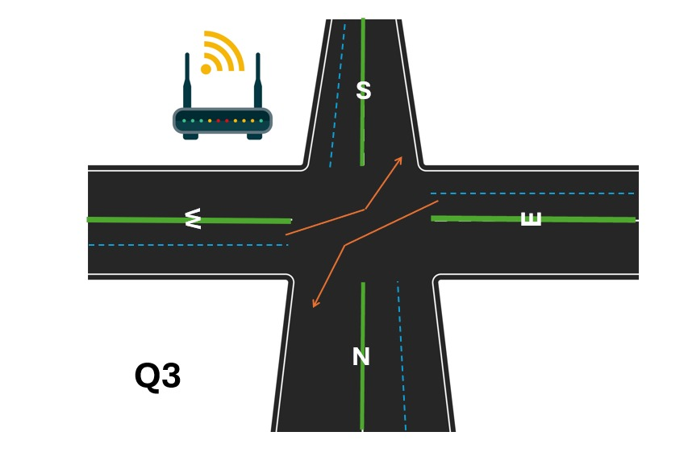

Slide 9
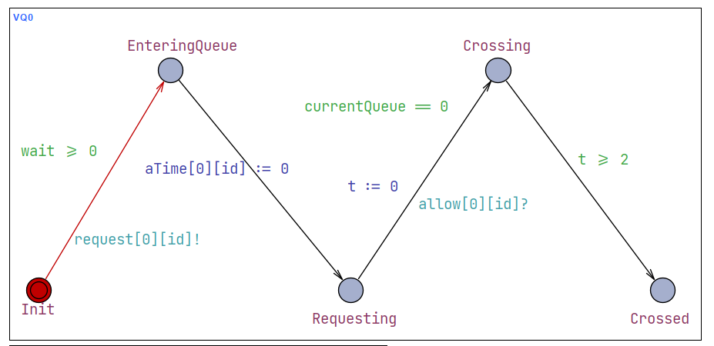
uppaal

Slide 10
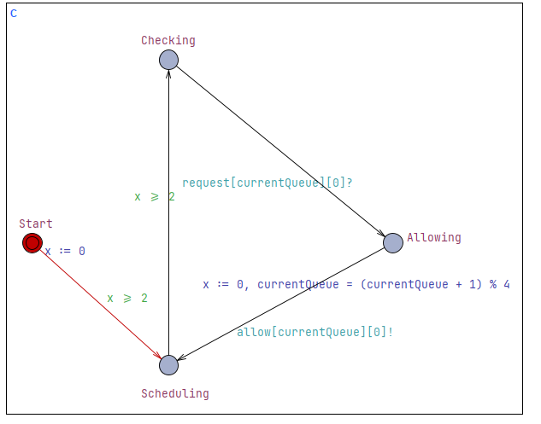
Uppaal Controller

Slide 11
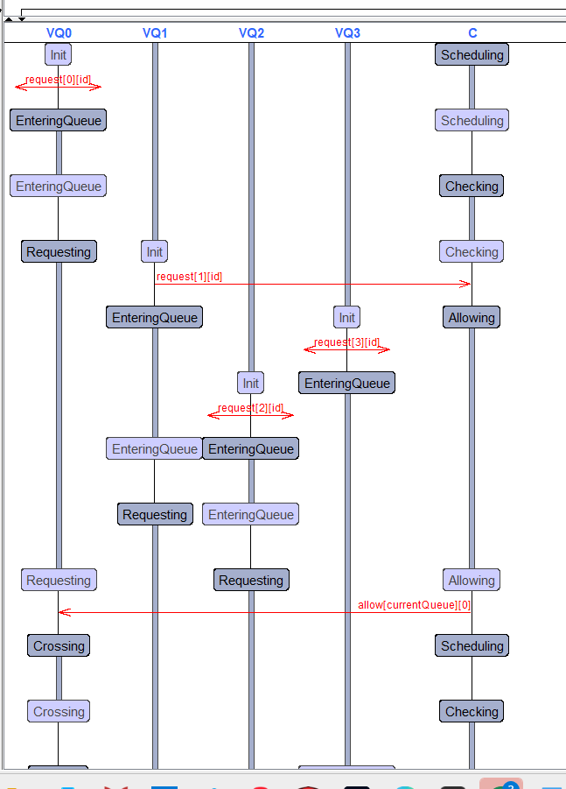
Uppaal Sequence Diagram

Slide 12
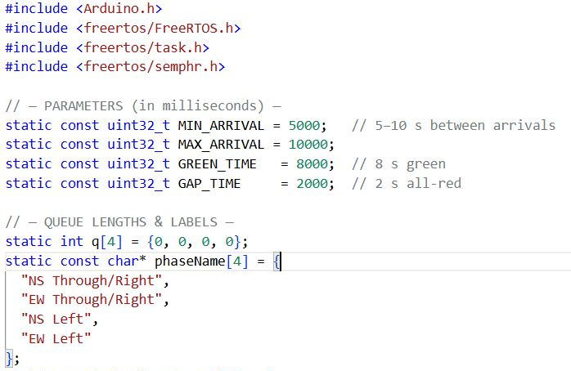
Code Setup & Parameters
ESP32 microcontroller to implement the FreeRTOS-based scheduling algorithm and display queue updates and traffic signal phases via the Serial Monitor
Includes necessary libraries for Arduino and FreeRTOS.
Defines timing parameters for arrival, green light, and all-red gap.
Initializes an array to track the number of cars in 4 directions.
Assigns readable names for each traffic phase (used in logs).

Slide 13
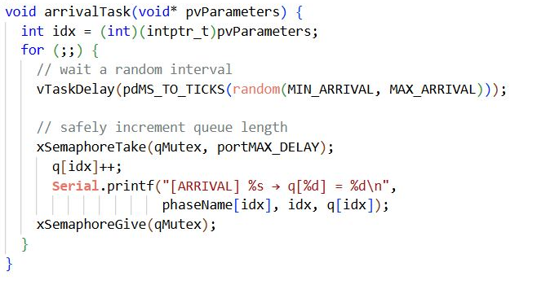
Simulates Cars Entering Queues
Runs continuously using for(;;) loop.
Waits a random time between 5–10 seconds.
Safely increments the queue count using a mutex.

Slide 14
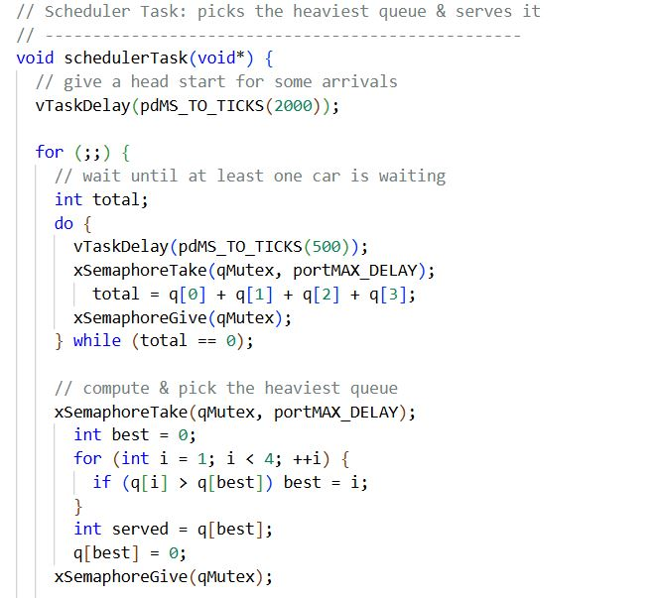
Picks the Heaviest Queue
Waits until at least one car is present.
Selects the queue with the most cars.
Sets it to green for 8 seconds, then all-red for 2 seconds.
Resets the served queue to zero.

Slide 15
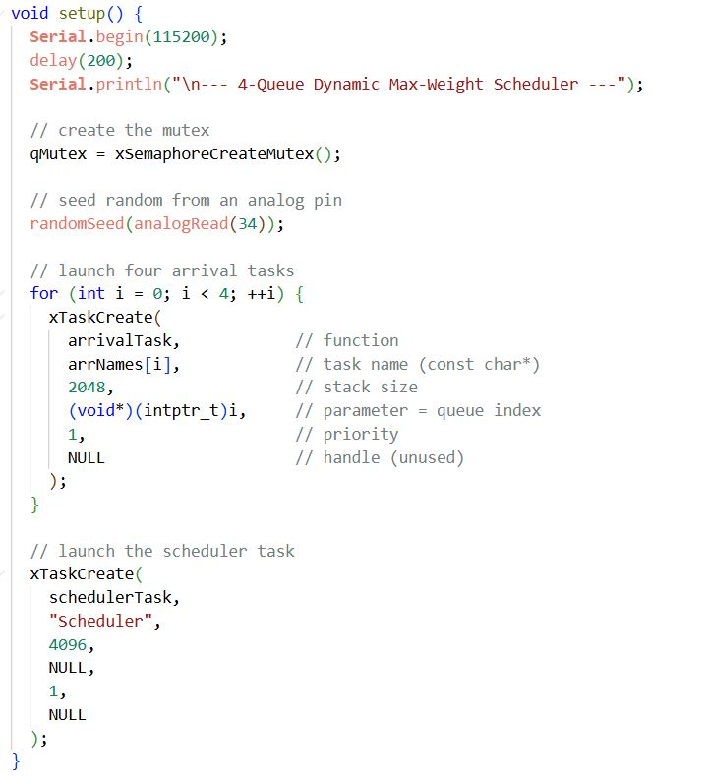
System Initialization with FreeRTOS
Initializes serial, random seed, and FreeRTOS mutex.
Creates 4 arrival tasks and 1 scheduler task using xTaskCreate().
FreeRTOS enables multitasking, each task runs independently.

Slide 16
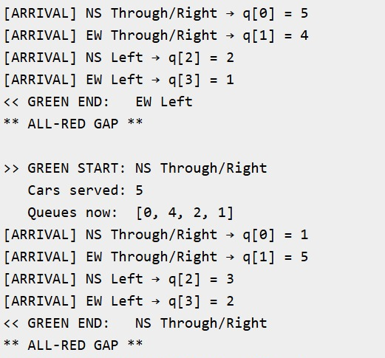
Output : Dynamic Traffic Light Control

Slide 17
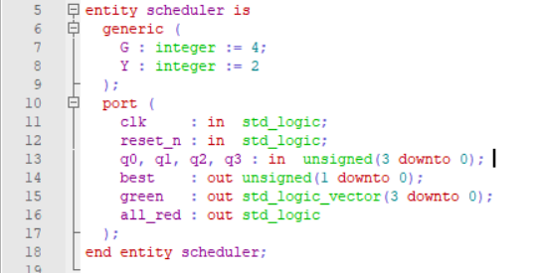
VHDL
Entity Declaration

Slide 18
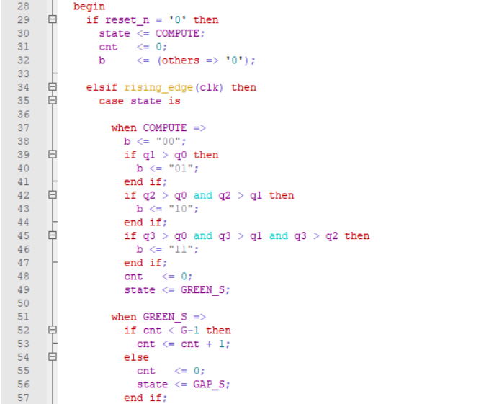
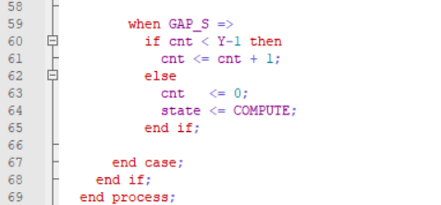
Main Process Block

Slide 19
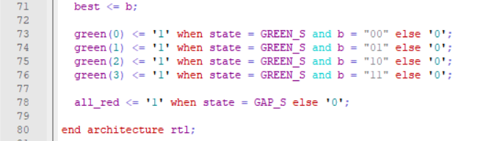
Green Signal Control

Slide 20
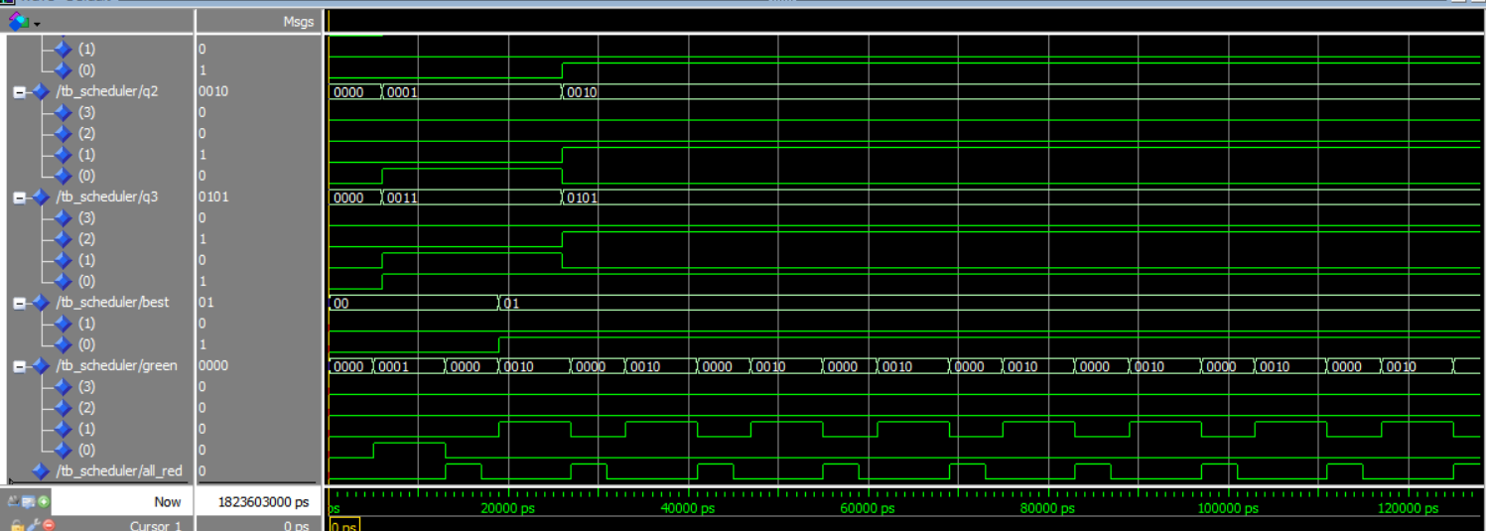
Modelsim Simulation

Slide 21
Key takeaways from the project
Hardware Feasibility: VHDL/ModelSim simulation confirmed that the scheduling logic can be mapped efficiently to FPGA/ASIC platforms for ultra-low latency.
Autonomous-Ready: Provides a robust foundation for integrating autonomous vehicle fleets into smart-city traffic infrastructures.
Real-Time Performance: Showcased FreeRTOS integration for deterministic task scheduling and predictable intersection control under load.

Slide 22
Thank You

