Slide 1
Introduction to Algorithms
1/13/2017
Lecture 1
FABIHA NAWAR DEEPA

Slide 2
Welcome to Introduction to Algorithms, Spring 2017
1/13/2017
Course Information
Course Calendar
Problem Set 1

Slide 3
What is course about?
1/13/2017
The theoretical study of design and analysis of computer algorithms
Basic goals for an algorithm:
always correct
always terminates
This class: performance
  Performance often draws the line between
what is possible and what is impossible.

Slide 4
Design and Analysis of Algorithms
1/13/2017
Analysis: predict the cost of an algorithm in terms of resources and performance
Design: design algorithms which minimize the cost

Slide 5
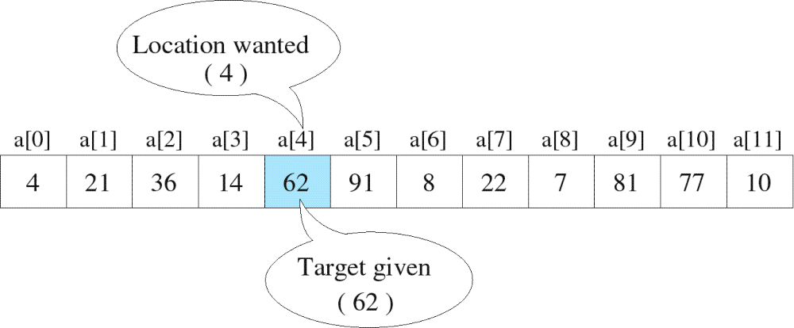
Searching
The process used to find the location of a target among a list of objects
  Searching an array finds the index of first element in an array containing that value
1/13/2017

Slide 6
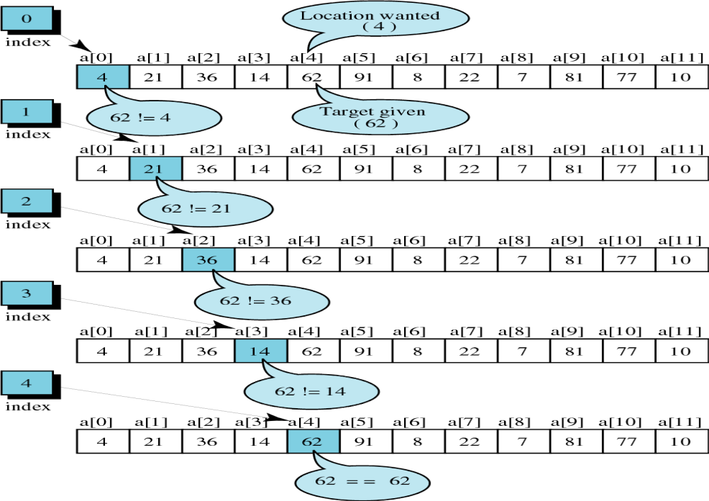
successful
1/13/2017

Slide 7
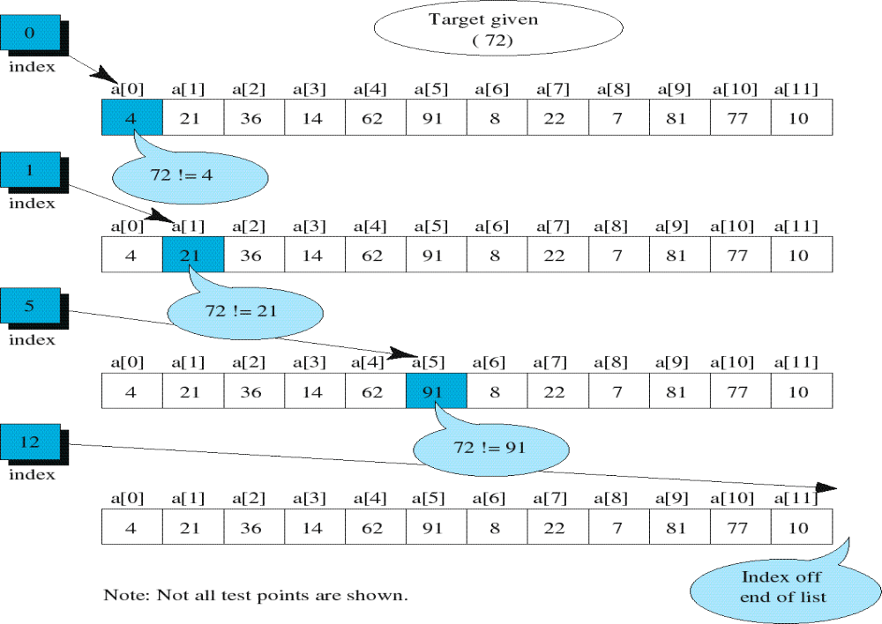
unsuccessful
1/13/2017

Slide 8

Unordered Linear Search
Search an unordered array of integers for a value and return its index if the value is found. Otherwise, return -1.
A[0] A[1] A[2] A[3] A[4] A[5] A[6] A[7]
Algorithm:
Start with the first array element (index 0)
while(more elements in array){
if value found at current index, return index;
Try next element (increment index);
}
Value not found, return -1;
1/13/2017
14 2 10 5 1 3 17 2

Slide 9
Unordered Linear Search
// Searches an unordered array of integers
int search(int data[], //input: array
int size, //input: array size
int value){ //input: search value
// output: if found, return index;
// otherwise, return –1.
for(int index = 0; index < size; index++){
if(data[index] == value)
return index;
}
return -1;
}
1/13/2017

Slide 10

Unordered Linear Search
#include <iostream>
Using namespace std;
int main() {
const int array_size = 8;
int list[array_size]={14,2,10,5,1,3,17,2};
int search_value;
cout << "Enter search value: ";
cin >> search_value;
cout << search(list,array_size,search_value)
<< endl;
return 0;
}
1/13/2017

Slide 11

Ordered Linear Search
Search an ordered array of integers for a value and return its index if the value is found; Otherwise, return -1.
A[0] A[1] A[2] A[3] A[4] A[5] A[6] A[7]
Linear search can stop immediately when it has passed the possible position of the search value.
1/13/2017
1 2 3 5 7 10 14 17

Slide 12

Ordered Linear Search
Algorithm:
Start with the first array element (index 0)
while(more elements in the array){
if value at current index is greater than value, value not found, return –1;
if value found at current index, return index;
Try next element (increment index);
}
value not found, return –1;
1/13/2017

Slide 13

Ordered Linear Search
// Searches an ordered array of integers
int lsearch(int data[],// input: array
int size, // input: array size
int value // input: value to find
) { // output: index if found
for(int index=0; index<size; index++){
if(data[index] > value)
return -1;
else if(data[index] == value)
return index;
}
return -1;
}
1/13/2017

Slide 14
Ordered Linear Search
#include <iostream>
using namespace std;
int main() {
const int array_size = 8;
int list[array_size]={1,2,3,5,7,10,14,17};
int search_value;
cout << "Enter search value: ";
cin >> search_value;
cout << lsearch(list,array_size,search_value)
<< endl;
return 0;
}
1/13/2017

Slide 15
Binary Search
1/13/2017
Search an ordered array of integers for a value and return its index if the value is found. Otherwise, return -1.
A[0] A[1] A[2] A[3] A[4] A[5] A[6] A[7]
Binary search skips over parts of the array if the search value cannot possibly be there.
1 2 3 5 7 10 14 17

Slide 16
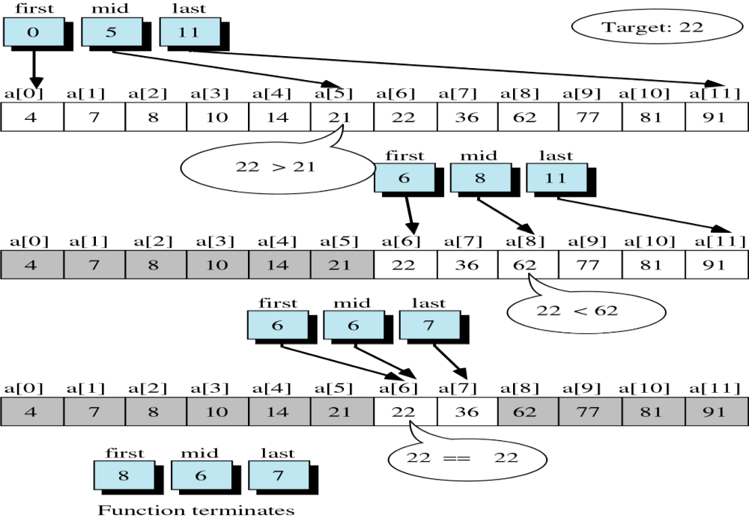
successful
1/13/2017
6

Slide 17
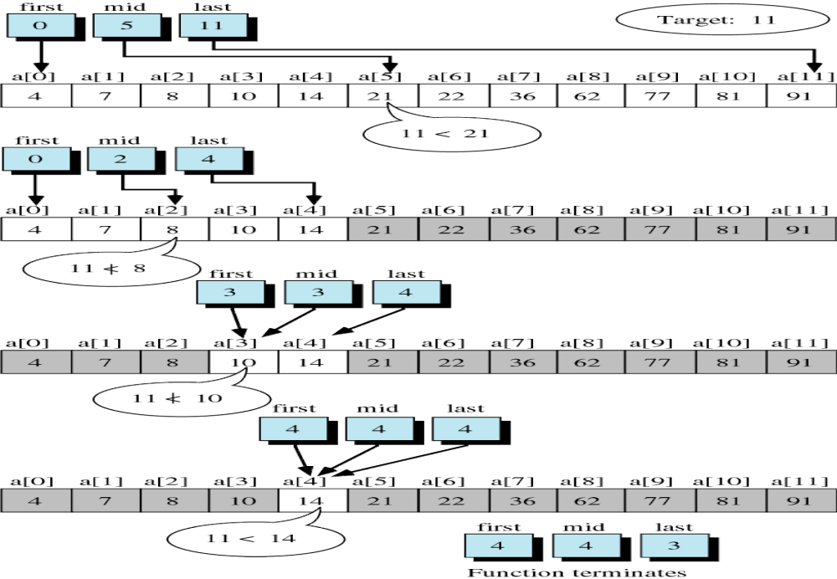
unsuccessful
1/13/2017

Slide 18
Binary Search
Binary search is based on the “divide-and-conquer” strategy which works as follows:
  Start by looking at the middle element of the array
    1. If the value it holds is lower than the search element, eliminate the first half of the array from further consideration.
    2. If the value it holds is higher than the search element, eliminate the second half of the array from further consideration.
  Repeat this process until the element is found, or until the entire array has been eliminated.
1/13/2017

Slide 19
Binary Search
Algorithm:
Set first and last boundary of array to be searched
Repeat the following:
Find middle element between first and last boundaries;
if (middle element contains the search value)
return middle_element position;
else if (first >= last )
return –1;
else if (value < the value of middle_element)
set last to middle_element position – 1;
else
set first to middle_element position + 1;
1/13/2017

Slide 20

Binary Search
// Searches an ordered array of integers
int bsearch(int data[], // input: array
int size, // input: array size
int value // input: value to find
) // output: if found,return index
{ // otherwise, return -1
int first, middle, last;
first = 0;
last = size - 1;
while (true) {
middle = (first + last) / 2;
if (data[middle] == value)
return middle;
else if (first >= last)
return -1;
else if (value < data[middle])
last = middle - 1;
else
first = middle + 1;
}
}
1/13/2017

Slide 21

Binary Search
int main() {
const int array_size = 8;
int list[array_size]={1,2,3,5,7,10,14,17};
int search_value;
cout << "Enter search value: ";
cin >> search_value;
cout << bsearch(list,array_size,search_value)
<< endl;
return 0;
}
1/13/2017

Slide 22
Example: binary search
successful
1/13/2017
A[0] A[1] A[2] A[3] A[4] A[5] A[6] A[7]
14 ?
first mid last
A[4] A[5] A[6] A[7]
first mid last
A[6] A[7]
f mid last
1 2 3 5 7 10 14 17
7 10 14 17
In this case,
(data[middle] == value)
return middle;
14 17

Slide 23
Example: binary search
unsuccessful
1/13/2017
A[0] A[1] A[2] A[3] A[4] A[5] A[6] A[7]
8 ?
first mid last
A[4] A[5] A[6] A[7]
first mid last
A[4]
f m l
1 2 3 5 7 10 14 17
7 10 14 17
In this case, (first == last)
return -1;
7

Slide 24
Example: binary search
unsuccessful
1/13/2017
4 ? A[0] A[1] A[2] A[3] A[4] A[5] A[6] A[7]
first mid last
A[0] A[1] A[2]
first mid last
A[2]
f m l
1 2 3 5 7 10 14 17
1 2 3
In this case, (first == last)
return -1;
3

