Slide 1
Computer Algorithms
LECTURE 2
FABIHA NAWAR DEEPA

Slide 2
Algorithm
"An algorithm is any well-defined computational procedure that takes some value, or set of values, as input and produces some value, or set of values as output."
An algorithm is a procedure or formula for solving a problem, based on conducting a sequence of specified actions.
SWE 213

Slide 3
Like,
Making a Cup of Tea
Finding the largest of Three Numbers
Finding the Even and Odd number
Secret of Migratory birds “how can they able to cross long distance ”

Slide 4
Where To USE
Algorithms are widely used throughout all areas of IT (information technology). A search engine algorithm, for example, takes search strings of keywords and operators as input, searches its associated database for relevant web pages, and returns results.
An encryption algorithm transforms data according to specified actions to protect it. A secret key algorithm such as the U.S. Department of Defense's Data Encryption Standard (DES), for example, uses the same key to encrypt and decrypt data. As long as the algorithm is sufficiently sophisticated, no one lacking the key can decrypt the data.
Find More USE of Algorithm

Slide 5
Example
Write an algorithm to calculate the total mark of a student and indicate that whether he pass/fail
Algorithm:
  Step 1: Input M1, M2, M3, M4
  Step 2: GRADE (M1 + M2 + M3+ M4)/ 4
  Step 3: IF (GRADE < 40) then
  Print “FAIL”
  else
  Print “PASS”
  END IF

Slide 6
Needs of Algorithm
Sorting, provides a good example of an algorithm that is very frequently used by computer scientists. The simplest way to sort a group of items is to start by removing the smallest item from the group, and put it first.
Shortest Path
Algorithms for finding the shortest path from one point to another have been researched for years. Applications abound, but lets keep things simple by saying we want to find the shortest path from point A to point B in a city with just a few streets and intersections.

Slide 7
Random Algorithms
Yet another approach to some problems is to randomize an algorithm is some way. While doing so does not improve the algorithm in the worst case, it often makes very good algorithms in the average case. Quicksort is a good example of an algorithm where randomization is often used.

Slide 8
Needs of Algorithm…….
Compression
Another class of algorithm deals with situations such as data compression. This type of algorithm does not have an expected output (like a sorting algorithm), but instead tries to optimize some other criteria.
Approximate algorithms
Sometimes, however, even the most advanced algorithm, with the most advanced heuristics, on the fastest computers is too slow. In this case, sacrifices must be made that relate to the correctness of the result. Rather than trying to get the shortest path, a programmer might be satisfied to find a path that is at most 10% longer than the shortest path.
SWE 213

Slide 9
The Importance of Knowing Algorithms
As a computer scientist, it is important to understand all of these types of algorithms so that one can use them properly.
If you are working on an important piece of software, you will likely need to be able to estimate how fast it is going to run. Such an estimate will be less accurate without an understanding of runtime analysis.
Furthermore, you need to understand the details of the algorithms involved so that you’ll be able to predict if there are special cases in which the software won’t work quickly, or if it will produce unacceptable results.
There are often times when you’ll run across a problem that has not been previously studied. In these cases, you have to come up with a new algorithm, or apply an old algorithm in a new way.
The more you know about algorithms in this case, the better your chances are of finding a good way to solve the problem. In many cases, a new problem can be reduced to an old problem without too much effort, but you will need to have a fundamental understanding of the old problem in order to do this.
SWE 213

Slide 10
Characteristics of Algorithm
Each and every instruction should precise and unambiguous
Each instruct should be such that it can be performed in a finite time
One or more instruction should not be repeated infinitely. This ensure that the algorithm will ultimately terminate
After performing the instruction, that is, after algorithm is terminates, the desired results must be OBTAINED
SWE 213

Slide 11
Needs for Algorithm
Finiteness: It must be finite.
Definiteness: It must be unambiguous
Non-intuitiveness: It must be executable
Input: It must have 0 or more input
Output: It must have 1 or more output
Completeness: it should be general so that it can solve any problem of a particular type for which it is constructed
SWE 213

Slide 12
Analyzing Algorithms
Predict the amount of resources required:
  memory: how much space is needed?
  computational time: how fast the algorithm runs?
FACT: running time grows with the size of the input
Input size (number of elements in the input)
  Size of an array, polynomial degree, # of elements in a matrix, # of bits in the binary representation of the input, vertices and edges in a graph
Def: Running time = the number of primitive operations (steps) executed before termination
  Arithmetic operations (+, -, *), data movement, control, decision making (if, while), comparison

Slide 13
Algorithm Analysis: Example
Alg.: MIN (a[1], …, a[n])
  m ← a[1];
  for i ← 2 to n
  if a[i] < m
  then m ← a[i];
Running time:
  the number of primitive operations (steps) executed before termination
  T(n) =1 [first step] + (n) [for loop] + (n-1) [if condition] +
  (n-1) [the assignment in then] = 3n - 1
Order (rate) of growth:
  The leading term of the formula
  Expresses the asymptotic behavior of the algorithm

Slide 14
Typical Running Time Functions
1 (constant running time):
  Instructions are executed once or a few times
logN (logarithmic)
  A big problem is solved by cutting the original problem in smaller sizes, by a constant fraction at each step
N (linear)
  A small amount of processing is done on each input element
N logN
  A problem is solved by dividing it into smaller problems, solving them independently and combining the solution

Slide 15
Typical Running Time Functions
N² (quadratic)
  Typical for algorithms that process all pairs of data items (double nested loops)
N³ (cubic)
  Processing of triples of data (triple nested loops)
N^{K} (polynomial)
2^{N} (exponential)
  Few exponential algorithms are appropriate for practical use

Slide 16
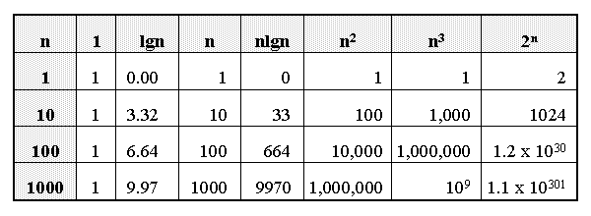
Growth of Functions

Slide 17
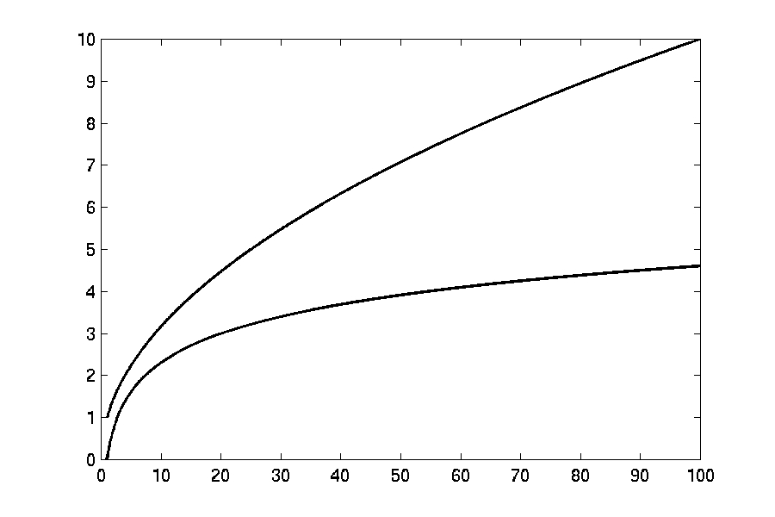

Complexity Graphs
log(n)

Slide 18
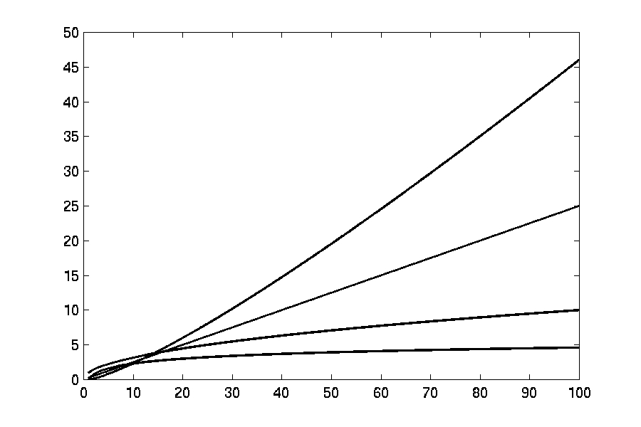
Complexity Graphs
n log(n)
n
log(n)

Slide 19
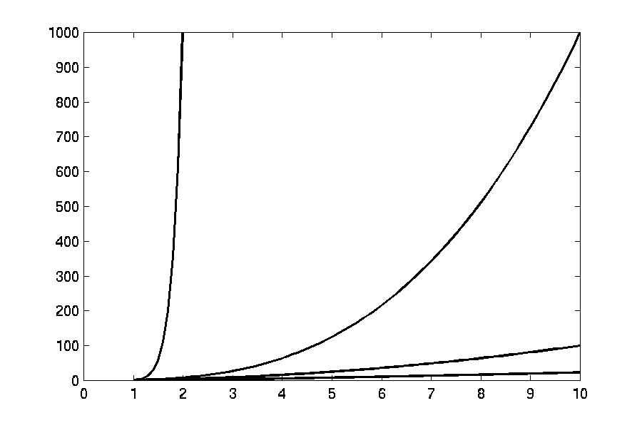
Complexity Graphs
n¹⁰
n³
n²
n log(n)

Slide 20
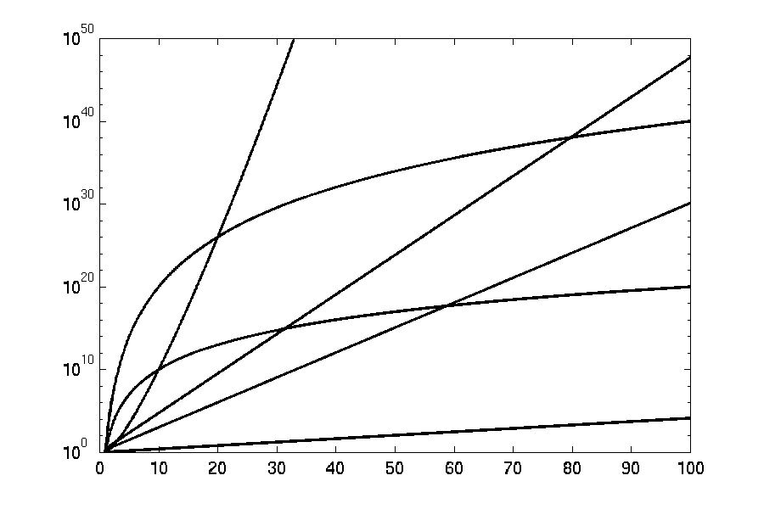
Complexity Graphs (log scale)
3^{n}
n^{n}
n²⁰
2^{n}
n¹⁰
1.1^{n}

Slide 21
Algorithm Complexity
Worst Case Complexity:
  the function defined by the maximum number of steps taken on any instance of size n
Best Case Complexity:
  the function defined by the minimum number of steps taken on any instance of size n
Average Case Complexity:
  the function defined by the average number of steps taken on any instance of size n

Slide 22
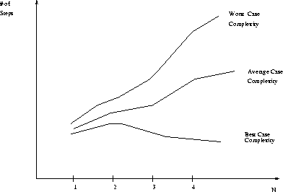
Best, Worst, and Average Case Complexity
Number of steps
Worst Case Complexity
Average Case Complexity
Best Case Complexity
N
(input size)

Slide 23
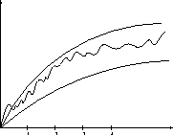
Doing the Analysis
It’s hard to estimate the running time exactly
  Best case depends on the input
  Average case is difficult to compute
  So we usually focus on worst case analysis
    Easier to compute
    Usually close to the actual running time
Strategy: find a function (an equation) that, for large n, is an upper bound to the actual function (actual number of steps, memory usage, etc.)
Upper bound
Actual function
Lower bound

Slide 24
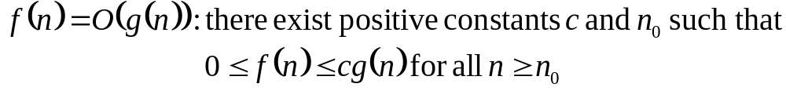
Big-O
What does it mean?
  If f(n) = O(n²), then:
    f(n) can be larger than n² sometimes, but…
    We can choose some constant c and some value n₀ such that for every value of n larger than n₀ : f(n) < cn²
    That is, for values larger than n₀, f(n) is never more than a constant multiplier greater than n²
    Or, in other words, f(n) does not grow more than a constant factor faster than n².

Slide 25
Visualization of O(g(n))
cg(n)
f(n)
n₀

Slide 26
Examples
  2n² = O(n³):
  n² = O(n²):
2n² ≤ cn³ ⇒ 2 ≤ cn ⇒ c = 1 and n₀= 2
n² ≤ cn² ⇒ c ≥ 1 ⇒ c = 1 and n₀= 1

Slide 27
Big O notation (cont.)
Example:
  int [] list = {7, 2, 9, 5, 6, 4};
  for (int i=0; i<list.length, i++)
  if (value == list[i])
  statement; // found it
  // didn’t find it

Slide 28
Big O notation (cont.)
If we assume that the list is ordered, we can still search the entire list from the beginning to the end to determine if we have a match
But, we do not need to search that way
Because the values are in numerical order, we can use a binary search algorithm
Algorithm is O(logn), where n is size of array

Slide 29
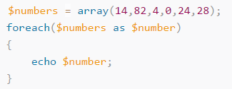
Big O Notation
The Big O notation is a notation for the time complexity of an algorithm. It is a mathematical representation of the upper bound of the limit of the scaling factor of the algorithm.
For example, if we double the size of an input array, by how much does the computing time increase? This might become clear with two examples:
Imagine that the $numbers array is the argument of the function. We have a foreach loop running through its items. If we calculate the time that the code takes to run, what happens if we double the size of the array?
We can easily see in this example
that it will double the time to run.
We see that there is a linear relationship
between the size of the array and the
computing time. So if we write the size
of the array as n, we can write the time
complexity as O(n).
SWE 213

Slide 30
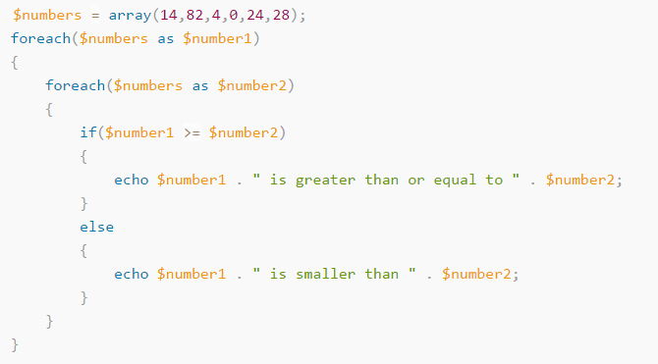
O(n²)
In this piece of code, there is a foreach loop located inside another
foreach loop. Let’s say ‘n’ is
the size of $numbers. Then
we loop ‘n’ times through ‘n’.
That makes the total amount
of loops n². As you might
guess, we write the time
complexity as O(n²).
SWE 213

Slide 31
Writing Algorithm
Keep in mind that algorithm is a step-by-step process.
Depending upon programming language, include syntax where necessary.
Begin.
Include variables and their usage.
If they are any loops, try to give sub number lists.
Try to give go back to step number if loop or condition fails.
Use jump statement to jump from one statement to another.
Define expressions.
Use break and stop to terminate the process.
Check if the entered username and password match the pre-stored credentials in the database.
If true, set session and redirect your user to the success page.
If false, print a failure message, redirect on the same login page and ask user to re-enter the credentials.
Exit.
SWE 213

Slide 32
Follow Chart
A flowchart is a formalized graphic representation of a logic sequence, work or manufacturing process, organization chart, or similar formalized structure. The purpose of a flow chart is to provide people with a common language or reference point when dealing with a project or process.
Flowcharts use simple geometric symbols and arrows to define relationships. In programming, for instance, the beginning or end of a program is represented by an oval. A process is represented by a rectangle, a decision is represented by a diamond and an I/O process is represented by a parallelogram. The Internet is represented by a cloud.
SWE 213

Slide 33
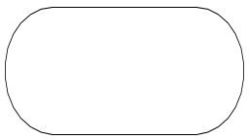

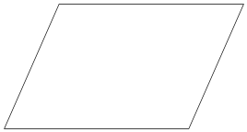
Flowchart Symbols
 | Terminal: Used to indicates the start and end of a flowchart. Single flow line. Only one “Start” and “Stop” terminal for each program. The end terminal for function/subroutine must use “Return” instead of “Stop”.
 | Process: Used whenever data is being manipulated. One flow line enters and one flow line exits.
 | Input/Output: Used whenever data is entered (input) or displayed (output). One flow line enters and one flow line exits.

Slide 34
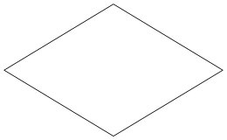
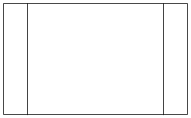



Flowchart Symbols
 | Decision: Used to represent operations in which there are two possible selections. One flow line enters and two flow lines (labeled as “Yes” and “No”) exit.
 | Function / Subroutine: Used to identify an operation in a separate flowchart segment (module). One flow line enters and one flow line exits.
 | On-page Connector: Used to connect remote flowchart portion on the same page. One flow line enters and one flow line exits.
 | Off-page Connector: Used to connect remote flowchart portion on different pages. One flow line enters and one flow line exits.
 | Comment: Used to add descriptions or clarification.
 | Flow line: Used to indicate the direction of flow of control.

Slide 35
Control structures of Algorithm & Flowchart
There are three kinds of Control Structures in Algorithm and Flowchart.
They are….
  Sequential Flow
  Conditional Flow
  Repetitive Flow
SWE 213

Slide 36
Sequential Flow
Sequence logic is executed in the sequential order. This sequence may be presented explicitly, by means of numbered steps, or implicitly, by the order in which the modules are written.
Algorithm: Module A Module B . . . . | Flowchart . . .
SWE 213
Process 1
Process 2

Slide 37
Conditional Flow
This is used for making Decisions. It is used selecting the proper path, out of two or more alternative paths, in program logic. It employs a number of conditions which lead to a selection one out of several alternative modules.
The structures which implement this logic is called conditional structures or IF structures
Three types of conditional structures
  Single alternative
  Double alternative
  Multiple alternative
SWE 213

Slide 38
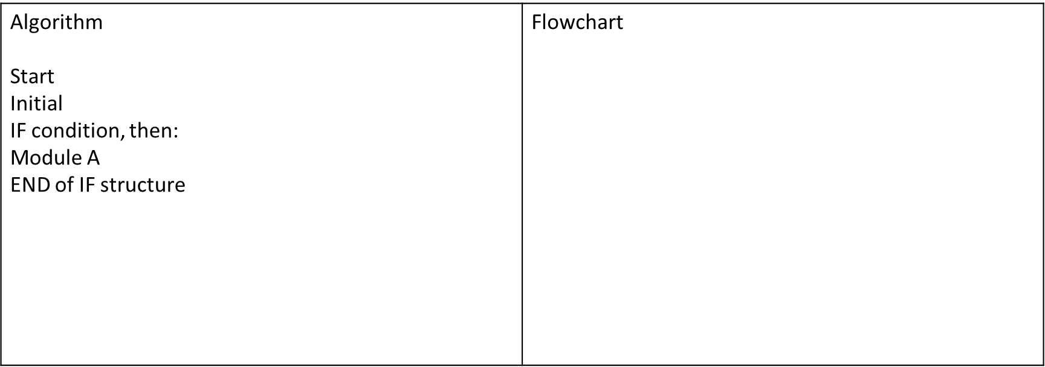
Single Alternatives
Condition ?
NO
YES
Module A
SWE 213

Slide 39
Double Alternatives
Algorithm Start Initial IF condition, then: Module A Else: Module B END of IF structure | Flow Chart
Condition?
YES
NO
Module A
Module B
SWE 213

Slide 40
Multiple Alternatives
Algorithm Start Initial IF condition (1), then: Module A1 Else: IF condition (2), then: Module A2 . . IF condition (N), then: Module AN Else: Module B END of IF structure | Flow chart
Condition 1
NO
Module A1
YES
Condition 2
NO
Module A2
YES
SWE 213
Condition 3
NO
Module A3
YES
Module B

Slide 41
Repeated Flow
Algorithm: Repeat FOR K:= R to S by T: Module End of loop | Flowchart
K R
IS K > S
YES
NO
SWE 213
Module
K K+T

Slide 42
Write an algorithm to add two numbers entered by user.
Step 1: Start
Step 2: Declare variables num1, num2 and sum.
Step 3: Read values num1 and num2.
Step 4: Add num1 and num2 and assign the result to sum.
sum←num1+num2
Step 5: Display sum
Step 6: Stop
SWE 213

Slide 43
Write an algorithm to find the largest among three different numbers entered by user.
Step 1: Start
Step 2: Declare variables a, b and c.
Step 3: Read variables a, b and c.
Step 4: If a>b
If a>c
Display a is the largest number.
Else
Display c is the largest number.
Else
If b>c
Display b is the largest number.
Else
Display c is the greatest number.
Step 5: Stop
SWE 213

