Slide 1



Slide 2
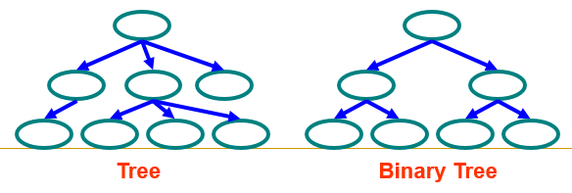
Trees
Tree
  Each node can have 0 or more children
  A node can have at most one parent
Binary tree
  Tree with 0–2 children per node
  Also known as Decision Making Tree

Slide 3
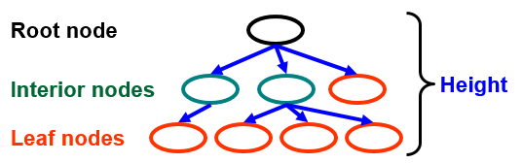
Trees
Terminology
  Root ⇒ no parent
  Leaf ⇒ no child
  Interior ⇒ non-leaf
  Height ⇒ distance from root to leaf (H)

Slide 4



Slide 5

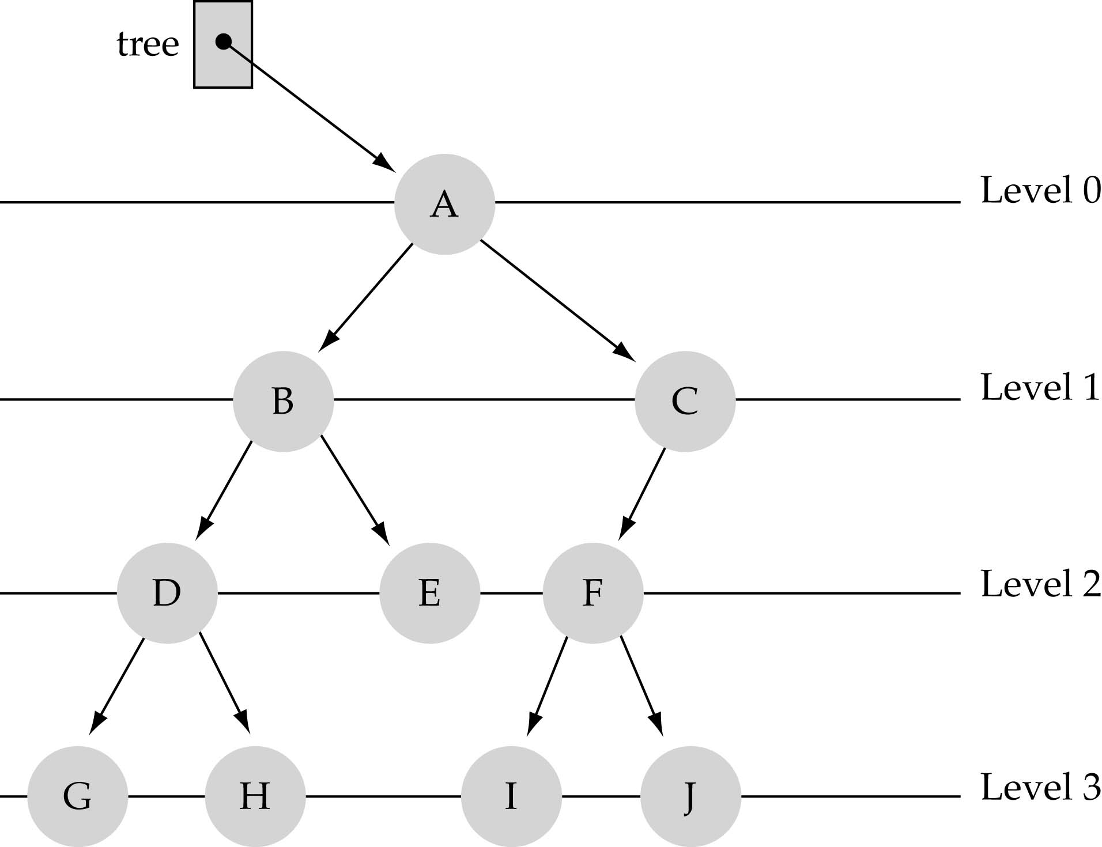
Property 1: Each node can have up to two successor nodes.

Slide 6

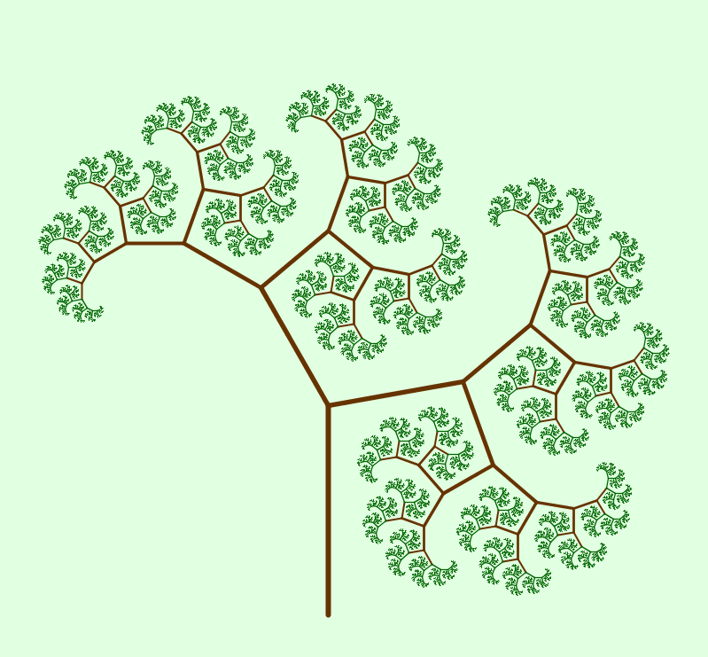

Slide 7

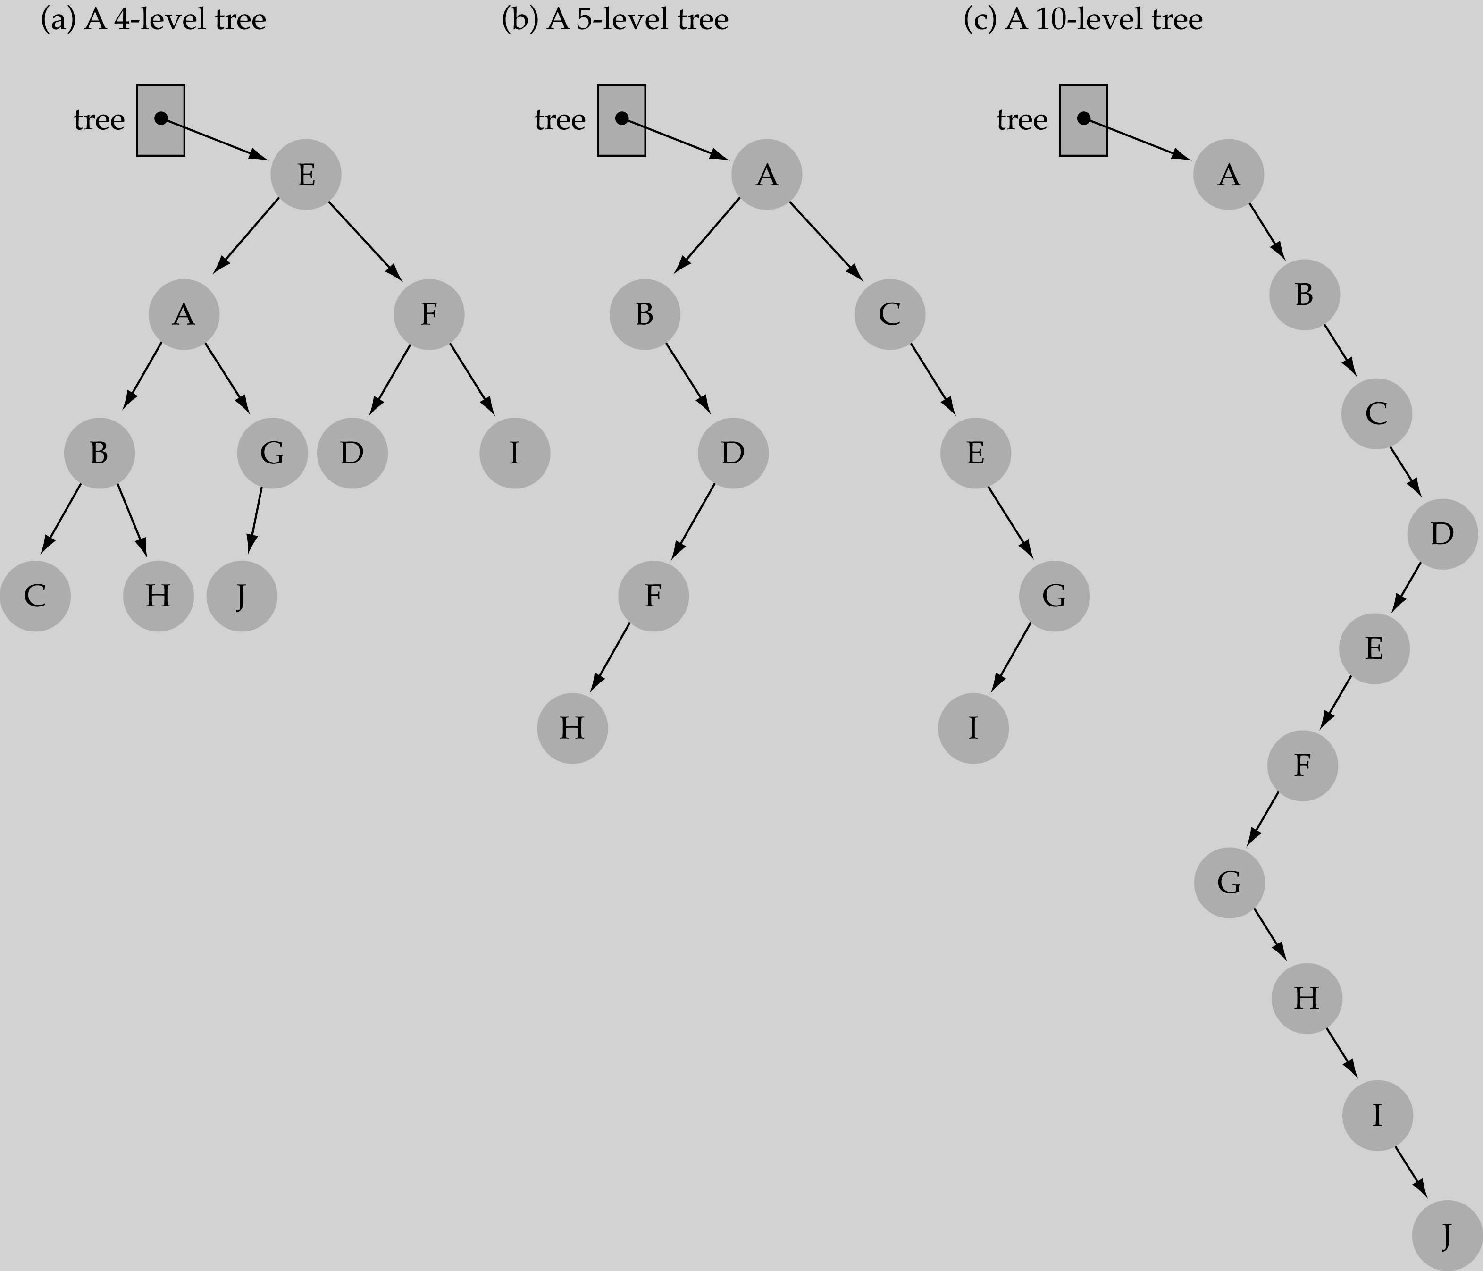
The successor nodes of a node are called its children
The predecessor node of a node is called its parent
The "beginning" node is called the root (has no parent)
A node without children is called a leaf

Slide 8
Nodes are organize in levels (indexed from 0).
Level (or depth) of a node: number of edges in the path from the root to that node.
Height of a tree h: #levels = L (some books define h as number of levels-1).
Full tree: every node has exactly two children and all the leaves are on the same level.
not full!

Slide 9

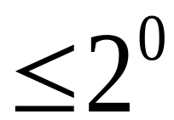
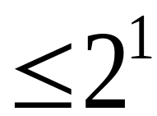
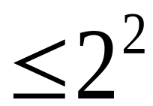
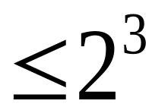
The maximum number of nodes at any level l is less than or equal to 2^{l} where l=0, 1, 2, 3,….. L-1

Slide 10

Consider that you want to find the location of some word in a dictionary.
I guess you are not fool enough to search it in a linear way or in other words apply linear search. That is no one search page by page from the start to end of the book.
Rather, I guess you will open or divide the dictionary in the middle to determine which half contains the word.
Then consider new probable half and open or divide that half in the middle to determine which half contains the word. This process goes on.
Eventually you will find the location of the word and thus you are reducing the number of possible locations for the word in the dictionary.

Slide 11


Start at the root
Search the tree level by level, until you find the element you are searching for or you reach a leaf.

Slide 12

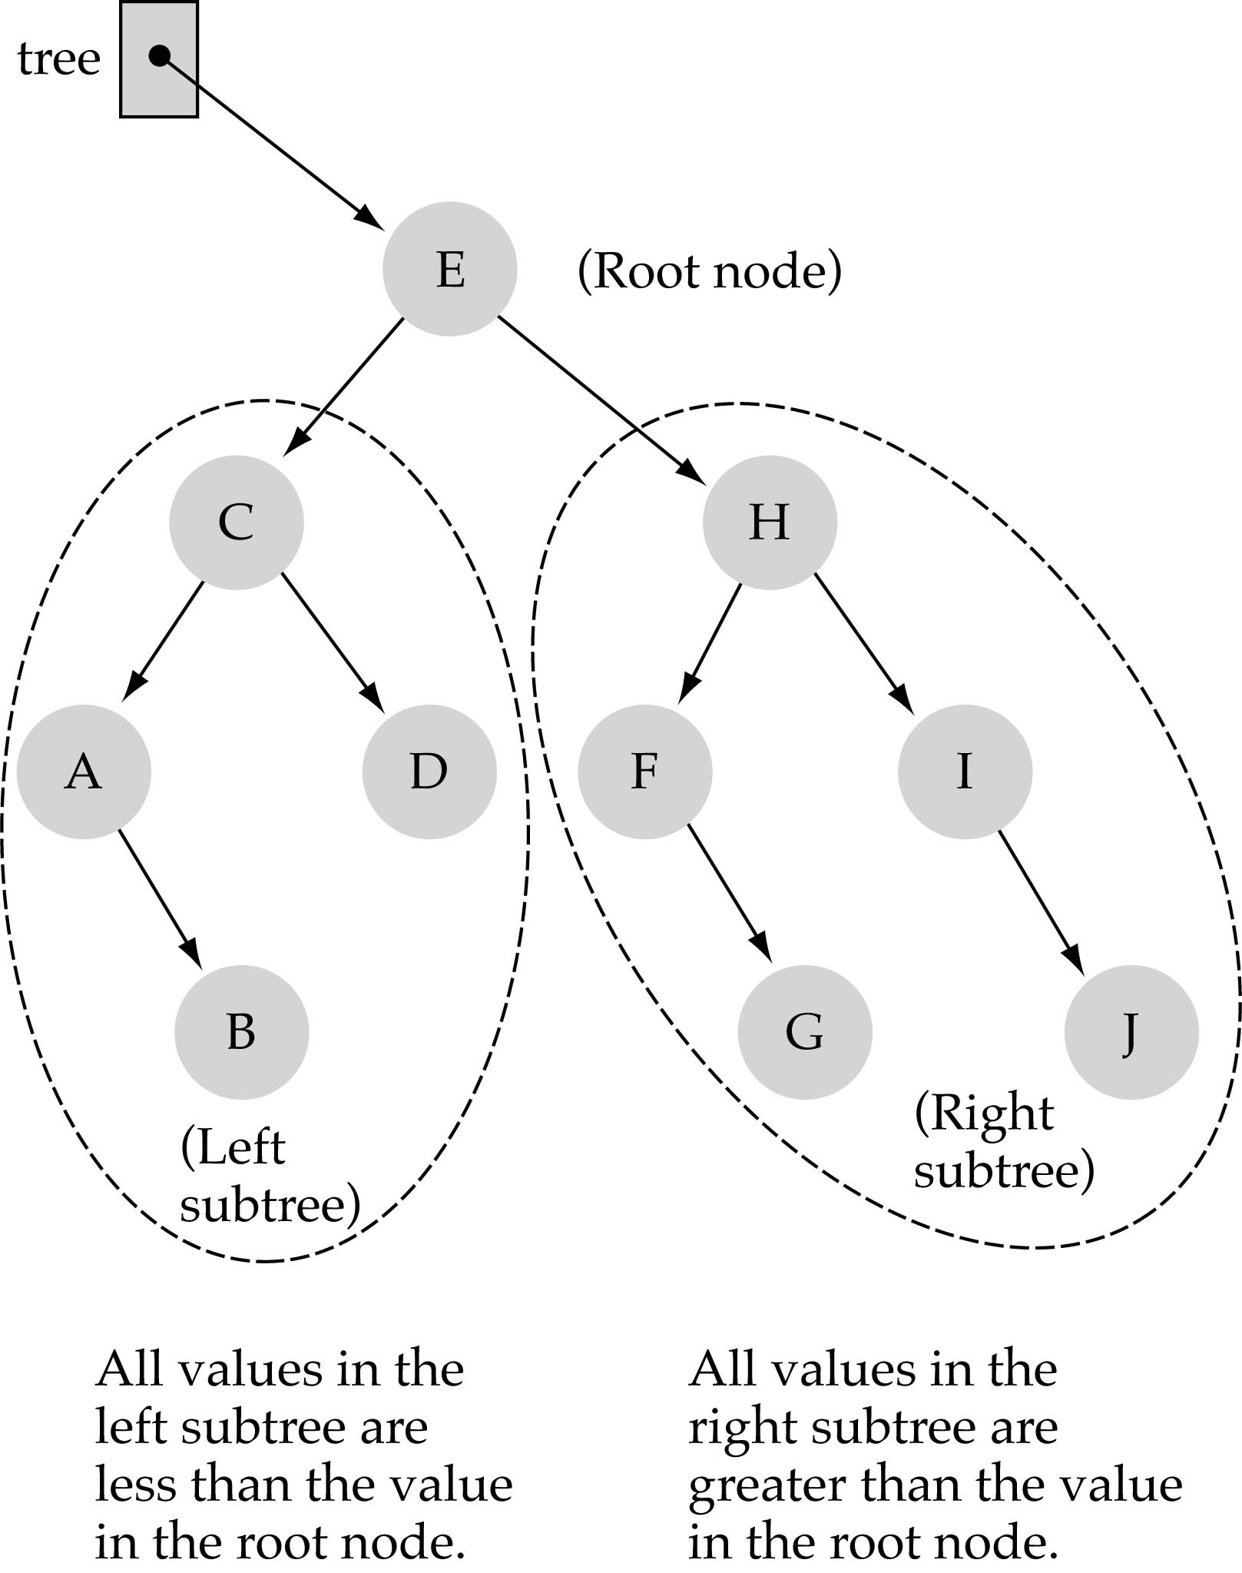
Binary Search Tree Property:
The value stored at
a node is greater than
the value stored at its
left child and less than
the value stored at its
right child

Slide 13
Binary Search Trees
In a BST, the value stored at the root of a subtree is greater than any value in its left subtree and less than any value in its right subtree!

Slide 14
Binary Search Trees
Where is the smallest element?
Ans: leftmost element
Where is the largest element?
Ans: rightmost element

Slide 15
Binary Search Tree
Key property is value at node
Smaller values in left subtree
Larger values in right subtree
Example
X > Y
X < Z
X
Y
Z

Slide 16

Start at the root
Compare the value of the item you are searching for with the value stored at the root
If the values are equal, then item found; otherwise, if it is a leaf node, then not found

Slide 17
If it is less than the value stored at the root, then search the left subtree
If it is greater than the value stored at the root, then search the right subtree.

Slide 18

A binary tree is simply a tree in which each node can have at most two children.
A binary search tree is a binary tree in which the nodes are assigned values, with the following restrictions :
No duplicate values.
The left subtree of a node can only have values less than the node
The right subtree of a node can only have values greater than the node and recursively defined
The left subtree of a node is a binary search tree.
The right subtree of a node is a binary search tree.

Slide 19

Let x be a node in a binary search tree and k is the value, we are supposed to search.
Then according to the binary search tree property we know that: if y is a node in the left subtree of x, then y.key <= x.key. If y is a node in the right subtree of x, then y.key>=x.key. (x.key denotes the value at node x)
To search the location of given data k, the binary search tree algorithm begins its search at the root and traces the path downward in the tree.
For each node x it compares the value k with x.key. If the values are equal then the search terminates and x is the desired node.

Slide 20
If k is smaller than x.key, then the search continues in the left subtree of x, since the binary search tree property implies that k could not be in the right subtree.
Symmetrically, if k is larger than x.key, then the search continues in the right subtree.
The nodes encountered during the recursion form a simple path downward from the root of the tree, and thus the running time of TREE-SEARCH is O(h), where h is the height of the tree.

Slide 21
Example: key =4 then find(4)
  Call TREE-SEARCH(x,k)
6
2
9
1
4
8

Slide 22
x=root
Example: k =4 and x=root
  Call TREE-SEARCH(root,4)
  Now x.key=6 then k<x.key
  So call TREE-SEARCH(x.left,k)
6
2
9
1
4
8

Slide 23
Example: k =4 and x=root.left
  Call TREE-SEARCH(x,4)
  Now x.key=2 then k>x.key
  TREE-SEARCH(x.right,k)
6
x=root.left
2
9
1
4
8

Slide 24
Example: k =4 and x=root.left.right
  Call TREE-SEARCH(x,4)
  Now x.key=4 then k=x.key
  Search terminates
6
x=root.left.right
2
9
1
4
8

Slide 25
Example: k =4 and x=root.left.right
  Now x.key=4 then k=x.key
  Search terminates and x=root.left.right is the desired node or location
6
x=root.left.right
2
9
1
4
8

Slide 26

To insert a new value v into a binary search tree T, we use the procedure TREE-INSERT.
The procedure takes a node z for which z.key=v , z.left=NIL and z.right=NIL.
It modifies T and some of the attributes of z in such a way that it inserts z into an appropriate position in the tree

Slide 27
Suppose v is the value we want to insert and z is the node (New or NIL) we are supposed to find to insert the value v. z.p denotes the parent of z.
X is a pointer that traces a simple path downward the tree and y is the trailing pointer as the parent of x. T.root denote the root of the tree.
Now the intention is to find a new or NIL node that will satisfy the BST property after placing the value v. The procedure first consider x as the root of the tree thus the parent of the root y=NIL.
In steps 3 to 7 the procedure causes the two pointer y and x to move down the tree, going left or right depending on the comparison of z.key with x.key, until x becomes NIL.

Slide 28
Now this NIL occupies the position z, where we wish to place the input item.
At this time we need y the parent of the desired node. This is why at step four we always storing the parent of current node x while moving downward. At the end of step 7 (in step 8) we make this node the parent of z (z.p).
From steps 9 to 11:
Now if tree is empty (y==NIL) then create a root node with the new key(T.root=z)
If the value v is less than the value of the parent(z.key<y.key) then make it as the left-child of the parent(y.left=z)
If the value v is greater than the value of the parent(z.key>y.key) then make it as the right-child of the parent(y.right=z)

Slide 29
TREE-INSERT(T , z)
y=NIL
x= T.root
While x ≠ NIL
y=x
if z.key<x.key
x=x.left
else x=x.right
z.p=y
if y== NIL
T.root = z
elseif z.key < y.key
y.left=z
else y.right = z

Slide 30

We are supposed to insert an item value 5 and find an appropriate node z for it
6
2
9
1
4
8

Slide 31
x=T.root
Y=NIL and x=T.root
6
2
9
1
4
8

Slide 32
x=T.root
Now x≠NIL and z.key<x.key
That is [5<6]
6
2
9
1
4
8

Slide 33
y
Y=T.root and x=T.root.left
And z.key>x.key[5>2]
6
x
2
9
1
4
8

Slide 34
Y=T.root.left and x=T.root.left.right
And z.key>x.key[5>4]
6
y
x
2
9
1
4
8

Slide 35
Y=T.root.left.right and x=NIL
Then z.p=T.root.left.right
6
y
2
9
1
4
8

Slide 36
Y=T.root.left.right [y ≠ NIL]
And z.key>y.key [5>4]
So y.right=z that is
T.root.left.right.right=z
6
y
2
9
1
4
8
z
5

Slide 37
Delete a value from the BST
Removing a node from a BST is a bit more complex, since we do not want to create any "holes" in the tree. The intention is to remove the specified item from the BST and adjusts the tree
The binary search algorithm is used to locate the target item: starting at the root it probes down the tree till it finds the target or reaches a leaf node (target not in the tree)
If the node has one child then the child is spliced to the parent of the node. If the node has two children then its successor has no left child; copy the successor into the node and delete the successor instead TREE-DELETE (T, z) removes the node pointed to by z from the tree T. IT returns a pointer to the node removed so that the node can be put on a free-node list
The overall strategy for deleting a node or item from a binary search tree can be described through some cases.

Slide 38

Experimenting the cases:
if the tree is empty return false
else Attempt to locate the node containing the target using the binary search algorithm:
if the target is not found return false
else the target is found, then remove its node. Now while removing the node four cases may happen

Slide 39
Delete a value from the BST
Case 1: if the node has 2 empty subtrees
- replace the link in the parent with null
Case 2: if the node has a left and a right subtree
- replace the node's value with the max value in the
left subtree
- delete the max node in the left subtree
Case 3: if the node has no left child
- link the parent of the node to the right
(non-empty) subtree
Case 4: if the node has no right child
- link the parent of the target to the left
(non-empty) subtree

Slide 40
Delete a value from the BST
Case 1: removing a node with 2 EMPTY SUBTREES -replace the link in the parent with null
Removing 4
Parent
7
7
5
9
5
9
Z
4
6
8
10
6
8
10

Slide 41
Delete a value from the BST
Case 2: removing a node with 2 SUBTREES
- replace the node's value with the max value in the left subtree
- delete the max node in the left subtree
Z
Removing 7
7
6
5
9
5
9
4
6
8
10
4
8
10

Slide 42
Delete a value from the BST
Case 3: if the node has no left child
- link the parent of the node to the right (non-empty) subtree
Parent
Parent
Removing 5
Z
7
7
5
9
9
6
6
8
10
8
10

Slide 43
Delete a value from the BST
Case 4: if the node has no right child
- link the parent of the node to the left (non-empty) subtree
Parent
Parent
Removing 5
Z
7
7
5
9
9
4
4
8
10
8
10

Slide 44

TREE-DELETE (T, z)
if left [z] = NIL .OR. right[z] = NIL
then y ← z
else y ← TREE-SUCCESSOR (z)
if left [y] ≠ NIL
then x ← left[y]
else x ← right [y]
if x ≠ NIL
then p[x] ← p[y]
if p[y] = NIL
then root [T] ← x
else if y = left [p[y]]
then left [p[y]] ← x
else right [p[y]] ← x
if y ≠ z
then key [z] ← key [y]
if y has other field, copy them, too
return y

Slide 45
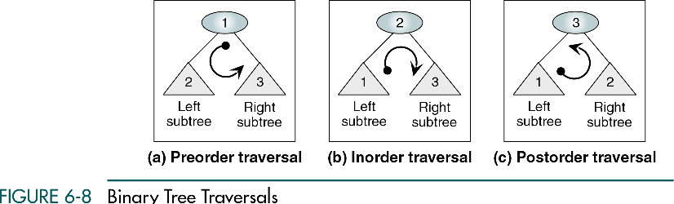
BST Traversal

Slide 46
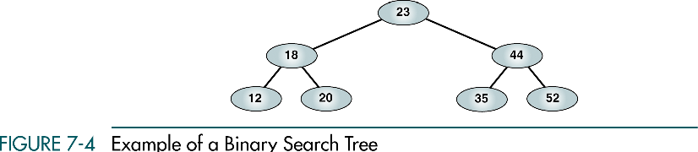
Preorder Traversal
Root Left Right
23 18 12 20 44 35 52

Slide 47
Postorder Traversal
Left Right Root
12 20 18 35 52 44 23

Slide 48
Inorder Traversal
Left Root Right
12 18 20 23 35 44 52
Produces a sequenced list

Slide 49
Inorder Traversal
1
10
8
4
6
3
2
5
1
10
8
4
3
6
2
5

Slide 50
Inorder Traversal
1
10
8
4
6
3
2
5
1
10
8
4
3
6
2
5

Slide 51
Inorder Traversal
1
10
8
4
6
3
2
5
1
10
8
4
3
6
2
5

Slide 52
Inorder Traversal
1
10
8
4
6
3
2
5
1
10
8
4
3
6
2
5
1

Slide 53
Inorder Traversal
1
10
8
4
6
3
2
5
1
10
8
4
3
6
2
5
1

Slide 54
Inorder Traversal
1
10
8
4
6
3
2
5
1
10
8
4
3
6
2
5
1

Slide 55
Inorder Traversal
1
10
8
4
6
3
2
5
1
10
8
4
3
6
2
5
1

Slide 56
Inorder Traversal
1
10
8
4
6
3
2
5
1
10
8
4
3
6
2
5
1

Slide 57
Inorder Traversal
1
10
8
4
6
3
2
5
1
10
8
4
3
6
2
5
1

Slide 58
Inorder Traversal
1
10
8
4
6
3
2
5
1
10
8
4
3
6
2
5
1

Slide 59
Inorder Traversal
1
10
8
4
6
3
2
5
1
10
8
4
3
6
2
5
1
2

Slide 60
Inorder Traversal
1
10
8
4
6
3
2
5
1
10
8
4
3
6
2
5
1
2

Slide 61
Inorder Traversal
1
10
8
4
6
3
2
5
1
10
8
4
3
6
2
5
1
2

Slide 62
Inorder Traversal
1
10
8
4
6
3
2
5
1
10
8
4
3
6
2
5
1
2
3

Slide 63
Inorder Traversal
1
10
8
4
6
3
2
5
1
10
8
4
3
6
2
5
1
2
3

Slide 64
Inorder Traversal
1
10
8
4
6
3
2
5
1
10
8
4
3
6
2
5
1
2
3

Slide 65
Inorder Traversal
1
10
8
4
6
3
2
5
1
10
8
4
3
6
2
5
1
2
3
4

Slide 66
Inorder Traversal
1
10
8
4
6
3
2
5
1
10
8
4
3
6
2
5
1
2
3
4

Slide 67
Inorder Traversal
1
10
8
4
6
3
2
5
1
10
8
4
3
6
2
5
1
2
3
4

Slide 68
Inorder Traversal
1
10
8
4
6
3
2
5
1
10
8
4
3
6
2
5
1
2
3
4

Slide 69
Inorder Traversal
1
10
8
4
6
3
2
5
1
10
8
4
3
6
2
5
1
2
3
4
5

Slide 70
Inorder Traversal
1
10
8
4
6
3
2
5
1
10
8
4
3
6
2
5
1
2
3
4
5

Slide 71
Inorder Traversal
1
10
8
4
6
3
2
5
1
10
8
4
3
6
2
5
1
2
3
4
5

Slide 72
Inorder Traversal
1
10
8
4
6
3
2
5
1
10
8
4
3
6
2
5
1
2
3
4
5
6

Slide 73
Inorder Traversal
1
10
8
4
6
3
2
5
1
10
8
4
3
6
2
5
1
2
3
4
5
6

Slide 74
Inorder Traversal
1
10
8
4
6
3
2
5
1
10
8
4
3
6
2
5
1
2
3
4
5
6

Slide 75
Inorder Traversal
1
10
8
4
6
3
2
5
1
10
8
4
3
6
2
5
1
2
3
4
5
6

Slide 76
Inorder Traversal
1
10
8
4
6
3
2
5
1
10
8
4
3
6
2
5
1
2
3
4
5
6
8

Slide 77
Inorder Traversal
1
10
8
4
6
3
2
5
1
10
8
4
3
6
2
5
1
2
3
4
5
6
8

Slide 78
Inorder Traversal
1
10
8
4
6
3
2
5
1
10
8
4
3
6
2
5
1
2
3
4
5
6
8

Slide 79
Inorder Traversal
1
10
8
4
6
3
2
5
1
10
8
4
3
6
2
5
1
2
3
4
5
6
8
10

Slide 80
Inorder Traversal
1
10
8
4
6
3
2
5
1
10
8
4
3
6
2
5
1
2
3
4
5
6
8
10

Slide 81


Slide 82
Binary Tree Insertion
1
10
8
4
6
3
2
5

Slide 83
Binary Tree Insertion
1
10
8
4
6
3
2
5

Slide 84
Binary Tree Insertion
1
10
8
4
6
3
2
5
1

Slide 85
Binary Tree Insertion
1
10
8
4
6
3
2
5
1

Slide 86
Binary Tree Insertion
1
10
8
4
6
3
2
5
1

Slide 87
Binary Tree Insertion
1
10
8
4
6
3
2
5
1

Slide 88
Binary Tree Insertion
1
10
8
4
6
3
2
5
1
10

Slide 89
Binary Tree Insertion
1
10
8
4
6
3
2
5
1
10

Slide 90
Binary Tree Insertion
1
10
8
4
6
3
2
5
1
10

Slide 91
Binary Tree Insertion
1
10
8
4
6
3
2
5
1
10

Slide 92
Binary Tree Insertion
1
10
8
4
6
3
2
5
1
10

Slide 93
Binary Tree Insertion
1
10
8
4
6
3
2
5
1
10
8

Slide 94
Binary Tree Insertion
1
10
8
4
6
3
2
5
1
10
8

Slide 95
Binary Tree Insertion
1
10
8
4
6
3
2
5
1
10
8

Slide 96
Binary Tree Insertion
1
10
8
4
6
3
2
5
1
10
8

Slide 97
Binary Tree Insertion
1
10
8
4
6
3
2
5
1
10
8

Slide 98
Binary Tree Insertion
1
10
8
4
6
3
2
5
1
10
8

Slide 99
Binary Tree Insertion
1
10
8
4
6
3
2
5
1
10
8
4

Slide 100
Binary Tree Insertion
1
10
8
4
6
3
2
5
1
10
8
4

Slide 101
Binary Tree Insertion
1
10
8
4
6
3
2
5
1
10
8
4

Slide 102
Binary Tree Insertion
1
10
8
4
6
3
2
5
1
10
8
4

Slide 103
Binary Tree Insertion
1
10
8
4
6
3
2
5
1
10
8
4

Slide 104
Binary Tree Insertion
1
10
8
4
6
3
2
5
1
10
8
4

Slide 105
Binary Tree Insertion
1
10
8
4
6
3
2
5
1
10
8
4

Slide 106
Binary Tree Insertion
1
10
8
4
6
3
2
5
1
10
8
4
6

Slide 107
Binary Tree Insertion
1
10
8
4
6
3
2
5
1
10
8
4
6

Slide 108
Binary Tree Insertion
1
10
8
4
6
3
2
5
1
10
8
4
6

Slide 109
Binary Tree Insertion
1
10
8
4
6
3
2
5
1
10
8
4
6

Slide 110
Binary Tree Insertion
1
10
8
4
6
3
2
5
1
10
8
4
6

Slide 111
Binary Tree Insertion
1
10
8
4
6
3
2
5
1
10
8
4
6

Slide 112
Binary Tree Insertion
1
10
8
4
6
3
2
5
1
10
8
4
6

Slide 113
Binary Tree Insertion
1
10
8
4
6
3
2
5
1
10
8
4
3
6

Slide 114
Binary Tree Insertion
1
10
8
4
6
3
2
5
1
10
8
4
3
6

Slide 115
Binary Tree Insertion
1
10
8
4
6
3
2
5
1
10
8
4
3
6

Slide 116
Binary Tree Insertion
1
10
8
4
6
3
2
5
1
10
8
4
3
6

Slide 117
Binary Tree Insertion
1
10
8
4
6
3
2
5
1
10
8
4
3
6

Slide 118
Binary Tree Insertion
1
10
8
4
6
3
2
5
1
10
8
4
3
6

Slide 119
Binary Tree Insertion
1
10
8
4
6
3
2
5
1
10
8
4
3
6

Slide 120
Binary Tree Insertion
1
10
8
4
6
3
2
5
1
10
8
4
3
6

Slide 121
Binary Tree Insertion
1
10
8
4
6
3
2
5
1
10
8
4
3
6
2

Slide 122
Binary Tree Insertion
1
10
8
4
6
3
2
5
1
10
8
4
3
6
2

Slide 123
Binary Tree Insertion
1
10
8
4
6
3
2
5
1
10
8
4
3
6
2

Slide 124
Binary Tree Insertion
1
10
8
4
6
3
2
5
1
10
8
4
3
6
2

Slide 125
Binary Tree Insertion
1
10
8
4
6
3
2
5
1
10
8
4
3
6
2

Slide 126
Binary Tree Insertion
1
10
8
4
6
3
2
5
1
10
8
4
3
6
2

Slide 127
Binary Tree Insertion
1
10
8
4
6
3
2
5
1
10
8
4
3
6
2

Slide 128
Binary Tree Insertion
1
10
8
4
6
3
2
5
1
10
8
4
3
6
2

Slide 129
Binary Tree Insertion
1
10
8
4
6
3
2
5
1
10
8
4
3
6
2
5

Slide 130
Binary Tree Insertion
1
10
8
4
6
3
2
5
1
10
8
4
3
6
2
5

Slide 131


Slide 132
Binary Tree Deletion
1
10
8
4
6
3
2
5
1
10
8
4
3
6
2
5

Slide 133
Binary Tree Deletion
1
10
8
4
6
3
2
5
1
10
8
4
3
6
2
5

Slide 134
Binary Tree Deletion
1
10
8
4
6
3
2
5
1
10
8
4
3
6
5

Slide 135
Binary Tree Deletion
1
10
8
4
6
3
2
5
1
10
8
4
3
6
5

Slide 136
Binary Tree Deletion
1
10
8
4
6
3
5
1
10
8
4
3
6
5

Slide 137
Binary Tree Deletion
1
10
8
4
6
3
5
1
10
8
4
3
6
5

Slide 138
Binary Tree Deletion
1
10
8
4
6
3
5
1
10
8
4
3
6
5

Slide 139
Binary Tree Deletion
1
10
8
4
6
3
5
1
10
4
3
6
5

Slide 140
Binary Tree Deletion
1
10
8
4
6
3
5
1
10
4
3
6
5

Slide 141
Binary Tree Deletion
1
10
8
4
6
3
5
1
10
4
3
6
5

Slide 142
Binary Tree Deletion
1
10
4
6
3
5
1
10
4
3
6
5

Slide 143
Binary Tree Deletion
1
10
4
6
3
5
1
10
4
3
6
5

Slide 144
Binary Tree Deletion
1
10
4
6
3
5
1
10
4
3
6
5

Slide 145
Binary Tree Deletion
1
10
4
6
3
5
1
10
4
3
6
5

Slide 146
Binary Tree Deletion
1
10
4
6
3
5
1
10
4
3
6
5

Slide 147
Binary Tree Deletion
1
10
4
6
3
5
1
10
5
3
6
5

Slide 148
Binary Tree Deletion
1
10
4
6
3
5
1
10
5
3
6
5

Slide 149
Binary Tree Deletion
1
10
4
6
3
5
1
10
5
3
6
5

Slide 150
Binary Tree Deletion
1
10
4
6
3
5
1
10
5
3
6

Slide 151
Binary Tree Deletion
1
10
4
6
3
5
1
10
5
3
6

Slide 152
Binary Tree Deletion
1
10
6
3
5
1
10
5
3
6

Slide 153
Thank you

