Slide 1
Towards Traffic Light Control through a Multiagent Cooperative System:
A Simulation-Based Study
Guzman, Francisco
Garrido, Leonardo
Spring Simulation Multiconference
San Diego CA
April 4th 2005

Slide 2
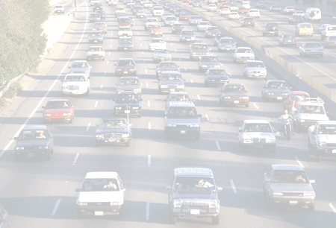
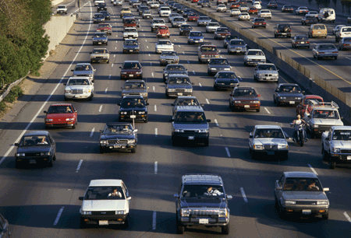
the traffic problem…
Traffic networks are unable to handle traffic through urban areas
Improvements to urban traffic congestion must focus on reducing internal bottlenecks
The primary concern is the optimization of the traffic lights

Slide 3
… lead to set an objective …
To simulate car traffic in different crossways of the Monterrey metropolitan zone using multi agent technologies
To propose new control algorithms for traffic lights in order to optimize car traffic and
To anticipate the behavior of new traffic systems.

Slide 4
… methodology …
Design of Simulator
Calibration of Model
Optimization
Experimentation
Results

Slide 5
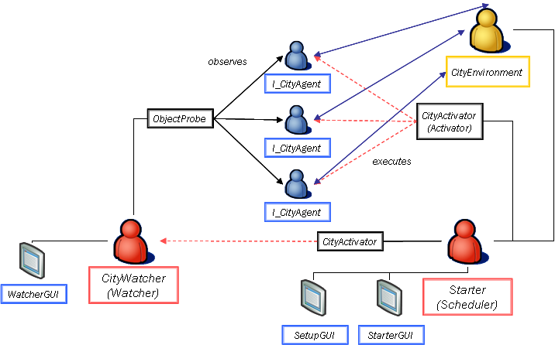


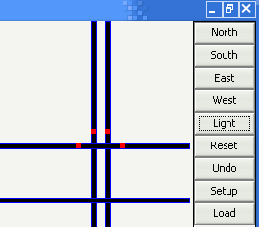

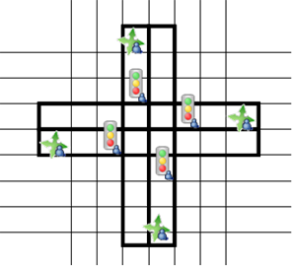
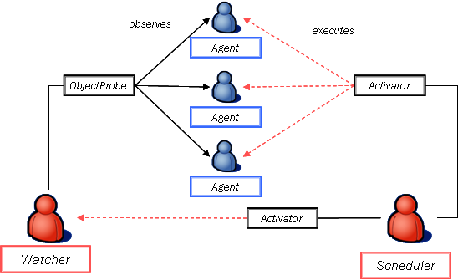
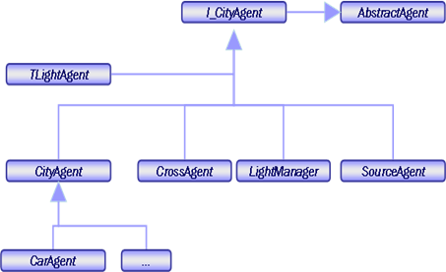
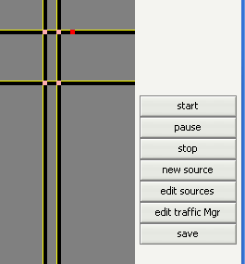
…system’s architecture …
  Setup GUI
  Watcher’s GUI
  Agents’ GUI
  Scheduler
  Activator
  Watcher
  n x m grid
  collection of agents
Synchronous Engine
Environment
Agents
Graphical User Interfaces
  CarAgent
  TLightAgent
  LightManager
  SourceAgent

Slide 6
… calibration of model…
Series of data were taken from real intersections
Data was analyzed and compared to the simulator’s output
Corrections were made to the model
Building the model
Executions
Model design
Similarity
Results
Assumptions
Data
Urban
Traffic
Observations
Knowledge

Slide 7
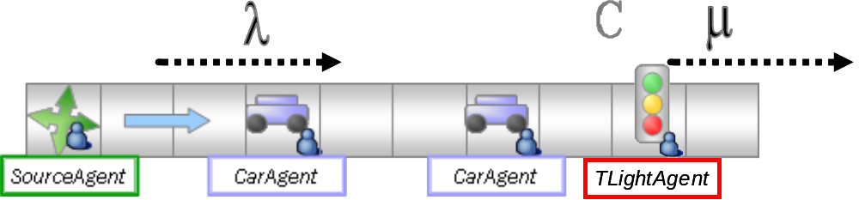
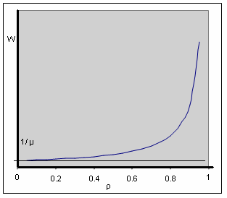
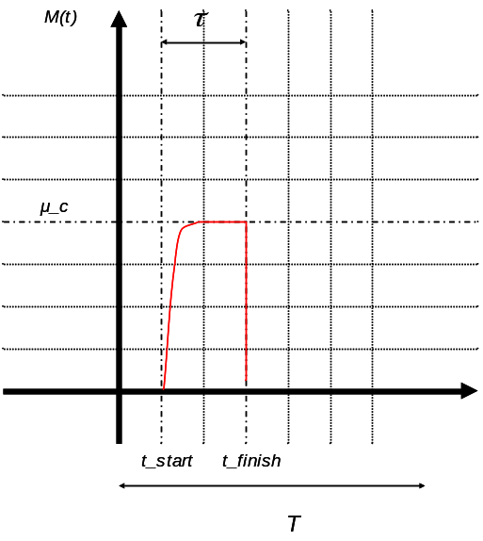
…cooperative system…
We have a M/M/1 queue model
We want to minimize the waiting time by increasing the service time (green time)

Slide 8
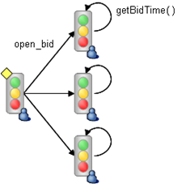
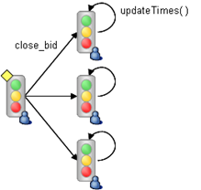
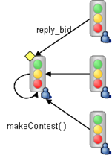
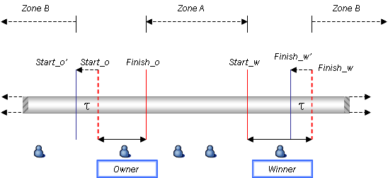
… to regulate traffic flow
A traffic light opens a proposal for extra service time (open_proposal)
The others make an offer (reply_proposal)
The leader picks the best and closes the bid
The lights update their times

Slide 9
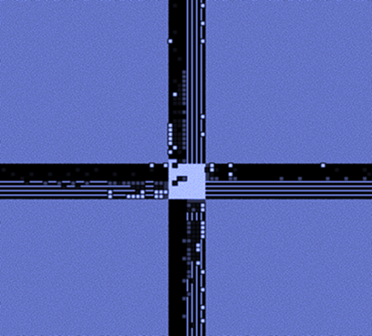
…experimentation
Setup of different simulation scenarios
Spawn probability (λ) of 0.01 for all sources, increasing in steps of 0.005
No turning cars
Several runs of 200 simulation cycles
Collected data was analyzed and discussed

Slide 10
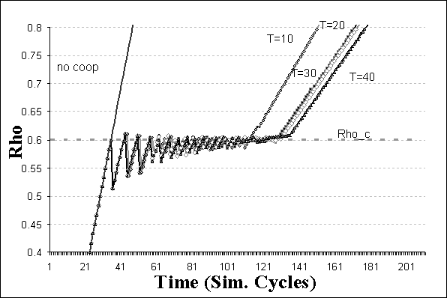
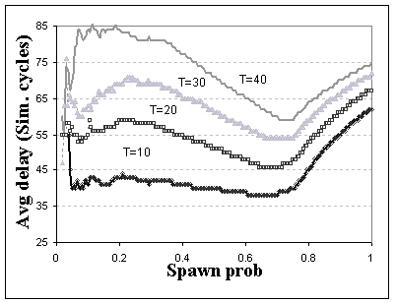
… service time (τ) variation …
service time varied between 10 and 40
sets = 4

Slide 11
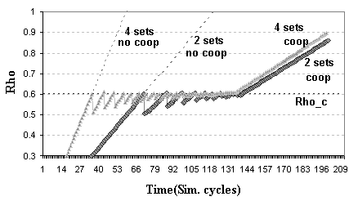
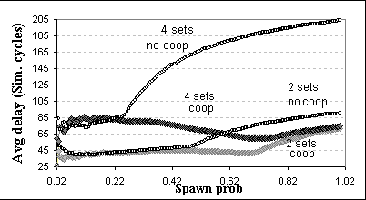
…number of sets per intersection…
service time=40
sets varied between 2 and 4

Slide 12
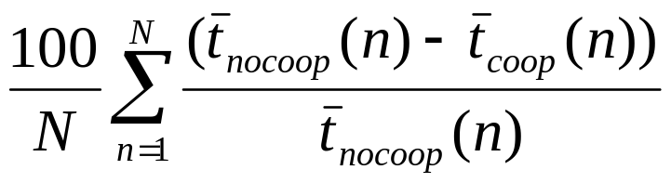
…performance of the system
Sets/τ | 10 | 20 | 30 | 40
2 | 13.8 | 15.3 | 14.1 | 17.9
4 | 48.7 | 47.5 | 49.5 | 43.1
Table 1. Table showing the performance of different runs (in %)

Slide 13


In conclusion…
We have implemented a customizable system to conceive real traffic scenarios and micro-simulate them using Multi Agent technology
We are studying new control algorithms that optimize traffic flow by implementing cooperative systems

Slide 14

…there’s still work to do!
Implementation of time dependent model
Implementation of cooperative systems that include interleaved light times
Implementation of a higher level manager
Distribution of the simulation

Slide 15


Slide 16
…that involves simulation…
Traffic Simulation can be
  Macroscopic
    model traffic flow as a single quantity
    don’t represent real traffic behavior
  Microscopic
    model traffic at the individual vehicle level
    enables more accurate study of congestion
MAS are excellent to simulate microscopic systems

Slide 17
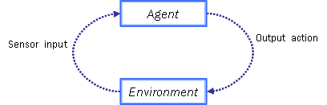
… using multi agent technologies…
The Agent
  Autonomous
  Reactive
  Proactive
  Social
The Environment
  An agent’s decisions is mostly based on the environment’s characteristics

Slide 18

… by the MadKit way!
Distributable
Light weighted
Flexible and customizable
Written in JAVA
With a Simulation tool

Slide 19

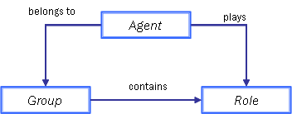
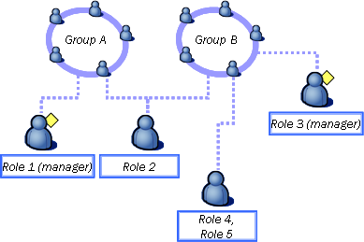
The Aalaadin model is…
Agent
Group
Role

Slide 20
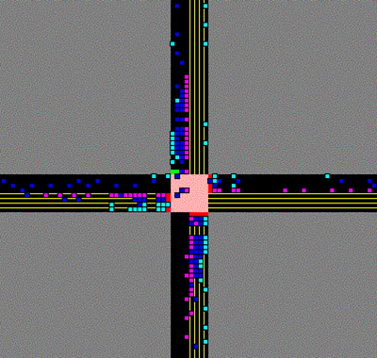
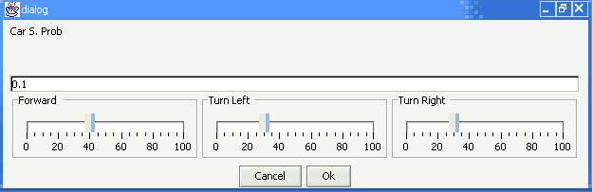
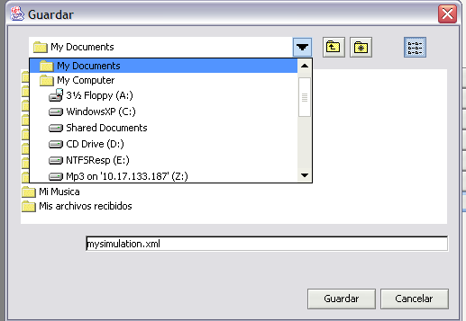
… state of the Art…
Permits to save the configuration of a simulation and load it
Allows the obtention of relevant statistical data
Allows simulate turning cars, multiple crossway
Allows the user to customize his
environment and agents
Scenario Setup
Simulation
Save/Restore(XML)

