Slide 1

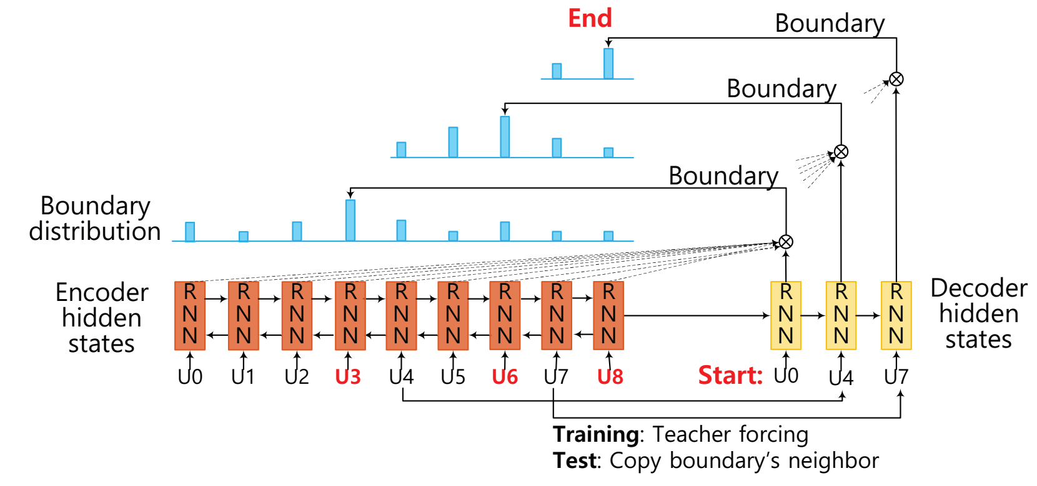
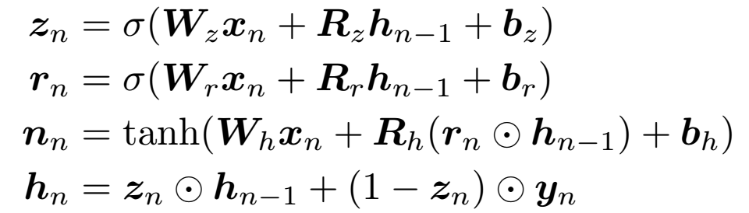
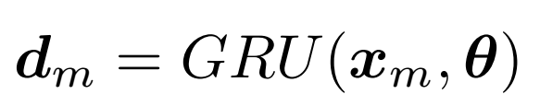
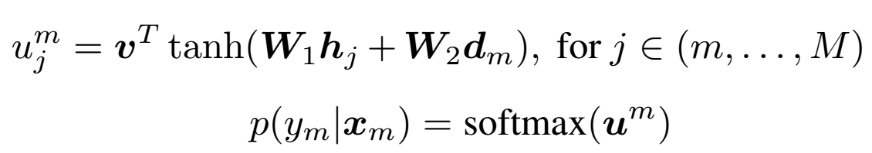
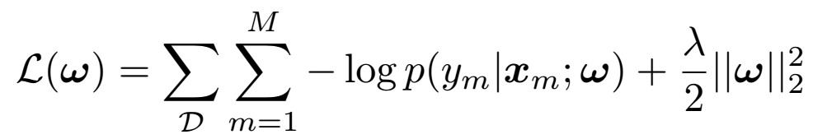
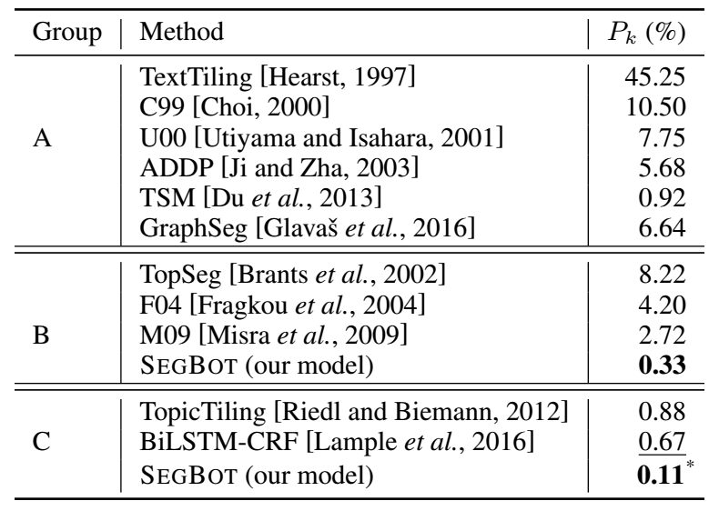
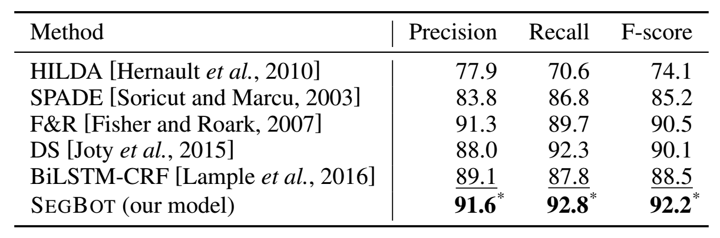
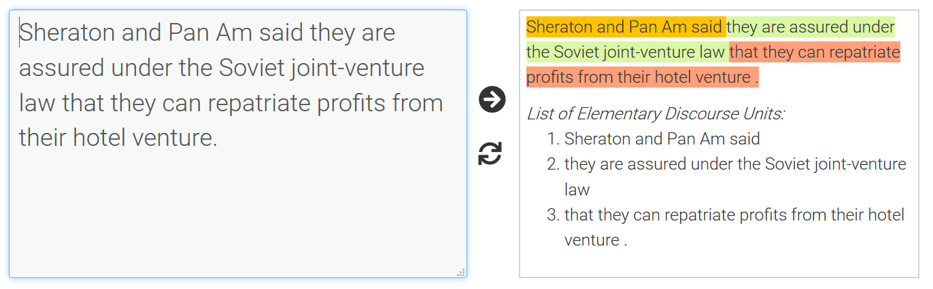
SegBot: A Generic Neural Text Segmentation Model with Pointer Network
Jing Li, Aixin Sun, Shafiq Joty
Nanyang Technological University, Singapore
Contact: jli030@e.ntu.edu.sg
Introduction
Text segmentation is a fundamental task in natural language processing that comes in two levels of granularity: (i) segmenting a document into a sequence of topical segments (topic segmentation), and (ii) segmenting a sentence into a sequence of elementary discourse units (EDU segmentation).
Traditional solutions to the two tasks heavily rely on carefully designed features.
The recently proposed neural models do not need manual feature engineering, but they either suffer from sparse boundary tags or they cannot well handle the issue of variable size output vocabulary.
We propose SEGBOT– a generic end-to-end model for text segmentation at various levels of granularity. SEGBOT learns informative features automatically while alleviating the problem of tag sparsity in output sequence and the problem of variable size output vocabulary.
We conduct experiments at two levels of granularity: document-level topic segmentation, and sentence-level EDU segmentation. Our results show that SEGBOT achieves new state-of-the-art results on both tasks.
SegBot: Neural Text Segmentation Model
Encoding
Decoding
Pointing
The model architecture of SEGBOT. Input sequence: U0; U1,…,U8. Identified boundaries: U3; U6; U8.
Model Training
Experiment I: Topic Segmentation
Experiment II: EDU Segmentation
Segmentation results on RST-DT Dataset.
Segmentation results on Choi dataset.
Tool Implementation
The Web interface: http://138.197.118.157:8000/segbot/

