Slide 1


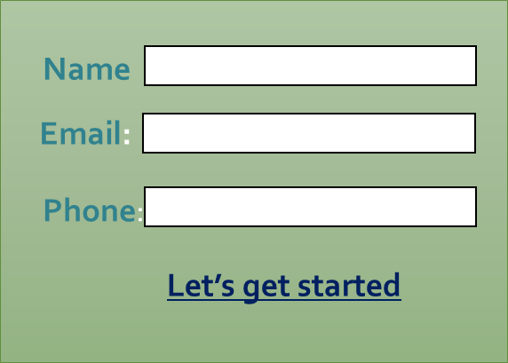
NAV’S TUITIONS
Filling in this form will send an email to selected webmail/email address
Address: Noble Park, Victoria
Who we are
What we provide
Extras
Meet the tutors
Contact us via phone/email or simply fill in the form below. One of our tutors will get back to you as soon as possilbe
.
Contact Info: Email: navstuitions@gmail.com Phone: +61430153489

Slide 2

Who we are
What we provide
Extras
Meet the tutors
Who we are:
Nav’s Tuitions comprises of a group of dedicated tutors willing to make a difference in the way students absorb information.
Our main goal is to break away from conventional methods of tutoring and provide an environment where students feel like they are a part of a community working together, with us and each other, to tackle the biggest obstacle in their high school career - VCE. We are trying to transform this study experience in a way that students achieve their end goal along with enjoying the whole path that leads to it.
We aim for students to understand and reach their full potential.
ALL OUR STAFF MEMBERS ARE HIGHLY QUALIFIED WITH WORKING WITH CHILDREN”S CHECK.
Contact us via phone/email or simply fill in the form below. One of our tutors will get back to you as soon as possilbe
.
Name
Email:
Phone:
Let’s get started
Contact Info: Email: navstuitions@gmail.com Phone: +61430153489

Slide 3
Who we are
What we provide
Extras
Meet the tutors
Contact us via phone/email or simply fill in the form below. One of our tutors will get back to you as soon as possible
What we provide:
• Provision of notes in Mathematics, Science and English for VCE
• Support classes to discuss and correct homework questions as well as other advanced questions beneficial for exam preparation
• Exam preparation under timed setting
• Essay checker for English
• After hours support via email
.
Contact Info: Email: navstuitions@gmail.com Phone: +61430153489

Slide 4
Who we are
What we provide
Extras
Meet the tutors
Contact us via phone/email or simply fill in the form below. One of our tutors will get back to you as soon as possilbe
.
Extras
We have group meeting facilities available. This is to encourage group learning and tackle assignments and exams together!
Use our centre to advance your learning, ask for help as required and most importantly, have fun in this process. Our goal here is to take the boredom away from studies.
Email:
Phone:
Let’s get started
Contact Info: Email: navstuitions@gmail.com Phone: +61430153489

Slide 5
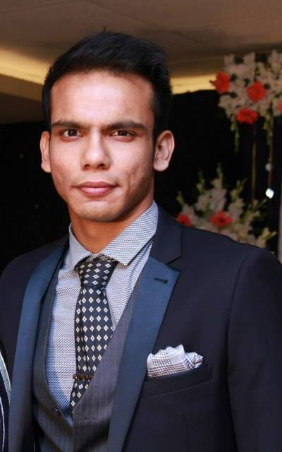
This page will be linked to “Meet the Tutors” in the homepage
Clicking this arrow goes to next tutor profile
Naveed R
Hey guys
I am the owner as well as the Math/ Science tutor for Nav’s Tuitions. With over 5 years of tutoring experience and having worked for successful tutoring companies, I believe that it’s time to introduce my ideologies into tutoring. I want to fill in gaps left by schools and not being addressed by other tutors while trying to ensure that students enjoy what they are learning. I have recently completed my double degree in Chemical Engineering and Pharmaceutical Science with Honours from Monash University. I have also achieved top marks in VCE and was awarded DUX of Cheltenham Secondary College in 2008.
It is my promise to you all that at Nav’s Tuitions, I will try my best to ensure that your time and money is properly utilized.
Contact Info: Email: navstuitions@gmail.com Phone: +61430153489

Slide 6
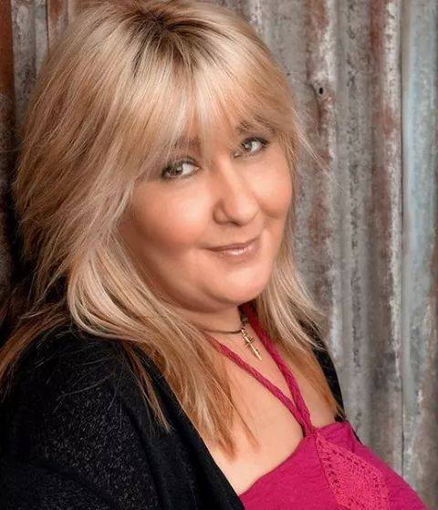
This page will be linked to “Meet the Tutors” in the homepage
Clicking this arrow goes to next tutor profile
Hi I’m Maria
I am the head English tutor at Nav’s Tuitions. With over 20 years of teaching experience and 10 years of VCE experience , having worked in schools, tuition centres and after conducting years of private/online tutoring. It is safe to say that I have experience in most educational fields necessary to lead students to a path of excellence in English. My main goal at Nav’s Tuitions is to customize the lesson structure in a way that students acquire individualized assistance.
I have a Bachelor of Education and Post Graduate from Prep to Year 12.
Last but not the least, I am a huge Bon Jovi fan!
Maria L
Contact Info: Email: navstuitions@gmail.com Phone: +61430153489

Slide 7
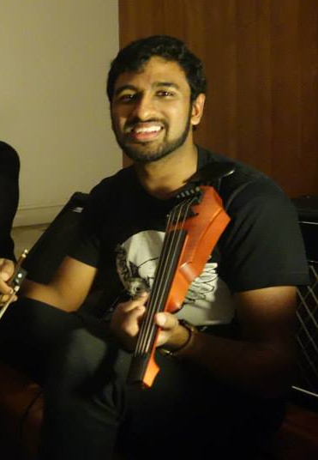
This page will be linked to “Meet the Tutors” in the homepage
Clicking this arrow goes to next tutor profile
Navin G
Hi everyone!
My name is Navin and I'm a Chemistry/Science tutor for Nav's Tuition.
I strongly believe that education is a combination of academic progress and development of life/social skills whilst experiencing a journey to find out what one's true passion is.
I have recently completed my Bachelor of Engineering (Chemical) at Monash University with a first class honours and have just started a graduate diploma in music performance at the Melbourne Conservatory of Music at the University of Melbourne. It is my goal to make education a fun, engaging and enriching experience for students to truly excel at what they want to achieve in life.
I also tutor refugee students on the side along with teaching violin!
Contact Info: Email: navstuitions@gmail.com Phone: +61430153489

Slide 8
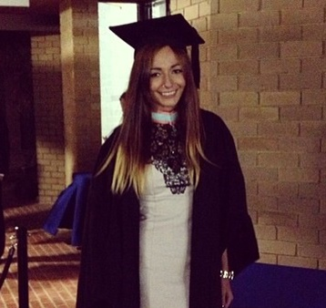
This page will be linked to “Meet the Tutors” in the homepage
Clicking this arrow goes to next tutor profile
Cristana T
Hey guys
My name is Cristiana and I have been teaching and tutoring English for about five years now. I have completed a Bachelor of Arts and a Bachelor of Law and have had much experience in writing and improving essays and reports.
My role here is to motivate students and keep them focused on the end goal. Nav’s Tuitions gives me the opportunity to be creative with my educational techniques and design my lessons in ways in which I believe will guide students to recognize their weaknesses and turn them into strengths.
At the end of the day, what this means is that I’ll try my best to ensure that we keep our minds on track and aim for our best whilst having fun in the whole process.
Contact Info: Email: navstuitions@gmail.com Phone: +61430153489

