Slide 1
e-Healthcare
Members:
Onika Hossain Sumu
Nusrat Jahan Ivee
Anika Tabassum
Md. Golam Rabby
Merina Kawser

Slide 2
Introduction
eHealthcare is a relatively recent healthcare practice supported by electronic processes and communication .
It refers to various info. and services that's either shared or modified through technology such as the internet .
A broad range of elements are covered by eHealthcare such as:
1 - Telemedicine
2 - EMR ( Electronic Medical Records )
3 - MHealth ( Mobile Health)
4 - Health Informatics
5 - Evidence Based Medicine

Slide 3
Objective
Main objective of e-Healthcare -
to reduce the manual work by managing the Doctors & Patients or Users an appointment booking system on online,
and tracking all the details about the Doctors according to user’s choice or demands.
Beside these it also provides the following functionalities:
Show hospital names with details and location on map
Patients can predict their diseases by doing some answering of the questions about the diseases and find specific doctors
Blog
4. Google translation

Slide 4
Project Module
The entire project mainly consists of 3 modules, which are
Admin module
User module (patient)
Doctor module

Slide 5
Admin module:
Admin have some knowledge about the medical
To see all the doctors lists with status
Can add doctors for membership of this site and can remove doctor's account
To see all the users/patients list with status
Can remove accounts of users
To see all the doctors registration request and can approve or delete their account
Can send confirmation messages to the doctors about an approval or deleting their request
To see all the appointments
Can write blogs

Slide 6
Doctor module:
Manage own profile and appointment schedule
See all the appointment requests from the patients with their(patients) status and can approve or cancel booking
Can see the messages from all the users and reply back to them(patients)
Get notification messages from the users who are to cancel appointments
Can comment about the site and blog

Slide 7
User/patient module
Manage own profile
Estimate their diseases
See all the doctors list with their(doctors) status
Search doctors by their names
Make an appointment according to their own choice or demand
See their own appointments and manage their appointments(cancel booking)
Get to notice notification messages from the doctors who approved or canceled his/her appointments
Send a message for an emergency to the doctors and also can reply to them.
Comment about the site and blog

Slide 8
System Analysis
Existing System
Feasibility Study
Proposed System

Slide 9
Existing System
Many hospitals or clinics currently use a manual system for the management and maintenance of critical informations. This system requires numerous paper forms, calling for ensuring availability of doctors’ and have confusions and all indecision to choose specific specialized doctors.
Feasibility Study
Operational Feasibility
Time savings : Patients can schedule their own appointment. They do not even need to leave their home .
Lower administrative burden : Many doctors now offer patients the opportunity to schedule appointments online.
Don't need to do registration : Users don’t need to register for knowing doctors info. , can get info. about the nearest hospitals & also can read articles .

Slide 10
Feasibility Study, Proposed System
Technical feasibility :
User do not need any sort of ID (Gmail or social ID ).
They can access the website form any browser .
For getting an appointment at first user need to login/register at this site .
Economical Feasibility :
Our health-care website system will interact with different websites like hospital operators .
Proposed System
control the information of doctors, patients, schedules, patient invoices, and locations of hospitals.

Slide 11
Diagrams
Data flow diagram (DFD)
Entity relationship diagram(ERD)

Slide 12
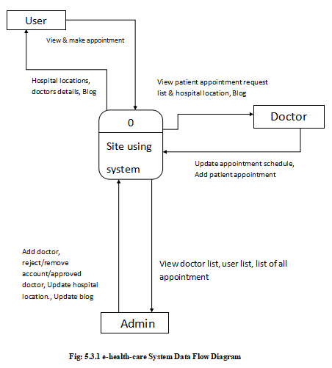
Context diagram of e-health-care using System:

Slide 13
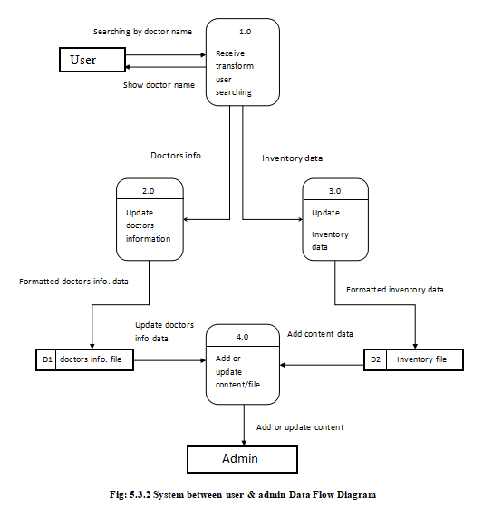
System between user & admin Data Flow Diagram

Slide 14
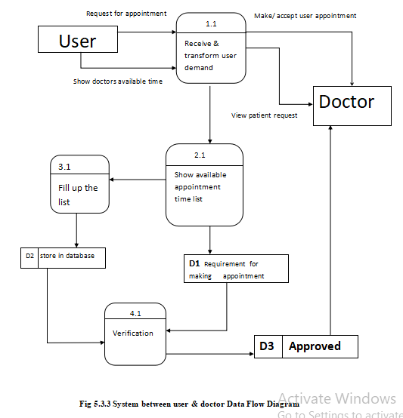
System between user & doctor Data Flow Diagram

Slide 15
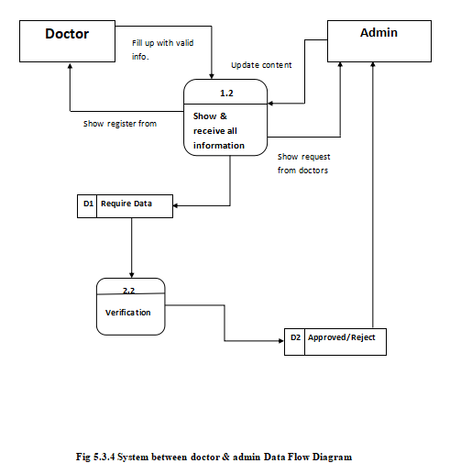
System between doctor & admin Data Flow Diagram

Slide 16
Entity Relationship Diagram ( ERD )

Slide 17
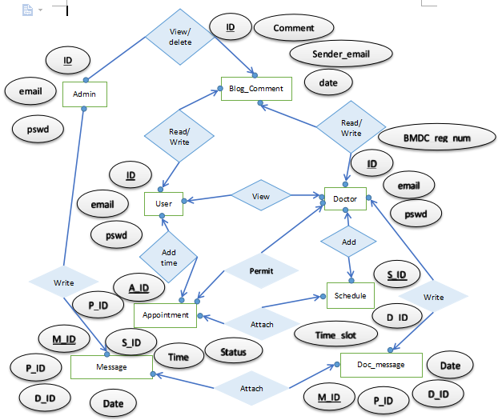
User registration &login Entity Relationship Diagram:

Slide 18
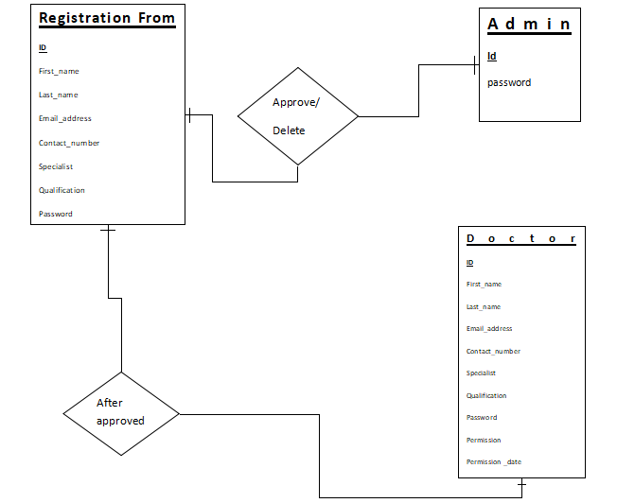
Doctor registration & login E-R Diagram:

Slide 19
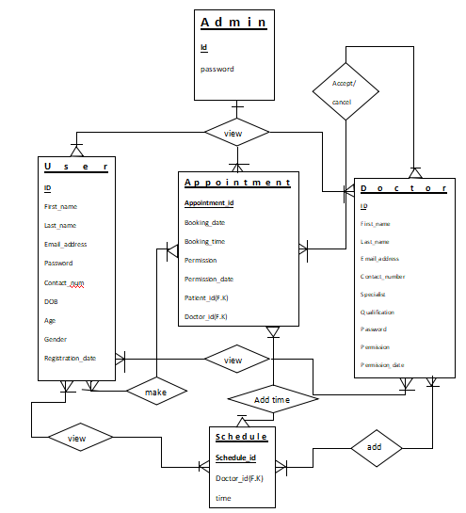
Appointment process of ER diagram Appointment process of ER diagram

Slide 20
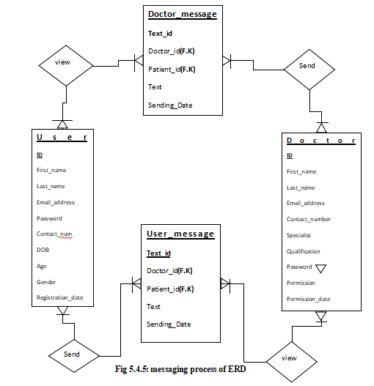
Messaging process of ER Diagram

Slide 21
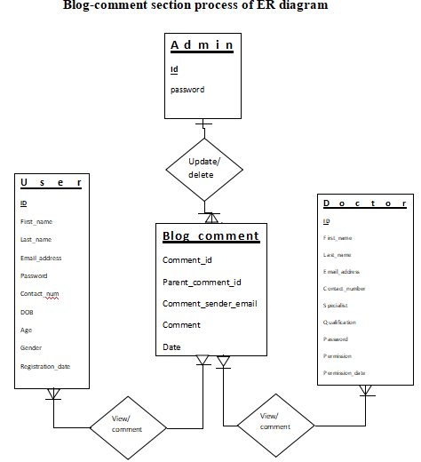
Blog-comment section process of ER diagram

Slide 22
Use Case Diagram

Slide 23
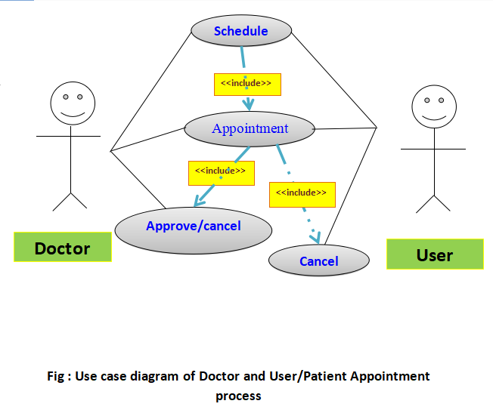
Use case diagram of Doctor and User/ Patient Appointment process

Slide 24
Limitation,Future Work, Conclusion

Slide 25
Limitations
For now it is only available in our country not through out the world.
Some important messages like admin’s approval of registration requests are shown publically.
Doctors and patients have to enter their own id’s (which id’s are shown) for specification.
This project management is only for doctor-patients community.
Future Work
To rid of all the limitations.
Provide individual messaging or chatting section.
Add more information about the hospitals with their locations.
Make a progressive disease prediction.

Slide 26
Conclusion
Due to lack of proper treatment millions of patient remains untreated .
Or they shift to abroad for better treatment.
So our goal is to build a reliable and trustable site where patients can get proper guidance and specific treatment under one roof in an ultimate easy way.

Slide 27
Project show

