Slide 1

CSE 450 CAPSTONE PROJECT · DEPARTMENT OF CSE, BUET
Exploratory Testing Automation
An autonomous agent that decides what to test, runs it, and learns from every run.
TEAM
SUPERVISOR
INDUSTRY PARTNER
Mohammad Raihan Rashid · 2105046
Mehemud Azad · 2105014
Jonayed Mohiuddin Shanto · 2105060
Khalid Hasan Tuhin · 2105002
Niloy Kumar Mondal · 2105044
Dr. A. B. M. Alim Al Islam
Professor, Department of CSE, BUET
Samsung R&D Institute Bangladesh

Slide 2
Three ways to test. Each gives up something.
Raihan
Manual exploratory
Scripted automation
Random / Monkey
Finds real defects.
Repeatable and cheap.
Explores at scale.
Does not scale.
Only checks what its author thought of.
No idea what correct looks like.
1

Slide 3
“A tool can tell you an application crashed.
It cannot tell you it quietly charged
the wrong account.”
What is missing is an oracle: knowing what correct looks like.
No system in our literature review ingests a specification. That is our position.
2

Slide 4

Three agents, one shared memory
3

Slide 5
They never talk to each other
Planner
Executor
Investigator
decides what to test next
drives the real application
decides what the run proved
The knowledge graph is the only channel between them.
Every model call is stateless and rebuilt from the graph, so “learning” is something you can inspect. The graph either grew or it did not.
4

Slide 6
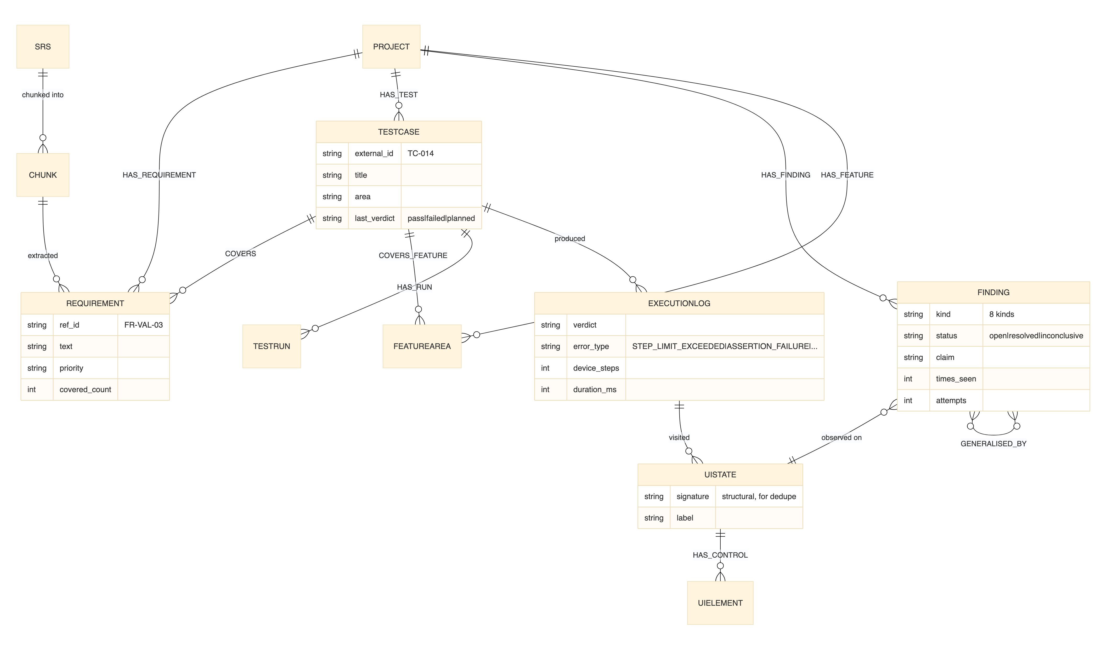
Two graphs in one store
A PRIORI
Requirements, validation rules, source chunks.
From documents.
A POSTERIORI
UI states, transitions, navigation paths, execution logs.
From observation.
Test cases and findings span both. Exploration is steered by the gap between them.
5

Slide 7
The planner: choose the single most valuable next test
Mehemud
It cannot see the screen. Everything it knows, it reads from the graph.
Pipeline mode
Tool-calling mode
shipped default
selectable
A LangGraph state machine. Fixed retrieval rounds, then one generation call.
The model calls graph tools itself and reads each answer before asking the next question.
Both are shipped. One setting switches them, and both produce the same output contract, so a campaign can be run on each and compared without touching the executor.
6

Slide 8
What the planner is allowed to ask the graph
Seven tools, each answering one question. A tool whose source is empty is never registered.
search_requirements
semantic and keyword search over the ingested specification
list_untested_requirements
the coverage frontier: what no executed test covers yet
get_screen
the real controls observed on one screen of the running app
list_screens
every screen the agent has actually seen, with visit counts
list_findings
what previous runs already established about this app
get_coverage
tests run so far, and which areas repeatedly fail
get_nav_path
a route to a screen the executor has already walked
So a blank answer can never mislead the model into planning against something that is not there.
7

Slide 9
One planning round, turn by turn
1 to 2
Read the frontier
search_requirements, list_untested_requirements
3 to 4
Check it is real
get_screen and list_screens, so the named screen exists
5
Avoid repeating
list_findings and get_coverage
6 onward
Forced to commit
the tool choice is pinned to propose_test_case
Ceiling of 12 turns. A model left free will investigate to the ceiling and never commit: we watched it do exactly that on the first live run.
8
Notes:
Detail slide. Skip the middle two rows if running short.

Slide 10
What the planner actually emits
A test case in plain language, never a tap sequence.
title
objective
expected_result
preconditions[]
screen_hint
area
test_type
requirement_ids[]
objective
“Verify that a survey cannot be submitted while a required question is unanswered, and that the error names the question.”
requirement_ids
FR-RESP-03, FR-RESP-07
These identifiers are what make requirement coverage reportable at all, instead of activity coverage as a proxy.
9

Slide 11
Nothing reaches a device unvalidated
1
The screen must exist
checked against screens actually observed
2
Requirement IDs must exist
invented identifiers are rejected, not silently stored
3
Not a duplicate
semantic similarity check against tests already executed
4
Preconditions must be reachable
no test that depends on a state nobody can create
Three rejections and the best effort is accepted with a recorded degradation. A round never returns nothing.
10

Slide 12
16%
The cause was structural
The old planner chose what to fetch next without having read what it just fetched. Only a one line note came back.
of proposals named a screen that really existed, under the first planner design.
After the redesign: one rejection across eight test cases.
11

Slide 13
The Android agent: driving a real handset
Built on mobilerun, over the Android Debug Bridge and the accessibility service.
MobileAgent + AndroidDriver
the action loop and the device connection
accessibility tree
every control with its role, text and content description
screenshot each step
so the model can ground an action it cannot name
RecordUIStateEvent
the executor subscribes to the event stream as it runs
normalize_ui_state
each observed screen is normalised before it reaches the graph
Controls are addressed by role and name, never by pixel coordinates.
At most 50 device actions per test, about 20 seconds per step.
12

Slide 14
Is this a screen we have seen before?
Every observation must be matched to the app model or added to it. Five tests, cheapest first.
1
Exact signature
string comparison of the structural key
2
Structural Jaccard
tolerates dynamic chrome such as counters and timestamps
0.90
3
Containment
a screen captured before its late painting chrome arrives
0.95
4
Skeleton containment
resource id and class only: same widgets, different values
0.95
5
Perceptual hash
last resort when the accessibility tree is too thin to describe the screen
6
Merge too eagerly and the map collapses. Split too eagerly and it is destroyed: one wizard produced nine states before this cascade existed.
13
Notes:
Hand off: 'But notice the planner never writes the steps, only the goal.'

Slide 15
An objective, never a tap sequence
Jonayed
What the planner sends
Why not a script
A goal, the expected result, and preconditions. Nothing positional.
The planner cannot see the live screen.
The executor can recover from a vague goal. It cannot recover from instructions that do not match the screen in front of it.
The executor resolves every control at runtime against what is actually on the screen.
This is the contract both executors implement. One planner, two bodies.
14

Slide 16
The web agent: what it sees
Playwright, reading an accessibility style description of the DOM rather than screenshots.
role, name
how every control is addressed, the same vocabulary as Android
value, checked, options
the current state of each field, so a change can be verified
required, invalid
native HTML5 validation, including the browser's own message
filled_chars
a password is described, never echoed, not even as asterisks
headings, messages
page structure and any alert or status region
captcha, loading
flags the agent must act on rather than fight
Cheaper per step and more precise than the vision based approach most comparable systems use.
15

Slide 17
Nine actions, and two guards that stop a stalled run
click fill press select
goto back scroll wait finish
Passive oracles
Defect signals collected independently of anything the agent claims:
console_errors
page_errors, the uncaught exceptions
http_5xx, the application broke
http_4xx, often expected
network_errors
Repetition
warn at 2, abort at 4
the same action, on the same page state, already proven to change nothing
A 5xx can override a claimed pass. On the live site this caught a real HTTP 500 the agent had nearly filed as a interface error.
Wandering
conclude at 2, abort at 6
a different action every time, and still nothing changes
16

Slide 18
Running against live systems safely
Eight labels are refused outright
CAPTCHA
delete account · close account · deactivate account
log out · logout · sign out · signout
Visible run: it pauses, asks a person, and sounds a tone every 20 seconds for up to 3 minutes, then resumes where it stopped.
Headless run: it fails the test cleanly and says why.
Blocked at the configuration layer, before the action is attempted, and per target.
A run lock, because two campaigns at once corrupted both
The agent also learns the target's real API routes as it observes traffic, so it stops inventing plausible looking endpoints that do not exist. That single failure once cost an entire test.
17

Slide 19
Adding an application is a data change
kind
android or web
5
knowledge
specification, API notes, defect history
targets
guardrails
the controls this target must never activate
Two Android applications and three websites, on one planner, one graph and one report format.
run budget
steps per test, wall clock, rounds
login
a disposable test account, never shown to the planner
The dashboard can list, validate, save, ingest and run a profile, so a new target never touches the source tree.
18
Notes:
Hand off: 'So how do we know that 500 is real and not the agent imagining it?'

Slide 20
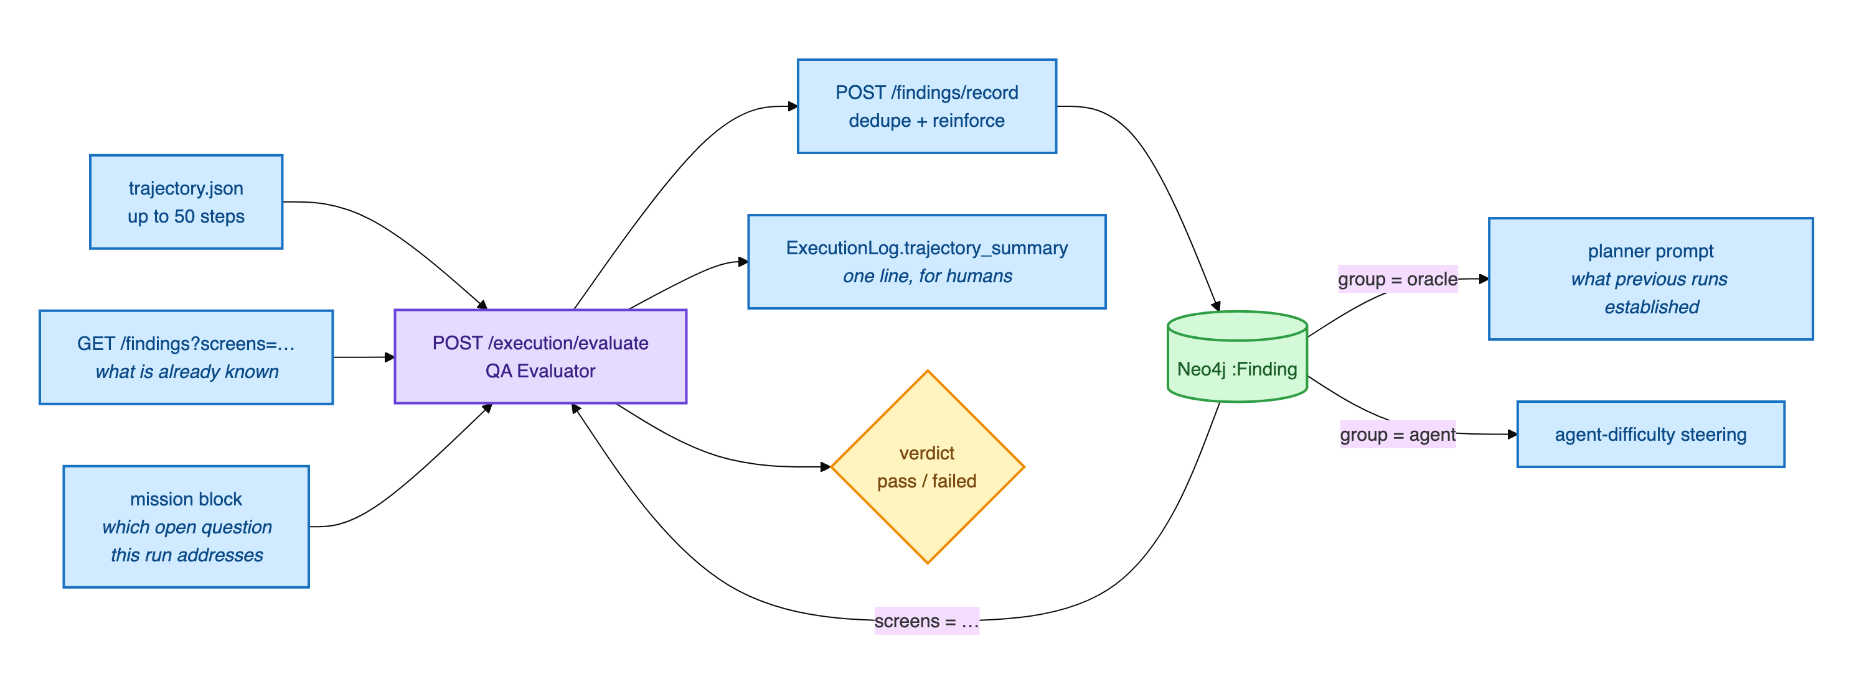
The investigator: turning a run into knowledge
Tuhin
It is given
the full trajectory, the test's own objective, and the findings already recorded for those screens
It returns
typed findings with a claim, evidence, severity, confidence and cited requirement ids
19

Slide 21
Eight kinds of finding, and only two are defects
SPEC_VIOLATION
observed behaviour contradicts a cited requirement
SUSPECTED_DEFECT
looks wrong against universal expectations, no requirement covers it
CONFIRMED_BEHAVIOUR
verified working as specified
UNEXPECTED_BEHAVIOUR
surprising or undocumented, needs judgement
SPEC_GAP
real behaviour the requirements do not describe
UNVERIFIED
could not be determined this run
CONTROL_DISCOVERED
a control or screen observed at runtime
AGENT_DIFFICULTY
our own agent struggled here, never app evidence
Only the first two ever reach a defect report. The rest are knowledge, and a spec gap is a finding about the specification, not the app.
20

Slide 22
The same finding, seen three times, is not three findings
times_seen
Why it matters
A repeat observation raises the count on the existing finding instead of creating a near duplicate.
A claim independently observed three times across three runs carries weight that a claim asserted once does not.
Open questions close themselves
When the investigator cannot settle something, it records an open question and the planner is steered to probe it. After three attempts it auto closes as inconclusive, which is a result a person can act on rather than an endless retry.
21

Slide 23
Not every failure is the application's fault
APP
AGENT
ENV
the application is wrong
we could not drive it
something blocked the test
crash · assertion failure · unresponsive · HTTP error · page error
element not found · timeout · navigation failure · livelock · stale element
precondition · permission · CAPTCHA · guardrail · step limit · browser closed
Only the first is ever evidence about the application. Conflating them inflates the defect count, which is the most expensive error this system can make.
22

Slide 24
100%
67%
was the autonomy we reported.
was the truth.
The taxonomy had been defined in two places and the copies drifted. It is now three frozen sets in one module, imported everywhere, and a configuration guard asserts they stay disjoint.
23

Slide 25
So does it cry wolf?
A comparable published agent
Ours, on the live site
158 defects reported
against a human team's 80.
It flagged what looked like a serious access control hole.
At 52 to 66% accuracy, where the humans were at 100%. Two in five of its reports were false.
We checked. It was gated by the site's own privacy setting, working as designed.
So we did not report it.
24

Slide 26
189 autonomous runs across five targets
Niloy
Target | Platform | Tests | Passed | App fault | Agent fault
DataGhurhi, survey platform | Web | 64 | 51 | 4 | 0
Shobar Khamar, marketplace | Android | 45 | 20 | 11 | 14
Google Contacts | Android | 50 | 20 | 19 | 10
broken-workshop | Web | 10 | 5 | 0 | 4
AcademyBug, no specification | Web | 20 | 1 | 3 | 16
Coverage on the two Android targets: 33 of 106 and 55 of 141 requirements, 97 and 60 UI states mapped.
25

Slide 27
The two end rows are the whole argument
With a specification
Without one
0
16
agent faults in 64 runs.
agent faults in 20 runs.
The specification is not decoration. It is what lets the agent know where it is going.
26

Slide 28
What the campaign curve actually shows
0% looked catastrophic.
82% of device steps were unparseable, so nothing could be attributed. The instrumentation worked and revealed that the evidence did not.
Four fixes, one day.
Log reassembly, containment matching, a precondition filter, a device reset. Two days later: 100% autonomy.
Then it met production.
Autonomy fell to 67%. A tuned agent does not transfer for free.
27

Slide 29
USD 0.008
Comparable published work reports about USD 18 per application, and states that the cost prevented the authors from repeating their own runs.
per executed test, measured against the provider's billing record at 10.1 device steps per test.
28

Slide 30
What we cannot yet claim
No precision or recall
Establishing them honestly needs seeded defects. The partner supplied neither a defect export nor a seeded build.
The models changed eight times
Pass rates rose and so did model quality. This report does not separate those two causes.
Deployment is local
A developer operated host. Not hardened for shared infrastructure.
Next: oracles that check the application's stored state, and judging after every step rather than only at the verdict.
29

Slide 31
Thank you
Architecture
Raihan
Planner and Android
Mehemud
Questions are welcome.
Web agent and safety
Jonayed
Verdicts and attribution
Tuhin
Results and cost
Niloy

