Slide 1

CSE 450 CAPSTONE PROJECT · DEPARTMENT OF CSE, BUET
Exploratory Testing Automation
An autonomous agent that decides what to test, runs it on a real Android device, and learns from every run.
TEAM
SUPERVISOR
INDUSTRY PARTNER
Mohammad Raihan Rashid · 2105046
Mehemud Azad · 2105014
Jonayed Mohiuddin Shanto · 2105060
Khalid Hasan Tuhin · 2105002
Niloy Kumar Mondal · 2105044
Dr. A. B. M. Alim Al Islam
Professor, Department of CSE, BUET
Samsung R&D Institute Bangladesh
Notes:
About 20 seconds. Introduce the project and the team. One sentence on what it is: an agent that plans its own tests, runs them on a real Android device and learns from every run. Mention the industry partner, because slide 4 quotes their brief.

Slide 2
THE PROBLEM
Why exploratory testing is hard to automate
Manual exploratory testing
Scripted automation
Random (Monkey) testing
Finds real bugs, because a person knows what correct looks like.
Repeatable, and cheap to run again.
Explores at scale, with no setup.
But it only checks what its author thought to check. It confirms; it does not discover.
But it has no idea what correct looks like. It can report a crash, not a wrong result.
But it does not scale, and the knowledge leaves with the tester.
“An automated tool can tell you an application crashed. It cannot tell you it quietly charged the wrong price, because it has no idea what the right price was.”
Exploratory Testing Automation · CSE 450 · BUET
2
Notes:
About 45 seconds. Three ways to test an app, and why none is enough. Manual exploratory testing finds real bugs but does not scale. Scripts only check what someone already expected. Random testing scales but has no notion of correct behaviour, so the only bug it can report is a crash. The quote at the bottom is the whole problem: without knowing what the app should do, a tool cannot tell a wrong result from a right one.

Slide 3
RELATED WORK
What existing research agents miss
Capability | Research agents today | Our system
Reads the requirements specification | No, so no oracle beyond a crash | Yes: every requirement becomes a queryable node
Remembers across runs | Only within one session | A persistent knowledge graph
Separates its own failures from app defects | No | Three-way fault attribution
Chooses its own test objectives | 5 of 7 are handed a task | Yes, and each test cites a requirement
From our review of seven LLM-based GUI testing systems, among them GPTDroid, DroidAgent and AutoDroid.
Exploratory Testing Automation · CSE 450 · BUET
3
Notes:
About 45 seconds. Recent research uses language models to drive Android apps. We read seven of these systems closely. None of them reads a specification, so a crash is the only thing they can call a bug. Their memory does not survive the session. None separates the agent failing from the app failing, which inflates their defect counts. And five of the seven are handed their task rather than choosing it. Our system is built on exactly these four gaps.

Slide 4
THE PARTNER'S BRIEF · SAMSUNG R&D INSTITUTE BANGLADESH
“Every execution cycle must make the agent smarter than the last.”
Our answer: three stateless AI agents that never talk to each other. Everything they learn goes into one shared knowledge graph, and every new test is planned from it.
Notes:
About 20 seconds. This is the requirement that shaped the whole design. The partner asked for an agent that improves with every run. Our answer has two parts. First, three separate agents, each with one job. Second, none of them keeps any memory of its own: every call starts fresh. So the only way the system can improve is that the shared knowledge graph grows. That makes the learning inspectable, because you can look at exactly what was learned.

Slide 5



ARCHITECTURE
Three agents, one shared memory
Knowledge graph · Neo4j
requirements · observed screens · test cases · execution history · findings
reads
writes screens seen
writes findings
Planner
test case
Executor
trajectory
Investigator
decides what to test next and writes the test case
drives the real app on an Android device
decides what each run actually proved
Stateless: no conversation history. Every call is rebuilt from the graph.
qwen3.7-flash plans and drives; glm-5.3-flash evaluates. All via OpenRouter.
Android device
app under test · on-device portal
Exploratory Testing Automation · CSE 450 · BUET
5
Notes:
About 50 seconds. The architecture is three agents around one knowledge graph. The planner reads the graph and writes one test case. The executor runs it on a real Android device through mobilerun, and records every screen it sees. The investigator reads the step-by-step trajectory and writes findings back. They hand each other a test case and a trajectory, but none of them remembers anything between calls. Everything durable lives in the graph: the requirements from the specification, the screens observed, every test and its result, and the findings. The next slide shows the same architecture with every component named.

Slide 6

ARCHITECTURE · IN DETAIL
Every component, and how they connect
Exploratory Testing Automation · CSE 450 · BUET
6
Notes:
About 30 seconds. The same architecture with every component named. Walk it by colour. Amber is what a person supplies: the specification, an optional design export and defect history. Green is the knowledge: the Neo4j graph and the vector index. Blue is the two services: the RAG API on port 9010, which owns the graph, and the agent gateway on 9100, which hosts the planner and the investigator. Purple is the three agents. Red is the model provider, which every agent calls. Grey is the device, reached over adb through the on-device portal.

Slide 7


HOW A TEST RUNS
One round: plan, run, interpret, remember
1
2
3
4
Plan
Run
Interpret
Remember
about 1 minute
5 to 15 minutes
about 20 seconds
end of every round
Reads what is known, then writes one test case.
Drives the real app, about 20 s per step, at most 50 steps.
Reads the step log against the goal and writes findings.
Findings, screens and coverage go into the graph.
the next round starts from the larger graph
Every model call is stateless. The agent improves only because the graph grew.
Exploratory Testing Automation · CSE 450 · BUET
7
Notes:
About 40 seconds. One test is one round of four steps. The planner takes about a minute to decide and write the test. The executor then drives the real app, and this is the long part: every step is a vision model call of about 20 seconds, with a budget of 50 steps. The investigator reads the result in about 20 seconds. Everything it learned is written to the graph, and the next round is planned from that larger graph. A campaign is simply this loop repeated. The timings are measured from our own campaigns.

Slide 8
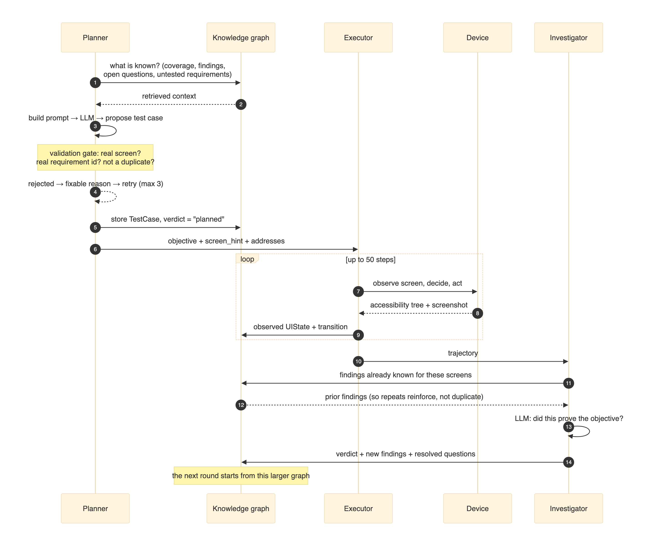
HOW A TEST RUNS · IN DETAIL
The fourteen messages of one round
1–5 · Planner
proposes and stores the test
6–9 · Executor
runs it, posting every screen
10–14 · Investigator
judges it, writes findings
Only the graph carries over.
Exploratory Testing Automation · CSE 450 · BUET
8
Notes:
About 30 seconds; skip if short on time. The full sequence of one round, message by message. Steps 1 to 5 are the planner: it asks the graph what is known, proposes a test, and stores it before the executor sees it. Steps 6 to 9 are the executor looping on the device, and on every step it posts the screen back to the graph. Steps 10 to 14 are the investigator: note step 11, where it first fetches what is already known about those screens, which is what lets a repeat observation reinforce an existing finding instead of creating a duplicate.

Slide 9
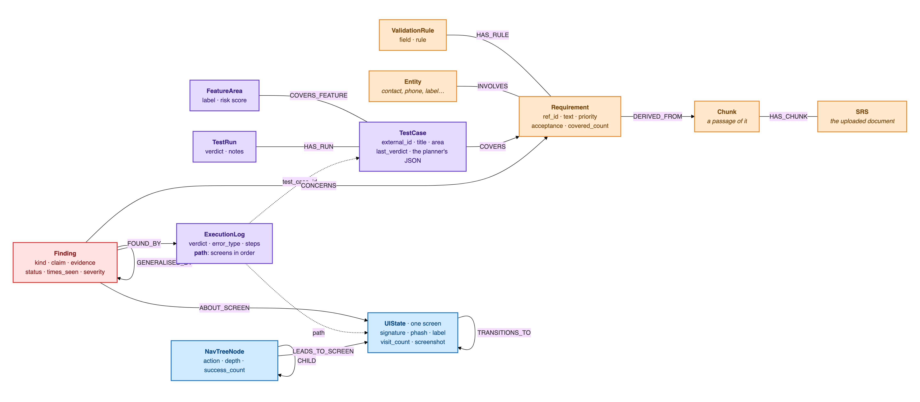
ARCHITECTURE · THE SHARED MEMORY
What the knowledge graph stores
Orange: from the specification · Purple: tests and runs · Blue: the app model · Red: findings · Dashed: stored as a property, not a relationship. Every node belongs to one project.
Exploratory Testing Automation · CSE 450 · BUET
9
Notes:
About 40 seconds. This is how the shared memory is organised, taken from the live Neo4j database. Orange is the specification: the document is split into passages, each requirement is traced to the passage it came from, with its validation rules and the entities it involves. Purple is testing: a test case covers requirements and a feature area, and every execution leaves a log with its verdict, its error type and the ordered path of screens it went through. Blue is the app model the executor builds: one node per distinct screen, with the transitions between them and learned navigation routes. Red is findings, written by the investigator: each one points to the run that found it, the screen it is about and the requirement it concerns, and related findings are grouped under a more general one. The point to make: every agent reads and writes this one structure, and nothing else survives between calls. Every node is scoped to a project, so two apps never mix.

Slide 10
MODELS
Which model does what, and why
Role | Model | Why this choice
Planner | qwen/qwen3.7-flash | Long context and dependable structured output matter more than deep reasoning. About 8% of a test's cost.
Executor (Android) | qwen/qwen3.7-flash, with vision | Reads the accessibility tree and a screenshot on every step, so it is about 92% of a test's cost.
Investigator and rate-limit fallback | z-ai/glm-5.3-flash | A different model family, so no model grades its own execution. Low reasoning effort cut an evaluation from 113.8 s to 22.7 s.
Specification extraction | qwen/qwen3-235b-a22b | Run once per document, and every later decision rests on it, so accuracy is worth paying for here.
Embeddings | BAAI/bge-small-en-v1.5 | Runs locally through fastembed, with no per-call charge.
All routed through OpenRouter. Every campaign in this deck ran on the planner, executor and investigator above; the planner is next moving to deepseek-v4-flash.
Exploratory Testing Automation · CSE 450 · BUET
10
Notes:
About 45 seconds. Each role has its own model, chosen for what that role needs. The planner needs long context and output that parses reliably, not deep reasoning, so a fast tier is right, and it is only about 8 percent of the cost. The executor has to see: it reads the accessibility tree and a screenshot on every step, which makes it about 92 percent of the cost. The investigator is deliberately a different model family, so no model is grading its own work, and setting its reasoning effort to low cut an evaluation from almost two minutes to 23 seconds. Specification extraction runs once per document but everything depends on it, so that is the one place we pay for a large model. Embeddings run locally for free. The history, briefly: we started on a free tier to prove the loop worked, tried self-hosting through a tunnel and dropped it, then moved each role down a tier once we had measured that quality held.

Slide 11
PLANNER · WHAT IT KNOWS
What the planner knows before it writes a test
Specification
Screens seen
Navigation paths
Every requirement as a node, retrieved by meaning and by keyword.
The live map of the app: 79 screens and 797 transitions on the contacts app.
Learned routes to each screen, and the routes known to fail.
Findings
Coverage
Defect history
What earlier runs confirmed, contradicted or left open.
Which requirements and feature areas are still untested.
Past bug reports, when a project has them.
Bounded context, so long campaigns stay cheap
The block summarising earlier runs was 35,233 characters, 69% of one prompt. Stored as findings instead of prose, it is now about 2,000.
Exploratory Testing Automation · CSE 450 · BUET
11
Notes:
About 45 seconds. Before it writes anything, the planner can draw on six kinds of knowledge. The specification, as individual requirements it can search by meaning or keyword. A live map of every screen the agent has actually seen, 79 screens on the contacts app. Learned navigation paths. Findings from earlier runs. Coverage, meaning what is still untested. And defect history when a project has it. All of it is capped, so the prompt does not grow with the campaign. The clearest example: the block describing earlier runs used to be 35,000 characters, 69 percent of one prompt. Storing findings as structured knowledge brought it down to about 2,000.

Slide 12

PLANNER · PIPELINE MODE · A LANGGRAPH STATE MACHINE
The planner asks what it still needs
bootstrap_context
planner_step
generate_testcase
duplicate_check
loads coverage, tests and findings
model: “what do I still need?”
writes the test as structured JSON
rejects near-duplicates by title and meaning
execute_retrieval
runs its tools: spec, screens, paths, defects
no model call
repeats until ready · 2 rounds in our campaigns
1 large model call
+1 call if rejected
Its tools: four sources it can look things up in
When it stops looking
Each round the model picks up to three lookups: search the specification, pull up a screen already seen, find a path to a screen, or check past defects there.
When the model says it is ready, after 2 rounds, when the context passes 9,000 characters, or when a retrieval returns nothing new.
Exploratory Testing Automation · CSE 450 · BUET
12
Notes:
About 50 seconds. The planner is a LangGraph state machine. It first loads what is already known, with no model call. Then the key step: planner_step asks the model what it still needs. It either picks tools to fetch more, from the specification, the screens it has seen, navigation paths or past defects, and execute_retrieval runs them, or it decides it has enough. That loop is what lets it reason about its own knowledge gaps instead of taking a fixed bundle of context. Then it writes the test, and a duplicate check compares it with every earlier test by title and by meaning, and forces a rewrite if it is too similar. The loop stops when the model says it is ready, after two rounds, which is what our runner asks for, when the context passes 9,000 characters, or when a retrieval brings nothing new. This pipeline planned the contacts campaign. The commerce campaign used the tools mode, two slides on.

Slide 13
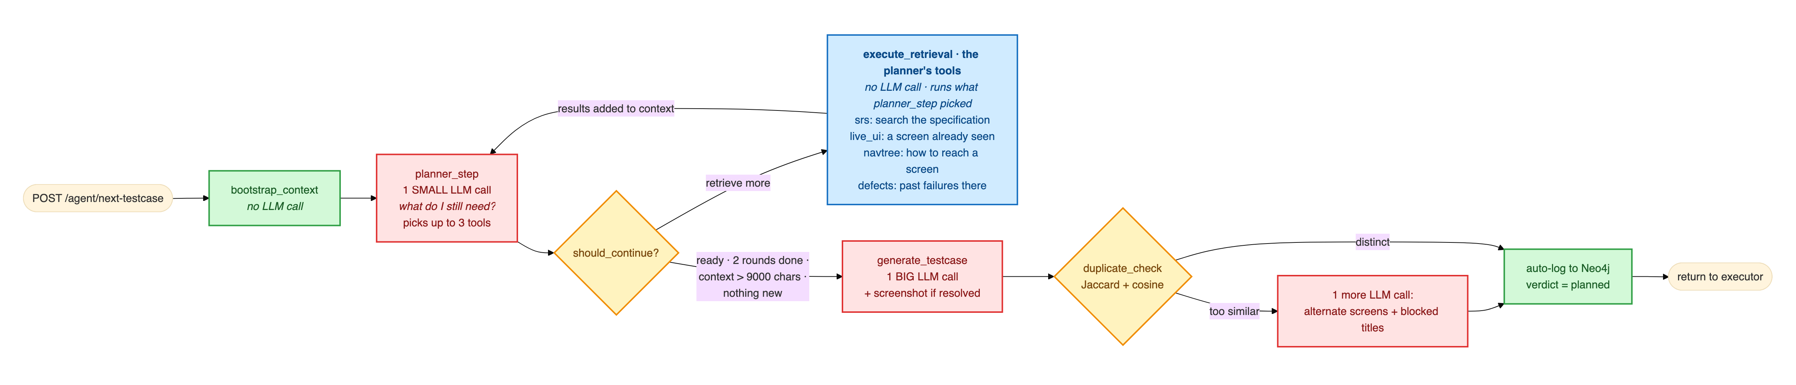
PLANNER · IN DETAIL
The full planning pipeline
Green: no model call
Blue: the planner's tools
Red: a model call
Amber: a decision
bootstrap_context and the final auto-log are plain graph work.
planner_step picks up to 3 lookups, each a source and a query; this step runs them.
planner_step is small, generate_testcase is large, and the retry fires only on a near-duplicate.
Keep retrieving, or write? And is the draft distinct enough to keep?
Exploratory Testing Automation · CSE 450 · BUET
13
Notes:
About 40 seconds. The planning pipeline in full, left to right. Read it by colour. Blue is where the planner uses its tools: in planner_step the model looks at what it has and names up to three lookups, each a source and a query. It can search the specification, pull up a screen it has already seen, ask how to reach a screen, or check past failures there. execute_retrieval runs those lookups, with no model call, and the results go back into the context for the next planner_step. Green steps are plain graph reads and writes; red steps are model calls; amber steps are decisions. Only two model calls are guaranteed per test, the small planner_step and the large generate_testcase; the retry fires only when the duplicate check rejects a draft. The test is logged to the graph as planned before the executor ever sees it. The next slide is the planner's other mode, where the model calls its tools directly.

Slide 14
PLANNER · TOOLS MODE · PLANNED THE COMMERCE CAMPAIGN
Tools mode: the model calls each tool itself
1
A short brief
The coverage map, the last few runs and the open questions.
Every proposal is validated
2
It investigates
It is rejected if it names a screen never observed, cites a requirement id that does not exist, repeats an earlier test, needs a precondition the tester cannot create, or falls outside the agreed scope. The model gets the reason and tries again, up to 3 times.
It calls a graph tool, reads the answer, and chooses the next question.
3
It proposes
One call to propose_test_case, which must pass the gate on the right.
Across all its commerce runs: 989 tool calls for 101 proposals, all nine tools used, most often search_requirements (247) and get_screen (199).
Exploratory Testing Automation · CSE 450 · BUET
14
Notes:
About 40 seconds. This is the planner's second mode, and it is the one that planned the 45-test commerce campaign. In the pipeline, the model writes down which lookups it wants and code runs them as a batch. Here the loop of planner_step and execute_retrieval is replaced by real function calls. The model starts from a short brief: the coverage map, the last few runs and the open questions. Then it investigates: it calls a tool, reads the answer, and decides what to ask next, so each question can depend on the last result. Finally it proposes one test case, and that proposal goes through a validation gate: a screen it has never seen, a requirement id that does not exist, a repeat, a precondition the tester cannot create, or something out of scope is rejected with a reason it can act on, up to three times. Across all its runs on the commerce app it made 989 tool calls for 101 proposals and used all nine tools. The next slides show the tools, a real round, and what it emits. The contacts campaign ran on the pipeline.

Slide 15
PLANNER · TOOLS MODE · THE TOOLS
What the planner is allowed to ask the graph
Nine read-only tools, each answering one question. A tool whose source has no data is never offered.
Tool | What it answers | Offered when
search_requirements | semantic and keyword search over the specification | a spec is ingested
list_untested_requirements | the coverage frontier: what no executed test covers yet | a spec is ingested
get_screen | the real controls observed on one screen | screens have been seen
list_screens | every screen actually seen, with visit counts | screens have been seen
get_nav_path | a route to a screen the executor has already walked | a route exists
findings_summary | counts of everything earlier runs found, per screen and kind | always
list_findings | the claims themselves: confirmed, suspected, unverified | always
list_open_questions | questions earlier runs raised but never settled | always
get_coverage | tests run, failing hot spots, dead ends, exhausted areas | always
So an empty answer can never mislead the model into planning against something that is not there.
Exploratory Testing Automation · CSE 450 · BUET
15
Notes:
About 40 seconds. These are the nine tools the planner can call in tools mode. All of them only read; none can change the graph. Two answer what the specification says should exist. Three answer what the app actually has: a screen's real controls, the list of screens seen, and a known route to a screen. Three answer what earlier runs already established: a summary count, the findings themselves, and the questions still open. And one reports coverage: where tests have gone, what keeps failing, and what is exhausted. The right-hand column is the safety rule: a tool is only offered when its source has data. On a brand-new app with no screens yet, get_screen simply does not exist for the model, so it cannot be misled by an empty answer into planning against a screen that is not there.

Slide 16
PLANNER · TOOLS MODE · ONE ROUND
One planning round, call by call
Orient: what is known, and where the gaps are
Calls 1–3
findings_summary, get_coverage, list_screens
Pick up an unfinished thread
Call 4
list_open_questions, list_findings
Ground it: a real requirement and a real screen
Call 5 onward
search_requirements, get_screen
Forced to commit, then validated
Turn 7 onward
the tool choice is pinned to propose_test_case
The most common tool at each position, over 62 rounds on the commerce app; a median of 13 calls per round. Ceiling of 12 turns: left free, the first live run investigated for ten turns and never proposed.
Exploratory Testing Automation · CSE 450 · BUET
16
Notes:
About 40 seconds. This is what a planning round actually looks like, measured from the logs of 62 rounds on the commerce app rather than how we hoped it would behave. Nothing in the code fixes this order; the prompt only sets rules, such as never naming a screen you have not confirmed. In practice the model orients first: a summary of what earlier runs found, the coverage state, and the list of screens. Then it picks up an unfinished thread, an open question or an existing finding. Only then does it ground the test: searching the specification for the exact requirement and confirming the screen exists. A round takes a median of 13 tool calls, often several in one turn. After six free turns it is told to propose, and the tool choice is pinned so that it must. That rule exists because the first live run investigated for ten turns and never produced a test at all. The proposal then goes through the validation gate from slide 14.

Slide 17
PLANNER · THE OUTPUT CONTRACT
What the planner actually emits
A test case in plain language, never a tap sequence. Both planner modes emit the same fields.
title
objective
expected_result
preconditions[]
screen_hint
area · priority · test_type
requirement_ids[]
rationale
addresses
TC-003 · commerce app · tools mode
objective
“Verify that clearing the farm name field to empty and attempting to save produces a visible error identifying the farm name as required.”
requirement_ids
addresses
FR-FARM-04
F-422162fd
Requirement ids make requirement coverage reportable. addresses names the open question this test settles: an earlier run suspected farm names were never validated.
Exploratory Testing Automation · CSE 450 · BUET
17
Notes:
About 35 seconds. This is the contract between the planner and the executor, and both planner modes produce exactly these fields. It is a test case in plain language: a title, an objective, an expected result, preconditions, the screen to start from, and labels for area, priority and type. Never a sequence of taps; the executor works those out on the device. Two fields do the most work. requirement_ids are what let us report requirement coverage at all, instead of counting screens visited as a proxy. And addresses links the test to an open question from an earlier run. Here, TC-003 from the commerce campaign: an earlier run suspected the farm name was never validated, so the planner wrote a test aimed at exactly that, citing FR-FARM-04, the requirement that mandatory fields show a specific error.

Slide 18
PLANNER · WHERE TO GO NEXT
Where to test next, without repeating itself
Steered to the gaps
A cap on every area
No near-duplicates
A coverage map and an exploration directive point it at untested requirements and feature areas.
After 5 tests an area is marked spent and is no longer promoted, whatever its results.
Each new title is compared with every earlier test, by word overlap (0.60) and by meaning (0.90 cosine).
Why the cap was needed
In one 13-round campaign, 9 tests landed on the same screen: a failing area kept being promoted, and nothing ever retired it. The intuitive fix, stopping once an area yields nothing new, would never have fired, because the ninth test was still producing technically new findings.
Exploratory Testing Automation · CSE 450 · BUET
18
Notes:
About 45 seconds. Three mechanisms decide where the next test goes. A coverage map points the planner at requirements and areas nobody has tested. A cap retires an area after five tests, whatever happened in them. And a duplicate check compares each new title with every earlier test, both by word overlap and by meaning. The cap exists because of a real failure: in one 13-round campaign, nine tests landed on the same screen. A failing area kept getting promoted and nothing retired it. We considered stopping when an area stops yielding new findings, and rejected it: the ninth test was still technically producing new ones, so that rule would never have fired.

Slide 19
PLANNER · ONE REAL TEST
One real test, from plan to finding
TC-018 · written by the planner
EXECUTOR
Verify duplicate detection triggers for a phone number match when the display name is intentionally different
48 steps. Created and saved the contact, then found both entries in the list.
Field | What the planner wrote (condensed)
Requirements | FR-DUP-02, FR-DUP-04
Why this test | Earlier runs saw silent duplicates but left phone-only detection unverified. A different name isolates FR-DUP-02 from the name rule.
Objective | Create a contact with a new name but an existing contact’s phone number.
Expected | A duplicate dialog shows both records (FR-DUP-04), instead of a silent save.
INVESTIGATOR
Objective refuted · spec violation, high severity
ITS VERDICT
“This directly answers the earlier open question: duplicate detection is not triggered by phone-number match alone.”
Exploratory Testing Automation · CSE 450 · BUET
19
Notes:
About 45 seconds. This is one real test from the contacts campaign, and it shows the loop working. Earlier runs had seen duplicate contacts saved silently, but detection on a phone-number match alone was still marked unverified, an open question the investigator had left in the graph. The planner picked it up. Its own rationale: give the new contact a completely different name, so that only the phone number matches, which tests FR-DUP-02 on its own instead of mixing it up with the name rule. The executor created the contact with an existing contact’s number, saved it, and found both entries side by side in the list: no duplicate dialog. It took 48 steps, but the evidence is in the first 15; the rest went to a search box that did not respond, and the investigator’s summary says so. The verdict: objective refuted, a high-severity spec violation of FR-DUP-02 and FR-DUP-04, and in its words it directly answers the earlier open question. Nobody told the agent to look at duplicates. It chose this from the specification and from what earlier runs had left unresolved.

Slide 20

EXECUTOR · THE PLAYER
We chose the executor by trying several
Surveyed benchmarks, then tried hands-on
What we needed from it
MUI
evaluated
Runs from a goal in plain language, not a script
Drives a real Android device through its accessibility tree and screenshots
Accepts our own model provider (OpenRouter)
Saves a step-by-step trajectory we can analyse
Streams every screen it sees, so we can map the app
GeLab
evaluated
MobileAgent-V3
evaluated
mobilerun (Droidrun)
selected
mobilerun is open source and third-party. Everything around it, on the next slides, is ours.
Exploratory Testing Automation · CSE 450 · BUET
20
Notes:
About 40 seconds. The executor, which we also call the player, is the one component we did not build, so we chose it carefully. We surveyed the mobile GUI-agent benchmarks and then tried several executors hands-on, among them MUI, GeLab and MobileAgent-V3, before selecting mobilerun, also known as Droidrun. [Add one line per alternative on why it was not chosen.] What decided it was what our design needs: it works from a goal in plain language rather than a script, drives a real device through the accessibility tree and screenshots, lets us plug in our own model provider, saves a step-by-step trajectory for the investigator, and streams every screen it sees, which is how we build the map of the app.

Slide 21

EXECUTOR · ONE RUN
How a test is executed on the device
Goal
Observe
Decide
Act
Trajectory
objective, screen hint, and login and input details
accessibility tree and screenshot
the model picks the next action
tap, type or swipe over adb
each step's thought, action and outcome
repeats up to 50 steps, about 20 seconds each
What we built around mobilerun
Goal assembly from the planner's test case
Every screen streamed into the live app map
On-device portal for reliable text input
Login secrets reach the executor, never the planner
Device reset and an app-only guard between tests
Waits out network loss; campaigns resume intact
Exploratory Testing Automation · CSE 450 · BUET
21
Notes:
About 45 seconds. The executor receives a goal, not a script: the planner's objective and screen hint, plus login and input details. It then loops: observe the screen through the accessibility tree and a screenshot, let the model decide the next action, and act, tapping, typing or swiping over adb. Up to 50 steps, about 20 seconds each. It returns a trajectory: every step's reasoning, action and result. The loop is mobilerun, but the harness around it is ours: building the goal from the test case, the on-device portal that makes typing reliable, resetting the app between tests and keeping the agent inside it, keeping login secrets out of the planner's prompt, streaming every screen into the live map, and surviving network loss mid-campaign.

Slide 22
EXECUTOR · MAPPING THE APP
Mapping the app while the tests run
Is this a screen we have seen? Checked in order, cheapest first:
79
1
Exact signature
same package, activity, controls and dialog
distinct screens
Structural similarity of at least 0.90
2,149
2
tolerates counters, timestamps and changing list data
Containment of at least 0.95
screen observations
3
a screen captured before it finished drawing
797
4
Perceptual image hash, distance of 6 or less
the last resort when the accessibility tree is thin
transitions between screens · contacts app
Match: a known screen, its visit counted. No match: a new screen, with its screenshot and the transition that led to it.
Exploratory Testing Automation · CSE 450 · BUET
22
Notes:
About 40 seconds. Every screen the executor passes through is matched against the screens already seen, and this is how the agent builds its own map of an app with no documentation. The checks run cheapest first: an exact signature; then structural similarity, which tolerates counters and timestamps; then containment, for a screen captured before it finished drawing; and finally a perceptual hash of the screenshot, for screens whose accessibility tree says almost nothing. A match counts a visit; a miss creates a new screen and records how we got there. On the contacts app that is 79 distinct screens from over two thousand observations, and 797 transitions. The planner uses this map to ground its screen hints and find paths.

Slide 23
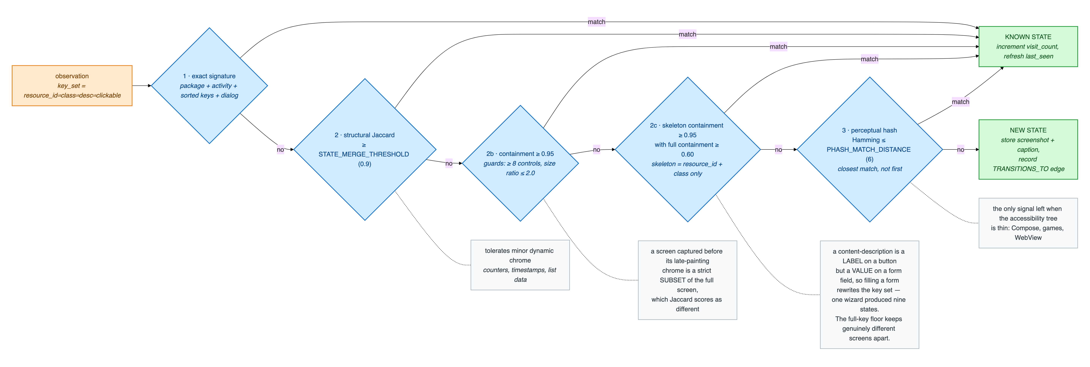
EXECUTOR · IN DETAIL
Is this a screen we have seen?
Checked left to right, cheapest first. Any match counts a visit to a known screen; no match stores a new screen and the transition that led to it. The grey notes say why each check exists.
Exploratory Testing Automation · CSE 450 · BUET
23
Notes:
About 25 seconds; skip if short on time. The full screen-identity cascade, left to right. Each check exists because the previous one failed on a real case, and the grey notes say which. Structural similarity handles counters and timestamps. Containment handles a screen captured before it finished drawing, which similarity scores as different. Skeleton containment handles form fields, where typing changes the labels: one wizard once produced nine separate states. And the perceptual hash is the last resort for screens built with Compose, games or web views, whose accessibility tree says almost nothing.

Slide 24
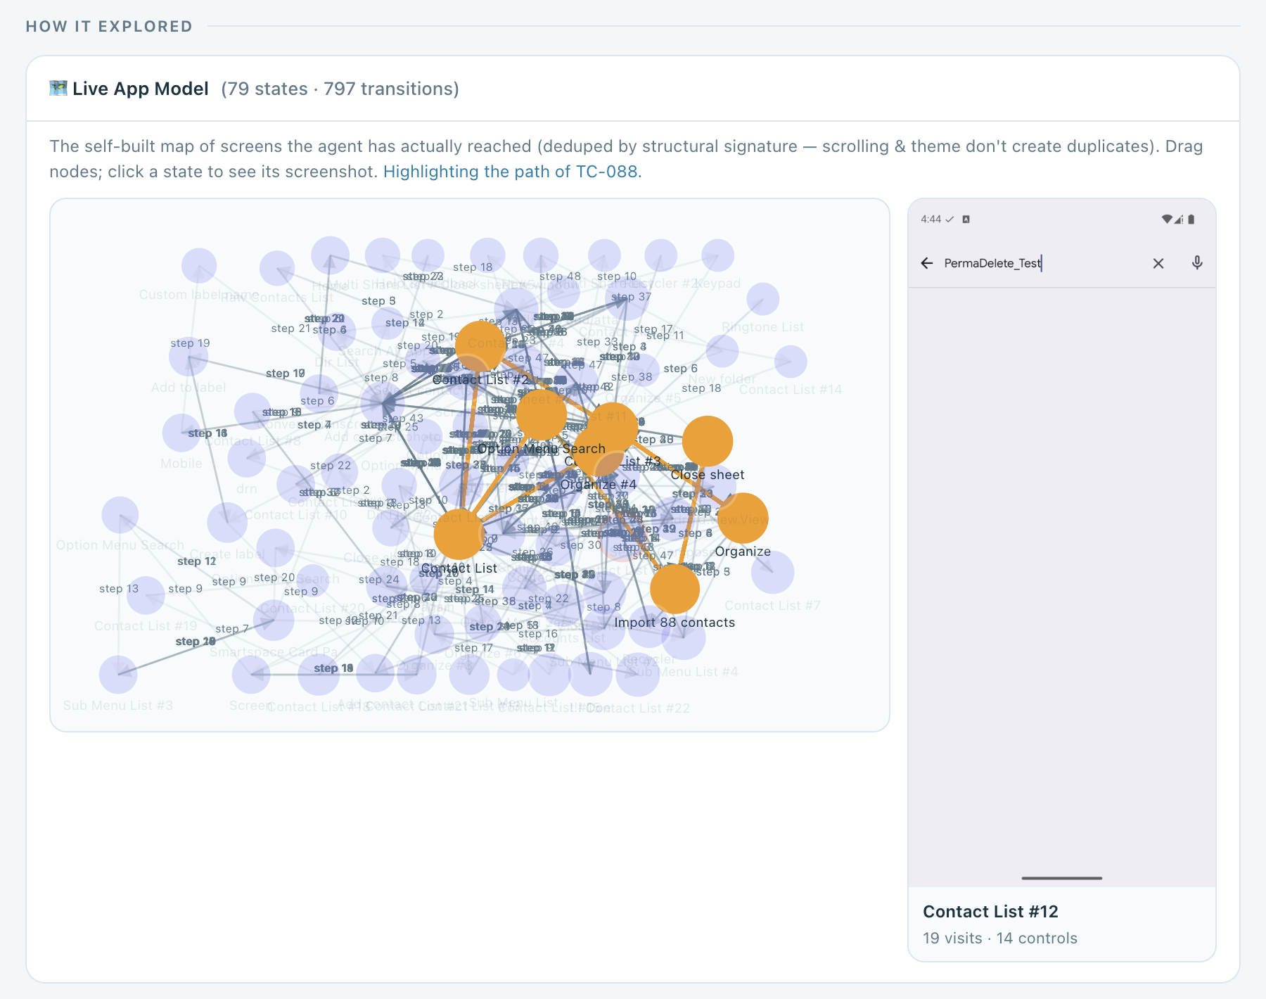
EXECUTOR · THE APP MAP
Every run's path through the map
79 screens · 797 transitions
The contacts app, mapped only from screens the agent actually reached.
Pick a run, see its path
In orange, the screens TC-088 visited, in order, read from that run's log.
Click a screen
Its stored screenshot, how often it was visited, and its controls.
Exploratory Testing Automation · CSE 450 · BUET
24
Notes:
About 35 seconds. This is the result of the screen matching on the previous slide, as it appears on our dashboard. Every circle is one distinct screen of the contacts app, 79 in all, joined by 797 recorded transitions. Nothing here came from documentation; it is only what the agent reached. Every execution stores the ordered list of screens it passed through, so we can pick any run and see exactly where it went: in orange, the path of TC-088, which imported a vCard of duplicates and then searched: from the contact list through Organize, the import screen and the close sheet, and back. Clicking a screen shows the screenshot we stored for it, here Contact List number 12, visited 19 times, with 14 controls. The same map is what the planner draws on when it looks up a screen or a route to one.

Slide 25
INVESTIGATOR
The investigator turns runs into knowledge
1
Reads the run
Group | Finding kinds | Used for
Defect | SUSPECTED_DEFECT, SPEC_VIOLATION | A human reviews it
Oracle | CONFIRMED_BEHAVIOUR, UNEXPECTED_BEHAVIOUR, SPEC_GAP, UNVERIFIED | Fed back to the planner
UI | CONTROL_DISCOVERED | Adds to the app map
Agent | AGENT_DIFFICULTY | Our own limits, never app evidence
Compares the device's step log with what the test was meant to verify.
2
Writes typed findings
Each is one atomic claim. A repeat observation reinforces an existing finding instead of creating a new one.
3
Settles open questions
A question one run raises is answered by a later run, or retired as inconclusive after three attempts.
Contacts app so far: 345 findings, including 36 suspected defects and 21 specification violations.
Exploratory Testing Automation · CSE 450 · BUET
25
Notes:
About 45 seconds. Before the investigator, nothing a run observed ever reached the next plan. Now it reads each trajectory against what the test intended and writes typed findings. Each finding is one claim, and repeats are merged, so the graph records how often something was seen rather than piling up duplicates. There are eight kinds in four groups. Defects go to a human. Oracle findings feed back to the planner, which is how the next test is better informed. And the agent's own difficulties are kept separate, because they say nothing about the app. Open questions have a lifecycle, so the agent reaches conclusions instead of asking the same thing forever.

Slide 26
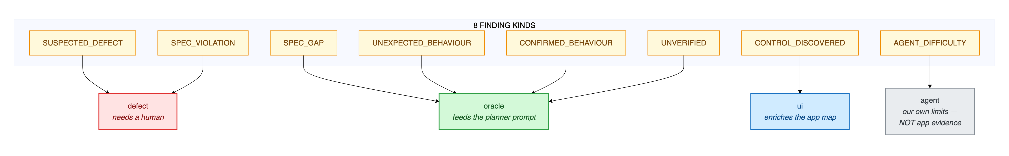
INVESTIGATOR · IN DETAIL
Eight kinds of finding, four destinations
Red: defect
Green: oracle
Blue: UI
Grey: agent
Suspected defects and spec violations go to a human.
What the app does, or leaves unclear, feeds the planner.
A newly found control enriches the app map.
Our own difficulties, never counted as app evidence.
Exploratory Testing Automation · CSE 450 · BUET
26
Notes:
About 25 seconds; skip if short on time. The eight finding kinds across the top, each routed to exactly one destination. Red is defects, which a human reviews. Green is the oracle group, which is what the planner reads back next round. Blue is new controls, which enrich the map. Grey is the agent's own difficulties, kept apart so they can never inflate the defect count.

Slide 27
INVESTIGATOR · DEDUPLICATION
Knowing a finding is the same finding
1 · Shown what is known
2 · Says what it confirms
3 · Embedding safety net
The model sees up to 12 known findings for the screens this run touched.
A confirmation reinforces the existing finding instead of adding a new one.
A new claim at 0.90 cosine or more to one in the same group is merged anyway.
Why the model decides, not similarity alone: a true restatement of one finding scored 0.846, while a genuinely different defect scored 0.853.
Clusters become one claim
Findings, not prose, keep input small
Three or more similar findings on one screen (0.72) can be merged into a general claim. On the contacts app, 5 general claims stand for 26 specific ones.
With prose reports the investigator's input grew from 28,344 to 97,796 characters over a campaign. With findings it shrank from 20,466 to 10,959.
Exploratory Testing Automation · CSE 450 · BUET
27
Notes:
About 45 seconds. The hard question is how the system knows it has seen something before, when every run is described by a model in different words. We first tried embedding similarity alone, and measured that it cannot work: a true restatement of a finding scored 0.846, while a genuinely different defect scored higher, 0.853. So the model decides. It is shown the known findings for the screens it touched and states which ones this run confirms; a confirmation reinforces the existing finding. Similarity is kept only as a safety net at 0.90. Similar findings on one screen can also be collapsed into one general claim. And storing findings rather than prose reports reversed the growth of the investigator's input: under prose it grew to almost 98,000 characters over a campaign; with findings it shrinks as the campaign goes on.

Slide 28


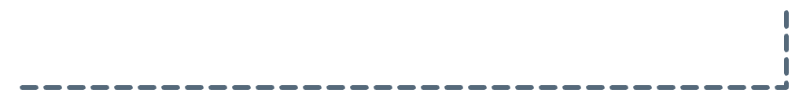

INVESTIGATOR · OPEN QUESTIONS
From observations to conclusions
Resolved
Open
Attempted
the run settled it, confirmed or refuted
a run raised a question it could not settle
a later test declares it addresses it
Inconclusive
retired after 3 attempts, instead of asked forever
not settled, fewer than 3 attempts
8
115
Open questions become the planner's missions
The planner reserves room for open questions, so older ones are not crowded out by new ones. Its test declares which question it addresses, and the investigator records the answer.
settled by a later run
still open
Contacts app. The loop works; most questions need longer campaigns.
Exploratory Testing Automation · CSE 450 · BUET
28
Notes:
About 40 seconds. A finding that poses a question, such as "does this field really accept anything?", stays open until a later run settles it. The planner treats open questions as missions: it reserves room for them so old ones are not forgotten, and its test declares which question it is addressing. If the run settles it, it is resolved, confirmed or refuted. If three attempts fail to settle it, it is retired as inconclusive rather than asked forever. This is how the agent reaches conclusions instead of re-testing the same doubt. To be honest about scale: on the contacts app, 8 questions have been settled by a later run and 115 are still open, mostly unverified observations. The mechanism works end to end; it needs longer campaigns to pay off fully.

Slide 29
FAULT ATTRIBUTION
Not every failure is the app's fault
App fault
Agent fault
Environment
The agent reached its checkpoint and the app misbehaved. These are the findings.
Our executor could not drive the app. Says nothing about its quality.
A precondition was missing, or the step budget ran out before any evidence.
ASSERTION_FAILURE · CRASH · APP_UNRESPONSIVE
NAVIGATION_FAILURE · ELEMENT_NOT_FOUND · TIMEOUT · NAVIGATION_LIVELOCK
PRECONDITION_NOT_MET · PERMISSION_DENIED · STEP_LIMIT_EXCEEDED
11
32
2
6
12
10
commerce
contacts
commerce
contacts
commerce
contacts
Only the first column counts as defects: 11 of 25 failures on the commerce app, 32 of 48 on the contacts app.
Exploratory Testing Automation · CSE 450 · BUET
29
Notes:
About 45 seconds. This slide answers the question you will be asked about the pass rate. When a test fails, we record why, and classify it three ways. An app fault means the agent reached its checkpoint and the app really did the wrong thing: that is a finding. An agent fault means our executor could not drive the app, which says nothing about the app. An environment fault means a precondition was missing or the step budget ran out before any evidence. On the commerce app only 11 of 25 failures were about the app. Reporting the raw failure rate would have more than doubled the apparent defect count. None of the research systems we reviewed makes this distinction.

Slide 30
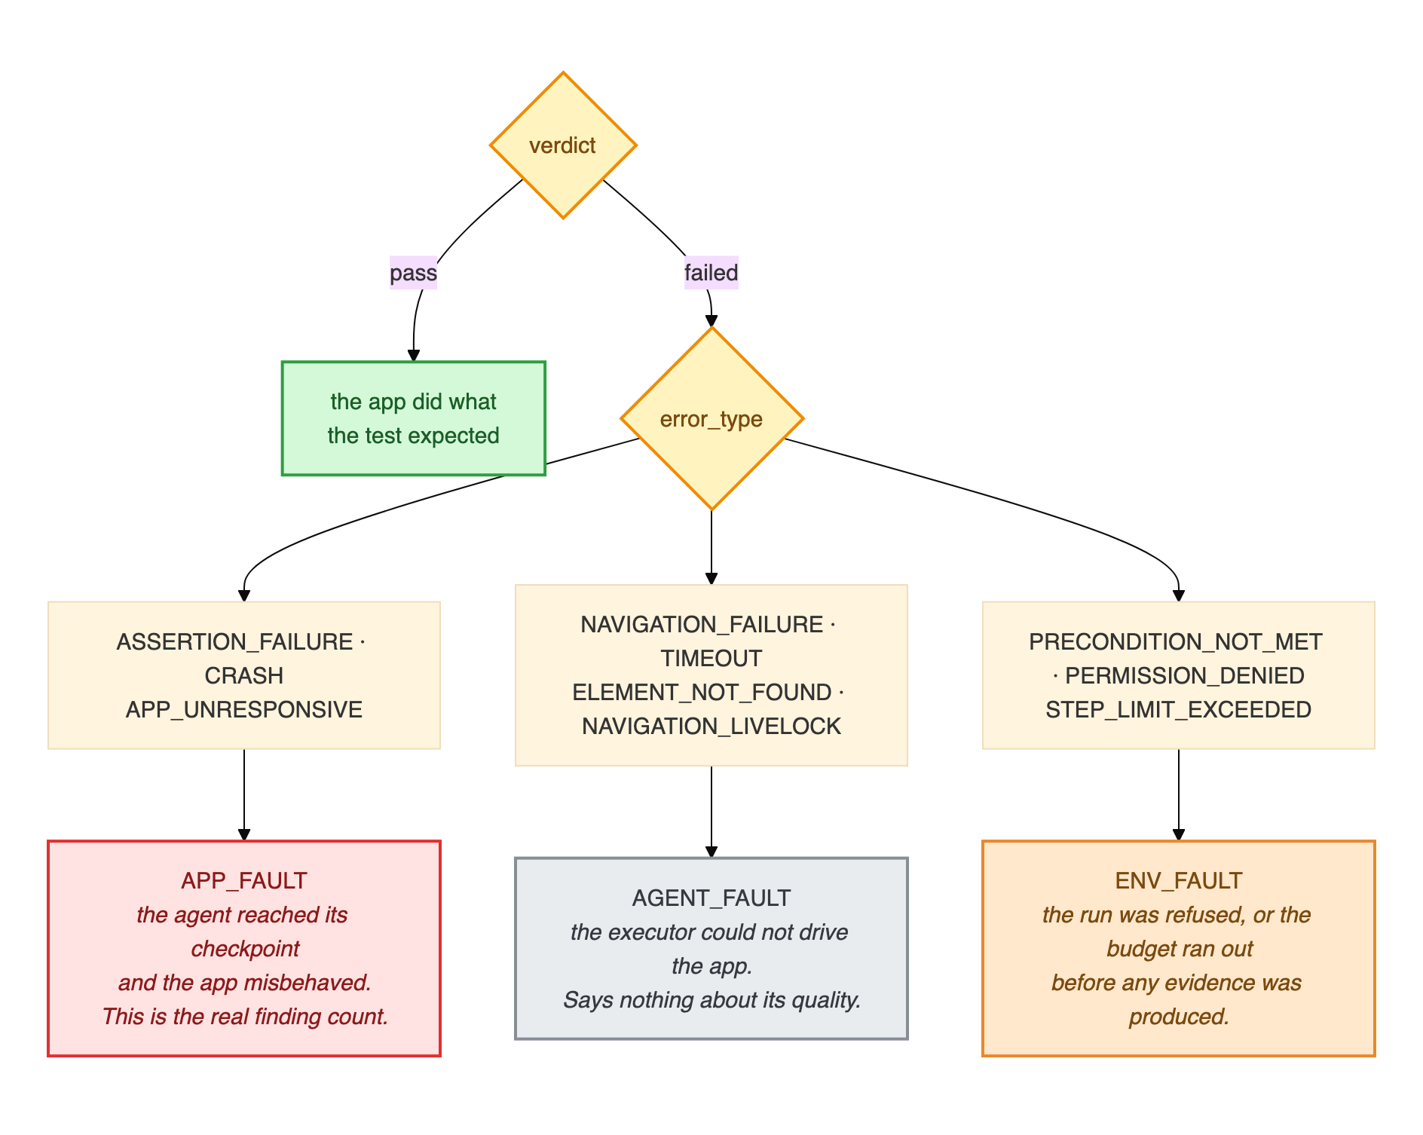
FAULT ATTRIBUTION · IN DETAIL
Every error type, and where it goes
How to read it
Green: pass, the app did what the test expected
Red: app fault, the real finding count
Grey: agent fault, our executor could not drive the app
Orange: environment fault, refused or out of budget before any evidence
The taxonomy has a single definition in the code, so the dashboard, the reports and these slides all count the same way.
Exploratory Testing Automation · CSE 450 · BUET
30
Notes:
About 25 seconds; skip if short on time. The full tree behind the previous slide. A pass needs no classification. A failure is routed by its error type into exactly one of three classes: red is an app fault, and only these count as findings; grey is our executor failing to drive the app; orange is the environment, including running out of step budget before any evidence was produced. There is one definition of this mapping in the code, so every number in this deck is counted the same way.

Slide 31
RESULTS
Two real apps, 130 autonomous test runs
Commerce app
Contacts app
Production app with live users · 20 passed, 25 failed
Google Contacts, against a 141-requirement spec we wrote · 37 passed, 48 failed
45
31%
85
56%
test runs
requirements covered (33 of 106)
test runs
requirements covered (79 of 141)
11
5
32
21
app-fault failures
specification violations
app-fault failures
specification violations
About one US cent per test. No human wrote a single test case.
Exploratory Testing Automation · CSE 450 · BUET
31
Notes:
About 50 seconds. We ran the same unmodified system on two very different Android apps, which is our evidence that it is application-agnostic. The first is a production commerce app with live users, in Bengali. The second is Google Contacts, tested against a 141-requirement specification we wrote independently, before testing, so that it acts as a real oracle. Requirement coverage is the number to notice: no existing tool can report it, because none reads a specification. It rose from 31 percent on the first app to 56 percent on the second. The cost figure is the one in our report, reconciled against the provider's billing. Every one of these tests was designed by the agent itself.

Slide 32
COST
What it costs to run
$0.008
92%
$0.30
per executed test, about one taka
of it is the device agent; the planner is 8%
to ingest a specification, once per document
How the per-test figure is built
10.1 device steps per test across 232 stored observations, an accessibility tree averaging 4,686 bytes per step, and the planner's 384,000 logged tokens over 108 calls. Measured from the runs themselves, not taken from a price card.
At scale
The whole project
A 25-test campaign costs about $0.20; a 500-test nightly suite about $4.
Under $50 in cash (about BDT 5,500), almost all of it development. Emulators, laptops and open source cost nothing.
Exploratory Testing Automation · CSE 450 · BUET
32
Notes:
About 45 seconds. Running a test costs about 0.8 US cents, roughly one taka. It is built bottom-up from measurements: about 10 device steps per test, an accessibility tree of about 4,700 bytes per step, and the planner's logged tokens, then checked against the provider's billing record. 92 percent of it is the device agent, because it calls a vision model on every step, which is why cutting steps per test saved real money and optimising the planner's prompt would not have. So a 25-test campaign is about 20 cents and a 500-test nightly suite about 4 dollars. Ingesting a specification is the opposite shape: about 30 cents, the price of some 40 test runs, because it uses the most accurate model tier, but it is paid once per document. The whole project cost under 50 dollars in cash, almost all of it development, because every change to ingestion meant re-reading the specification. We had no GPU, so hosted inference was the only option, not a cost optimisation. [Confirm before presenting: the report's budget table says USD 2.69 was consumed across 88 device executions, which works out to about 3 cents per run, not 0.8. Ask whoever wrote the budget section what else that balance paid for, so you can answer if a sir divides the two.]

Slide 33
RESULTS · SAME COMMERCE APP, SAME SPECIFICATION
Old planner against the redesigned one
Old · 30 Aug · 25 tests
New · 20 Sep · 45 tests
Pipeline planner; wrote a step-by-step script
The executor judged its own success
No investigator, findings memory or validation gate
Tools mode: nine read-only tools and a validation gate
Writes a goal; the executor works out the steps
The investigator judges each run; its findings feed the next plan
Measure | Old | New | Fisher's p
Vague titles (“works correctly”) | 64% | 2% | < 0.0001
Titles citing a requirement | 0% | 26% | 0.003
Runs yielding app-level evidence | 12% | 24% | 0.35 (not significant)
This compares two whole configurations, not one change. Test design improved significantly; defect yield has not been shown to.
Exploratory Testing Automation · CSE 450 · BUET
33
Notes:
About 45 seconds. We rebuilt the planner during the project, so we compared the two on the same commerce app, with the same specification loaded in both. The old one, on 30 August, was the pipeline planner: it wrote a step-by-step script, the executor decided for itself whether it had succeeded, and there was no investigator, no findings memory and no validation gate. The new one, on 20 September, ran in tools mode with the validation gate; it writes a goal and lets the executor work out the steps, and the investigator judges every run and writes findings the next plan reads. Two things improved significantly. Vague titles like "verify it works correctly" fell from 64 percent to 2 percent, and titles citing a requirement rose from none to a quarter, even though both runs had the same specification. The share of runs producing evidence about the app doubled, but that is not significant at this sample size, and the two runs were judged differently, so we do not claim it. Be clear if asked: this is two whole configurations compared, not one change isolated, which is why an ablation is on our next-steps slide. Also, the area cap and a duplicate-generation fix were added during the new campaign itself.

Slide 34
RESULTS
What the agent found on its own
Spec violation · FR-VAL-02
Spec violation · FR-DUP-01, FR-DUP-02
A name made only of spaces saves with a success message, but the contact never appears in the list.
Saving a contact identical to an existing one raises no duplicate warning. Two identical entries appear.
Seen independently in 6 runs
Seen in 7 runs, by manual save and by vCard import
Suspected defect · against FR-EXP-05
Suspected defect · against FR-DEL-01
An import shows only “will be imported shortly”. It never reports how many contacts were read or created.
The delete dialog promises permanent deletion, while the specification requires a recovery period.
Seen in 5 runs
No recovery area was found anywhere in the app
Each finding is the model's claim from a device trajectory; a human still has to confirm it.
Exploratory Testing Automation · CSE 450 · BUET
34
Notes:
About 45 seconds. Four things the agent found without anyone telling it where to look. Notice that every one is tied to a requirement in the specification. That is the point of reading the spec: a random tester would never flag these, because nothing crashed. A name of only spaces is accepted with a success message and then vanishes from the list. Identical contacts are saved twice with no warning. An import never says how many contacts it brought in. And deletion is permanent, while the spec asks for a recovery period. Some of these may be deliberate design choices by the app's makers rather than bugs, and that is exactly the judgement the tool hands to a human.

Slide 35
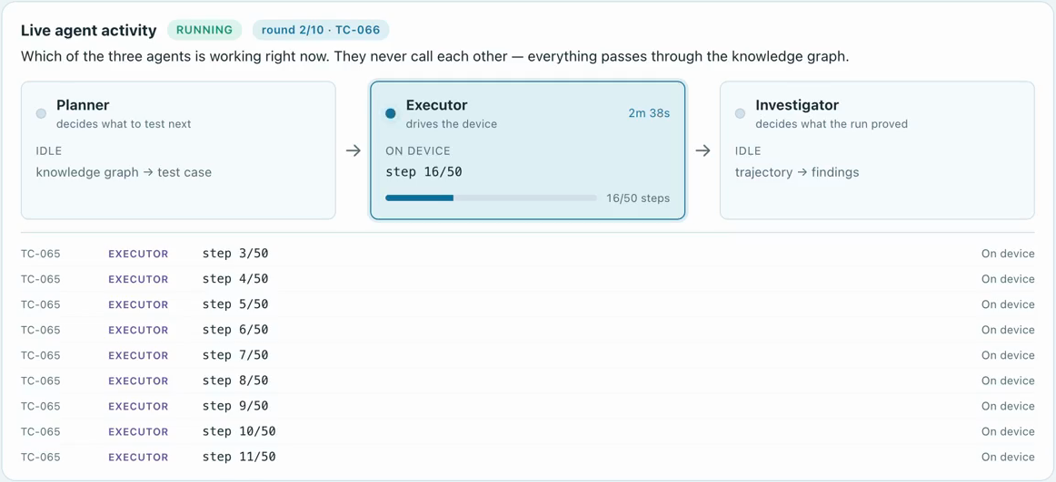
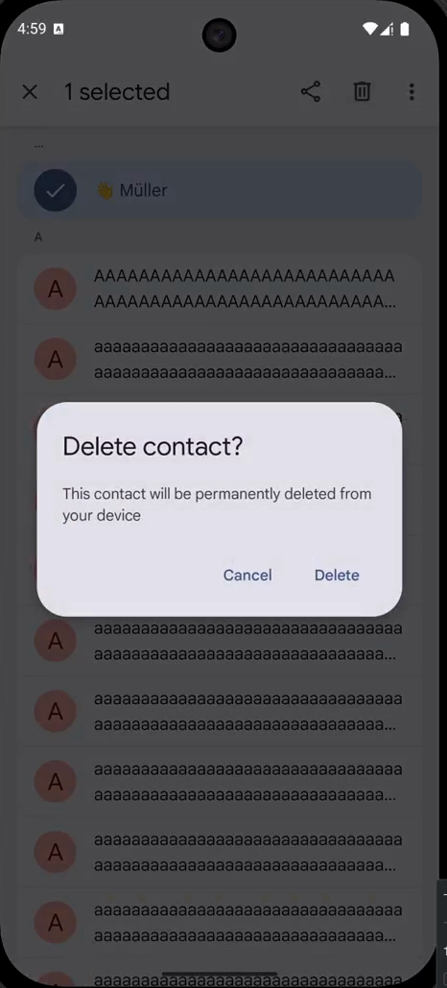
LIVE VIEW
Watching the agents work, live
The working agent lights up
with its stage, each retrieval and each model call.
Mid-campaign: the executor at step 16 of 50 on the contacts app, while the phone shows the deletion dialog it is exercising.
Exploratory Testing Automation · CSE 450 · BUET
35
Notes:
About 25 seconds. This is a frame from a real campaign. The dashboard shows which of the three agents is working at that moment. Here the executor is on step 16 of 50, and the feed below lists every step. On the right is the phone at that instant, showing the deletion dialog behind one of the findings on the previous slide. When the planner is working, the same panel shows each pipeline stage, each retrieval and each model call with its latency.

Slide 36
HONEST LIMITS
Limitations and next steps
What we cannot claim yet
What comes next
No ground truth: both apps are closed-source, so precision and recall cannot be computed.
No ablation yet: we have not measured what each component contributes.
Findings are model-written claims; each needs a human to confirm it.
16 of 48 contacts failures were not about the app.
An open-source benchmark with known, reproducible bugs (Themis) for bug-detection rate.
Ablations: findings off, memory off, and a random baseline.
Requirement coverage as a headline metric no other tool can report.
Exploratory Testing Automation · CSE 450 · BUET
36
Notes:
About 40 seconds. We want to be precise about what these results do not show. Both apps are closed-source, so there is no list of known bugs to measure against, and we cannot compute precision or recall. We have not yet switched components off one at a time, so we cannot say how much each contributes. The findings are the model's claims and need a human. And a third of the contacts failures were the agent or the environment, not the app. The next step fixes the biggest of these: running on an open-source benchmark of real, reproducible bugs, with ablations and a random baseline.

Slide 37
Thank you
Questions are welcome.
With thanks to our supervisor, Dr. A. B. M. Alim Al Islam, and to Samsung R&D Institute Bangladesh.
Notes:
About 10 seconds. Thank the supervisor and the partner, and invite questions. If a question needs a diagram, the detailed ones are slides 6, 8, 9, 13, 23, 24, 26 and 30.

