Slide 1
RESULTS
Two real apps, 130 autonomous test runs
Commerce app
Contacts app
Production app with live users · 20 passed, 25 failed
Google Contacts, against a 141-requirement spec we wrote · 37 passed, 48 failed
45
31%
85
56%
test runs
requirements covered (33 of 106)
test runs
requirements covered (79 of 141)
11
5
32
21
app-fault failures
specification violations
app-fault failures
specification violations
About one US cent per test. No human wrote a single test case.
Exploratory Testing Automation · CSE 450 · BUET
31
Notes:
About 50 seconds. We ran the same unmodified system on two very different Android apps, which is our evidence that it is application-agnostic. The first is a production commerce app with live users, in Bengali. The second is Google Contacts, tested against a 141-requirement specification we wrote independently, before testing, so that it acts as a real oracle. Requirement coverage is the number to notice: no existing tool can report it, because none reads a specification. It rose from 31 percent on the first app to 56 percent on the second. The cost figure is the one in our report, reconciled against the provider's billing. Every one of these tests was designed by the agent itself.

Slide 2
COST
What it costs to run
$0.008
92%
$0.30
per executed test, about one taka
of it is the device agent; the planner is 8%
to ingest a specification, once per document
How the per-test figure is built
10.1 device steps per test across 232 stored observations, an accessibility tree averaging 4,686 bytes per step, and the planner's 384,000 logged tokens over 108 calls. Measured from the runs themselves, not taken from a price card.
At scale
The whole project
A 25-test campaign costs about $0.20; a 500-test nightly suite about $4.
Under $50 in cash (about BDT 5,500), almost all of it development. Emulators, laptops and open source cost nothing.
Exploratory Testing Automation · CSE 450 · BUET
32
Notes:
About 45 seconds. Running a test costs about 0.8 US cents, roughly one taka. It is built bottom-up from measurements: about 10 device steps per test, an accessibility tree of about 4,700 bytes per step, and the planner's logged tokens, then checked against the provider's billing record. 92 percent of it is the device agent, because it calls a vision model on every step, which is why cutting steps per test saved real money and optimising the planner's prompt would not have. So a 25-test campaign is about 20 cents and a 500-test nightly suite about 4 dollars. Ingesting a specification is the opposite shape: about 30 cents, the price of some 40 test runs, because it uses the most accurate model tier, but it is paid once per document. The whole project cost under 50 dollars in cash, almost all of it development, because every change to ingestion meant re-reading the specification. We had no GPU, so hosted inference was the only option, not a cost optimisation. [Confirm before presenting: the report's budget table says USD 2.69 was consumed across 88 device executions, which works out to about 3 cents per run, not 0.8. Ask whoever wrote the budget section what else that balance paid for, so you can answer if a sir divides the two.]

Slide 3
RESULTS · SAME COMMERCE APP, SAME SPECIFICATION
Old planner against the redesigned one
Old · 30 Aug · 25 tests
New · 20 Sep · 45 tests
Pipeline planner; wrote a step-by-step script
The executor judged its own success
No investigator, findings memory or validation gate
Tools mode: nine read-only tools and a validation gate
Writes a goal; the executor works out the steps
The investigator judges each run; its findings feed the next plan
Measure | Old | New | Fisher's p
Vague titles (“works correctly”) | 64% | 2% | < 0.0001
Titles citing a requirement | 0% | 26% | 0.003
Runs yielding app-level evidence | 12% | 24% | 0.35 (not significant)
This compares two whole configurations, not one change. Test design improved significantly; defect yield has not been shown to.
Exploratory Testing Automation · CSE 450 · BUET
33
Notes:
About 45 seconds. We rebuilt the planner during the project, so we compared the two on the same commerce app, with the same specification loaded in both. The old one, on 30 August, was the pipeline planner: it wrote a step-by-step script, the executor decided for itself whether it had succeeded, and there was no investigator, no findings memory and no validation gate. The new one, on 20 September, ran in tools mode with the validation gate; it writes a goal and lets the executor work out the steps, and the investigator judges every run and writes findings the next plan reads. Two things improved significantly. Vague titles like "verify it works correctly" fell from 64 percent to 2 percent, and titles citing a requirement rose from none to a quarter, even though both runs had the same specification. The share of runs producing evidence about the app doubled, but that is not significant at this sample size, and the two runs were judged differently, so we do not claim it. Be clear if asked: this is two whole configurations compared, not one change isolated, which is why an ablation is on our next-steps slide. Also, the area cap and a duplicate-generation fix were added during the new campaign itself.

Slide 4
RESULTS
What the agent found on its own
Spec violation · FR-VAL-02
Spec violation · FR-DUP-01, FR-DUP-02
A name made only of spaces saves with a success message, but the contact never appears in the list.
Saving a contact identical to an existing one raises no duplicate warning. Two identical entries appear.
Seen independently in 6 runs
Seen in 7 runs, by manual save and by vCard import
Suspected defect · against FR-EXP-05
Suspected defect · against FR-DEL-01
An import shows only “will be imported shortly”. It never reports how many contacts were read or created.
The delete dialog promises permanent deletion, while the specification requires a recovery period.
Seen in 5 runs
No recovery area was found anywhere in the app
Each finding is the model's claim from a device trajectory; a human still has to confirm it.
Exploratory Testing Automation · CSE 450 · BUET
34
Notes:
About 45 seconds. Four things the agent found without anyone telling it where to look. Notice that every one is tied to a requirement in the specification. That is the point of reading the spec: a random tester would never flag these, because nothing crashed. A name of only spaces is accepted with a success message and then vanishes from the list. Identical contacts are saved twice with no warning. An import never says how many contacts it brought in. And deletion is permanent, while the spec asks for a recovery period. Some of these may be deliberate design choices by the app's makers rather than bugs, and that is exactly the judgement the tool hands to a human.

Slide 5
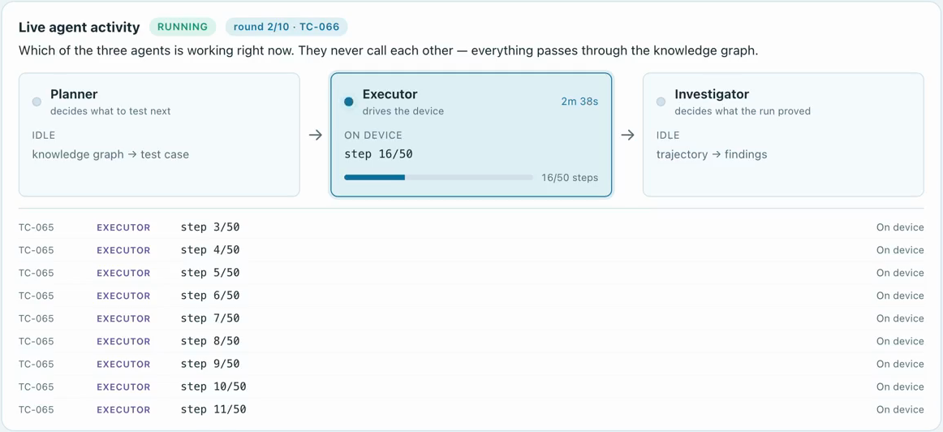
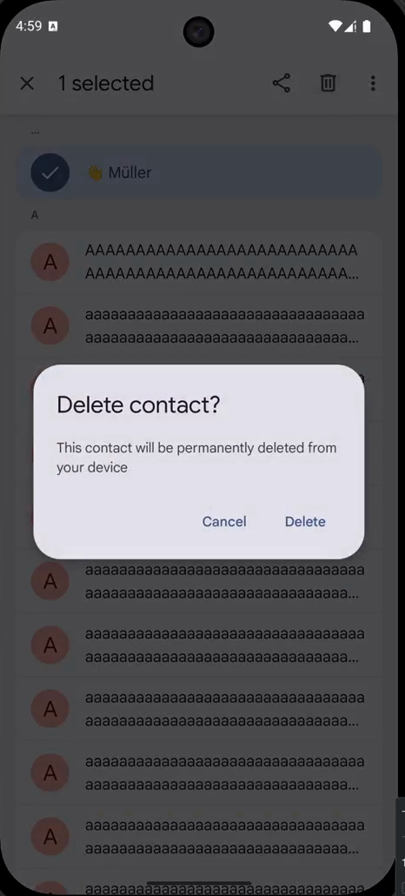
LIVE VIEW
Watching the agents work, live
The working agent lights up
with its stage, each retrieval and each model call.
Mid-campaign: the executor at step 16 of 50 on the contacts app, while the phone shows the deletion dialog it is exercising.
Exploratory Testing Automation · CSE 450 · BUET
35
Notes:
About 25 seconds. This is a frame from a real campaign. The dashboard shows which of the three agents is working at that moment. Here the executor is on step 16 of 50, and the feed below lists every step. On the right is the phone at that instant, showing the deletion dialog behind one of the findings on the previous slide. When the planner is working, the same panel shows each pipeline stage, each retrieval and each model call with its latency.

Slide 6
HONEST LIMITS
Limitations and next steps
What we cannot claim yet
What comes next
No ground truth: both apps are closed-source, so precision and recall cannot be computed.
No ablation yet: we have not measured what each component contributes.
Findings are model-written claims; each needs a human to confirm it.
16 of 48 contacts failures were not about the app.
An open-source benchmark with known, reproducible bugs (Themis) for bug-detection rate.
Ablations: findings off, memory off, and a random baseline.
Requirement coverage as a headline metric no other tool can report.
Exploratory Testing Automation · CSE 450 · BUET
36
Notes:
About 40 seconds. We want to be precise about what these results do not show. Both apps are closed-source, so there is no list of known bugs to measure against, and we cannot compute precision or recall. We have not yet switched components off one at a time, so we cannot say how much each contributes. The findings are the model's claims and need a human. And a third of the contacts failures were the agent or the environment, not the app. The next step fixes the biggest of these: running on an open-source benchmark of real, reproducible bugs, with ablations and a random baseline.

Slide 7
Thank you
Questions are welcome.
With thanks to our supervisor, Dr. A. B. M. Alim Al Islam, and to Samsung R&D Institute Bangladesh.
Notes:
About 10 seconds. Thank the supervisor and the partner, and invite questions. If a question needs a diagram, the detailed ones are slides 6, 8, 9, 13, 23, 24, 26 and 30.

