Slide 1


EXECUTOR · THE PLAYER
We chose the executor by trying several
Surveyed benchmarks, then tried hands-on
What we needed from it
MUI
evaluated
Runs from a goal in plain language, not a script
Drives a real Android device through its accessibility tree and screenshots
Accepts our own model provider (OpenRouter)
Saves a step-by-step trajectory we can analyse
Streams every screen it sees, so we can map the app
GeLab
evaluated
MobileAgent-V3
evaluated
mobilerun (Droidrun)
selected
Exploratory Testing Automation · CSE 450 · BUET
20
Notes:
About 40 seconds. The executor, which we also call the player, is the one component we did not build, so we chose it carefully. We surveyed the mobile GUI-agent benchmarks and then tried several executors hands-on, among them MUI, GeLab and MobileAgent-V3, before selecting mobilerun, also known as Droidrun. [Add one line per alternative on why it was not chosen.] What decided it was what our design needs: it works from a goal in plain language rather than a script, drives a real device through the accessibility tree and screenshots, lets us plug in our own model provider, saves a step-by-step trajectory for the investigator, and streams every screen it sees, which is how we build the map of the app.

Slide 2


EXECUTOR · ONE RUN
How a test is executed on the device
Goal
Observe
Decide
Act
Trajectory
objective, screen hint, and login and input details
accessibility tree and screenshot
the model picks the next action
tap, type or swipe over adb
each step's thought, action and outcome
repeats up to 50 steps, about 20 seconds each
What we built around mobilerun
Goal assembly from the planner's test case
Every screen streamed into the live app map
On-device portal for reliable text input
Login secrets reach the executor, never the planner
Device reset and an app-only guard between tests
Waits out network loss; campaigns resume intact
Exploratory Testing Automation · CSE 450 · BUET
21
Notes:
About 45 seconds. The executor receives a goal, not a script: the planner's objective and screen hint, plus login and input details. It then loops: observe the screen through the accessibility tree and a screenshot, let the model decide the next action, and act, tapping, typing or swiping over adb. Up to 50 steps, about 20 seconds each. It returns a trajectory: every step's reasoning, action and result. The loop is mobilerun, but the harness around it is ours: building the goal from the test case, the on-device portal that makes typing reliable, resetting the app between tests and keeping the agent inside it, keeping login secrets out of the planner's prompt, streaming every screen into the live map, and surviving network loss mid-campaign.

Slide 3
EXECUTOR · THE INPUT
What the executor is actually given
TC-002, contacts app. Assembled from the planner's test case and the target profile.
Open the Contacts app on this device.
Navigate to the 'Search Results' screen if not already there.
Preconditions: App is open.
Step 1: Navigate to 'Contacts List' screen.
Step 2: Tap 'FAB: Create Contact' to create a new contact.
Step 3: Enter 'First name' as 'Alice'.
Step 4: Tap 'Save' button.
Step 5: Navigate back to 'Contacts List'.
Step 6: Tap the search input field to focus.
Step 7: Type 'Bob' into the search input.
Step 8: Observe the search results area.
Expected result: Search results should be empty. The app should
show an empty state and not crash or show any error.
Exploratory Testing Automation · CSE 450 · BUET
22

Slide 4
EXECUTOR · THE TRACE
Thought, action, outcome, every step
Step 1/30 "I'm on a contact detail page for 'john doe'
instead of the Contacts List."
click(index=21) -> 'Navigate up' | Button | (74, 226)
Step 2/30 "I can see the FAB 'Create contact' at index 76."
click(index=76) -> 'Create contact' | FAB | (943, 2076)
Step 3/30 "'First name' EditText is at index 30."
click(index=30) -> focused, then typed 'Alice'
Result: the search area is empty, no contacts matching "Bob". The app did not crash and no error occurred.
Exploratory Testing Automation · CSE 450 · BUET
23

Slide 5
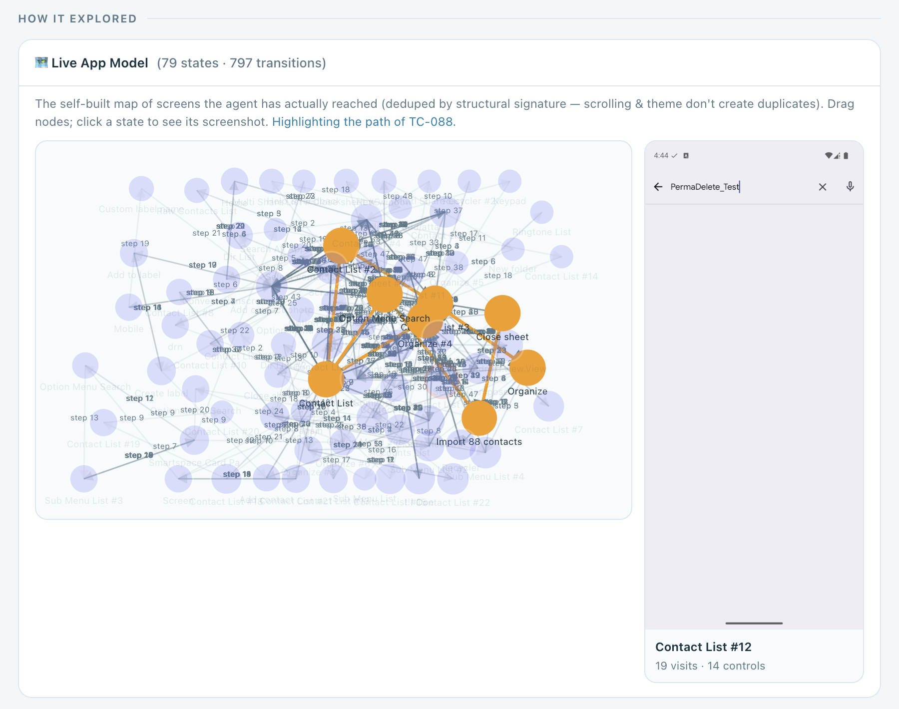
EXECUTOR · THE APP MAP
Every run's path through the map
79 screens · 797 transitions
The contacts app, mapped only from screens the agent actually reached.
Pick a run, see its path
In orange, the screens TC-088 visited, in order, read from that run's log.
Click a screen
Its stored screenshot, how often it was visited, and its controls.
Exploratory Testing Automation · CSE 450 · BUET
26
Notes:
About 35 seconds. This is the result of the screen matching on the previous slide, as it appears on our dashboard. Every circle is one distinct screen of the contacts app, 79 in all, joined by 797 recorded transitions. Nothing here came from documentation; it is only what the agent reached. Every execution stores the ordered list of screens it passed through, so we can pick any run and see exactly where it went: in orange, the path of TC-088, which imported a vCard of duplicates and then searched: from the contact list through Organize, the import screen and the close sheet, and back. Clicking a screen shows the screenshot we stored for it, here Contact List number 12, visited 19 times, with 14 controls. The same map is what the planner draws on when it looks up a screen or a route to one.

Slide 6
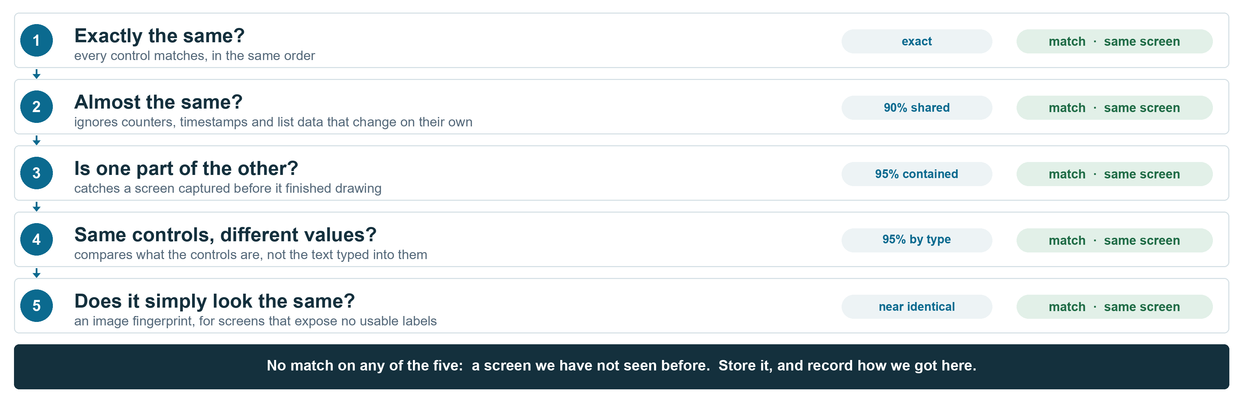
EXECUTOR · IN DETAIL
Is this a screen we have seen?
Exploratory Testing Automation · CSE 450 · BUET
25
Notes:
About 25 seconds; skip if short on time. The full screen-identity cascade, left to right. Each check exists because the previous one failed on a real case, and the grey notes say which. Structural similarity handles counters and timestamps. Containment handles a screen captured before it finished drawing, which similarity scores as different. Skeleton containment handles form fields, where typing changes the labels: one wizard once produced nine separate states. And the perceptual hash is the last resort for screens built with Compose, games or web views, whose accessibility tree says almost nothing.

Slide 7

WEB EXECUTOR · PLAYWRIGHT
The same planner, a browser instead of a device
A second executor behind the same contract. The planner does not know which one will run.
What it observes
What it can do
How it knows something broke
An accessibility style description of the DOM, not screenshots
role and name, the same vocabulary the Android executor uses
native HTML5 validation, including the browser's own message
a password is described, never echoed
click fill press select
goto back scroll wait finish
nine actions, each checked against the target's guardrails
CAPTCHA escalates to a person when visible, fails cleanly when headless
console errors
uncaught page errors
HTTP 4xx and 5xx responses
dialogs the page never showed
Those signals are collected independently of anything the agent claims, so a 5xx can override a claimed pass. On the live site this caught a real HTTP 500.
Exploratory Testing Automation · CSE 450 · BUET
27

Slide 8
WEB EXECUTOR · A REAL RUN
Testing Bangla text on a live survey platform
TC-001 on DataGhurhi. The same thought, action, outcome loop, over the DOM.
[1/80] dataghurhi.cse.buet.ac.bd
think: find a survey with a text question to test
Bangla Unicode input
act: {"action":"click","ref":"e9"}
-> clicked [e9] button "Test Project for Survey"
[4/80] /view-survey/601
act: {"action":"scroll","direction":"down"}
-> scrolled down page: 56 controls
[5/80] /view-survey/601
act: {"action":"select","ref":"e20","value":"Text"}
-> selected 'Text' in the question type dropdown
[7/80] /view-survey/601
act: {"action":"fill","ref":"e19","text":"আপনার নাম লিখুন"}
-> filled "Enter your question here"
Controls by reference, not pixels
Each observed control gets a stable reference the model addresses by name.
Non Latin text end to end
Bangla is typed, stored and read back, then checked character for character.
Bounded like the device runs
Up to 80 steps, with guards that end a run repeating a dead action or wandering.
5 targets · 2 platforms · 1 planner
Exploratory Testing Automation · CSE 450 · BUET
28

