Slide 1
Three ways to test. Each gives up something.
Raihan
Manual exploratory
Scripted automation
Random / Monkey
Finds real defects.
Repeatable and cheap.
Explores at scale.
Does not scale.
Only checks what its author thought of.
No idea what correct looks like.
1

Slide 2
“A tool can tell you an application crashed.
It cannot tell you it quietly charged
the wrong account.”
What is missing is an oracle: knowing what correct looks like.
No system in our literature review ingests a specification. That is our position.
2

Slide 3

Three agents, one shared memory
3

Slide 4
They never talk to each other
Planner
Executor
Investigator
decides what to test next
drives the real application
decides what the run proved
The knowledge graph is the only channel between them.
Every model call is stateless and rebuilt from the graph, so “learning” is something you can inspect. The graph either grew or it did not.
4

Slide 5
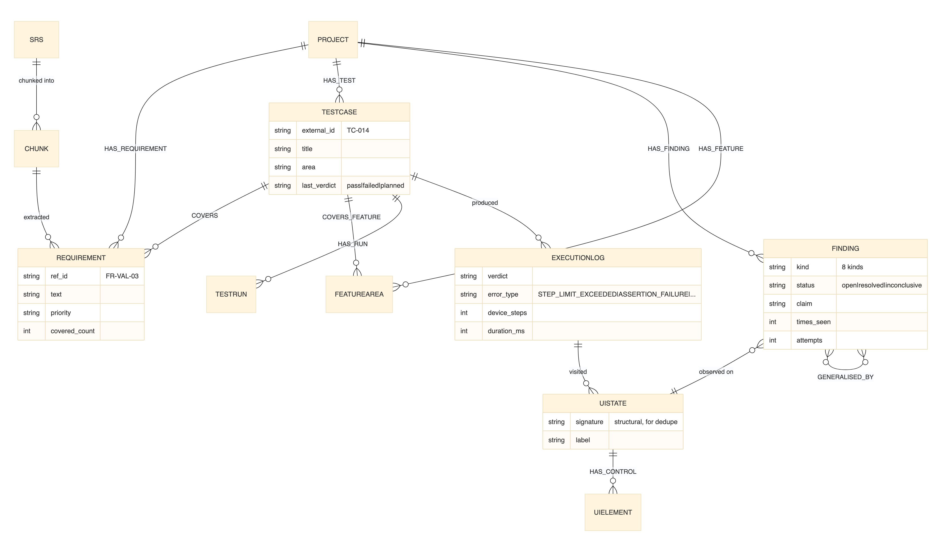
Two graphs in one store
A PRIORI
Requirements, validation rules, source chunks.
From documents.
A POSTERIORI
UI states, transitions, navigation paths, execution logs.
From observation.
Test cases and findings span both. Exploration is steered by the gap between them.
5

