Slide 1
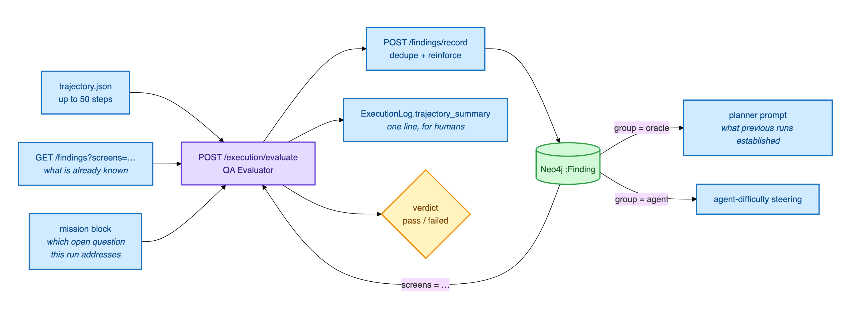
The investigator: turning a run into knowledge
Tuhin
It is given
the full trajectory, the test's own objective, and the findings already recorded for those screens
It returns
typed findings with a claim, evidence, severity, confidence and cited requirement ids
19

Slide 2
Eight kinds of finding, and only two are defects
SPEC_VIOLATION
observed behaviour contradicts a cited requirement
SUSPECTED_DEFECT
looks wrong against universal expectations, no requirement covers it
CONFIRMED_BEHAVIOUR
verified working as specified
UNEXPECTED_BEHAVIOUR
surprising or undocumented, needs judgement
SPEC_GAP
real behaviour the requirements do not describe
UNVERIFIED
could not be determined this run
CONTROL_DISCOVERED
a control or screen observed at runtime
AGENT_DIFFICULTY
our own agent struggled here, never app evidence
Only the first two ever reach a defect report. The rest are knowledge, and a spec gap is a finding about the specification, not the app.
20

Slide 3
The same finding, seen three times, is not three findings
times_seen
Why it matters
A repeat observation raises the count on the existing finding instead of creating a near duplicate.
A claim independently observed three times across three runs carries weight that a claim asserted once does not.
Open questions close themselves
When the investigator cannot settle something, it records an open question and the planner is steered to probe it. After three attempts it auto closes as inconclusive, which is a result a person can act on rather than an endless retry.
21

Slide 4
Not every failure is the application's fault
APP
AGENT
ENV
the application is wrong
we could not drive it
something blocked the test
crash · assertion failure · unresponsive · HTTP error · page error
element not found · timeout · navigation failure · livelock · stale element
precondition · permission · CAPTCHA · guardrail · step limit · browser closed
Only the first is ever evidence about the application. Conflating them inflates the defect count, which is the most expensive error this system can make.
22

Slide 5
100%
67%
was the autonomy we reported.
was the truth.
The taxonomy had been defined in two places and the copies drifted. It is now three frozen sets in one module, imported everywhere, and a configuration guard asserts they stay disjoint.
23

Slide 6
So does it cry wolf?
A comparable published agent
Ours, on the live site
158 defects reported
against a human team's 80.
It flagged what looked like a serious access control hole.
At 52 to 66% accuracy, where the humans were at 100%. Two in five of its reports were false.
We checked. It was gated by the site's own privacy setting, working as designed.
So we did not report it.
24

