Slide 1

CSE 450 CAPSTONE PROJECT · DEPARTMENT OF CSE, BUET
Exploratory Testing Automation
An autonomous agent that decides what to test, runs it, and learns from every run.
TEAM
SUPERVISOR
INDUSTRY PARTNER
Mohammad Raihan Rashid · 2105046
Mehemud Azad · 2105014
Jonayed Mohiuddin Shanto · 2105060
Khalid Hasan Tuhin · 2105002
Niloy Kumar Mondal · 2105044
Dr. A. B. M. Alim Al Islam
Professor, Department of CSE, BUET
Samsung R&D Institute Bangladesh

Slide 2
Three ways to test. Each gives up something.
Raihan
Manual exploratory
Scripted automation
Random / Monkey
Finds real defects.
Repeatable and cheap.
Explores at scale.
Does not scale.
Only checks what its author thought of.
No idea what correct looks like.
1
Notes:
Raihan opens. Three cards, one line each — do not elaborate.

Slide 3
“A tool can tell you an application crashed.
It cannot tell you it quietly charged
the wrong account.”
What is missing is an oracle — knowing what correct looks like.
No system we reviewed ingests a specification. That is our position.
2
Notes:
Pause after the quote. This is the thesis of the whole talk.

Slide 4

Three agents, one shared memory
3
Notes:
Point at the three agent roles and the graph between them. Say: they never call each other.

Slide 5
They never talk to each other
Planner
Executor
Investigator
decides what to test next
drives the real application
decides what the run proved
The knowledge graph is the only channel between them.
Every model call is stateless and rebuilt from the graph — so “learning” is something you can inspect. The graph either grew or it did not.
4

Slide 6
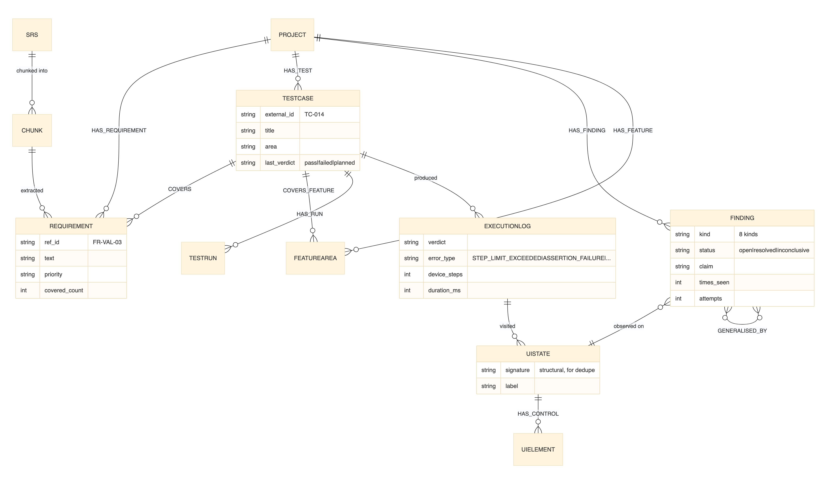
Two graphs in one store
A PRIORI
What the application should do.
From documents.
A POSTERIORI
What it actually does.
From observation.
Exploration is steered by the gap between them.
5
Notes:
Hand off: 'So the first question is — what does it decide to test?'

Slide 7
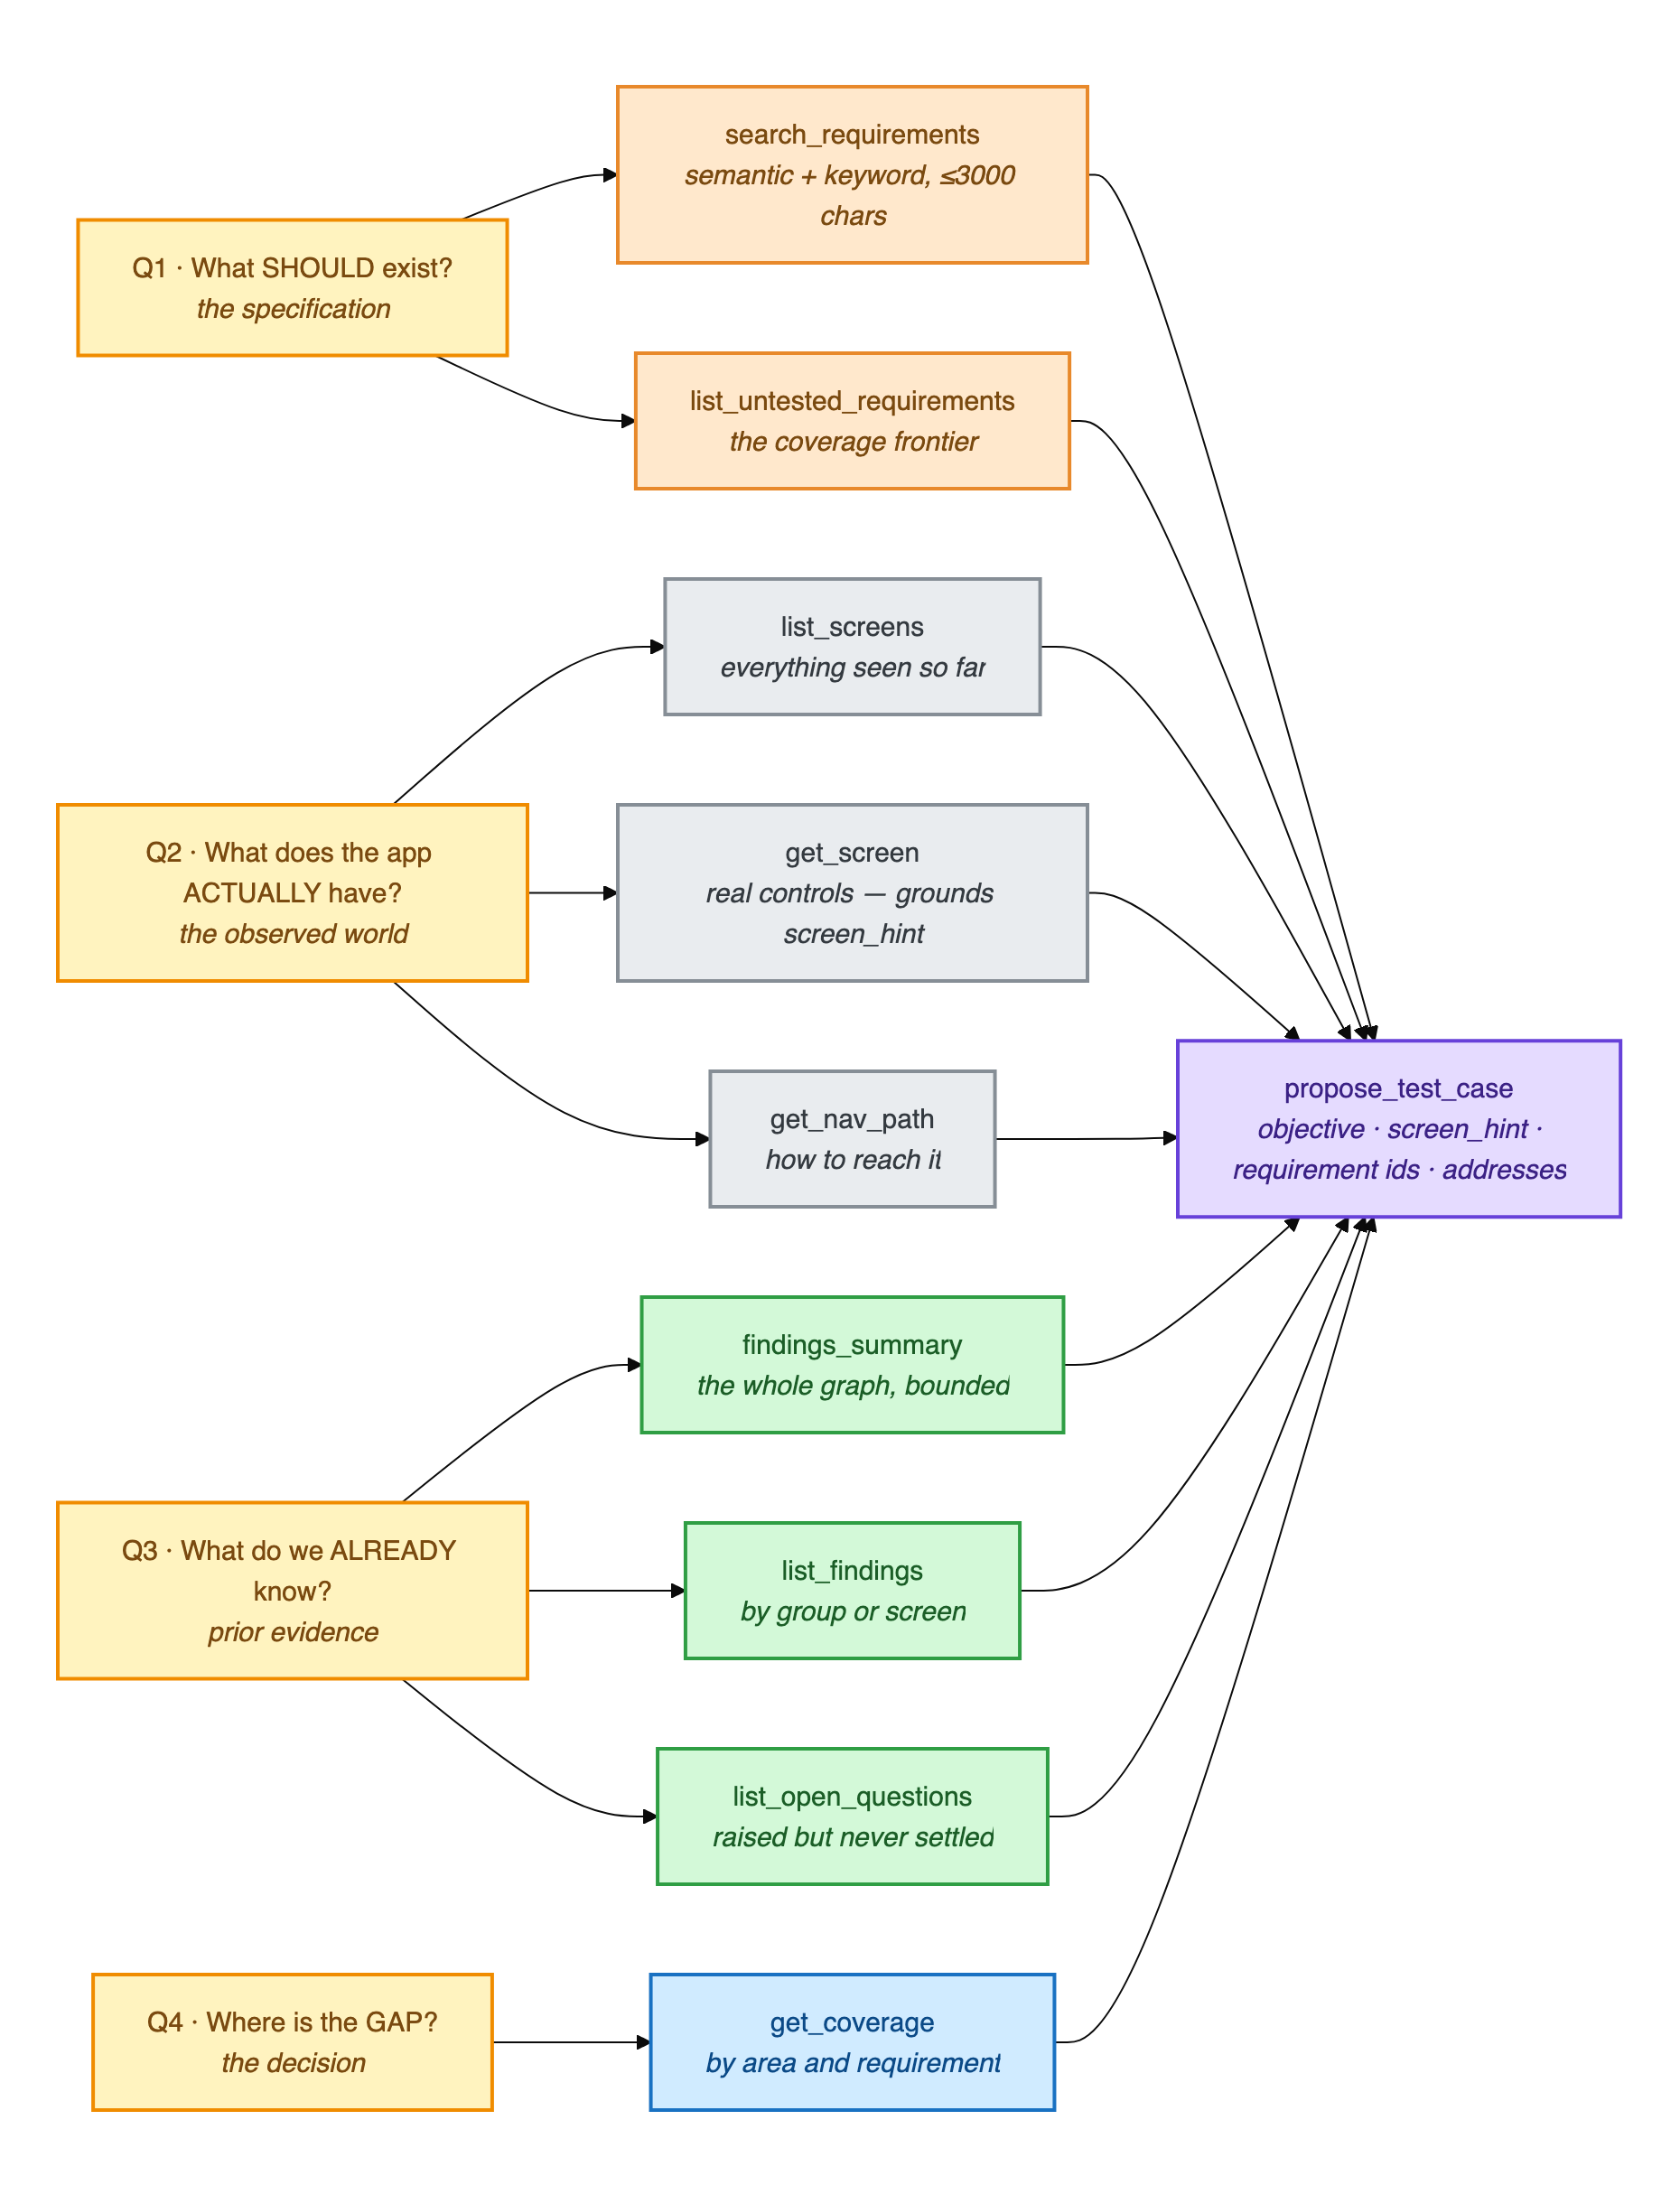
The planner reads the graph through nine tools
Mehemud
What should exist
requirements not yet tested
What the app has
screens observed, paths taken
What is already known
findings, open questions
6

Slide 8
Every loop is bounded
An exploratory agent has no natural stopping point.
12
6
50
turns maximum in the planning loop
after this turn it is told to propose — left free, it investigates forever
device actions per test, then the run ends
Three rejected proposals and the best effort is accepted with a recorded degradation — a planning round never returns nothing.
7

Slide 9
Nothing reaches a device unvalidated
1
The screen must exist
checked against screens actually observed
2
Requirement IDs must exist
invented identifiers are rejected
3
Not a duplicate
semantic check against tests already run
4
Preconditions must be reachable
no test depending on an impossible state
8

Slide 10
16%
After the redesign
One rejection across eight test cases — corrected on the next turn.
of proposals named a screen that really existed, under the first planner design.
9
Notes:
Say the 16 per cent slowly. This is Mehemud's number.

Slide 11
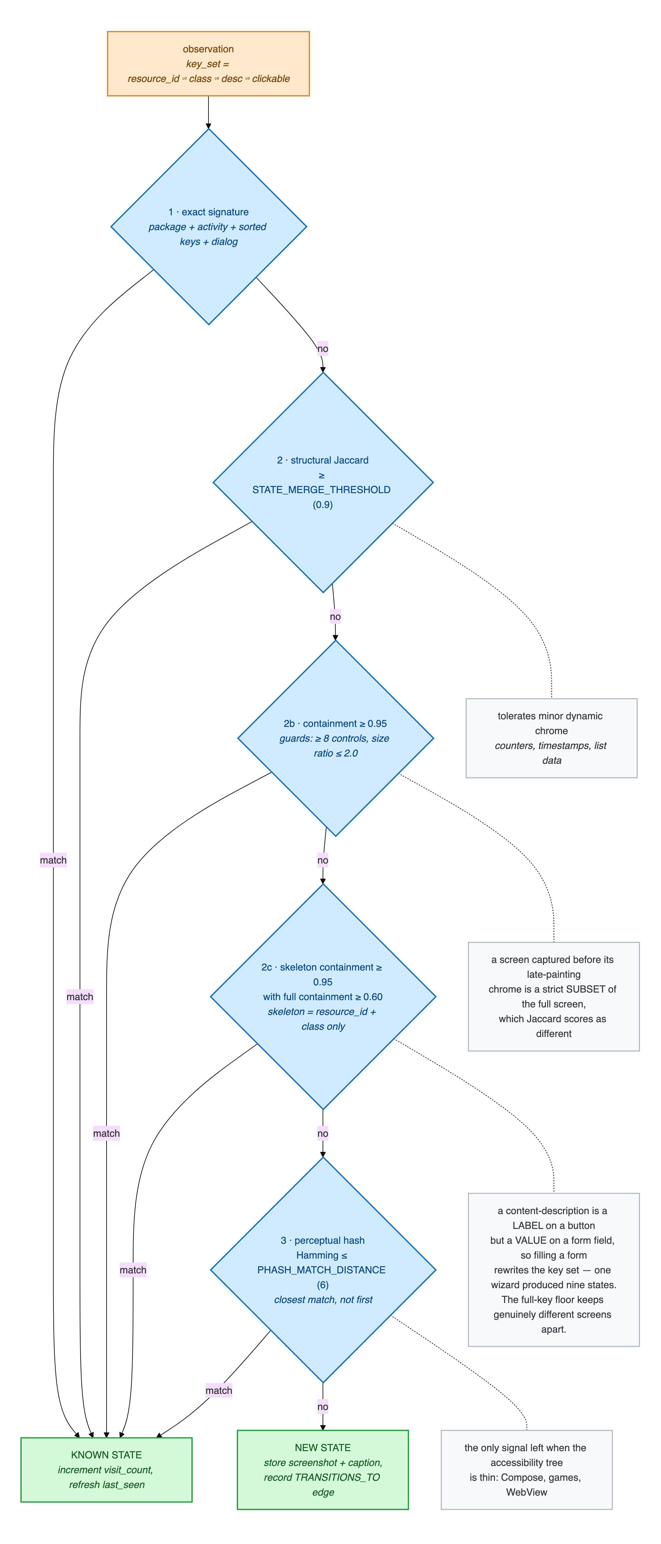
On Android: a real handset, over the accessibility tree
Controls addressed by role and name — never by pixel coordinates.
Every screen reached is written back to the graph as a UI state.
So the map of the application grows while the tests run.
Is this a screen we have seen?
Five tests, cheapest first.
Merge too eagerly and the map collapses. Split too eagerly and it is destroyed.
10
Notes:
Hand off: 'But notice the planner never writes the steps — only the goal.'

Slide 12
An objective, never a tap sequence
Jonayed
What the planner sends
Why not a script
“Verify that a survey cannot be submitted while a required question is unanswered.”
The planner cannot see the live screen.
The executor can recover from a vague goal. It cannot recover from instructions that do not match the screen in front of it.
11

Slide 13
Some controls are never touched
Refused at the configuration layer, before the action is attempted.
Log out
Delete account
Change password
Payment controls
The agent runs against live systems. A test that logs itself out ends the campaign; a test that deletes an account ends more than that.
12

Slide 14
The same planner, a different body
Playwright, reading an accessibility snapshot of the DOM — not screenshots.
Cheaper per step and more precise than the vision-based approach most systems use.
In-loop guards end a stalled run: repeating a dead action, or wandering with nothing changing.
One planner. Two executors. Neither knows about the other.
13

Slide 15
Watching the app, not the agent's story
Defect signals collected independently of anything the agent claims.
Console errors
Uncaught page errors
HTTP 4xx and 5xx
Unexpected dialogs
On the live site, these caught a genuine HTTP 500
— one the agent itself had nearly filed as a user-interface error.
14

Slide 16
Adding an application is a data change
Platform
android / web
5
Knowledge
specification, defect history
targets
Guardrails
what must never be touched
Two Android applications and three websites — one planner, one graph, one report format.
Budgets
steps, wall clock, rounds
Credentials
a disposable test account
15
Notes:
Hand off: 'So how do we know that 500 is real and not the agent imagining it?'

Slide 17
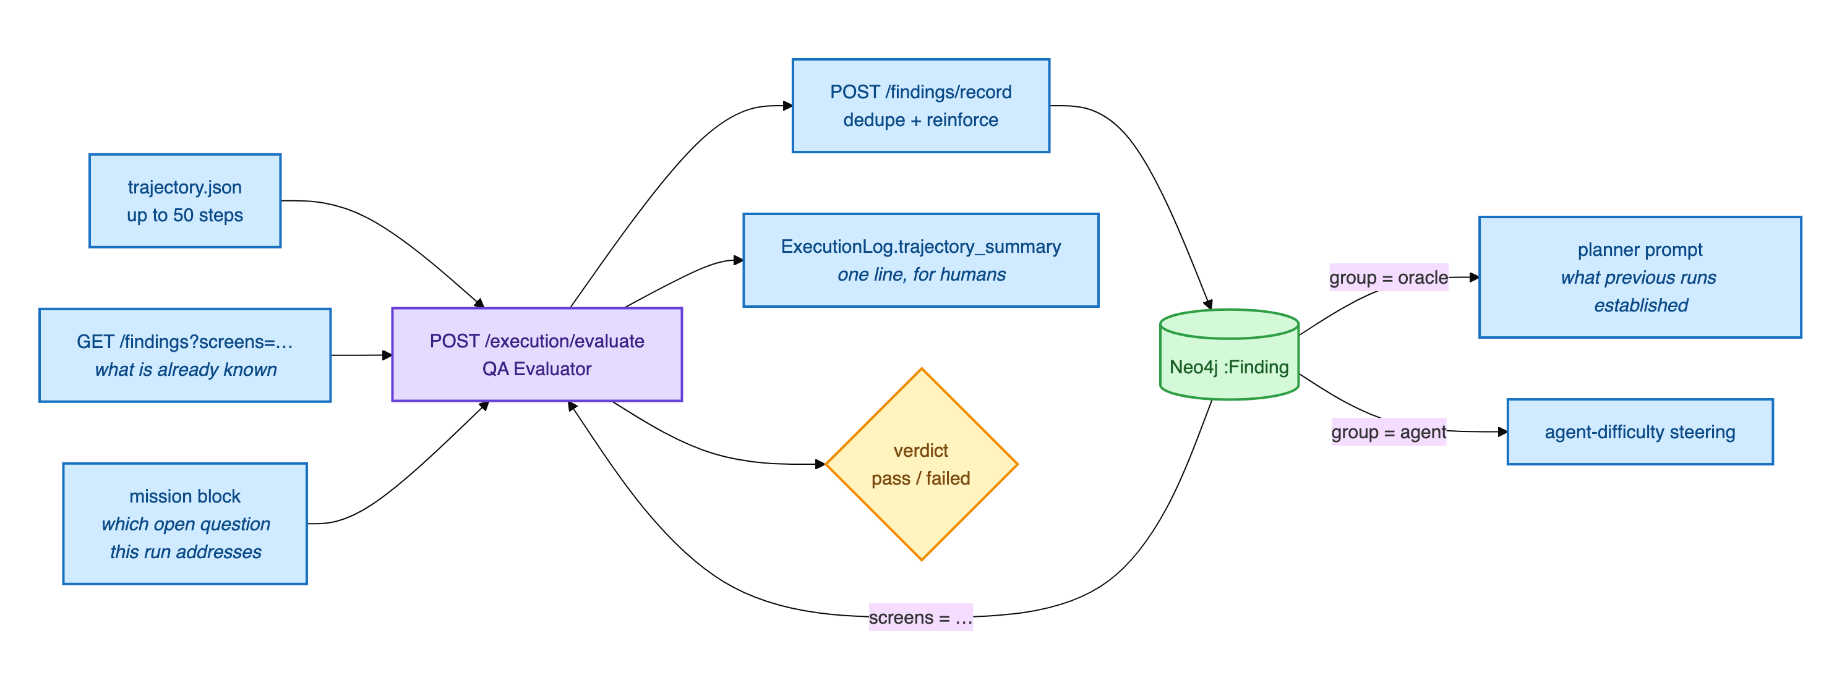
Turning a run into knowledge that outlives it
Tuhin
It reads the whole trajectory against what the test intended — not just the final screen.
16

Slide 18
Findings, not opinions
Deduplicated
A repeat observation raises an existing finding's count instead of making a near-duplicate.
Verdict kept separate
A failed run still contributes knowledge.
Evidence or nothing
A verdict the observations do not support is recorded as unverified.
17

Slide 19
Not every failure is the application's fault
APP
AGENT
ENV
the application is wrong
we could not drive it
something blocked the test
crash · assertion · HTTP error
element not found · timeout · livelock
precondition · CAPTCHA · guardrail
Only the first is ever a defect report.
18

Slide 20
100%
67%
was the autonomy we reported.
was the truth.
The taxonomy had been defined in two places. The copies drifted. It is now three frozen sets in one module, imported everywhere.
19
Notes:
This story justifies the whole taxonomy in one sentence.

Slide 21
So does it cry wolf?
A comparable published agent
Ours, on the live site
158 defects reported
against a human team's 80.
It flagged what looked like a serious access-control hole.
At 52–66% accuracy, where the humans were at 100%. Two in five of its reports were false.
We checked. It was gated by the site's own privacy setting, working as designed.
So we did not report it.
20
Notes:
This is the answer to the question you WILL be asked.

Slide 22
189 autonomous runs across five targets
Niloy
Target | Platform | Tests | Passed | App fault | Agent fault
DataGhurhi — survey platform | Web | 64 | 51 | 4 | 0
Shobar Khamar — marketplace | Android | 45 | 20 | 11 | 14
Google Contacts | Android | 50 | 20 | 19 | 10
broken-workshop | Web | 10 | 5 | 0 | 4
AcademyBug — no specification | Web | 20 | 1 | 3 | 16
21

Slide 23
The two end rows are the whole argument
With a specification
Without one
0
16
agent faults in 64 runs.
agent faults in 20 runs.
The specification is not decoration. It is what lets the agent know where it is going.
22

Slide 24
What the campaign curve actually shows
0% looked catastrophic.
82% of device steps were unparseable. Nothing could be attributed.
Four fixes, one day.
Two days later: 100% autonomy, zero silent fallbacks.
Then it met production.
Autonomy fell to 67%. A tuned agent does not transfer for free.
23
Notes:
Do not hide the zero. Explaining it is the strongest thing here.

Slide 25
USD 0.008
Comparable published work reports about USD 18 per application — and says the cost stopped the authors repeating their own runs.
per executed test, measured against the provider's billing record.
24

Slide 26
What we cannot yet claim
No precision or recall
Establishing them honestly needs seeded defects. We had none.
The models changed eight times
So improvement cannot be attributed to the system alone.
Deployment is local
Not hardened for shared infrastructure.
Next: oracles that check the application's stored data, and checking after every step.
25

Slide 27
Thank you
Architecture
Raihan
Planner and models
Mehemud
Questions are welcome.
Execution and safety
Jonayed
Verdicts and attribution
Tuhin
Results and cost
Niloy

