Slide 1

CSE 450 CAPSTONE PROJECT · DEPARTMENT OF CSE, BUET
Exploratory Testing Automation
An autonomous agent that decides what to test, runs it on a real Android device or in a browser, and learns from every run.
TEAM
SUPERVISOR
INDUSTRY PARTNER
Mohammad Raihan Rashid · 2105046
Mehemud Azad · 2105014
Jonayed Mohiuddin Shanto · 2105060
Khalid Hasan Tuhin · 2105002
Niloy Kumar Mondal · 2105044
Dr. A. B. M. Alim Al Islam
Professor, Department of CSE, BUET
Samsung R&D Institute Bangladesh
Notes:
15 minutes total, five speakers, three minutes each. Raihan opens.

Slide 2
THE PROBLEM
Raihan
Why exploratory testing resists automation
Three existing approaches. Each gives up something the other two need.
Manual exploratory testing
Scripted automation
Random / Monkey testing
Finds real defects, because a person knows what correct looks like.
Repeatable, fast, and cheap to run again.
Explores at scale with no setup at all.
Does not scale. The knowledge leaves with the tester.
Only checks what its author already thought of. It confirms; it does not discover.
No idea what correct looks like. Reports a crash, never a wrong result.
“An automated tool can tell you an application crashed. It cannot tell you it quietly charged the wrong account.”
Exploratory Testing Automation · CSE 450 · BUET
1
Notes:
Open here. The gap is the oracle: knowing what correct looks like. That is what a specification gives us and what nobody else ingests.

Slide 3

ARCHITECTURE
Raihan
Three agents, one shared memory
Planner — decides what to test next and writes the test case.
Executor — drives the real application, Android or browser.
Investigator — decides what the run actually proved.
They never call each other. The knowledge graph is the only channel.
Every model call is stateless and rebuilt from the graph, so “learning” is something you can inspect: the graph either grew or it did not.
Amber: an input · Green: knowledge · Blue: a service · Purple: an agent role · Red: a model call
Exploratory Testing Automation · CSE 450 · BUET
2
Notes:
Do not read the diagram. Point at the three purple roles and the green graph in the middle. That is the whole idea.

Slide 4
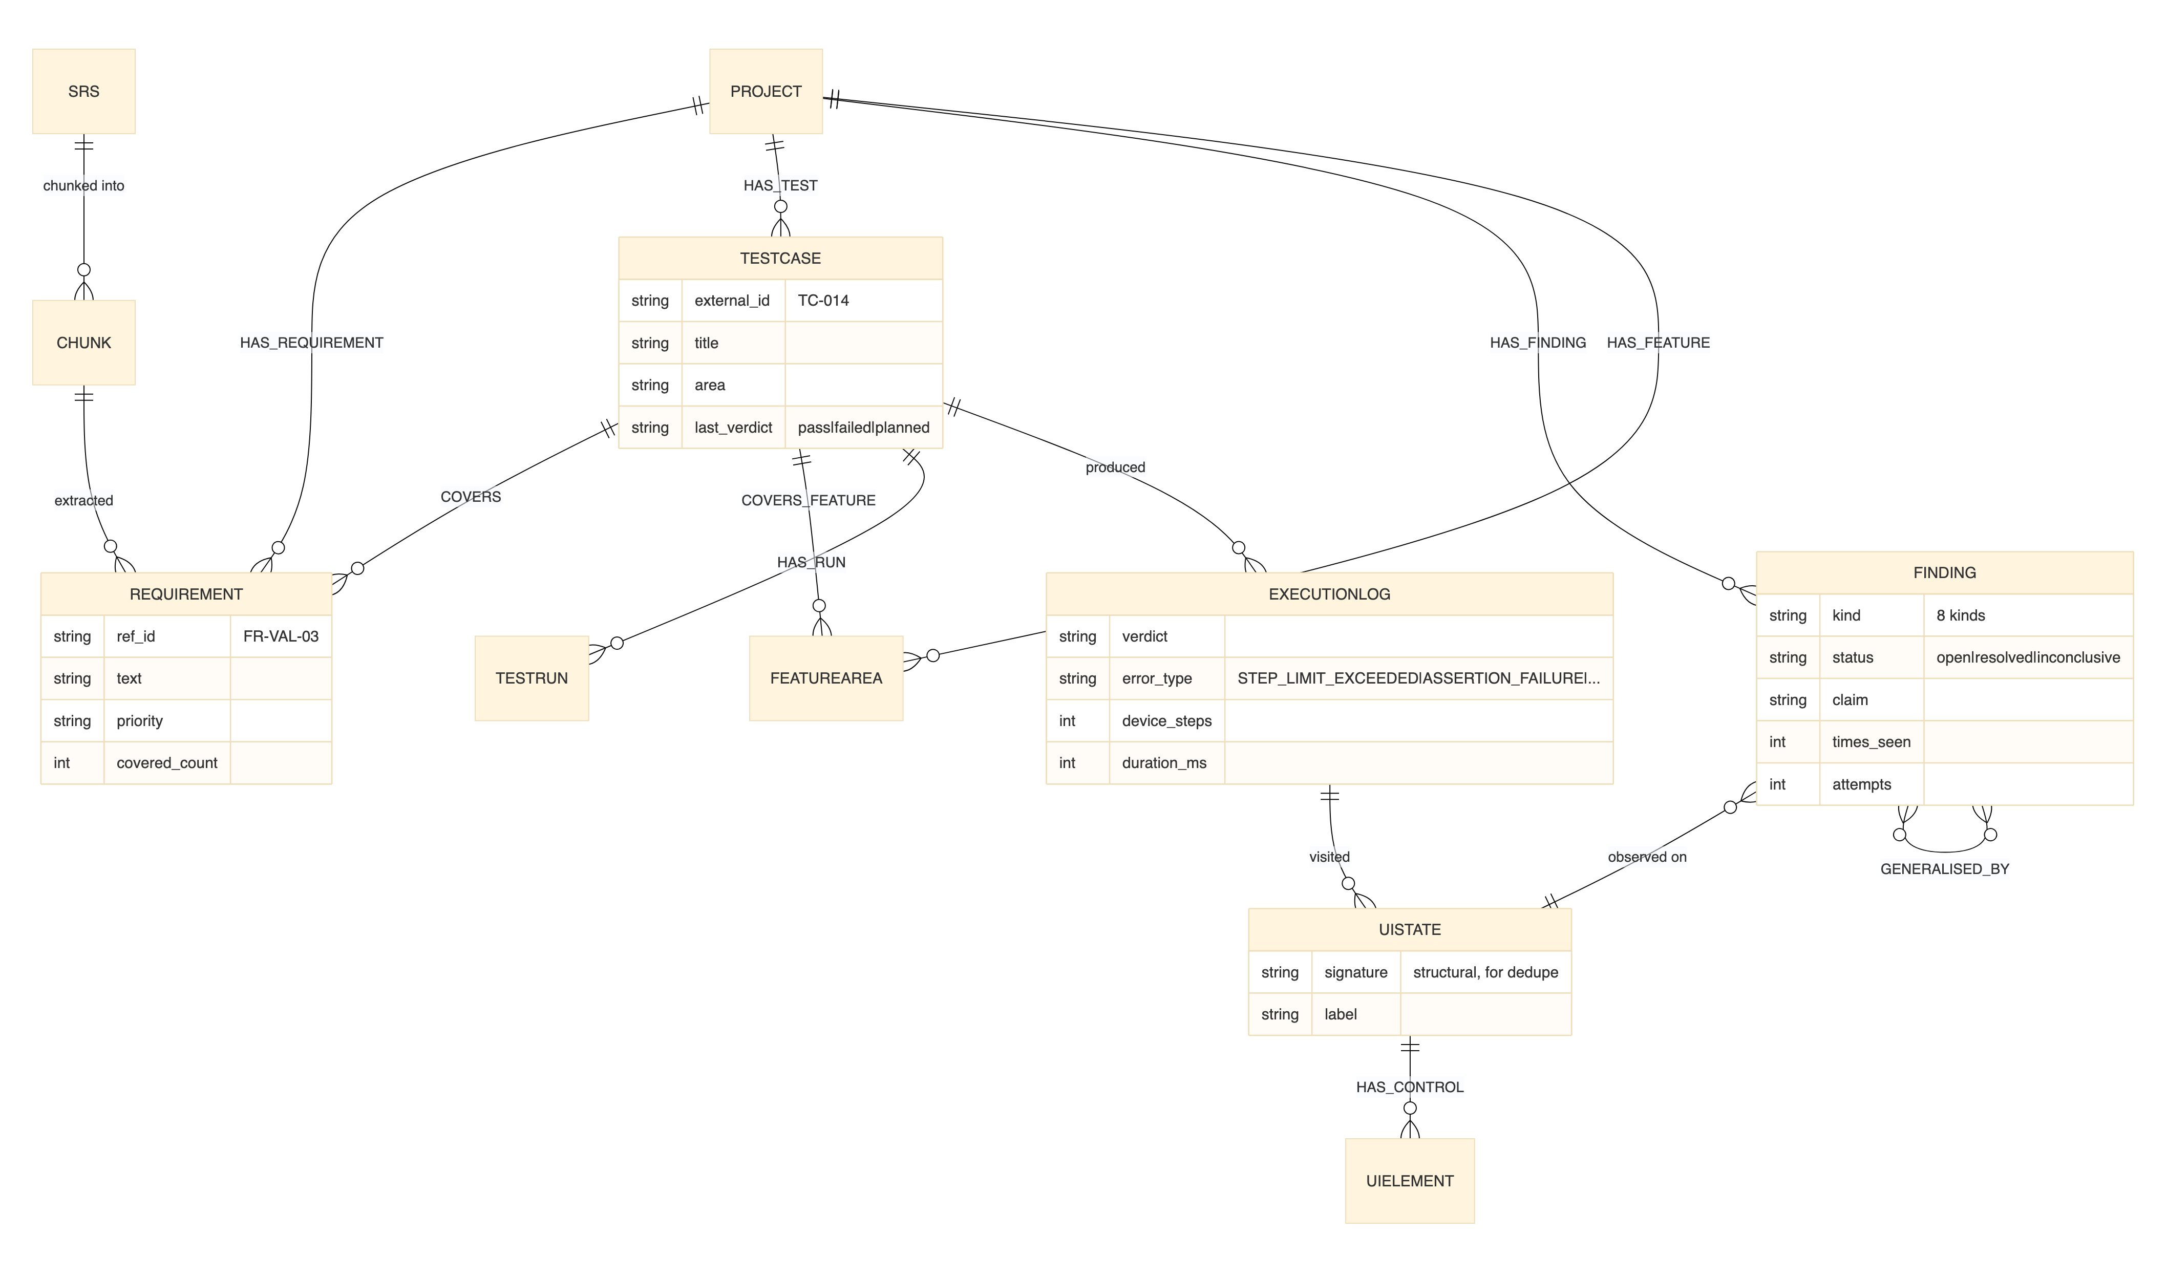
THE KNOWLEDGE MODEL
Raihan
Two graphs in one store, and the gap between them
This is the project's central idea and where it differs from every system we reviewed.
A PRIORI — from documents
Requirements, validation rules, source chunks. What the application should do.
Test cases and findings span both.
Exploration is steered by the gap between them.
A POSTERIORI — from observation
UI states, transitions, navigation paths, execution logs. What it actually does.
Exploratory Testing Automation · CSE 450 · BUET
3
Notes:
Hand off: 'So the first question is — what does it decide to test?' Then Mehemud.

Slide 5
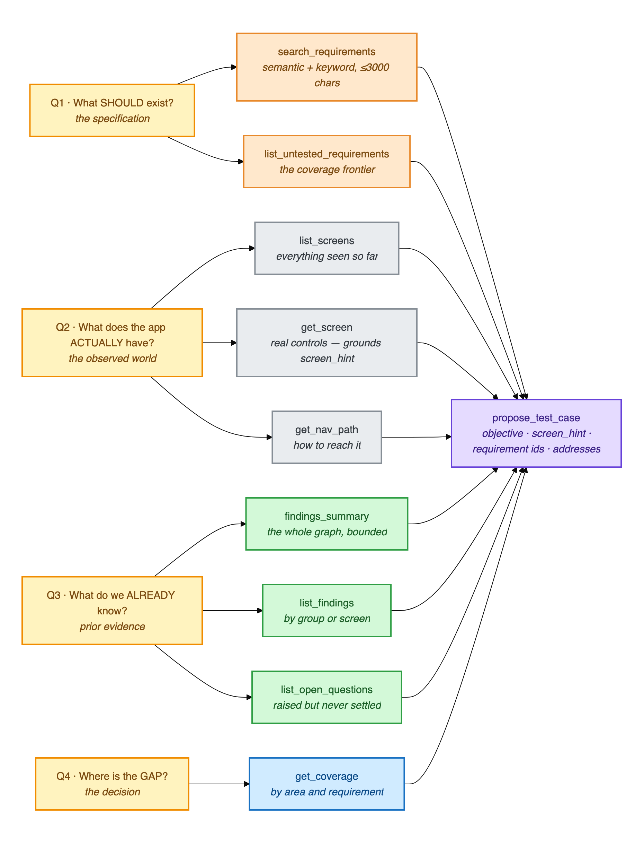
THE PLANNER
Mehemud
What it knows before it writes a test
The planner reads the graph through nine tools, grouped by the question each answers.
What should exist — requirements not yet tested, validation rules.
What the application actually has — screens observed, navigation paths.
What is already known — findings, open questions, coverage.
A tool whose source is empty is never registered, so an absent source cannot mislead the model with a blank answer.
Bounded: 12 turns, and from turn 6 the model is told to propose — left free it investigates forever.
Exploratory Testing Automation · CSE 450 · BUET
4
Notes:
The grouping IS the architecture in miniature: should / does / already known — therefore where the gap is.

Slide 6
THE PLANNER
Mehemud
Nothing reaches a device unvalidated
1
Screen must exist
THE RESULT
Named screen is checked against screens actually observed.
16%
2
Requirement IDs must exist
of proposals named a screen that really existed, under the first planner design.
Invented identifiers are rejected, not silently stored.
3
Not a duplicate
Semantic check against tests already executed.
After the redesign: one rejection across eight test cases, corrected on the next turn.
4
Preconditions must be creatable
No test that depends on a state nobody can reach.
Three rejections and the best effort is accepted with a recorded degradation — a planning round never returns nothing.
Exploratory Testing Automation · CSE 450 · BUET
5
Notes:
The 16 per cent is the number to land. Say it slowly.

Slide 7
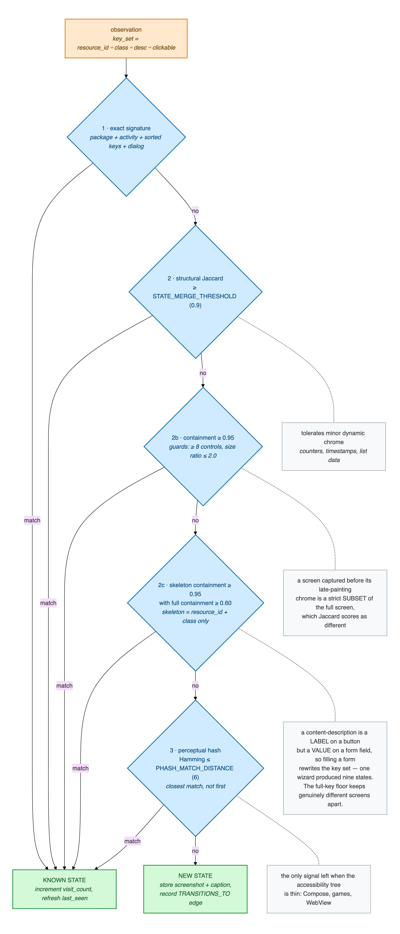
THE EXECUTOR — ANDROID
Mehemud
Driving a real handset
Runs on a physical device over ADB, through the Android accessibility service.
Controls are addressed by role, name and content description — never by pixel coordinates.
Every screen it reaches is posted back to the graph as a UI state, so the map grows while the tests run.
Bounded: at most 50 device actions per test, roughly 20 seconds per step.
IS THIS A SCREEN WE HAVE SEEN?
Five tests, cheapest first: exact signature, structural Jaccard, containment, skeleton containment, perceptual hash.
Merge too eagerly and the map collapses; split too eagerly and it is destroyed. One wizard produced nine states before this cascade existed.
Exploratory Testing Automation · CSE 450 · BUET
6
Notes:
Hand off: 'But notice the planner never writes the steps — only the goal.' Then Jonayed.

Slide 8
PLANNER → EXECUTOR
Jonayed
An objective, never a tap sequence
The planner cannot see the live screen. So it states the goal and the executor decides the steps.
WHAT THE PLANNER SENDS
WHY NOT A SCRIPT
“Verify that a survey cannot be submitted while a required question is unanswered, and that the error names the question.”
A wrong tap-script is worse than a vague goal.
The executor can recover from an imprecise objective. It cannot recover from instructions that do not match the screen in front of it.
So the planner is never allowed to guess coordinates it has not seen.
Plus preconditions, the expected result, and the area under test — all in plain language.
Guardrails sit at the configuration layer: log out, delete account, change password and payment controls are refused before the action is attempted.
Exploratory Testing Automation · CSE 450 · BUET
7
Notes:
Pick up Mehemud's handoff line directly. This slide is the seam between the two planner halves.

Slide 9
THE EXECUTOR — WEB
Jonayed
The same planner, a different body
Playwright, reading an accessibility-style snapshot of the DOM rather than screenshots — cheaper per step and more precise than the vision-based approach most comparable systems use.
Nine actions: click, fill, press, select, navigate, back, scroll, wait, finish.
In-loop guards end a stalled run: repetition of an action already proven inert, and wandering — a different action each time with nothing changing.
PASSIVE ORACLES
Defect detection that does not depend on what the agent claims:
console errors
uncaught page errors
HTTP 4xx and 5xx responses
native dialogs the page never shows
On the live site under test these caught a genuine HTTP 500 that the agent itself had nearly filed as a UI error.
Guardrails, CAPTCHA handling and a run lock are enforced here too — a CAPTCHA escalates to a human when visible, and fails the test cleanly when headless.
Exploratory Testing Automation · CSE 450 · BUET
8
Notes:
Hand off: 'So how do we know that 500 is a real bug and not the agent imagining one?' Then Tuhin.

Slide 10
GENERALITY
Jonayed
Adding an application is a data change, not a code change
One validated JSON profile selects the target, its platform, and everything that depends on them.
Platform
android / web
RUN AGAINST
5
Knowledge
specification, API notes, defect history
targets
Guardrails
controls the agent must never activate
Two Android applications — a production marketplace and Google Contacts — and three websites, including a live survey platform.
One planner. One graph. One report format.
Budgets
steps per test, wall clock, rounds
Credentials
a disposable test account, never shown to the planner
The dashboard can list, validate, save, ingest and run a profile, so a new target never touches the source tree.
Exploratory Testing Automation · CSE 450 · BUET
9
Notes:
If short on time, this is the slide to compress to one sentence.

Slide 11
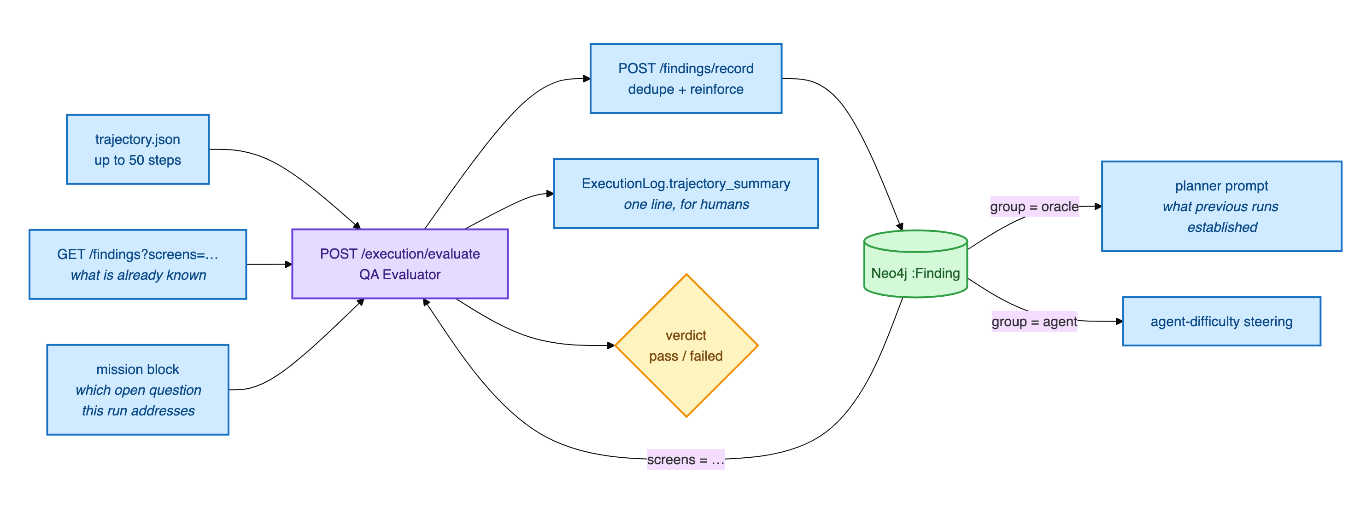
THE INVESTIGATOR
Tuhin
Turning a run into knowledge that outlives it
It reads the whole trajectory against what the test intended — not just the final screen.
Typed and deduplicated
Verdict separated from findings
Evidence or nothing
A repeated observation increments an existing finding's count instead of creating a near-duplicate.
A failed run still contributes knowledge. The two are stored independently.
A verdict the observations do not support is recorded as unverified, not resolved either way.
Exploratory Testing Automation · CSE 450 · BUET
10
Notes:
That claim seen three times across three evaluations is worth more than one asserted once — that is what the count buys.

Slide 12
FAULT ATTRIBUTION
Tuhin
Not every failure is the application's fault
Conflating these three inflates the reported defect count — the most expensive error this system can make.
APP FAULT
AGENT FAULT
ENV FAULT
the application is wrong
we could not drive it
something blocked the test
assertion failure · crash · unresponsive · HTTP error · page error
element not found · timeout · navigation failure · livelock · stale element
precondition not met · permission denied · CAPTCHA · guardrail · step limit
This is the only one that becomes a defect report.
Defined once as three frozen sets and imported everywhere. An earlier version defined them twice, the copies drifted, and autonomy was reported as 100% when it was 67%.
Exploratory Testing Automation · CSE 450 · BUET
11
Notes:
The 100-versus-67 story is the one that lands. It justifies the entire taxonomy in one sentence.

Slide 13
THE HARD QUESTION
Tuhin
How do we know the defects are real?
WHAT THE LITERATURE SHOWS
WHAT OURS DID
A comparable published agent reported 158 defects against a human team's 80 — at roughly 52–66% accuracy, where the humans were at 100%.
It flagged what looked like a serious access-control hole on the live site — one user reading another's private project.
Two in five of its reports were false. An agent that reports everything is not useful; it moves the work rather than removing it.
We checked. The endpoint was gated by the site's own privacy setting and behaving exactly as designed.
So we did not report it.
Su et al., FSE 2025
Attribution is what makes that restraint possible.
Exploratory Testing Automation · CSE 450 · BUET
12
Notes:
This is the answer to the question you WILL be asked. Deliver it as the close, then hand to Niloy.

Slide 14
RESULTS
Niloy
189 autonomous test runs across five targets
Two platforms, two Android applications and three websites, all executed end to end.
Target | Platform | Tests | Passed | App fault | Agent fault
DataGhurhi — survey platform | Web | 64 | 51 | 4 | 0
Shobar Khamar — marketplace | Android | 45 | 20 | 11 | 14
Google Contacts 4.86.23 | Android | 50 | 20 | 19 | 10
broken-workshop | Web | 10 | 5 | 0 | 4
AcademyBug — no specification | Web | 20 | 1 | 3 | 16
DataGhurhi: 64 runs, zero agent faults. The web executor is mature.
AcademyBug: no specification ingested — and 16 of 20 runs failed on our side. That contrast is the thesis.
Exploratory Testing Automation · CSE 450 · BUET
13
Notes:
Point at the two end rows. Zero agent faults with a spec; 16 of 20 without one.

Slide 15
RESULTS
Niloy
What the campaign curve actually shows
0% pass looked catastrophic — it was not.
82% of device steps were unparseable, so almost nothing could be attributed. The instrumentation worked and revealed that the evidence did not.
Four unglamorous fixes, one day.
Log reassembly, containment matching, a precondition filter, a device reset. Two days later: 100% autonomy, zero silent fallbacks.
Then it met production, and fell to 67%.
Per cent, across six instrumented campaigns
A tuned agent does not transfer for free. That is the most honest result we have.
Exploratory Testing Automation · CSE 450 · BUET
14
Notes:
Do not hide the 0 per cent. Explaining it is the strongest thing on this slide.

Slide 16
COST AND HONEST LIMITS
Niloy
What it costs, and what we cannot yet claim
WHAT WE CANNOT CLAIM
USD 0.008
No precision or recall. Establishing them honestly needs seeded defects, and the partner supplied neither a defect export nor a seeded build.
The model configuration changed eight times over the project, so improvement cannot be attributed to the system alone.
Deployment is local and developer-operated; it is not hardened for shared infrastructure.
per executed test, measured against the provider's billing record at 10.1 device steps per test.
Comparable published work reports about USD 18 per application for a two-hour campaign, and states that the cost prevented the authors from repeating their own runs.
NEXT
State-based oracles that check the application's stored data, not the agent's narrative.
Checking after every step rather than only at the verdict.
Exploratory Testing Automation · CSE 450 · BUET
15
Notes:
Say the limits plainly and without apology. Examiners reward this.

Slide 17
WHO TAKES WHICH QUESTION
Thank you
Architecture, novelty
Raihan
Planner, prompts, models
Mehemud
Questions are welcome.
Execution, platforms, safety
Jonayed
Verdicts, attribution, false positives
Tuhin
Results, cost, evaluation
Niloy
github.com/raihanrsdV1/Exploratory-Testing-Planner-Agent
Notes:
Q&A ownership agreed in advance so nobody talks over anyone.

