Slide 1
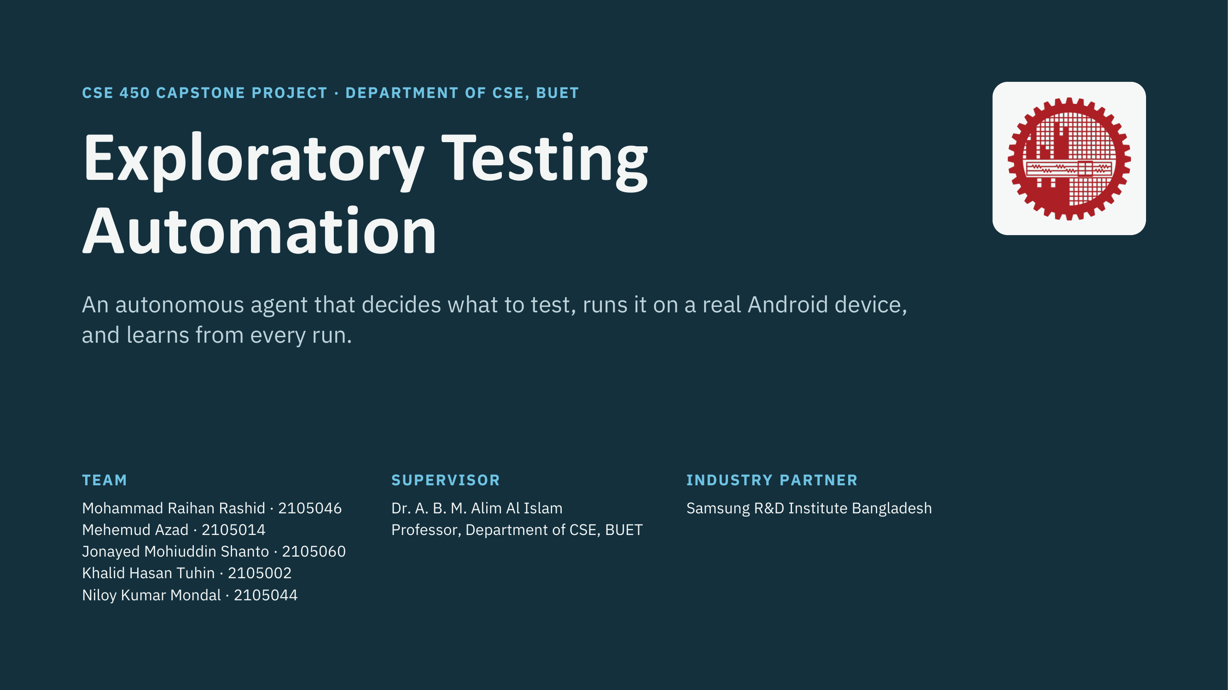

Slide 2
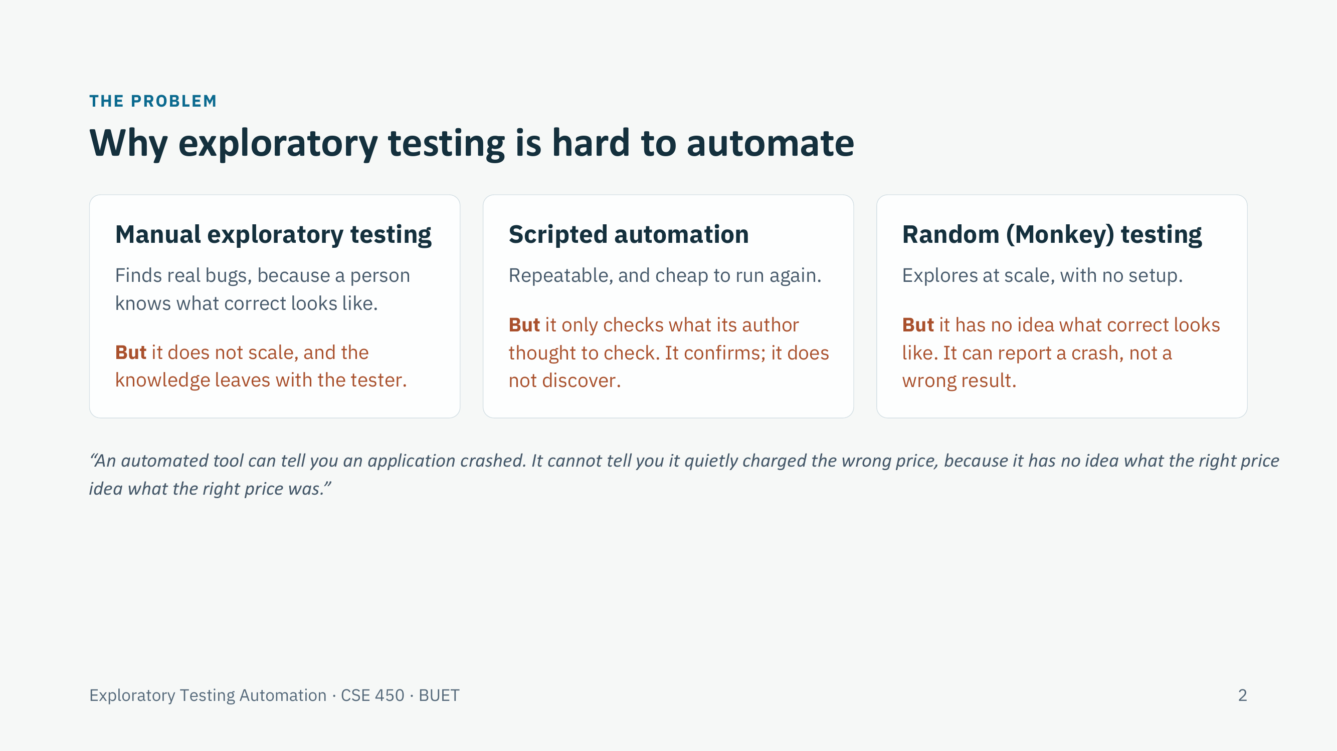

Slide 3
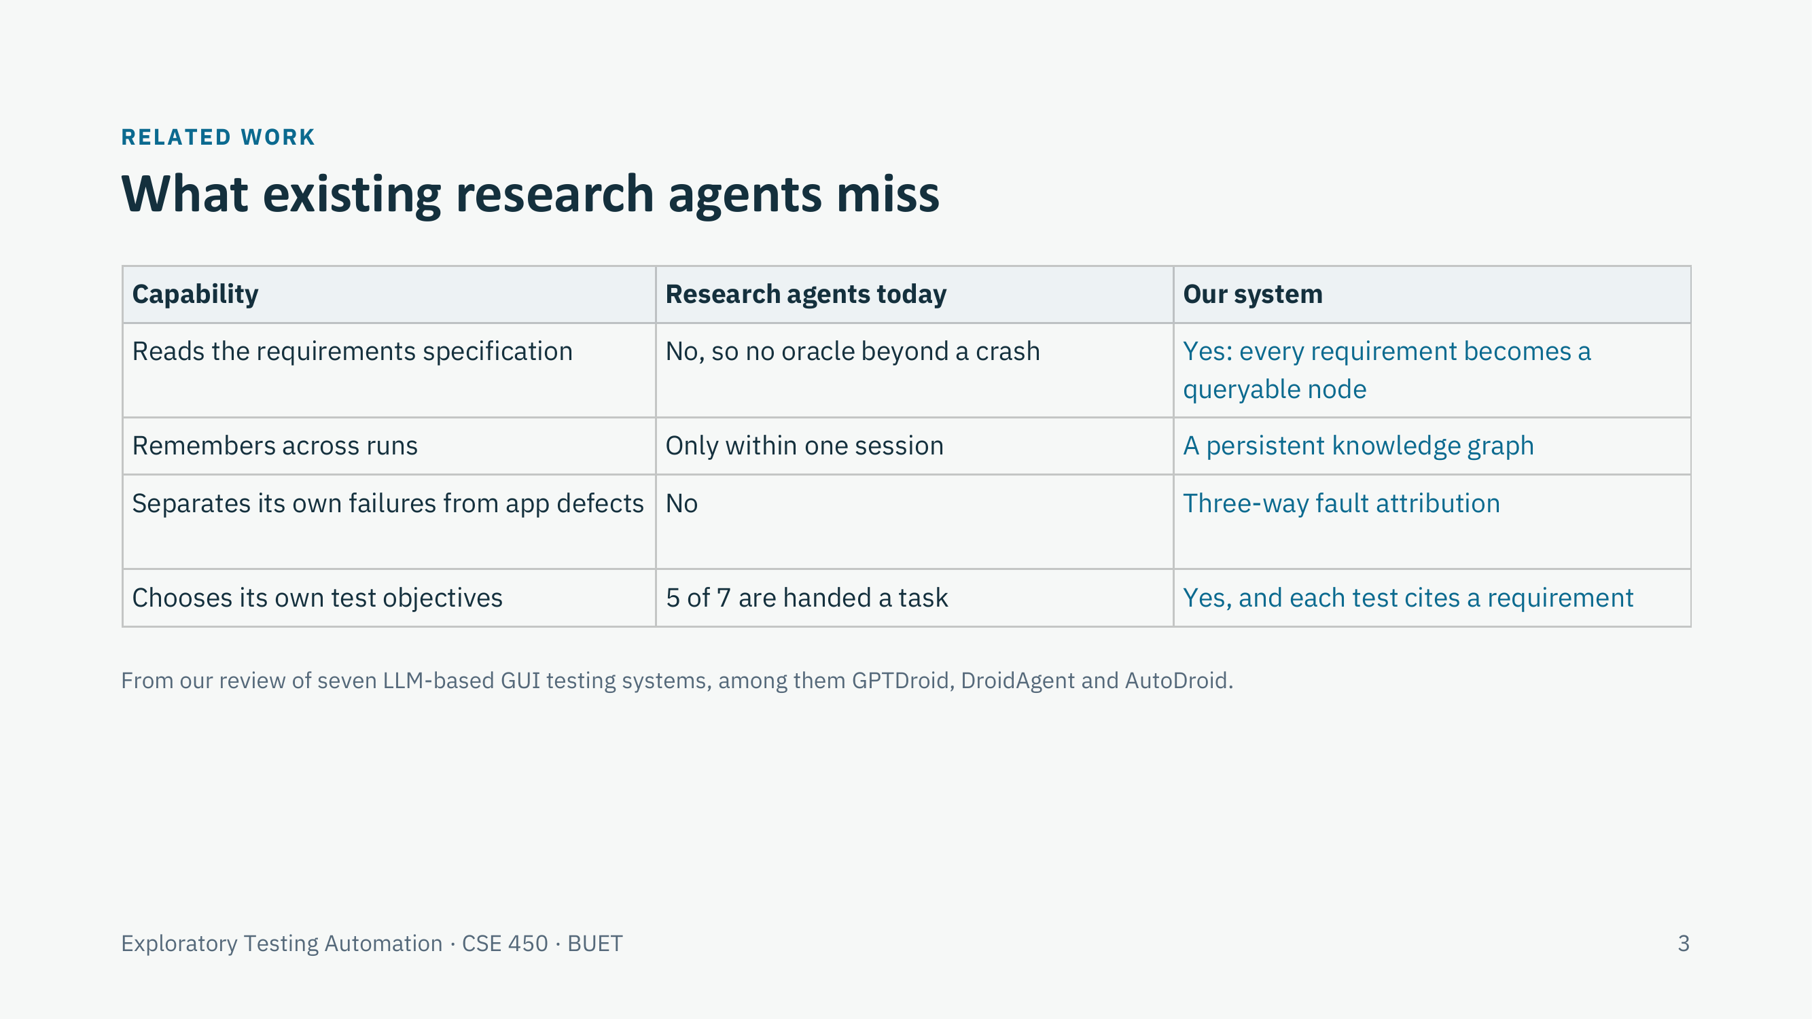

Slide 4
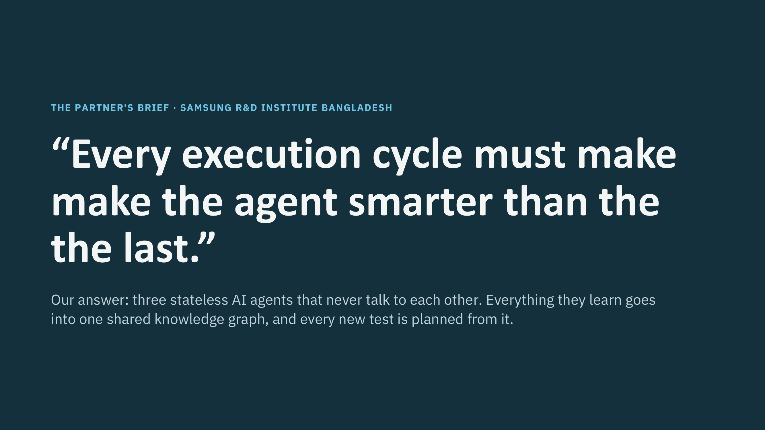

Slide 5
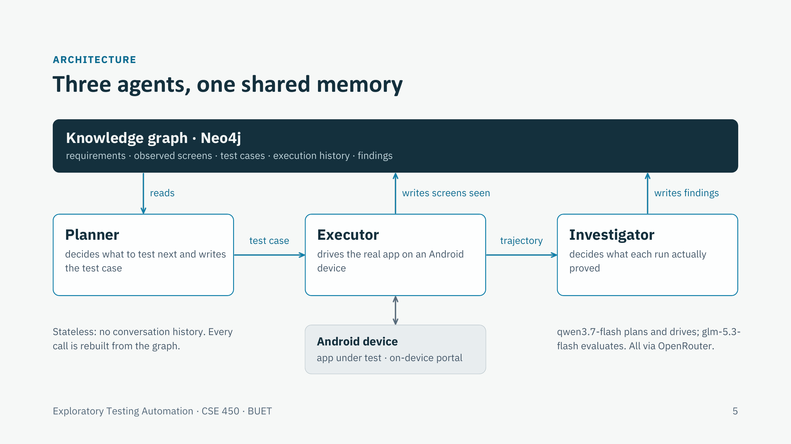

Slide 6
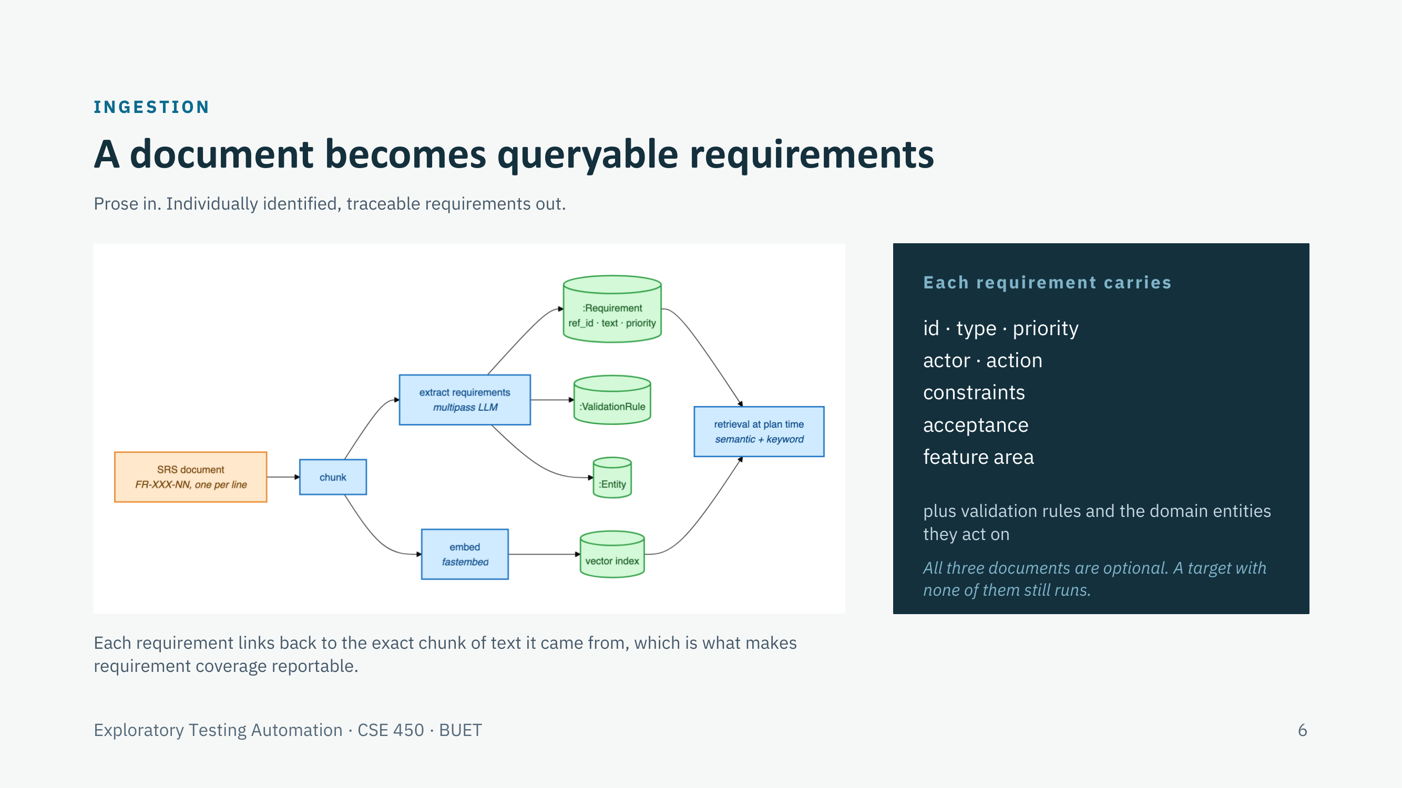

Slide 7
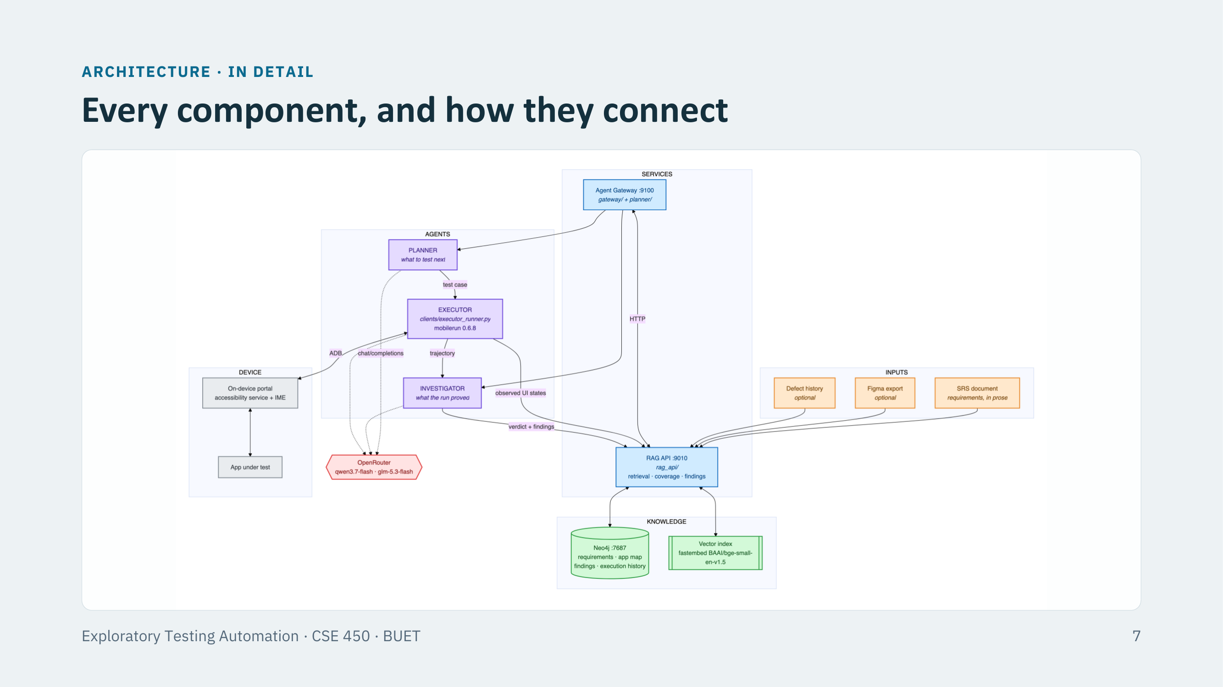

Slide 8
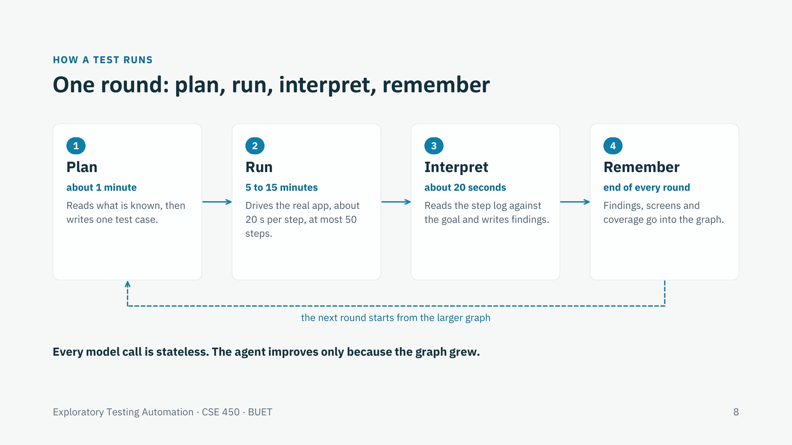

Slide 9
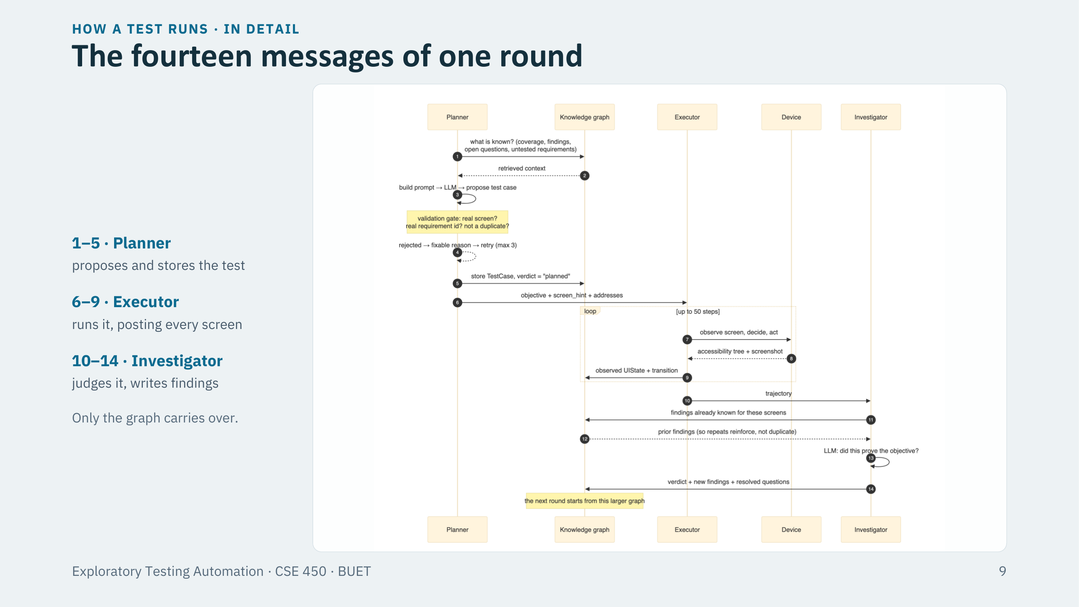

Slide 10
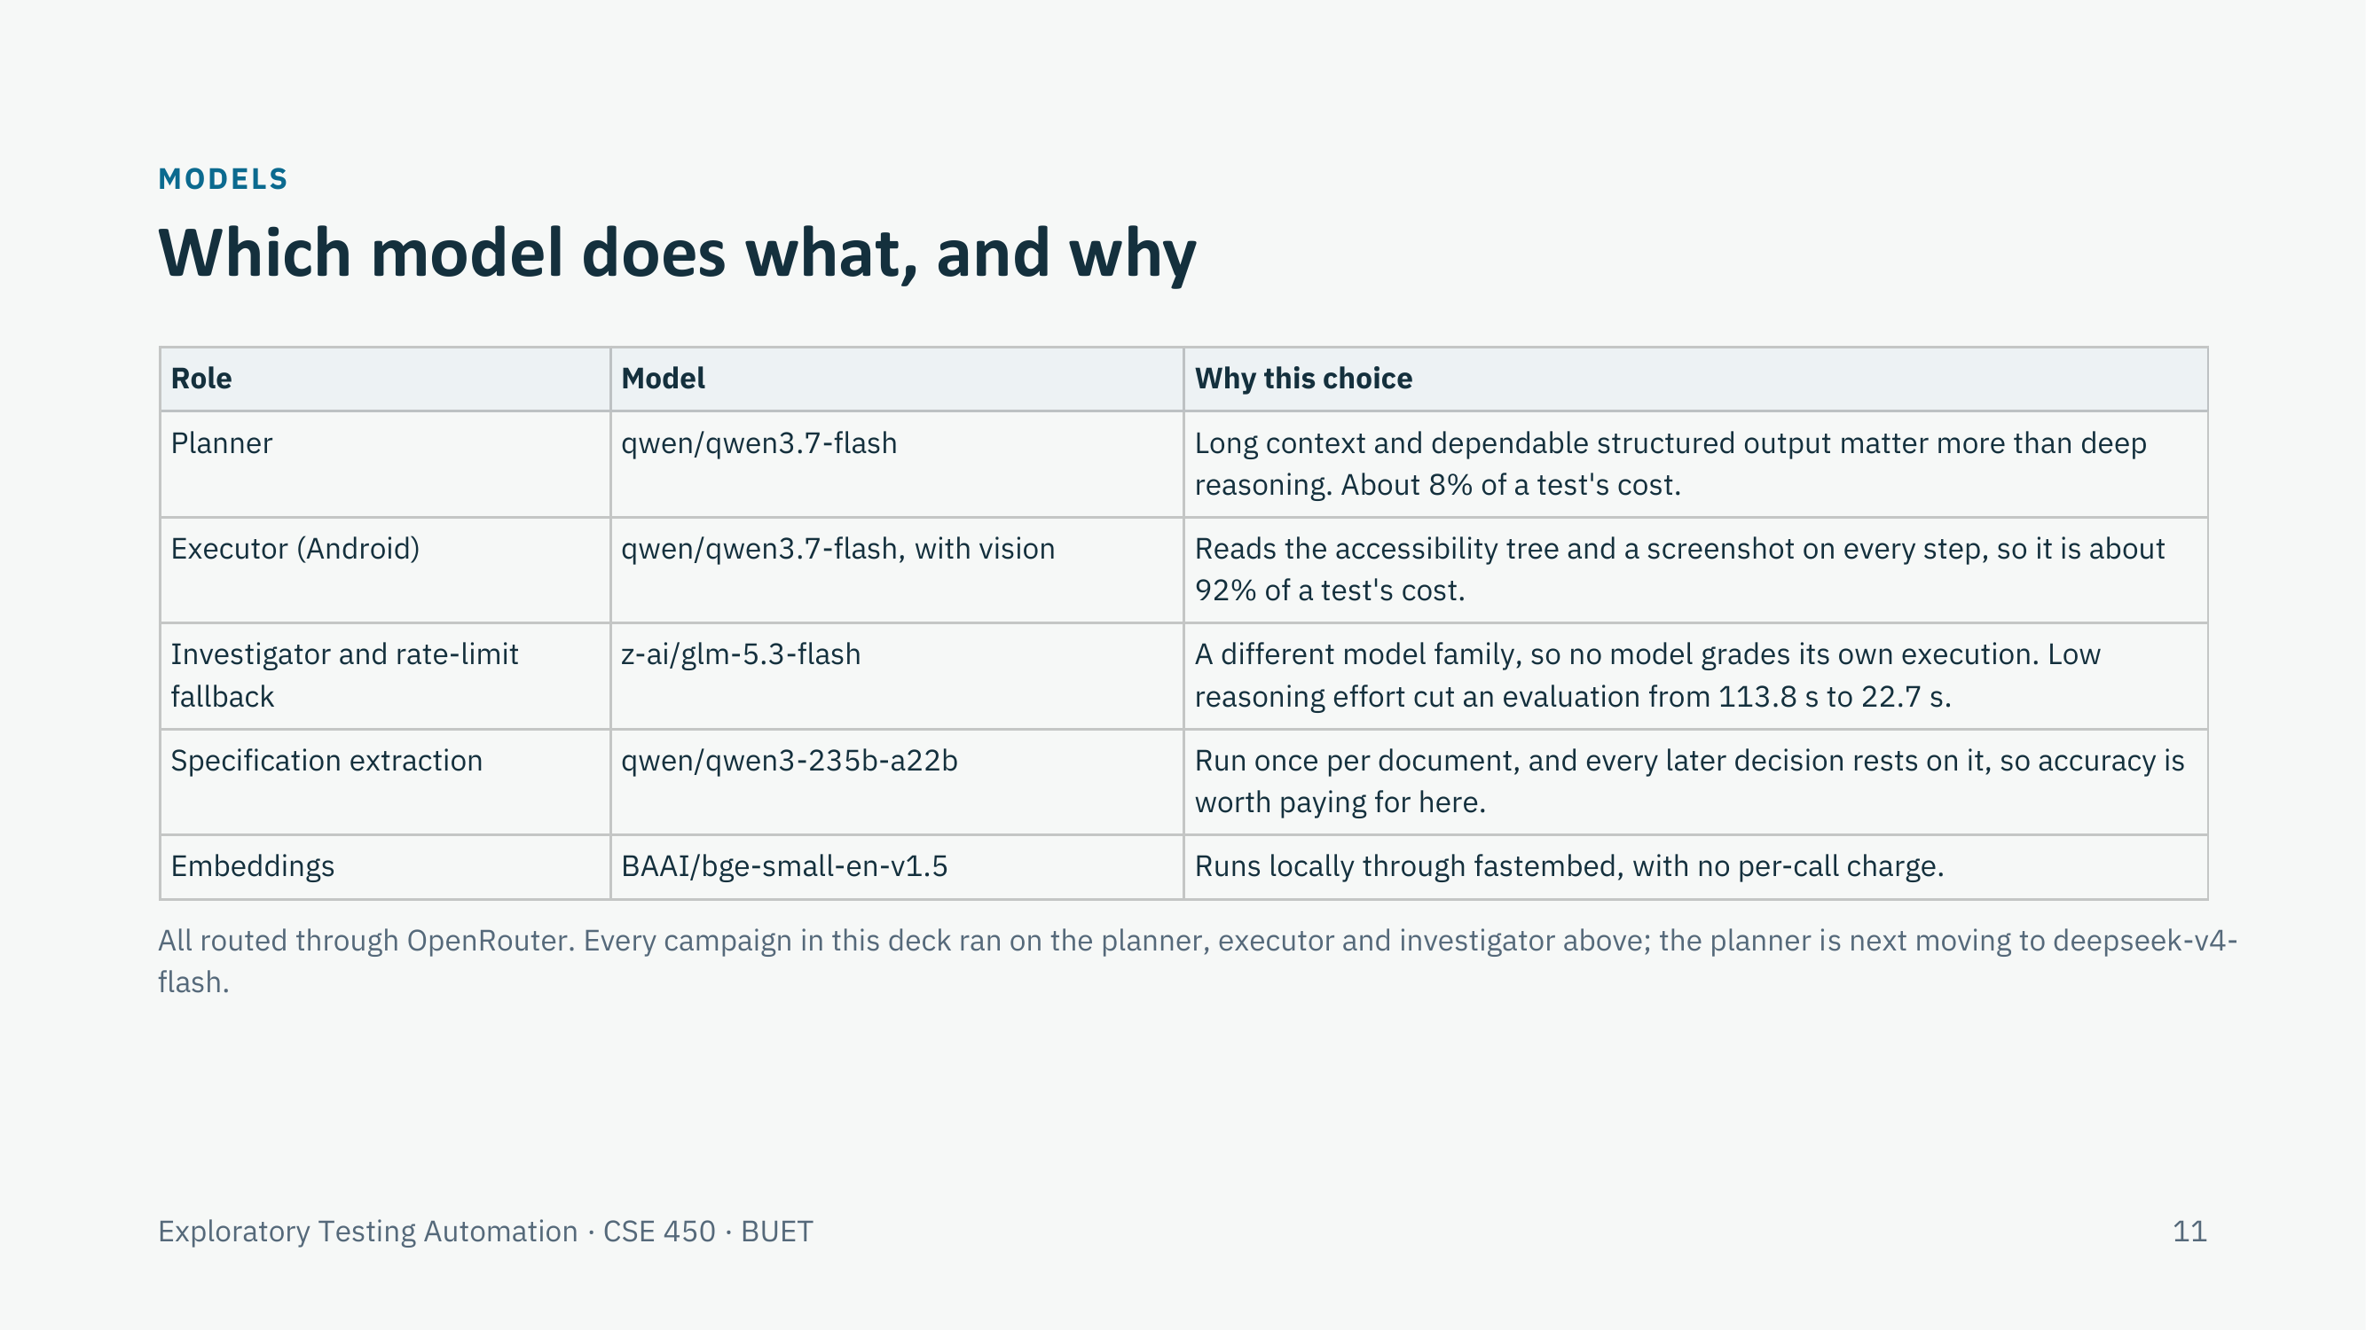

Slide 11
PLANNER · WHAT IT KNOWS
What the planner knows before it writes a test
Specification
Screens seen
Navigation paths
Every requirement as a node, retrieved by meaning and by keyword.
The live map of the app: 79 screens and 797 transitions on the contacts app.
Learned routes to each screen, and the routes known to fail.
Findings
Coverage
Defect history
What earlier runs confirmed, contradicted or left open.
Which requirements and feature areas are still untested.
Past bug reports, when a project has them.
Bounded context, so long campaigns stay cheap
The block summarising earlier runs was 35,233 characters, 69% of one prompt. Stored as findings instead of prose, it is now about 2,000.
Exploratory Testing Automation · CSE 450 · BUET
10
Notes:
About 40 seconds. [Opening, after the intro] Thank you. I'll take you inside the first of the three agents, the planner. Its job is to choose the single most useful test to run next. It cannot see the phone, so everything it knows, it reads from the graph. There are six kinds of knowledge: the specification, split into individual requirements; the screens we have actually seen, 79 on the contacts app; learned routes to each screen; findings from earlier runs; coverage, meaning what is still untested; and past bug reports when a project has them. All of it is capped, so the prompt does not grow as a campaign goes on. The summary of earlier runs used to be 35,000 characters, 69 percent of a prompt; stored as findings, it is about 2,000. [Transition] So where does all of this live?

Slide 12
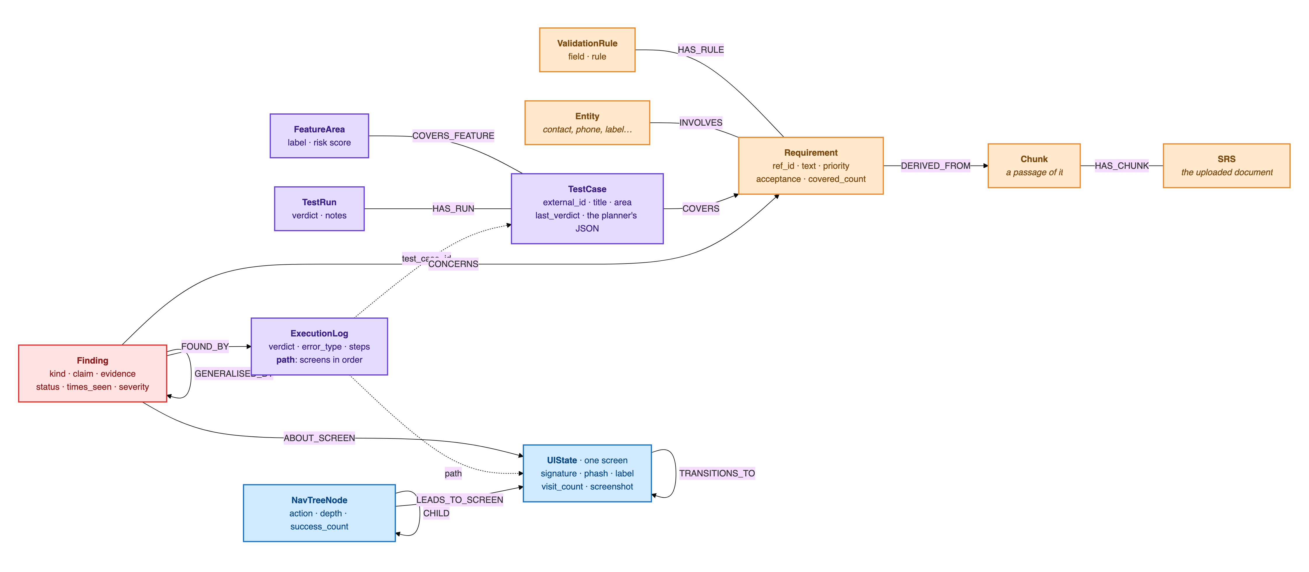
PLANNER · WHERE IT ALL LIVES
What the knowledge graph stores
Orange: from the specification · Purple: tests and runs · Blue: the app model · Red: findings · Dashed: stored as a property, not a relationship. Every node belongs to one project.
Exploratory Testing Automation · CSE 450 · BUET
11
Notes:
About 40 seconds. In one Neo4j graph. Orange is the specification: each requirement is traced to the passage of the document it came from. Purple is testing: test cases, the requirements they cover, and a log for every run, including the ordered path of screens it went through. Blue is the app map the executor builds: one node per distinct screen, and the transitions between them. Red is findings, each tied to the run that found it, the screen it is about and the requirement it concerns. Every agent reads and writes this one structure, and nothing else survives between calls. [Transition] The planner reads this graph in one of two modes. The first is a fixed pipeline.

Slide 13

PLANNER · PIPELINE MODE · A LANGGRAPH STATE MACHINE
The planner asks what it still needs
bootstrap_context
planner_step
generate_testcase
duplicate_check
loads coverage, tests and findings
model: “what do I still need?”
writes the test as structured JSON
rejects near-duplicates by title and meaning
execute_retrieval
runs its tools: spec, screens, paths, defects
no model call
repeats until ready · 2 rounds in our campaigns
1 large model call
+1 call if rejected
Its tools: four sources it can look things up in
When it stops looking
Each round the model picks up to three lookups: search the specification, pull up a screen already seen, find a path to a screen, or check past defects there.
When the model says it is ready, after 2 rounds, when the context passes 9,000 characters, or when a retrieval returns nothing new.
Exploratory Testing Automation · CSE 450 · BUET
12
Notes:
About 40 seconds. The pipeline is a LangGraph state machine. It first loads what is known, with no model call. Then a small model call asks: what do I still need? The model can pick up to three lookups: search the specification, pull up a screen it has seen, find a route to a screen, or check past defects there. Those run, the answers come back, and it asks again, for at most two rounds. Then one large call writes the test, and a duplicate check compares it with every earlier test, by wording and by meaning. This mode planned the contacts campaign. [Transition] Here is the same pipeline in full.

Slide 14






PLANNER · IN DETAIL
The full planning pipeline
bootstrap_context
planner_step
should_continue?
generate_testcase
1 · loads coverage, tests and findings · no model call
2 · small model call: “what do I still need?” Picks up to 3 lookups.
3 · write when ready, after 2 rounds, or nothing new
4 · large model call · writes the test as JSON
answers
retrieve more
execute_retrieval · the planner's tools
no model call · srs: search the spec · live_ui: a screen already seen · navtree: a route to it · defects: past failures there
6 · Auto-log to Neo4j
One more model call
too similar
duplicate_check
stored as planned, then handed to the executor
rewrite with other screens; similar titles blocked
5 · wording and meaning against every earlier test
distinct
Exploratory Testing Automation · CSE 450 · BUET
13
Notes:
About 30 seconds; skip if short of time. Read it by colour, and follow the numbers. Red boxes are model calls: only two are guaranteed per test, the small planner_step and the large generate_testcase. Blue is the planner's tools, the lookups it asked for. Green is plain graph work, and amber are decisions. The loop between steps 2 and 3 is the planner deciding whether it knows enough. The retry at the bottom only fires when a draft is too similar to an earlier test, and every test is stored as planned before the executor ever sees it. The weakness is in that loop: the model lists its lookups up front and gets them back as a batch, so one answer cannot shape the next question. [Transition] That is what the second mode fixes.

Slide 15
PLANNER · TOOLS MODE · PLANNED THE COMMERCE CAMPAIGN
Tools philosophy: the model asks the graph itself
It calls one tool, reads the answer, then chooses the next question. Nine read-only tools, each offered only when its source has data.
Tool | What it answers | Offered when
search_requirements | semantic and keyword search over the specification | a spec is ingested
list_untested_requirements | the coverage frontier: what no executed test covers yet | a spec is ingested
get_screen | the real controls observed on one screen | screens have been seen
list_screens | every screen actually seen, with visit counts | screens have been seen
get_nav_path | a route to a screen the executor has already walked | a route exists
findings_summary | counts of everything earlier runs found, per screen and kind | always
list_findings | the claims themselves: confirmed, suspected, unverified | always
list_open_questions | questions earlier runs raised but never settled | always
get_coverage | tests run, failing hot spots, dead ends, exhausted areas | always
Exploratory Testing Automation · CSE 450 · BUET
14
Notes:
About 40 seconds. In tools mode, the model calls the graph itself. It calls one tool, reads the answer, and decides what to ask next, so each question can depend on the last result. It has nine read-only tools: two for what the specification says should exist, three for what the app actually has, three for what earlier runs established, and one for coverage. The right-hand column is the safety rule: a tool is offered only when its source has data. On a brand-new app with no screens yet, get_screen does not exist for the model, so an empty answer can never mislead it. This mode planned the 45-test commerce campaign. [Transition] Here is what one planning round actually looked like.

Slide 16
PLANNER · TOOLS MODE · ONE ROUND
One round: investigate, then propose
Given
Starts from a short brief
Every proposal is validated
coverage map, last few runs, open questions
Rejected if it:
Calls 1–3
Orient: what is known, and where the gaps are
names a screen never observed
cites a requirement id that does not exist
repeats an earlier test
needs a precondition the tester cannot create
falls outside the agreed scope
findings_summary, get_coverage, list_screens
Call 4
Pick up an unfinished thread
list_open_questions, list_findings
The model is told why and retries, up to 3 times.
Call 5 on
Ground it in a real requirement and screen
search_requirements, get_screen
Turn 7 on
Forced to commit
the tool choice is pinned to propose_test_case
Measured over 62 rounds on the commerce app: the most common tool at each position, a median of 13 calls per round, 989 calls for 101 proposals. Left free, the first live run investigated for ten turns and never proposed.
Exploratory Testing Automation · CSE 450 · BUET
15
Notes:
About 45 seconds. We measured this from 62 real planning rounds on the commerce app. It starts from a short brief: the coverage map, the last few runs and the open questions. Nothing in the code fixes the order after that; the model chose it. It orients first, with a summary of the findings, the coverage state and the list of screens. Then it picks up an unfinished thread, usually an open question from an earlier run. Only then does it ground the test in a real requirement and a real screen. That is about 13 calls a round. After six free turns it is forced to propose, because on our first live run it investigated for ten turns and never wrote a test. And every proposal must pass the gate on the right: a screen we have really seen, requirement ids that exist, not a repeat, and no precondition the tester cannot create. If it fails, the model is told why and tries again, up to three times. [Transition] Whichever mode runs, it also has to decide where to test next without going in circles.

Slide 17
PLANNER · WHERE TO GO NEXT
Where to test next, without repeating itself
Steered to the gaps
A cap on every area
No near-duplicates
A coverage map and an exploration directive point it at untested requirements and feature areas.
After 5 tests an area is marked spent and is no longer promoted, whatever its results.
Each new title is compared with every earlier test, by word overlap (0.60) and by meaning (0.90 cosine).
Why the cap was needed
In one 13-round campaign, 9 tests landed on the same screen: a failing area kept being promoted, and nothing ever retired it. The intuitive fix, stopping once an area yields nothing new, would never have fired, because the ninth test was still producing technically new findings.
Exploratory Testing Automation · CSE 450 · BUET
16
Notes:
About 40 seconds. Three mechanisms steer it. A coverage map points it at untested requirements and feature areas. A cap retires an area after five tests, whatever happened in them. And a duplicate check runs against every earlier test. The cap came from a real failure: in one campaign, 9 of 13 tests landed on the same screen, because a failing area kept being promoted. The obvious fix, stopping when an area stops yielding new findings, would never have fired, because the ninth test was still producing technically new ones. [Transition] So after all of this, what does the planner actually hand over?

Slide 18
PLANNER · THE OUTPUT CONTRACT
What the planner actually emits
A test case in plain language, never a tap sequence. Both planner modes emit the same fields.
title
objective
expected_result
preconditions[]
screen_hint
area · priority · test_type
requirement_ids[]
rationale
addresses
TC-003 · commerce app · tools mode
objective
“Verify that clearing the farm name field to empty and attempting to save produces a visible error identifying the farm name as required.”
requirement_ids
addresses
FR-FARM-04
F-422162fd
Requirement ids make requirement coverage reportable. addresses names the open question this test settles: an earlier run suspected farm names were never validated.
Exploratory Testing Automation · CSE 450 · BUET
17
Notes:
About 30 seconds. A test case in plain language, never a sequence of taps; the executor works those out on the device. Both modes emit exactly these fields, so the executor does not care which planner ran. Two fields do the most work. requirement_ids are what let us report requirement coverage at all. And addresses links the test to the open question it settles. Here, TC-003 from the commerce app: an earlier run suspected farm names were never validated, so the planner aimed a test at exactly that, citing FR-FARM-04. [Transition] Let me finish with one test followed all the way through.

Slide 19
PLANNER · ONE REAL TEST
One real test, from plan to finding
TC-018 · written by the planner
EXECUTOR
Verify duplicate detection triggers for a phone number match when the display name is intentionally different
48 steps. Created and saved the contact, then found both entries in the list.
Field | What the planner wrote (condensed)
Requirements | FR-DUP-02, FR-DUP-04
Why this test | Earlier runs saw silent duplicates but left phone-only detection unverified. A different name isolates FR-DUP-02 from the name rule.
Objective | Create a contact with a new name but an existing contact’s phone number.
Expected | A duplicate dialog shows both records (FR-DUP-04), instead of a silent save.
INVESTIGATOR
Objective refuted · spec violation, high severity
ITS VERDICT
“This directly answers the earlier open question: duplicate detection is not triggered by phone-number match alone.”
Exploratory Testing Automation · CSE 450 · BUET
18
Notes:
About 45 seconds. TC-018, from the contacts campaign. Earlier runs had seen duplicate contacts saved silently, but whether a matching phone number alone triggers detection was still unverified. The planner picked that up and gave the new contact a completely different name, so that only the phone number matched. That isolates one requirement, FR-DUP-02. The executor saved the contact and found both entries side by side in the list: no duplicate dialog. The investigator marked the objective refuted, a high-severity spec violation, and in its words this directly answers the earlier open question. Nobody told the agent to look at duplicates; it chose this from the specification and from what earlier runs had left open. If asked about the 48 steps: the evidence is in the first 15, and the rest went to a search box that did not respond, which the investigator's summary says itself. [Handover] That run was driven on a real phone by the executor, which [next presenter] will now explain.

Slide 20


EXECUTOR · THE PLAYER
We chose the executor by trying several
Surveyed benchmarks, then tried hands-on
What we needed from it
MUI
evaluated
Runs from a goal in plain language, not a script
Drives a real Android device through its accessibility tree and screenshots
Accepts our own model provider (OpenRouter)
Saves a step-by-step trajectory we can analyse
Streams every screen it sees, so we can map the app
GeLab
evaluated
MobileAgent-V3
evaluated
mobilerun (Droidrun)
selected
Exploratory Testing Automation · CSE 450 · BUET
20
Notes:
About 40 seconds. The executor, which we also call the player, is the one component we did not build, so we chose it carefully. We surveyed the mobile GUI-agent benchmarks and then tried several executors hands-on, among them MUI, GeLab and MobileAgent-V3, before selecting mobilerun, also known as Droidrun. [Add one line per alternative on why it was not chosen.] What decided it was what our design needs: it works from a goal in plain language rather than a script, drives a real device through the accessibility tree and screenshots, lets us plug in our own model provider, saves a step-by-step trajectory for the investigator, and streams every screen it sees, which is how we build the map of the app.

Slide 21


EXECUTOR · ONE RUN
How a test is executed on the device
Goal
Observe
Decide
Act
Trajectory
objective, screen hint, and login and input details
accessibility tree and screenshot
the model picks the next action
tap, type or swipe over adb
each step's thought, action and outcome
repeats up to 50 steps, about 20 seconds each
What we built around mobilerun
Goal assembly from the planner's test case
Every screen streamed into the live app map
On-device portal for reliable text input
Login secrets reach the executor, never the planner
Device reset and an app-only guard between tests
Waits out network loss; campaigns resume intact
Exploratory Testing Automation · CSE 450 · BUET
21
Notes:
About 45 seconds. The executor receives a goal, not a script: the planner's objective and screen hint, plus login and input details. It then loops: observe the screen through the accessibility tree and a screenshot, let the model decide the next action, and act, tapping, typing or swiping over adb. Up to 50 steps, about 20 seconds each. It returns a trajectory: every step's reasoning, action and result. The loop is mobilerun, but the harness around it is ours: building the goal from the test case, the on-device portal that makes typing reliable, resetting the app between tests and keeping the agent inside it, keeping login secrets out of the planner's prompt, streaming every screen into the live map, and surviving network loss mid-campaign.

Slide 22
EXECUTOR · THE INPUT
What the executor is actually given
TC-002, contacts app. Assembled from the planner's test case and the target profile.
Open the Contacts app on this device.
Navigate to the 'Search Results' screen if not already there.
Preconditions: App is open.
Step 1: Navigate to 'Contacts List' screen.
Step 2: Tap 'FAB: Create Contact' to create a new contact.
Step 3: Enter 'First name' as 'Alice'.
Step 4: Tap 'Save' button.
Step 5: Navigate back to 'Contacts List'.
Step 6: Tap the search input field to focus.
Step 7: Type 'Bob' into the search input.
Step 8: Observe the search results area.
Expected result: Search results should be empty. The app should
show an empty state and not crash or show any error.
Exploratory Testing Automation · CSE 450 · BUET
22

Slide 23
EXECUTOR · THE TRACE
Thought, action, outcome, every step
Step 1/30 "I'm on a contact detail page for 'john doe'
instead of the Contacts List."
click(index=21) -> 'Navigate up' | Button | (74, 226)
Step 2/30 "I can see the FAB 'Create contact' at index 76."
click(index=76) -> 'Create contact' | FAB | (943, 2076)
Step 3/30 "'First name' EditText is at index 30."
click(index=30) -> focused, then typed 'Alice'
Result: the search area is empty, no contacts matching "Bob". The app did not crash and no error occurred.
Exploratory Testing Automation · CSE 450 · BUET
23

Slide 24
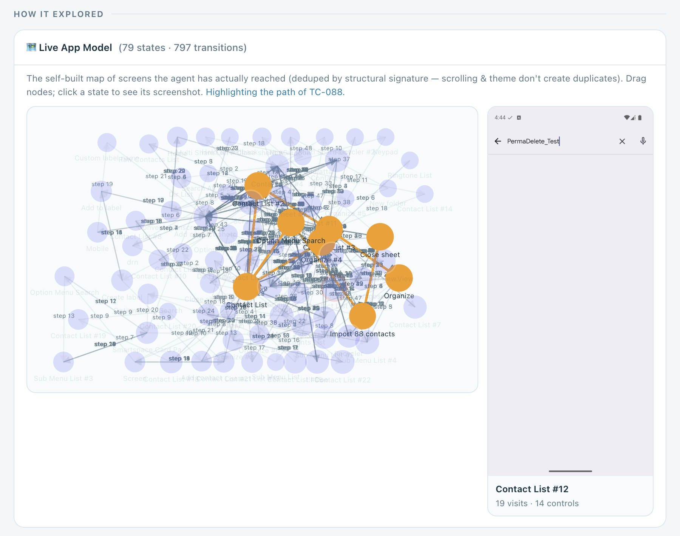
EXECUTOR · THE APP MAP
Every run's path through the map
79 screens · 797 transitions
The contacts app, mapped only from screens the agent actually reached.
Pick a run, see its path
In orange, the screens TC-088 visited, in order, read from that run's log.
Click a screen
Its stored screenshot, how often it was visited, and its controls.
Exploratory Testing Automation · CSE 450 · BUET
26
Notes:
About 35 seconds. This is the result of the screen matching on the previous slide, as it appears on our dashboard. Every circle is one distinct screen of the contacts app, 79 in all, joined by 797 recorded transitions. Nothing here came from documentation; it is only what the agent reached. Every execution stores the ordered list of screens it passed through, so we can pick any run and see exactly where it went: in orange, the path of TC-088, which imported a vCard of duplicates and then searched: from the contact list through Organize, the import screen and the close sheet, and back. Clicking a screen shows the screenshot we stored for it, here Contact List number 12, visited 19 times, with 14 controls. The same map is what the planner draws on when it looks up a screen or a route to one.

Slide 25
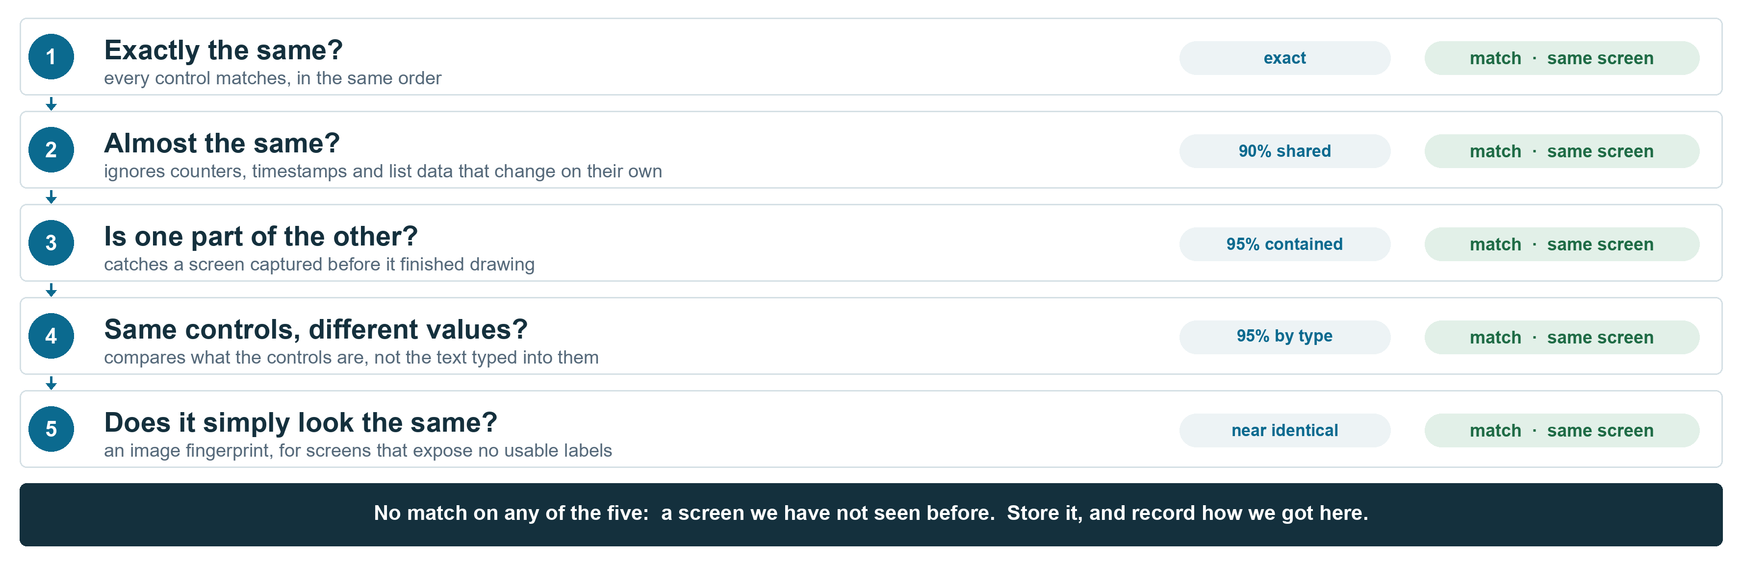
EXECUTOR · IN DETAIL
Is this a screen we have seen?
Exploratory Testing Automation · CSE 450 · BUET
25
Notes:
About 25 seconds; skip if short on time. The full screen-identity cascade, left to right. Each check exists because the previous one failed on a real case, and the grey notes say which. Structural similarity handles counters and timestamps. Containment handles a screen captured before it finished drawing, which similarity scores as different. Skeleton containment handles form fields, where typing changes the labels: one wizard once produced nine separate states. And the perceptual hash is the last resort for screens built with Compose, games or web views, whose accessibility tree says almost nothing.

Slide 26

WEB EXECUTOR · PLAYWRIGHT
The same planner, a browser instead of a device
A second executor behind the same contract. The planner does not know which one will run.
What it observes
What it can do
How it knows something broke
An accessibility style description of the DOM, not screenshots
role and name, the same vocabulary the Android executor uses
native HTML5 validation, including the browser's own message
a password is described, never echoed
click fill press select
goto back scroll wait finish
nine actions, each checked against the target's guardrails
CAPTCHA escalates to a person when visible, fails cleanly when headless
console errors
uncaught page errors
HTTP 4xx and 5xx responses
dialogs the page never showed
Those signals are collected independently of anything the agent claims, so a 5xx can override a claimed pass. On the live site this caught a real HTTP 500.
Exploratory Testing Automation · CSE 450 · BUET
27

Slide 27
WEB EXECUTOR · A REAL RUN
Testing Bangla text on a live survey platform
TC-001 on DataGhurhi. The same thought, action, outcome loop, over the DOM.
[1/80] dataghurhi.cse.buet.ac.bd
think: find a survey with a text question to test
Bangla Unicode input
act: {"action":"click","ref":"e9"}
-> clicked [e9] button "Test Project for Survey"
[4/80] /view-survey/601
act: {"action":"scroll","direction":"down"}
-> scrolled down page: 56 controls
[5/80] /view-survey/601
act: {"action":"select","ref":"e20","value":"Text"}
-> selected 'Text' in the question type dropdown
[7/80] /view-survey/601
act: {"action":"fill","ref":"e19","text":"আপনার নাম লিখুন"}
-> filled "Enter your question here"
Controls by reference, not pixels
Each observed control gets a stable reference the model addresses by name.
Non Latin text end to end
Bangla is typed, stored and read back, then checked character for character.
Bounded like the device runs
Up to 80 steps, with guards that end a run repeating a dead action or wandering.
5 targets · 2 platforms · 1 planner
Exploratory Testing Automation · CSE 450 · BUET
28

Slide 28
INVESTIGATOR
The investigator turns runs into knowledge
1
Reads the run
Group | Finding kinds | Used for
Defect | SUSPECTED_DEFECT, SPEC_VIOLATION | A human reviews it
Oracle | CONFIRMED_BEHAVIOUR, UNEXPECTED_BEHAVIOUR, SPEC_GAP, UNVERIFIED | Fed back to the planner
UI | CONTROL_DISCOVERED | Adds to the app map
Agent | AGENT_DIFFICULTY | Our own limits, never app evidence
Compares the device's step log with what the test was meant to verify.
2
Writes typed findings
Each is one atomic claim. A repeat observation reinforces an existing finding instead of creating a new one.
3
Settles open questions
A question one run raises is answered by a later run, or retired as inconclusive after three attempts.
Contacts app so far: 345 findings, including 36 suspected defects and 21 specification violations.
Exploratory Testing Automation · CSE 450 · BUET
25
Notes:
About 45 seconds. Before the investigator, nothing a run observed ever reached the next plan. Now it reads each trajectory against what the test intended and writes typed findings. Each finding is one claim, and repeats are merged, so the graph records how often something was seen rather than piling up duplicates. There are eight kinds in four groups. Defects go to a human. Oracle findings feed back to the planner, which is how the next test is better informed. And the agent's own difficulties are kept separate, because they say nothing about the app. Open questions have a lifecycle, so the agent reaches conclusions instead of asking the same thing forever.

Slide 29
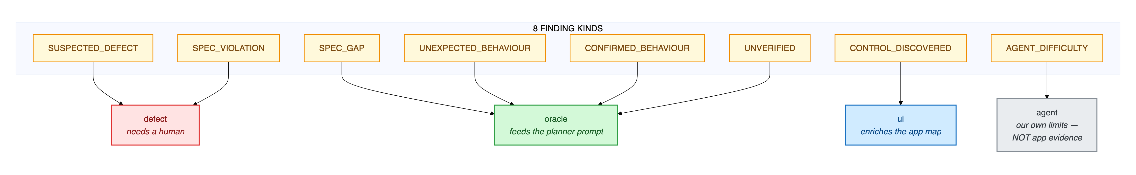
INVESTIGATOR · IN DETAIL
Eight kinds of finding, four destinations
Red: defect
Green: oracle
Blue: UI
Grey: agent
Suspected defects and spec violations go to a human.
What the app does, or leaves unclear, feeds the planner.
A newly found control enriches the app map.
Our own difficulties, never counted as app evidence.
Exploratory Testing Automation · CSE 450 · BUET
26
Notes:
About 25 seconds; skip if short on time. The eight finding kinds across the top, each routed to exactly one destination. Red is defects, which a human reviews. Green is the oracle group, which is what the planner reads back next round. Blue is new controls, which enrich the map. Grey is the agent's own difficulties, kept apart so they can never inflate the defect count.

Slide 30
INVESTIGATOR · DEDUPLICATION
Knowing a finding is the same finding
1 · Shown what is known
2 · Says what it confirms
3 · Embedding safety net
The model sees up to 12 known findings for the screens this run touched.
A confirmation reinforces the existing finding instead of adding a new one.
A new claim at 0.90 cosine or more to one in the same group is merged anyway.
Why the model decides, not similarity alone: a true restatement of one finding scored 0.846, while a genuinely different defect scored 0.853.
Clusters become one claim
Findings, not prose, keep input small
Three or more similar findings on one screen (0.72) can be merged into a general claim. On the contacts app, 5 general claims stand for 26 specific ones.
With prose reports the investigator's input grew from 28,344 to 97,796 characters over a campaign. With findings it shrank from 20,466 to 10,959.
Exploratory Testing Automation · CSE 450 · BUET
27
Notes:
About 45 seconds. The hard question is how the system knows it has seen something before, when every run is described by a model in different words. We first tried embedding similarity alone, and measured that it cannot work: a true restatement of a finding scored 0.846, while a genuinely different defect scored higher, 0.853. So the model decides. It is shown the known findings for the screens it touched and states which ones this run confirms; a confirmation reinforces the existing finding. Similarity is kept only as a safety net at 0.90. Similar findings on one screen can also be collapsed into one general claim. And storing findings rather than prose reports reversed the growth of the investigator's input: under prose it grew to almost 98,000 characters over a campaign; with findings it shrinks as the campaign goes on.

Slide 31




INVESTIGATOR · OPEN QUESTIONS
From observations to conclusions
Resolved
Open
Attempted
the run settled it, confirmed or refuted
a run raised a question it could not settle
a later test declares it addresses it
Inconclusive
retired after 3 attempts, instead of asked forever
not settled, fewer than 3 attempts
8
115
Open questions become the planner's missions
The planner reserves room for open questions, so older ones are not crowded out by new ones. Its test declares which question it addresses, and the investigator records the answer.
settled by a later run
still open
Contacts app. The loop works; most questions need longer campaigns.
Exploratory Testing Automation · CSE 450 · BUET
28
Notes:
About 40 seconds. A finding that poses a question, such as "does this field really accept anything?", stays open until a later run settles it. The planner treats open questions as missions: it reserves room for them so old ones are not forgotten, and its test declares which question it is addressing. If the run settles it, it is resolved, confirmed or refuted. If three attempts fail to settle it, it is retired as inconclusive rather than asked forever. This is how the agent reaches conclusions instead of re-testing the same doubt. To be honest about scale: on the contacts app, 8 questions have been settled by a later run and 115 are still open, mostly unverified observations. The mechanism works end to end; it needs longer campaigns to pay off fully.

Slide 32
FAULT ATTRIBUTION
Not every failure is the app's fault
App fault
Agent fault
Environment
The agent reached its checkpoint and the app misbehaved. These are the findings.
Our executor could not drive the app. Says nothing about its quality.
A precondition was missing, or the step budget ran out before any evidence.
ASSERTION_FAILURE · CRASH · APP_UNRESPONSIVE
NAVIGATION_FAILURE · ELEMENT_NOT_FOUND · TIMEOUT · NAVIGATION_LIVELOCK
PRECONDITION_NOT_MET · PERMISSION_DENIED · STEP_LIMIT_EXCEEDED
11
32
2
6
12
10
commerce
contacts
commerce
contacts
commerce
contacts
Only the first column counts as defects: 11 of 25 failures on the commerce app, 32 of 48 on the contacts app.
Exploratory Testing Automation · CSE 450 · BUET
29
Notes:
About 45 seconds. This slide answers the question you will be asked about the pass rate. When a test fails, we record why, and classify it three ways. An app fault means the agent reached its checkpoint and the app really did the wrong thing: that is a finding. An agent fault means our executor could not drive the app, which says nothing about the app. An environment fault means a precondition was missing or the step budget ran out before any evidence. On the commerce app only 11 of 25 failures were about the app. Reporting the raw failure rate would have more than doubled the apparent defect count. None of the research systems we reviewed makes this distinction.

Slide 33
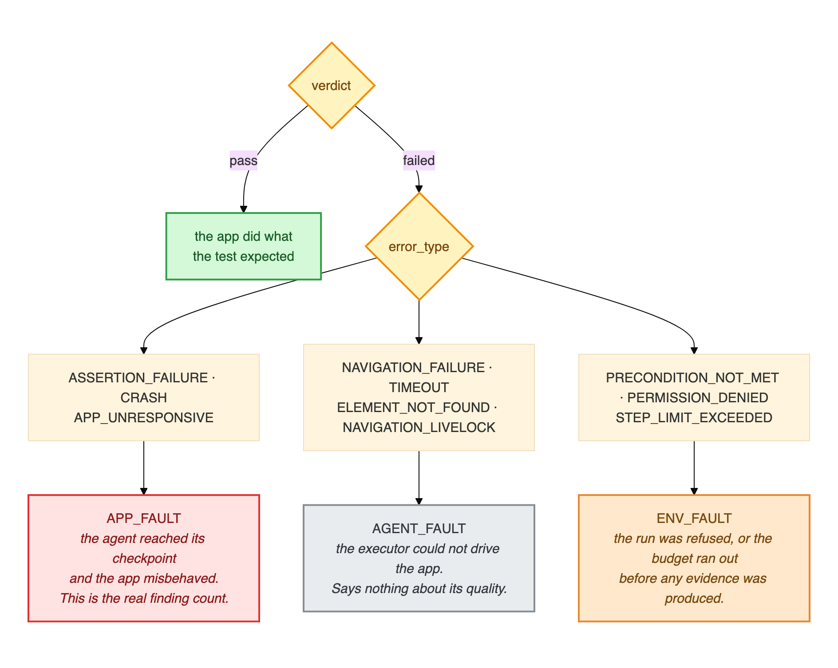
FAULT ATTRIBUTION · IN DETAIL
Every error type, and where it goes
How to read it
Green: pass, the app did what the test expected
Red: app fault, the real finding count
Grey: agent fault, our executor could not drive the app
Orange: environment fault, refused or out of budget before any evidence
The taxonomy has a single definition in the code, so the dashboard, the reports and these slides all count the same way.
Exploratory Testing Automation · CSE 450 · BUET
30
Notes:
About 25 seconds; skip if short on time. The full tree behind the previous slide. A pass needs no classification. A failure is routed by its error type into exactly one of three classes: red is an app fault, and only these count as findings; grey is our executor failing to drive the app; orange is the environment, including running out of step budget before any evidence was produced. There is one definition of this mapping in the code, so every number in this deck is counted the same way.

Slide 34
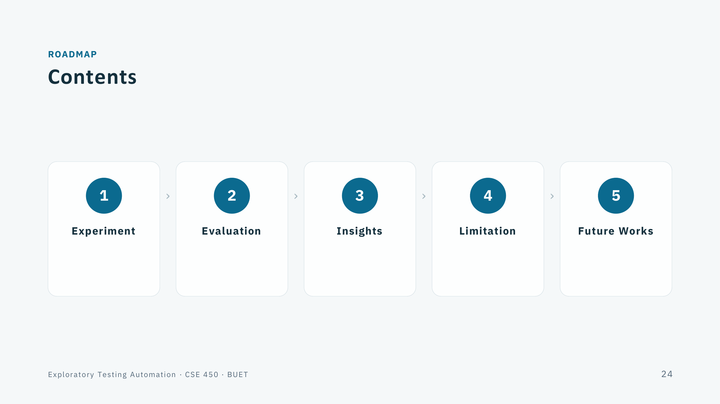

Slide 35
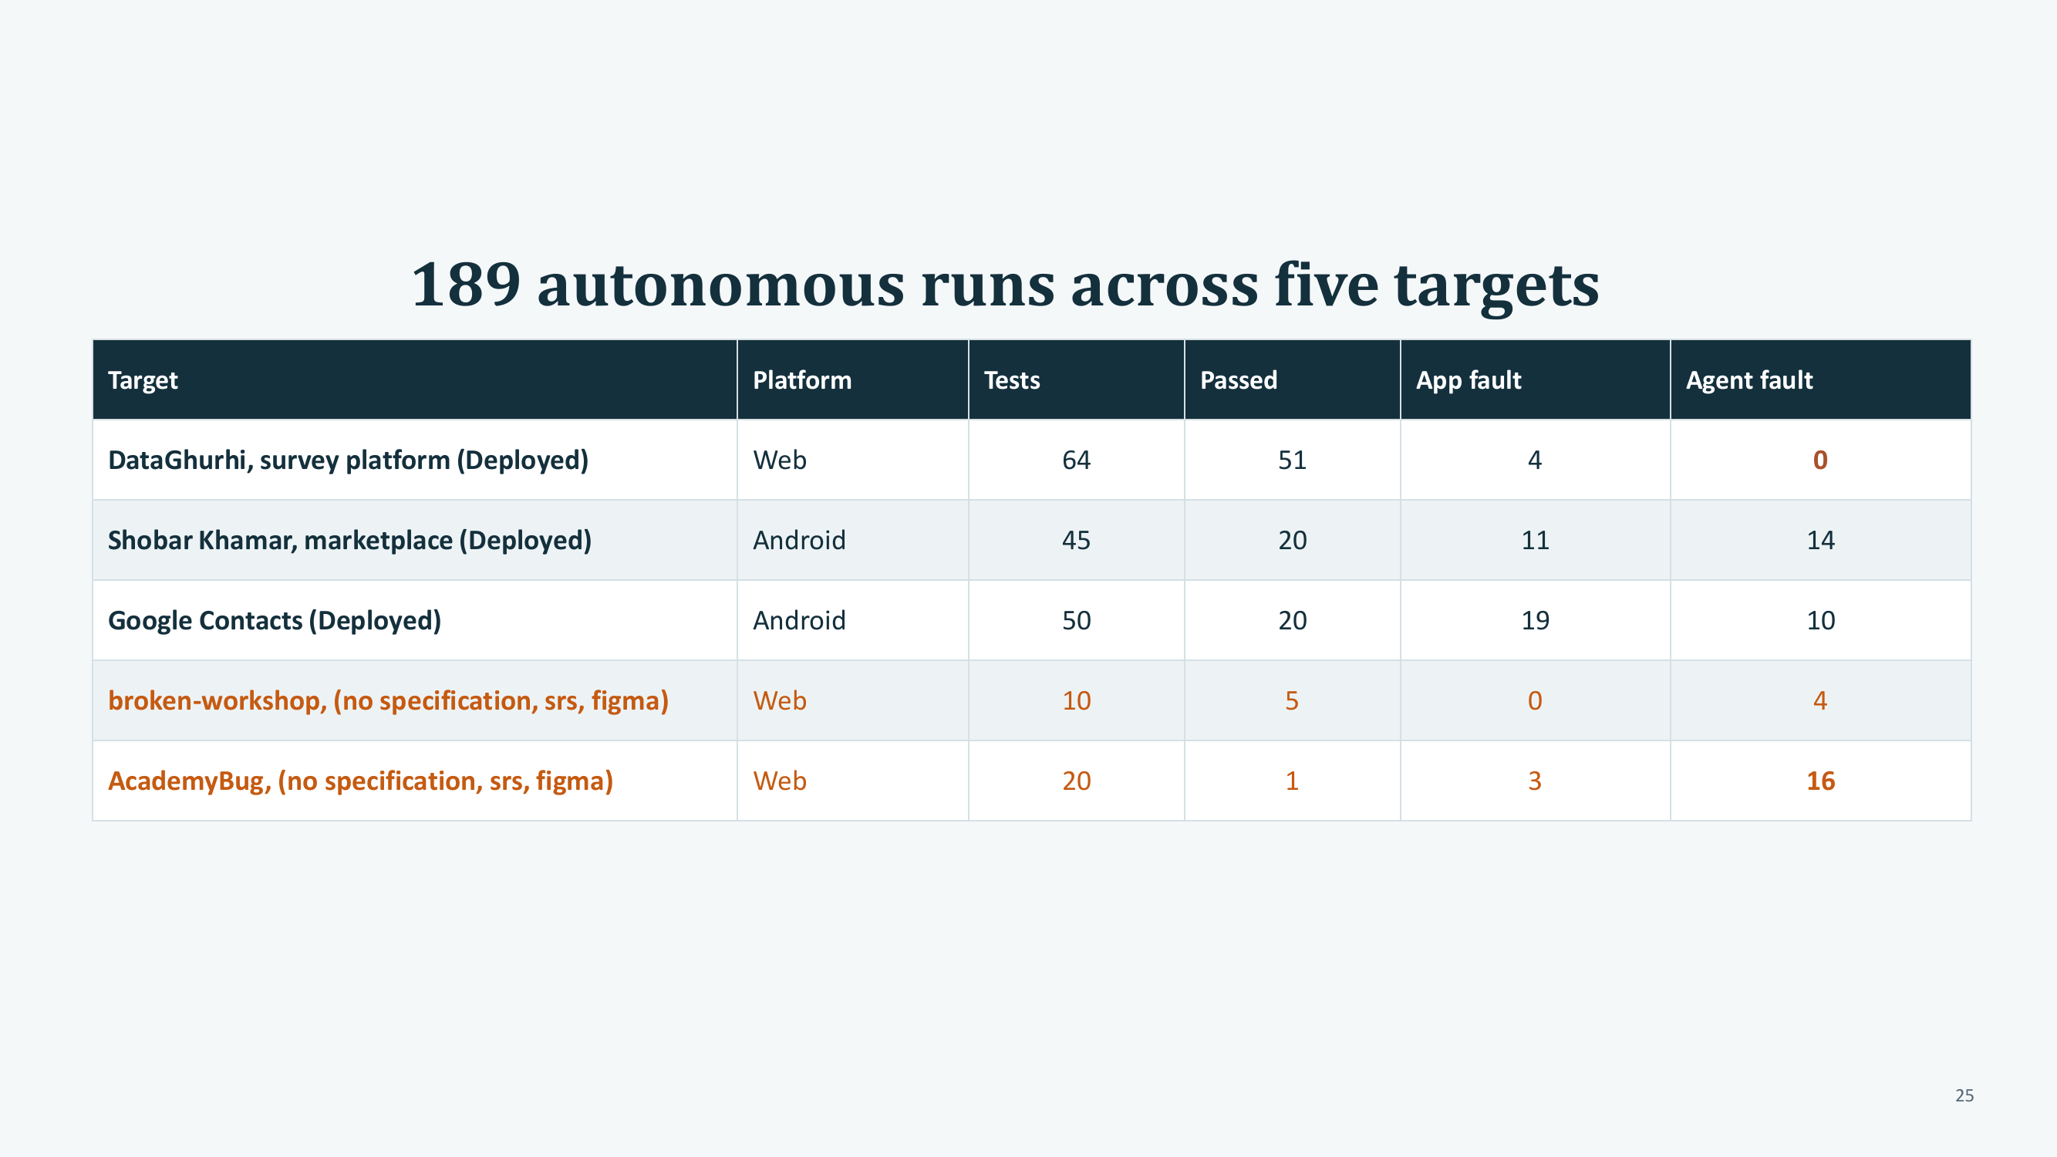

Slide 36
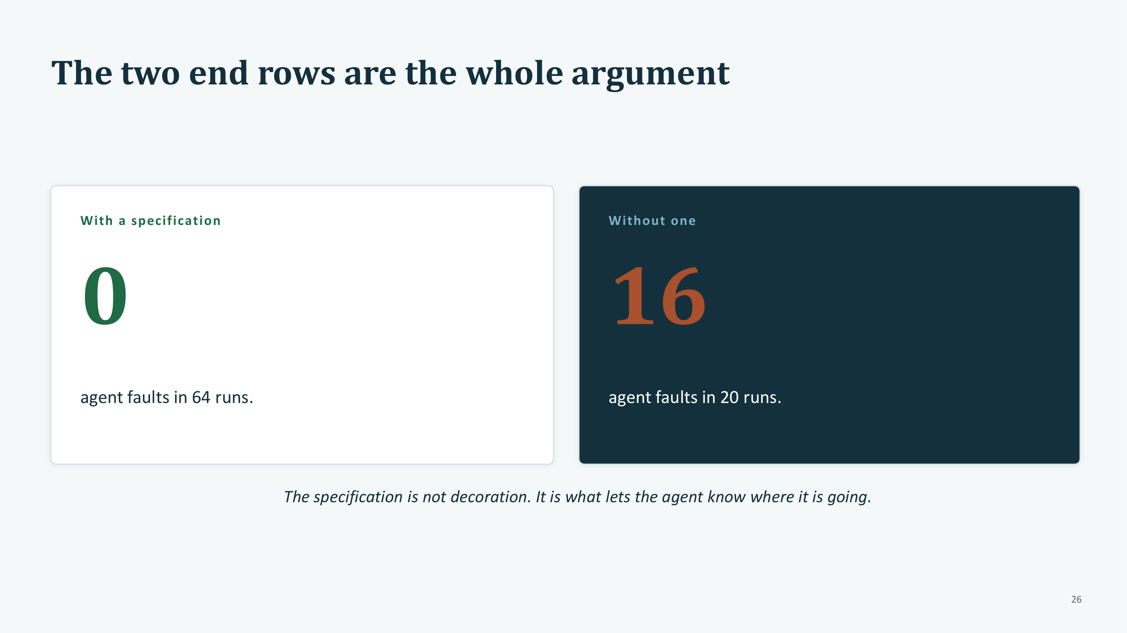

Slide 37


Slide 38
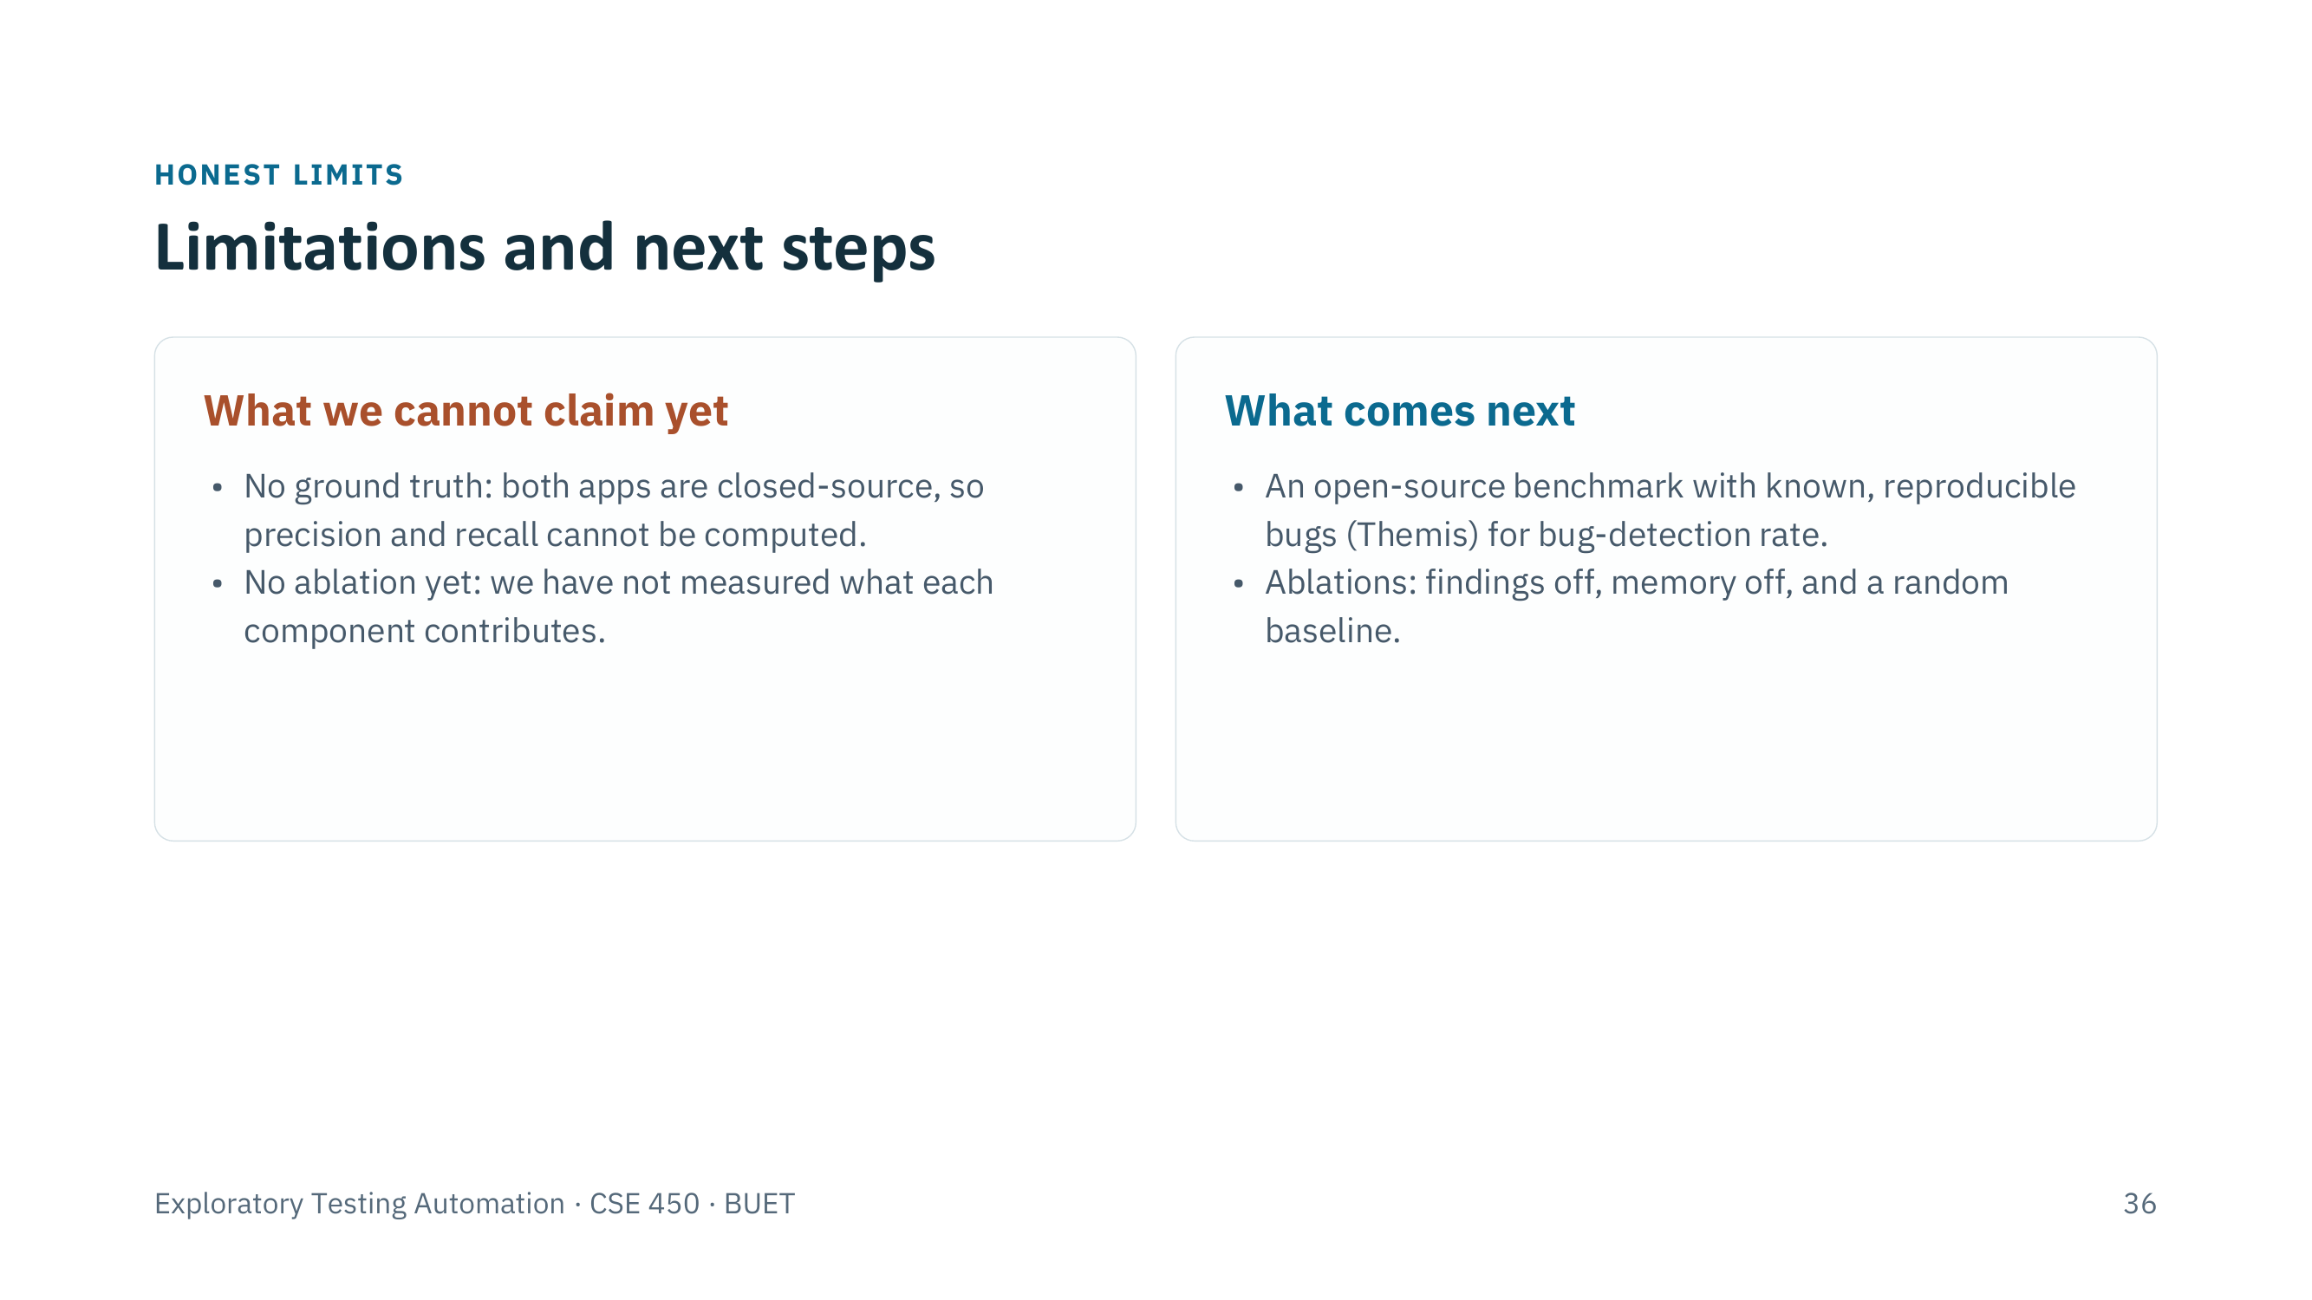

Slide 39


