Slide 1
PLANNER · WHAT IT KNOWS
What the planner knows before it writes a test
Specification
Screens seen
Navigation paths
Every requirement as a node, retrieved by meaning and by keyword.
The live map of the app: 79 screens and 797 transitions on the contacts app.
Learned routes to each screen, and the routes known to fail.
Findings
Coverage
Defect history
What earlier runs confirmed, contradicted or left open.
Which requirements and feature areas are still untested.
Past bug reports, when a project has them.
Bounded context, so long campaigns stay cheap
The block summarising earlier runs was 35,233 characters, 69% of one prompt. Stored as findings instead of prose, it is now about 2,000.
Exploratory Testing Automation · CSE 450 · BUET
10
Notes:
About 40 seconds. [Opening, after the intro] Thank you. I'll take you inside the first of the three agents, the planner. Its job is to choose the single most useful test to run next. It cannot see the phone, so everything it knows, it reads from the graph. There are six kinds of knowledge: the specification, split into individual requirements; the screens we have actually seen, 79 on the contacts app; learned routes to each screen; findings from earlier runs; coverage, meaning what is still untested; and past bug reports when a project has them. All of it is capped, so the prompt does not grow as a campaign goes on. The summary of earlier runs used to be 35,000 characters, 69 percent of a prompt; stored as findings, it is about 2,000. [Transition] So where does all of this live?

Slide 2
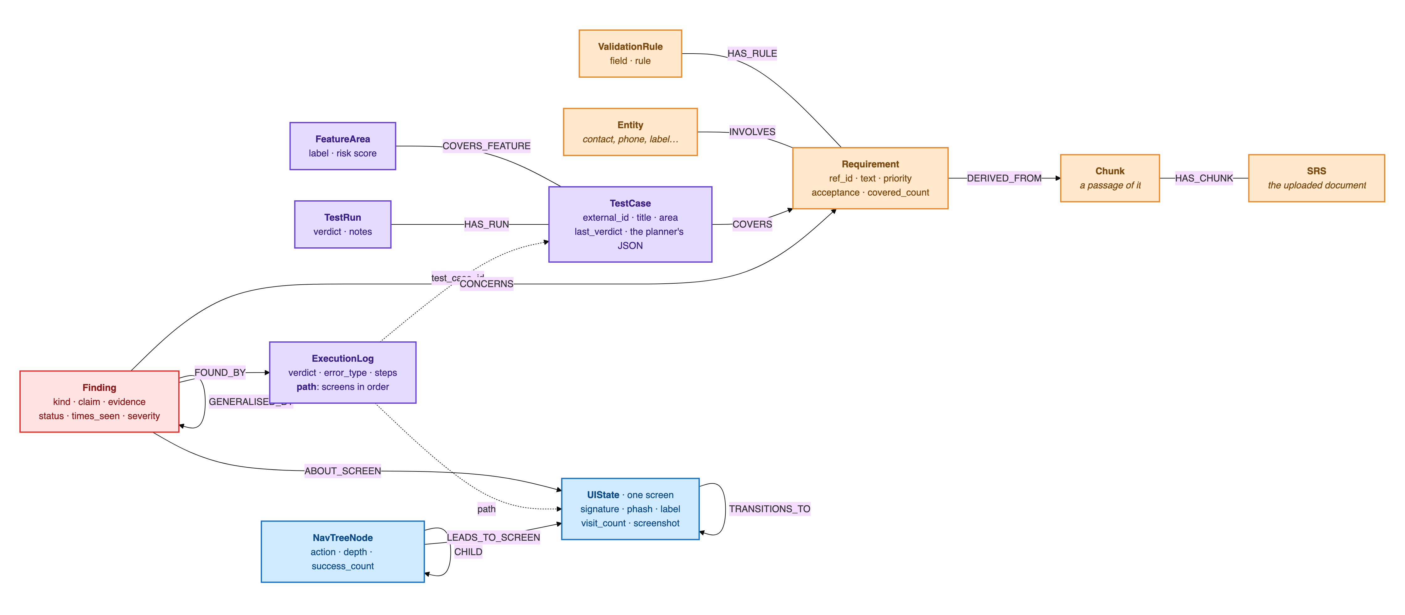
PLANNER · WHERE IT ALL LIVES
What the knowledge graph stores
Orange: from the specification · Purple: tests and runs · Blue: the app model · Red: findings · Dashed: stored as a property, not a relationship. Every node belongs to one project.
Exploratory Testing Automation · CSE 450 · BUET
11
Notes:
About 40 seconds. In one Neo4j graph. Orange is the specification: each requirement is traced to the passage of the document it came from. Purple is testing: test cases, the requirements they cover, and a log for every run, including the ordered path of screens it went through. Blue is the app map the executor builds: one node per distinct screen, and the transitions between them. Red is findings, each tied to the run that found it, the screen it is about and the requirement it concerns. Every agent reads and writes this one structure, and nothing else survives between calls. [Transition] The planner reads this graph in one of two modes. The first is a fixed pipeline.

Slide 3

PLANNER · PIPELINE MODE · A LANGGRAPH STATE MACHINE
The planner asks what it still needs
bootstrap_context
planner_step
generate_testcase
duplicate_check
loads coverage, tests and findings
model: “what do I still need?”
writes the test as structured JSON
rejects near-duplicates by title and meaning
execute_retrieval
runs its tools: spec, screens, paths, defects
no model call
repeats until ready · 2 rounds in our campaigns
1 large model call
+1 call if rejected
Its tools: four sources it can look things up in
When it stops looking
Each round the model picks up to three lookups: search the specification, pull up a screen already seen, find a path to a screen, or check past defects there.
When the model says it is ready, after 2 rounds, when the context passes 9,000 characters, or when a retrieval returns nothing new.
Exploratory Testing Automation · CSE 450 · BUET
12
Notes:
About 40 seconds. The pipeline is a LangGraph state machine. It first loads what is known, with no model call. Then a small model call asks: what do I still need? The model can pick up to three lookups: search the specification, pull up a screen it has seen, find a route to a screen, or check past defects there. Those run, the answers come back, and it asks again, for at most two rounds. Then one large call writes the test, and a duplicate check compares it with every earlier test, by wording and by meaning. This mode planned the contacts campaign. [Transition] Here is the same pipeline in full.

Slide 4






PLANNER · IN DETAIL
The full planning pipeline
bootstrap_context
planner_step
should_continue?
generate_testcase
1 · loads coverage, tests and findings · no model call
2 · small model call: “what do I still need?” Picks up to 3 lookups.
3 · write when ready, after 2 rounds, or nothing new
4 · large model call · writes the test as JSON
answers
retrieve more
execute_retrieval · the planner's tools
no model call · srs: search the spec · live_ui: a screen already seen · navtree: a route to it · defects: past failures there
6 · Auto-log to Neo4j
One more model call
too similar
duplicate_check
stored as planned, then handed to the executor
rewrite with other screens; similar titles blocked
5 · wording and meaning against every earlier test
distinct
Exploratory Testing Automation · CSE 450 · BUET
13
Notes:
About 30 seconds; skip if short of time. Read it by colour, and follow the numbers. Red boxes are model calls: only two are guaranteed per test, the small planner_step and the large generate_testcase. Blue is the planner's tools, the lookups it asked for. Green is plain graph work, and amber are decisions. The loop between steps 2 and 3 is the planner deciding whether it knows enough. The retry at the bottom only fires when a draft is too similar to an earlier test, and every test is stored as planned before the executor ever sees it. The weakness is in that loop: the model lists its lookups up front and gets them back as a batch, so one answer cannot shape the next question. [Transition] That is what the second mode fixes.

Slide 5
PLANNER · TOOLS MODE · PLANNED THE COMMERCE CAMPAIGN
Tools philosophy: the model asks the graph itself
It calls one tool, reads the answer, then chooses the next question. Nine read-only tools, each offered only when its source has data.
Tool | What it answers | Offered when
search_requirements | semantic and keyword search over the specification | a spec is ingested
list_untested_requirements | the coverage frontier: what no executed test covers yet | a spec is ingested
get_screen | the real controls observed on one screen | screens have been seen
list_screens | every screen actually seen, with visit counts | screens have been seen
get_nav_path | a route to a screen the executor has already walked | a route exists
findings_summary | counts of everything earlier runs found, per screen and kind | always
list_findings | the claims themselves: confirmed, suspected, unverified | always
list_open_questions | questions earlier runs raised but never settled | always
get_coverage | tests run, failing hot spots, dead ends, exhausted areas | always
Exploratory Testing Automation · CSE 450 · BUET
14
Notes:
About 40 seconds. In tools mode, the model calls the graph itself. It calls one tool, reads the answer, and decides what to ask next, so each question can depend on the last result. It has nine read-only tools: two for what the specification says should exist, three for what the app actually has, three for what earlier runs established, and one for coverage. The right-hand column is the safety rule: a tool is offered only when its source has data. On a brand-new app with no screens yet, get_screen does not exist for the model, so an empty answer can never mislead it. This mode planned the 45-test commerce campaign. [Transition] Here is what one planning round actually looked like.

Slide 6
PLANNER · TOOLS MODE · ONE ROUND
One round: investigate, then propose
Given
Starts from a short brief
Every proposal is validated
coverage map, last few runs, open questions
Rejected if it:
Calls 1–3
Orient: what is known, and where the gaps are
names a screen never observed
cites a requirement id that does not exist
repeats an earlier test
needs a precondition the tester cannot create
falls outside the agreed scope
findings_summary, get_coverage, list_screens
Call 4
Pick up an unfinished thread
list_open_questions, list_findings
The model is told why and retries, up to 3 times.
Call 5 on
Ground it in a real requirement and screen
search_requirements, get_screen
Turn 7 on
Forced to commit
the tool choice is pinned to propose_test_case
Measured over 62 rounds on the commerce app: the most common tool at each position, a median of 13 calls per round, 989 calls for 101 proposals. Left free, the first live run investigated for ten turns and never proposed.
Exploratory Testing Automation · CSE 450 · BUET
15
Notes:
About 45 seconds. We measured this from 62 real planning rounds on the commerce app. It starts from a short brief: the coverage map, the last few runs and the open questions. Nothing in the code fixes the order after that; the model chose it. It orients first, with a summary of the findings, the coverage state and the list of screens. Then it picks up an unfinished thread, usually an open question from an earlier run. Only then does it ground the test in a real requirement and a real screen. That is about 13 calls a round. After six free turns it is forced to propose, because on our first live run it investigated for ten turns and never wrote a test. And every proposal must pass the gate on the right: a screen we have really seen, requirement ids that exist, not a repeat, and no precondition the tester cannot create. If it fails, the model is told why and tries again, up to three times. [Transition] Whichever mode runs, it also has to decide where to test next without going in circles.

Slide 7
PLANNER · WHERE TO GO NEXT
Where to test next, without repeating itself
Steered to the gaps
A cap on every area
No near-duplicates
A coverage map and an exploration directive point it at untested requirements and feature areas.
After 5 tests an area is marked spent and is no longer promoted, whatever its results.
Each new title is compared with every earlier test, by word overlap (0.60) and by meaning (0.90 cosine).
Why the cap was needed
In one 13-round campaign, 9 tests landed on the same screen: a failing area kept being promoted, and nothing ever retired it. The intuitive fix, stopping once an area yields nothing new, would never have fired, because the ninth test was still producing technically new findings.
Exploratory Testing Automation · CSE 450 · BUET
16
Notes:
About 40 seconds. Three mechanisms steer it. A coverage map points it at untested requirements and feature areas. A cap retires an area after five tests, whatever happened in them. And a duplicate check runs against every earlier test. The cap came from a real failure: in one campaign, 9 of 13 tests landed on the same screen, because a failing area kept being promoted. The obvious fix, stopping when an area stops yielding new findings, would never have fired, because the ninth test was still producing technically new ones. [Transition] So after all of this, what does the planner actually hand over?

Slide 8
PLANNER · THE OUTPUT CONTRACT
What the planner actually emits
A test case in plain language, never a tap sequence. Both planner modes emit the same fields.
title
objective
expected_result
preconditions[]
screen_hint
area · priority · test_type
requirement_ids[]
rationale
addresses
TC-003 · commerce app · tools mode
objective
“Verify that clearing the farm name field to empty and attempting to save produces a visible error identifying the farm name as required.”
requirement_ids
addresses
FR-FARM-04
F-422162fd
Requirement ids make requirement coverage reportable. addresses names the open question this test settles: an earlier run suspected farm names were never validated.
Exploratory Testing Automation · CSE 450 · BUET
17
Notes:
About 30 seconds. A test case in plain language, never a sequence of taps; the executor works those out on the device. Both modes emit exactly these fields, so the executor does not care which planner ran. Two fields do the most work. requirement_ids are what let us report requirement coverage at all. And addresses links the test to the open question it settles. Here, TC-003 from the commerce app: an earlier run suspected farm names were never validated, so the planner aimed a test at exactly that, citing FR-FARM-04. [Transition] Let me finish with one test followed all the way through.

Slide 9
PLANNER · ONE REAL TEST
One real test, from plan to finding
TC-018 · written by the planner
EXECUTOR
Verify duplicate detection triggers for a phone number match when the display name is intentionally different
48 steps. Created and saved the contact, then found both entries in the list.
Field | What the planner wrote (condensed)
Requirements | FR-DUP-02, FR-DUP-04
Why this test | Earlier runs saw silent duplicates but left phone-only detection unverified. A different name isolates FR-DUP-02 from the name rule.
Objective | Create a contact with a new name but an existing contact’s phone number.
Expected | A duplicate dialog shows both records (FR-DUP-04), instead of a silent save.
INVESTIGATOR
Objective refuted · spec violation, high severity
ITS VERDICT
“This directly answers the earlier open question: duplicate detection is not triggered by phone-number match alone.”
Exploratory Testing Automation · CSE 450 · BUET
18
Notes:
About 45 seconds. TC-018, from the contacts campaign. Earlier runs had seen duplicate contacts saved silently, but whether a matching phone number alone triggers detection was still unverified. The planner picked that up and gave the new contact a completely different name, so that only the phone number matched. That isolates one requirement, FR-DUP-02. The executor saved the contact and found both entries side by side in the list: no duplicate dialog. The investigator marked the objective refuted, a high-severity spec violation, and in its words this directly answers the earlier open question. Nobody told the agent to look at duplicates; it chose this from the specification and from what earlier runs had left open. If asked about the 48 steps: the evidence is in the first 15, and the rest went to a search box that did not respond, which the investigator's summary says itself. [Handover] That run was driven on a real phone by the executor, which [next presenter] will now explain.

