Slide 1

CSE 450 CAPSTONE PROJECT · DEPARTMENT OF CSE, BUET
Exploratory Testing Automation
An autonomous agent that decides what to test, runs it on a real Android device, and learns from every run.
TEAM
SUPERVISOR
INDUSTRY PARTNER
Mohammad Raihan Rashid · 2105046
Mehemud Azad · 2105014
Jonayed Mohiuddin Shanto · 2105060
Khalid Hasan Tuhin · 2105002
Niloy Kumar Mondal · 2105044
Dr. A. B. M. Alim Al Islam
Professor, Department of CSE, BUET
Samsung R&D Institute Bangladesh
Notes:
About 20 seconds. Introduce the project and the team. One sentence on what it is: an agent that plans its own tests, runs them on a real Android device and learns from every run. Mention the industry partner, because slide 4 quotes their brief.

Slide 2
THE PROBLEM
Why exploratory testing is hard to automate
Manual exploratory testing
Scripted automation
Random (Monkey) testing
Finds real bugs, because a person knows what correct looks like.
Repeatable, and cheap to run again.
Explores at scale, with no setup.
But it only checks what its author thought to check. It confirms; it does not discover.
But it has no idea what correct looks like. It can report a crash, not a wrong result.
But it does not scale, and the knowledge leaves with the tester.
“An automated tool can tell you an application crashed. It cannot tell you it quietly charged the wrong price, because it has no idea what the right price was.”
Exploratory Testing Automation · CSE 450 · BUET
2
Notes:
About 45 seconds. Three ways to test an app, and why none is enough. Manual exploratory testing finds real bugs but does not scale. Scripts only check what someone already expected. Random testing scales but has no notion of correct behaviour, so the only bug it can report is a crash. The quote at the bottom is the whole problem: without knowing what the app should do, a tool cannot tell a wrong result from a right one.

Slide 3
RELATED WORK
What existing research agents miss
Capability | Research agents today | Our system
Reads the requirements specification | No, so no oracle beyond a crash | Yes: every requirement becomes a queryable node
Remembers across runs | Only within one session | A persistent knowledge graph
Separates its own failures from app defects | No | Three-way fault attribution
Chooses its own test objectives | 5 of 7 are handed a task | Yes, and each test cites a requirement
From our review of seven LLM-based GUI testing systems, among them GPTDroid, DroidAgent and AutoDroid.
Exploratory Testing Automation · CSE 450 · BUET
3
Notes:
About 45 seconds. Recent research uses language models to drive Android apps. We read seven of these systems closely. None of them reads a specification, so a crash is the only thing they can call a bug. Their memory does not survive the session. None separates the agent failing from the app failing, which inflates their defect counts. And five of the seven are handed their task rather than choosing it. Our system is built on exactly these four gaps.

Slide 4
THE PARTNER'S BRIEF · SAMSUNG R&D INSTITUTE BANGLADESH
“Every execution cycle must make the agent smarter than the last.”
Our answer: three stateless AI agents that never talk to each other. Everything they learn goes into one shared knowledge graph, and every new test is planned from it.
Notes:
About 20 seconds. This is the requirement that shaped the whole design. The partner asked for an agent that improves with every run. Our answer has two parts. First, three separate agents, each with one job. Second, none of them keeps any memory of its own: every call starts fresh. So the only way the system can improve is that the shared knowledge graph grows. That makes the learning inspectable, because you can look at exactly what was learned.

Slide 5



ARCHITECTURE
Three agents, one shared memory
Knowledge graph · Neo4j
requirements · observed screens · test cases · execution history · findings
reads
writes screens seen
writes findings
Planner
test case
Executor
trajectory
Investigator
decides what to test next and writes the test case
drives the real app on an Android device
decides what each run actually proved
Stateless: no conversation history. Every call is rebuilt from the graph.
qwen3.7-flash plans and drives; glm-5.3-flash evaluates. All via OpenRouter.
Android device
app under test · on-device portal
Exploratory Testing Automation · CSE 450 · BUET
5
Notes:
About 50 seconds. The architecture is three agents around one knowledge graph. The planner reads the graph and writes one test case. The executor runs it on a real Android device through mobilerun, and records every screen it sees. The investigator reads the step-by-step trajectory and writes findings back. They hand each other a test case and a trajectory, but none of them remembers anything between calls. Everything durable lives in the graph: the requirements from the specification, the screens observed, every test and its result, and the findings. The next slide shows the same architecture with every component named.

Slide 6
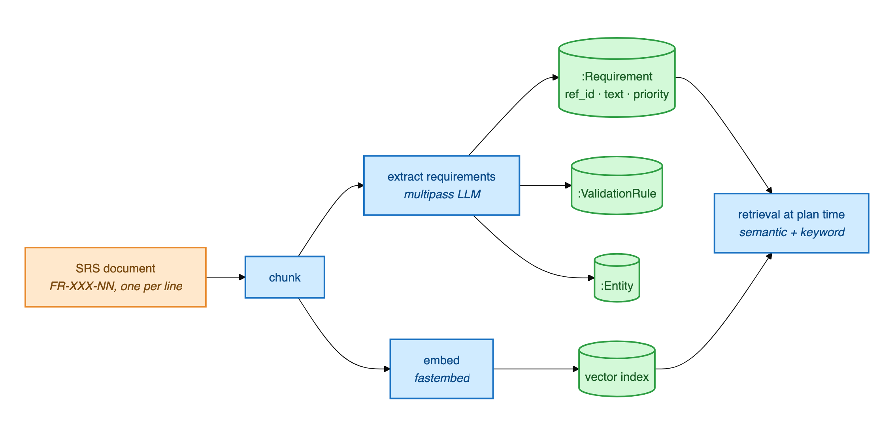
INGESTION
A document becomes queryable requirements
Prose in. Individually identified, traceable requirements out.
Each requirement carries
id · type · priority
actor · action
constraints
acceptance
feature area
plus validation rules and the domain entities they act on
All three documents are optional. A target with none of them still runs.
Each requirement links back to the exact chunk of text it came from, which is what makes requirement coverage reportable.
Exploratory Testing Automation · CSE 450 · BUET
6

Slide 7

ARCHITECTURE · IN DETAIL
Every component, and how they connect
Exploratory Testing Automation · CSE 450 · BUET
7
Notes:
About 30 seconds. The same architecture with every component named. Walk it by colour. Amber is what a person supplies: the specification, an optional design export and defect history. Green is the knowledge: the Neo4j graph and the vector index. Blue is the two services: the RAG API on port 9010, which owns the graph, and the agent gateway on 9100, which hosts the planner and the investigator. Purple is the three agents. Red is the model provider, which every agent calls. Grey is the device, reached over adb through the on-device portal.

Slide 8


HOW A TEST RUNS
One round: plan, run, interpret, remember
1
2
3
4
Plan
Run
Interpret
Remember
about 1 minute
5 to 15 minutes
about 20 seconds
end of every round
Reads what is known, then writes one test case.
Drives the real app, about 20 s per step, at most 50 steps.
Reads the step log against the goal and writes findings.
Findings, screens and coverage go into the graph.
the next round starts from the larger graph
Every model call is stateless. The agent improves only because the graph grew.
Exploratory Testing Automation · CSE 450 · BUET
8
Notes:
About 40 seconds. One test is one round of four steps. The planner takes about a minute to decide and write the test. The executor then drives the real app, and this is the long part: every step is a vision model call of about 20 seconds, with a budget of 50 steps. The investigator reads the result in about 20 seconds. Everything it learned is written to the graph, and the next round is planned from that larger graph. A campaign is simply this loop repeated. The timings are measured from our own campaigns.

Slide 9
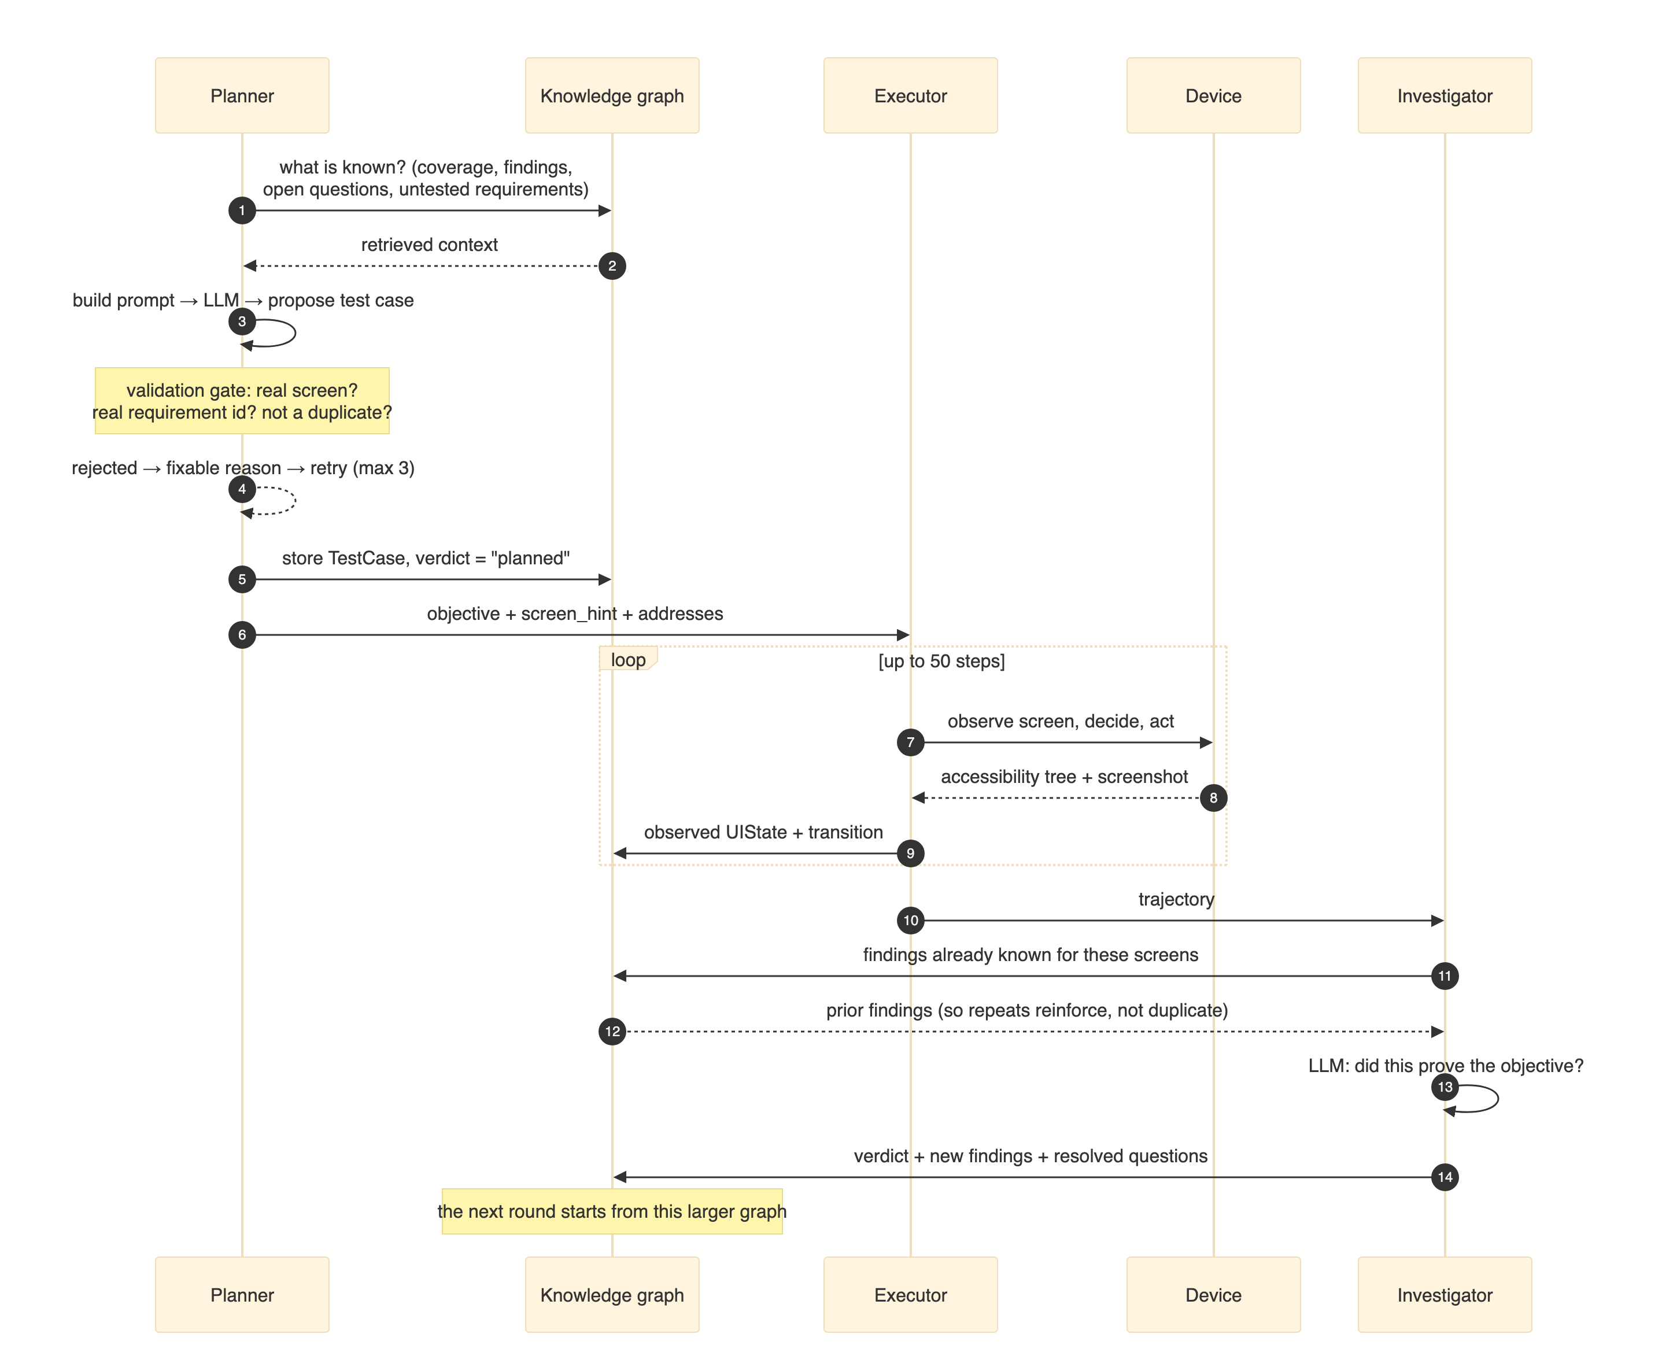
HOW A TEST RUNS · IN DETAIL
The fourteen messages of one round
1–5 · Planner
proposes and stores the test
6–9 · Executor
runs it, posting every screen
10–14 · Investigator
judges it, writes findings
Only the graph carries over.
Exploratory Testing Automation · CSE 450 · BUET
9
Notes:
About 30 seconds; skip if short on time. The full sequence of one round, message by message. Steps 1 to 5 are the planner: it asks the graph what is known, proposes a test, and stores it before the executor sees it. Steps 6 to 9 are the executor looping on the device, and on every step it posts the screen back to the graph. Steps 10 to 14 are the investigator: note step 11, where it first fetches what is already known about those screens, which is what lets a repeat observation reinforce an existing finding instead of creating a duplicate.

Slide 10
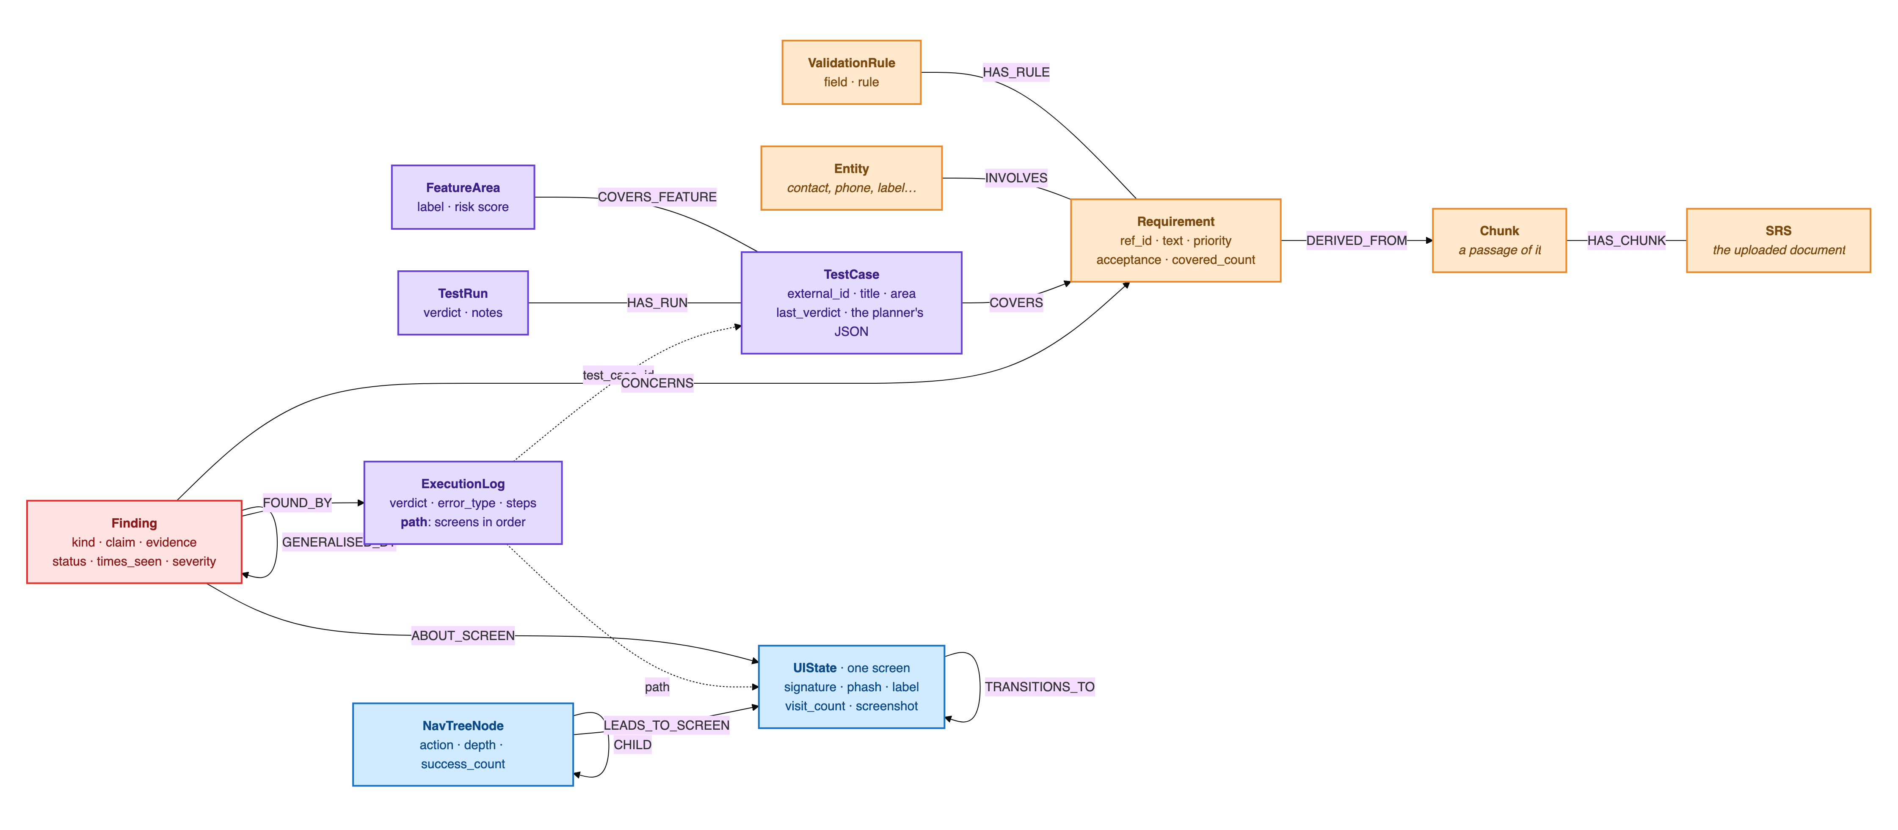
ARCHITECTURE · THE SHARED MEMORY
What the knowledge graph stores
Orange: from the specification · Purple: tests and runs · Blue: the app model · Red: findings · Dashed: stored as a property, not a relationship. Every node belongs to one project.
Exploratory Testing Automation · CSE 450 · BUET
10
Notes:
About 40 seconds. This is how the shared memory is organised, taken from the live Neo4j database. Orange is the specification: the document is split into passages, each requirement is traced to the passage it came from, with its validation rules and the entities it involves. Purple is testing: a test case covers requirements and a feature area, and every execution leaves a log with its verdict, its error type and the ordered path of screens it went through. Blue is the app model the executor builds: one node per distinct screen, with the transitions between them and learned navigation routes. Red is findings, written by the investigator: each one points to the run that found it, the screen it is about and the requirement it concerns, and related findings are grouped under a more general one. The point to make: every agent reads and writes this one structure, and nothing else survives between calls. Every node is scoped to a project, so two apps never mix.

Slide 11
MODELS
Which model does what, and why
Role | Model | Why this choice
Planner | qwen/qwen3.7-flash | Long context and dependable structured output matter more than deep reasoning. About 8% of a test's cost.
Executor (Android) | qwen/qwen3.7-flash, with vision | Reads the accessibility tree and a screenshot on every step, so it is about 92% of a test's cost.
Investigator and rate-limit fallback | z-ai/glm-5.3-flash | A different model family, so no model grades its own execution. Low reasoning effort cut an evaluation from 113.8 s to 22.7 s.
Specification extraction | qwen/qwen3-235b-a22b | Run once per document, and every later decision rests on it, so accuracy is worth paying for here.
Embeddings | BAAI/bge-small-en-v1.5 | Runs locally through fastembed, with no per-call charge.
All routed through OpenRouter. Every campaign in this deck ran on the planner, executor and investigator above; the planner is next moving to deepseek-v4-flash.
Exploratory Testing Automation · CSE 450 · BUET
11
Notes:
About 45 seconds. Each role has its own model, chosen for what that role needs. The planner needs long context and output that parses reliably, not deep reasoning, so a fast tier is right, and it is only about 8 percent of the cost. The executor has to see: it reads the accessibility tree and a screenshot on every step, which makes it about 92 percent of the cost. The investigator is deliberately a different model family, so no model is grading its own work, and setting its reasoning effort to low cut an evaluation from almost two minutes to 23 seconds. Specification extraction runs once per document but everything depends on it, so that is the one place we pay for a large model. Embeddings run locally for free. The history, briefly: we started on a free tier to prove the loop worked, tried self-hosting through a tunnel and dropped it, then moved each role down a tier once we had measured that quality held.

