Slide 1
INVESTIGATOR
The investigator turns runs into knowledge
1
Reads the run
Group | Finding kinds | Used for
Defect | SUSPECTED_DEFECT, SPEC_VIOLATION | A human reviews it
Oracle | CONFIRMED_BEHAVIOUR, UNEXPECTED_BEHAVIOUR, SPEC_GAP, UNVERIFIED | Fed back to the planner
UI | CONTROL_DISCOVERED | Adds to the app map
Agent | AGENT_DIFFICULTY | Our own limits, never app evidence
Compares the device's step log with what the test was meant to verify.
2
Writes typed findings
Each is one atomic claim. A repeat observation reinforces an existing finding instead of creating a new one.
3
Settles open questions
A question one run raises is answered by a later run, or retired as inconclusive after three attempts.
Contacts app so far: 345 findings, including 36 suspected defects and 21 specification violations.
Exploratory Testing Automation · CSE 450 · BUET
25
Notes:
About 45 seconds. Before the investigator, nothing a run observed ever reached the next plan. Now it reads each trajectory against what the test intended and writes typed findings. Each finding is one claim, and repeats are merged, so the graph records how often something was seen rather than piling up duplicates. There are eight kinds in four groups. Defects go to a human. Oracle findings feed back to the planner, which is how the next test is better informed. And the agent's own difficulties are kept separate, because they say nothing about the app. Open questions have a lifecycle, so the agent reaches conclusions instead of asking the same thing forever.

Slide 2
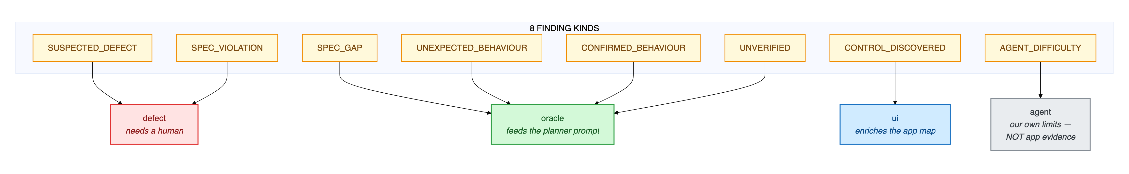
INVESTIGATOR · IN DETAIL
Eight kinds of finding, four destinations
Red: defect
Green: oracle
Blue: UI
Grey: agent
Suspected defects and spec violations go to a human.
What the app does, or leaves unclear, feeds the planner.
A newly found control enriches the app map.
Our own difficulties, never counted as app evidence.
Exploratory Testing Automation · CSE 450 · BUET
26
Notes:
About 25 seconds; skip if short on time. The eight finding kinds across the top, each routed to exactly one destination. Red is defects, which a human reviews. Green is the oracle group, which is what the planner reads back next round. Blue is new controls, which enrich the map. Grey is the agent's own difficulties, kept apart so they can never inflate the defect count.

Slide 3
INVESTIGATOR · DEDUPLICATION
Knowing a finding is the same finding
1 · Shown what is known
2 · Says what it confirms
3 · Embedding safety net
The model sees up to 12 known findings for the screens this run touched.
A confirmation reinforces the existing finding instead of adding a new one.
A new claim at 0.90 cosine or more to one in the same group is merged anyway.
Why the model decides, not similarity alone: a true restatement of one finding scored 0.846, while a genuinely different defect scored 0.853.
Clusters become one claim
Findings, not prose, keep input small
Three or more similar findings on one screen (0.72) can be merged into a general claim. On the contacts app, 5 general claims stand for 26 specific ones.
With prose reports the investigator's input grew from 28,344 to 97,796 characters over a campaign. With findings it shrank from 20,466 to 10,959.
Exploratory Testing Automation · CSE 450 · BUET
27
Notes:
About 45 seconds. The hard question is how the system knows it has seen something before, when every run is described by a model in different words. We first tried embedding similarity alone, and measured that it cannot work: a true restatement of a finding scored 0.846, while a genuinely different defect scored higher, 0.853. So the model decides. It is shown the known findings for the screens it touched and states which ones this run confirms; a confirmation reinforces the existing finding. Similarity is kept only as a safety net at 0.90. Similar findings on one screen can also be collapsed into one general claim. And storing findings rather than prose reports reversed the growth of the investigator's input: under prose it grew to almost 98,000 characters over a campaign; with findings it shrinks as the campaign goes on.

Slide 4


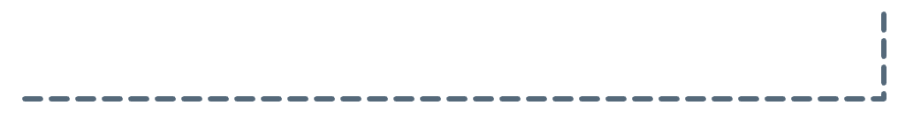

INVESTIGATOR · OPEN QUESTIONS
From observations to conclusions
Resolved
Open
Attempted
the run settled it, confirmed or refuted
a run raised a question it could not settle
a later test declares it addresses it
Inconclusive
retired after 3 attempts, instead of asked forever
not settled, fewer than 3 attempts
8
115
Open questions become the planner's missions
The planner reserves room for open questions, so older ones are not crowded out by new ones. Its test declares which question it addresses, and the investigator records the answer.
settled by a later run
still open
Contacts app. The loop works; most questions need longer campaigns.
Exploratory Testing Automation · CSE 450 · BUET
28
Notes:
About 40 seconds. A finding that poses a question, such as "does this field really accept anything?", stays open until a later run settles it. The planner treats open questions as missions: it reserves room for them so old ones are not forgotten, and its test declares which question it is addressing. If the run settles it, it is resolved, confirmed or refuted. If three attempts fail to settle it, it is retired as inconclusive rather than asked forever. This is how the agent reaches conclusions instead of re-testing the same doubt. To be honest about scale: on the contacts app, 8 questions have been settled by a later run and 115 are still open, mostly unverified observations. The mechanism works end to end; it needs longer campaigns to pay off fully.

Slide 5
FAULT ATTRIBUTION
Not every failure is the app's fault
App fault
Agent fault
Environment
The agent reached its checkpoint and the app misbehaved. These are the findings.
Our executor could not drive the app. Says nothing about its quality.
A precondition was missing, or the step budget ran out before any evidence.
ASSERTION_FAILURE · CRASH · APP_UNRESPONSIVE
NAVIGATION_FAILURE · ELEMENT_NOT_FOUND · TIMEOUT · NAVIGATION_LIVELOCK
PRECONDITION_NOT_MET · PERMISSION_DENIED · STEP_LIMIT_EXCEEDED
11
32
2
6
12
10
commerce
contacts
commerce
contacts
commerce
contacts
Only the first column counts as defects: 11 of 25 failures on the commerce app, 32 of 48 on the contacts app.
Exploratory Testing Automation · CSE 450 · BUET
29
Notes:
About 45 seconds. This slide answers the question you will be asked about the pass rate. When a test fails, we record why, and classify it three ways. An app fault means the agent reached its checkpoint and the app really did the wrong thing: that is a finding. An agent fault means our executor could not drive the app, which says nothing about the app. An environment fault means a precondition was missing or the step budget ran out before any evidence. On the commerce app only 11 of 25 failures were about the app. Reporting the raw failure rate would have more than doubled the apparent defect count. None of the research systems we reviewed makes this distinction.

Slide 6
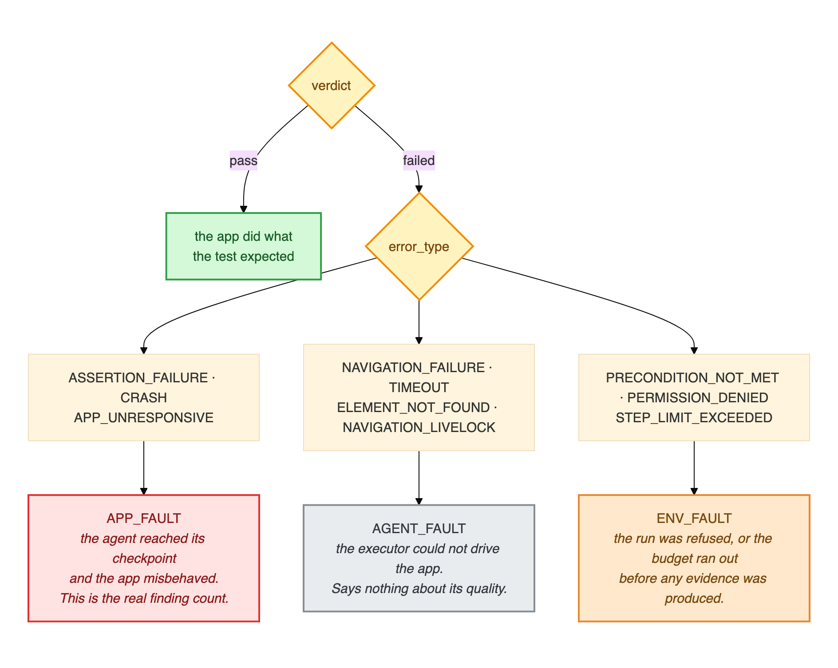
FAULT ATTRIBUTION · IN DETAIL
Every error type, and where it goes
How to read it
Green: pass, the app did what the test expected
Red: app fault, the real finding count
Grey: agent fault, our executor could not drive the app
Orange: environment fault, refused or out of budget before any evidence
The taxonomy has a single definition in the code, so the dashboard, the reports and these slides all count the same way.
Exploratory Testing Automation · CSE 450 · BUET
30
Notes:
About 25 seconds; skip if short on time. The full tree behind the previous slide. A pass needs no classification. A failure is routed by its error type into exactly one of three classes: red is an app fault, and only these count as findings; grey is our executor failing to drive the app; orange is the environment, including running out of step budget before any evidence was produced. There is one definition of this mapping in the code, so every number in this deck is counted the same way.

