Slide 1
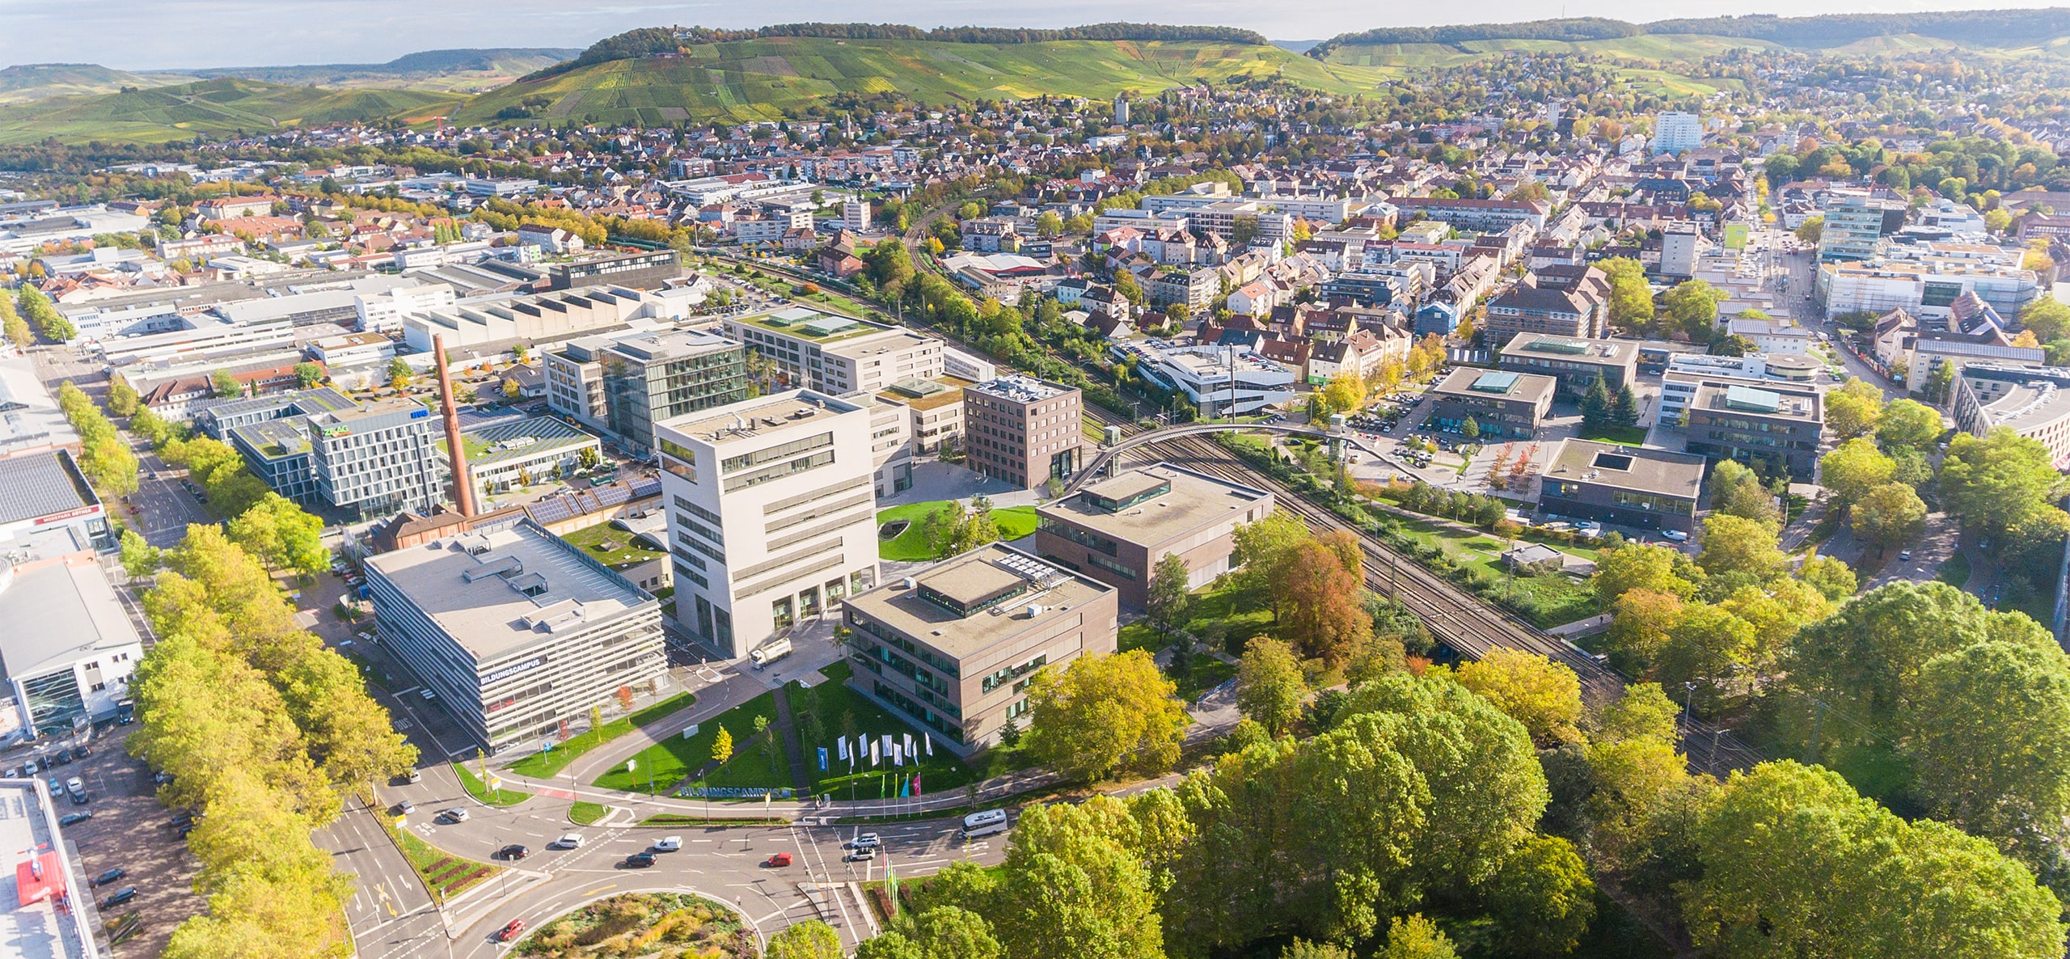
IAA LCV Hackathon 2026
Bring-Your-Own-Device
External devices. Useful vehicle applications.
digital.auto and prototype.club
Chris Cheng, Ferdinand-Steinbeis-Institut
Notes:
Source: project README.md and original Presentation.pptx. Opening: digital.auto and prototype.club invite teams to develop BYOD solutions for lightweight commercial vehicles. A camera is the first reference device.

Slide 2
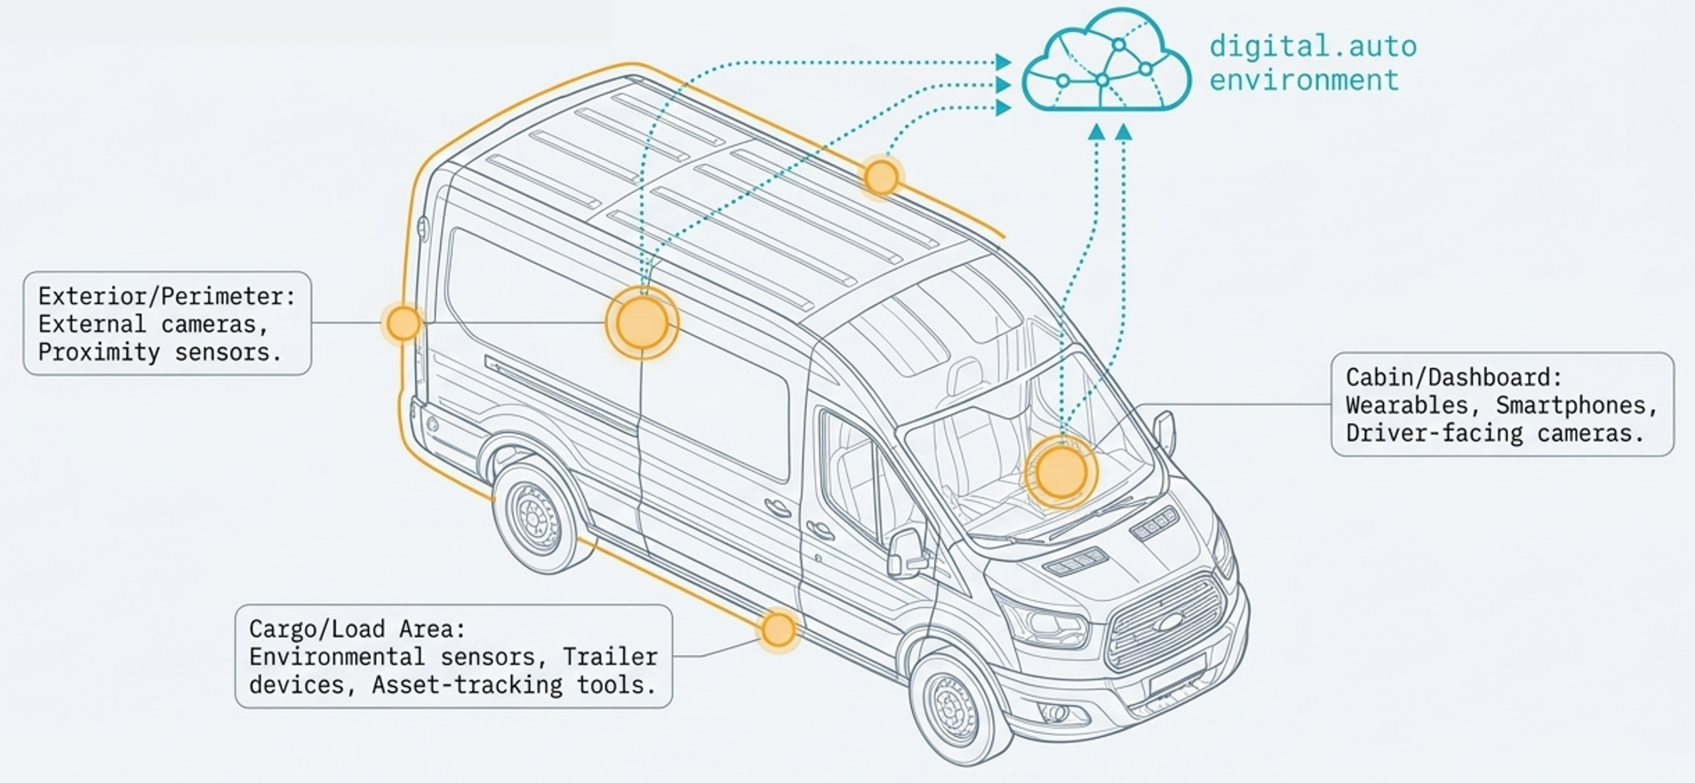
The job extends beyond the vehicle
A contractor’s tools. A sensitive load. Live cargo
Useful information often comes from outside the built-in vehicle systems.
Notes:
Source: project README.md and original Presentation.pptx.

Slide 3
BYOD in a commercial vehicle
External hardware connects with a software-defined commercial vehicle.
External devices
Application logic
Vehicle / Interface
Camera
Phone / Wearable
Tool / Sensor
Interpret the signal
Use the job context
Decide on a response
Make the result visible
Support the user’s task
The reference camera is a starting point for a broader ecosystem.
Notes:
Source: project README.md and original Presentation.pptx.

Slide 4
The challenge
Build a prototype that connects
an external device to a useful
commercial vehicle workflow.
USER
EVENT
RESPONSE
VALUE
Who needs help?
What should the device detect?
What should happen next?
Why does it matter?
Notes:
Source: project README.md and original Presentation.pptx. Explain the sequence: user, event, response, value.

Slide 5
Three starting points for your idea
Mobile workshop
Dangerous goods
Animal transport
Equipment and
operational security
Load conditions and
safety awareness
Live cargo and
transit conditions
Tool detection
Missing-item checks
Loading completeness
Gas-cylinder detection
Storage alerts
Safety-equipment checks
Behavior monitoring
Unusual movement
Position monitoring
Choose a user, an observable event and a useful response.
Notes:
Source: project README.md and original Presentation.pptx.

Slide 6
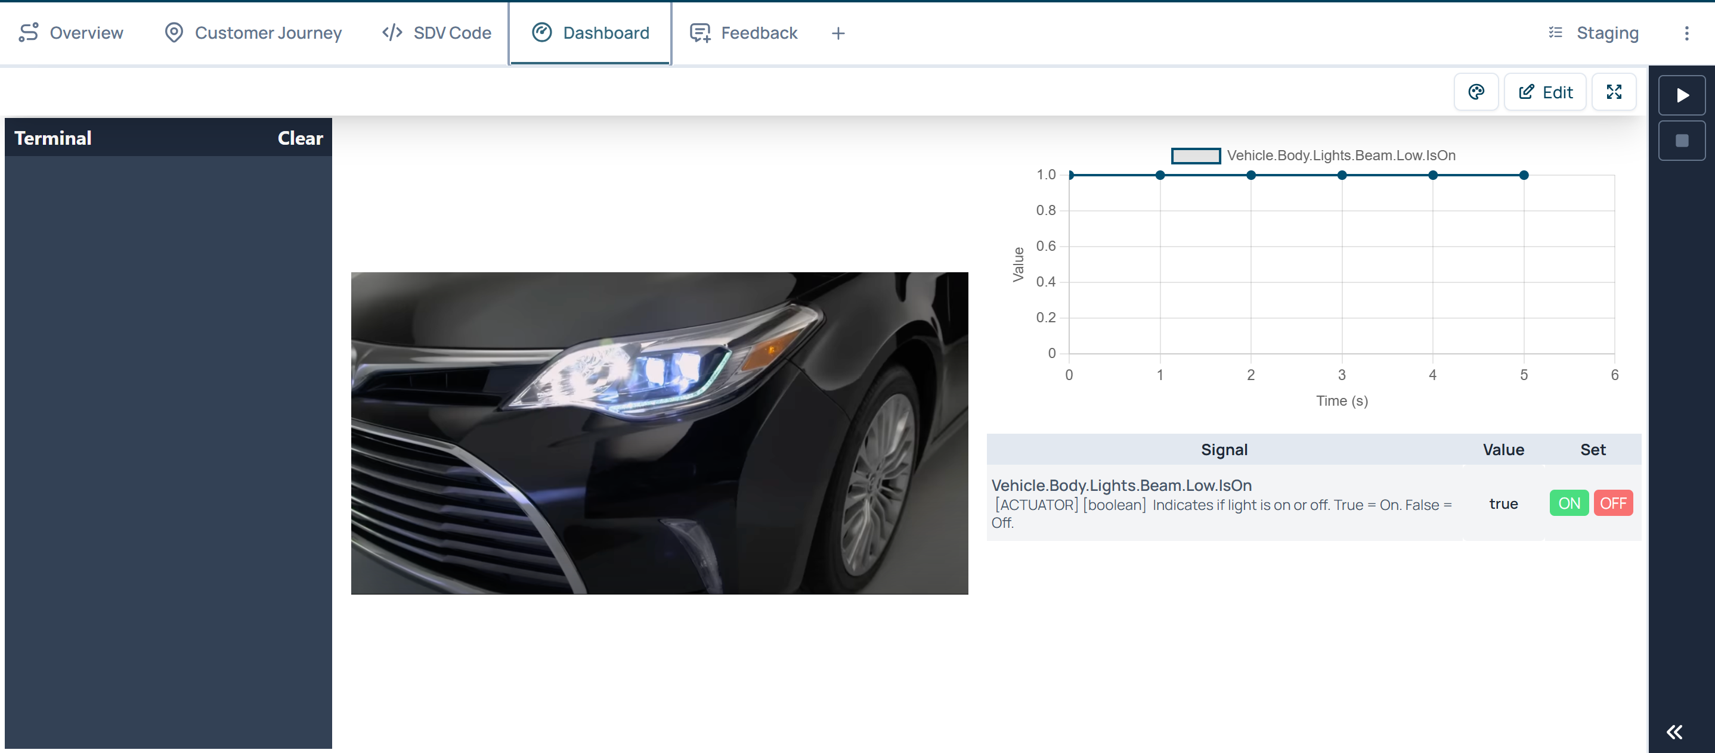
A complete device-to-vehicle loop
Technical reference: driver drowsiness
1 Camera input
Observe the driver.
2 Application logic
Detect a drowsiness event.
3 Vehicle response
Trigger headlights and horn.
4 Visible evidence
Inspect Dashboard values and logs.
Open the example prototype
Notes:
Source: project README.md and original Presentation.pptx. The driver-drowsiness application is a technical reference, not an additional challenge. Dashboard screenshot: Imgs/dashboard.png. Example code: https://playground.digital.auto/model/67d2eb3e880fe100272d033e/library/prototype/6a9684f804417b08156ceb7a/code

Slide 7
Your technical starting point
3
Extra sensors
reference cameras
Radar
Bosch gas sensor
PM sensor
Live feeds and dynamic snapshots
for computer-vision applications
Limited availability. Request from a mentor; teams handle setup.
Camera access: URLs are pending in the guide.
Ask a mentor before testing your connection.
Notes:
Source: project README.md and original Presentation.pptx. The source README lists three cameras, but stream and snapshot URLs remain placeholders. Do not imply endpoints have been validated. Optional sensors are limited and require teams to handle setup.

Slide 8
Building with digital.auto
Develop your application primarily in the Playground.
01
Choose the vehicle
02
Create your team project
IAA Hannover Hackathon 2026
Choose a multi-files template.
Use your team name.
03
Build in SDV Code
04
Configure your runtime
Manage source files and dependencies.
Get the assigned name from a mentor.
Select it before running your app.
playground.digital.auto
Setup screenshots: appendix, slides 13–14
Notes:
Source: project README.md and original Presentation.pptx. Use the exact model name in the README. Participants develop primarily on digital.auto Playground. Runtime names come from the supervisor.

Slide 9
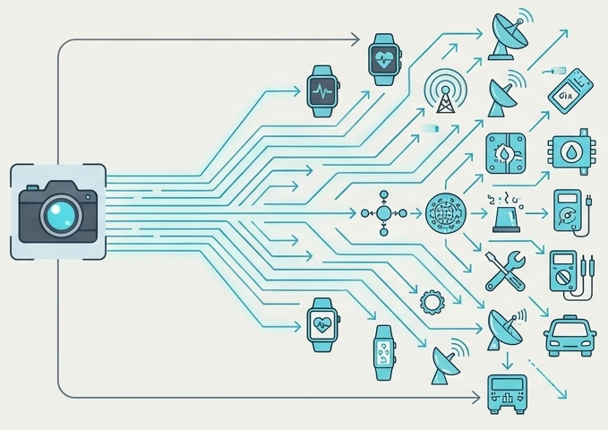
Beyond the reference camera
What other devices would
improve your application?
What vehicle data would they need?
How would discovery, onboarding,
and permissions work?
Show what works now. Explain the next integration.
Notes:
Source: project README.md and original Presentation.pptx. These are future BYOD design questions; do not imply discovery or permissions are implemented in the current platform.

Slide 10
What teams should bring back
Core outcome
Useful additions
Working prototype or proof of concept
Clear use-case description
Accessible source code
Short functional demo
Explanation of the BYOD integration
Architecture diagram
Additional device concepts
Future vehicle integration ideas
Platform feedback
To be confirmed by the organizers
Submission deadline and location, source-code format, pitch and demo duration.
Notes:
Source: project README.md and original Presentation.pptx. Organizers must confirm submission deadline, submission location, code format, pitch duration and demo duration before the event.

Slide 11
What makes a strong outcome
Indicative evaluation dimensions
Problem and value
Solution concept
Problem relevance
User value
Creativity
BYOD integration concept
Working implementation
Future integration
Technical implementation
Use of digital.auto
Demo quality
Scalability to additional devices
Final judging criteria and any weighting are to be confirmed.
Notes:
Source: project README.md and original Presentation.pptx. The README describes these as potential evaluation dimensions. Final rules and weights are not provided.

Slide 12
Start your prototype
Choose a challenge and create your team project.
Resources
Technical support
Hackathon guide and setup instructions
Chris Cheng
digital.auto Playground
Mohammed Raihan Soniwala
Example camera prototype
Ask a mentor for your Runtime name,
camera access and optional sensors.
digital.auto documentation
Select a resource or contact name to open its link.
Notes:
Source: project README.md and original Presentation.pptx. Repository URL derived from the local Git origin. Links are navigation resources, not confirmation of platform availability. Support contacts are from the README.

Slide 13
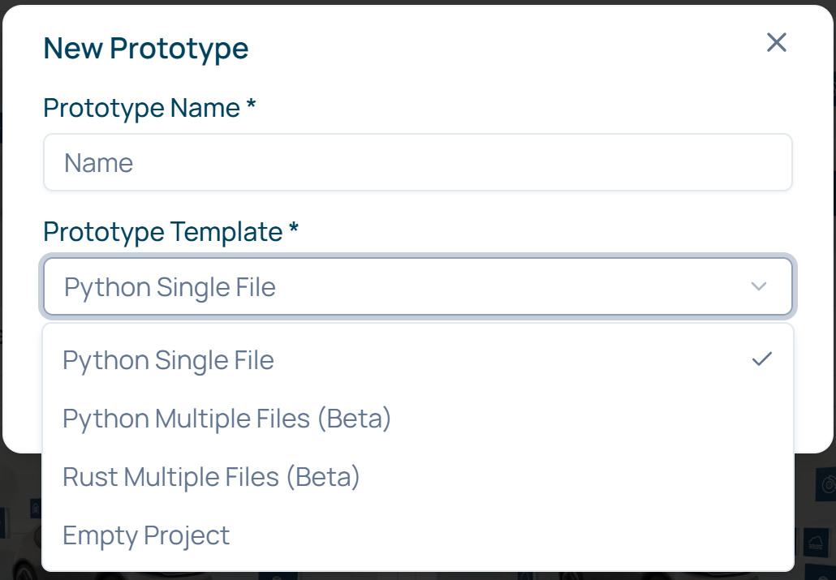
Appendix: create your team project
1 Select the hackathon vehicle
IAA Hannover Hackathon 2026
2 Name the prototype after your team
Choose Python Multiple Files (Beta)
for the Python reference workflow.
3 Open SDV Code
Manage your source and requirements files.
Example interface. Use the event vehicle and your own team name.
Notes:
Source: project README.md and original Presentation.pptx. Source screenshot: Imgs/prototype name.png, cropped to the New Prototype dialog. The screenshot opens with Python Single File selected. Choose Python Multi Files (Beta) from the visible dropdown for this Python reference workflow. Example names differ from the event assignment.

Slide 14
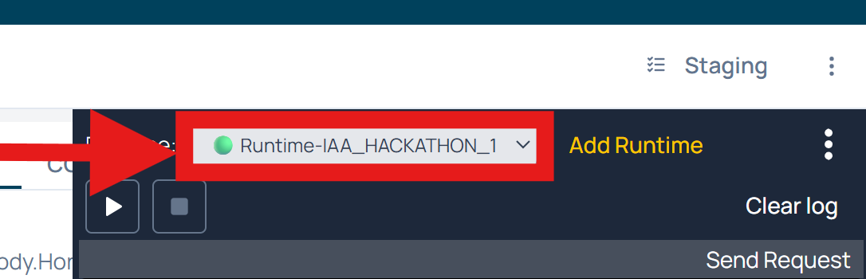
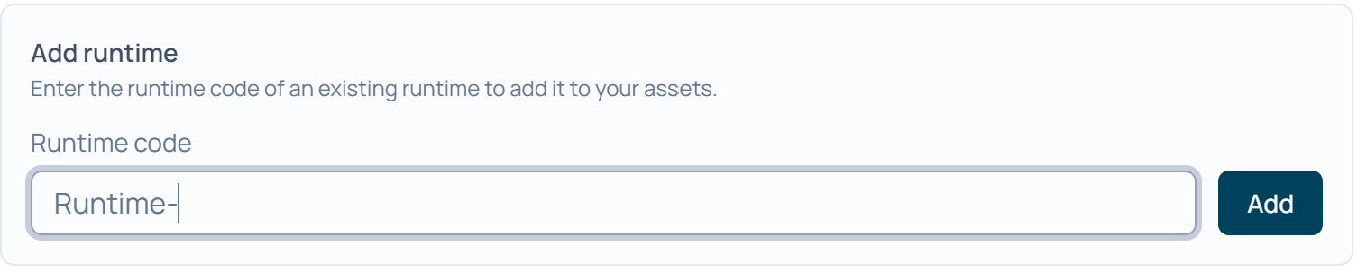
Appendix: connect your assigned runtime
1 Open Terminal, then Add Runtime
2 Enter the name supplied by a mentor
The Terminal toggle is at the bottom right.
Use the pre-filled Runtime- prefix once.
3 Select the runtime and run your app
Confirm the connection in Terminal, then inspect Dashboard values and logs.
Notes:
Source: project README.md and original Presentation.pptx. Sources: Imgs/runtime box.png and Imgs/runtime name.png, cropped to the controls. Ask the supervisor for the assigned runtime name. Do not add Runtime- twice.

