Slide 1
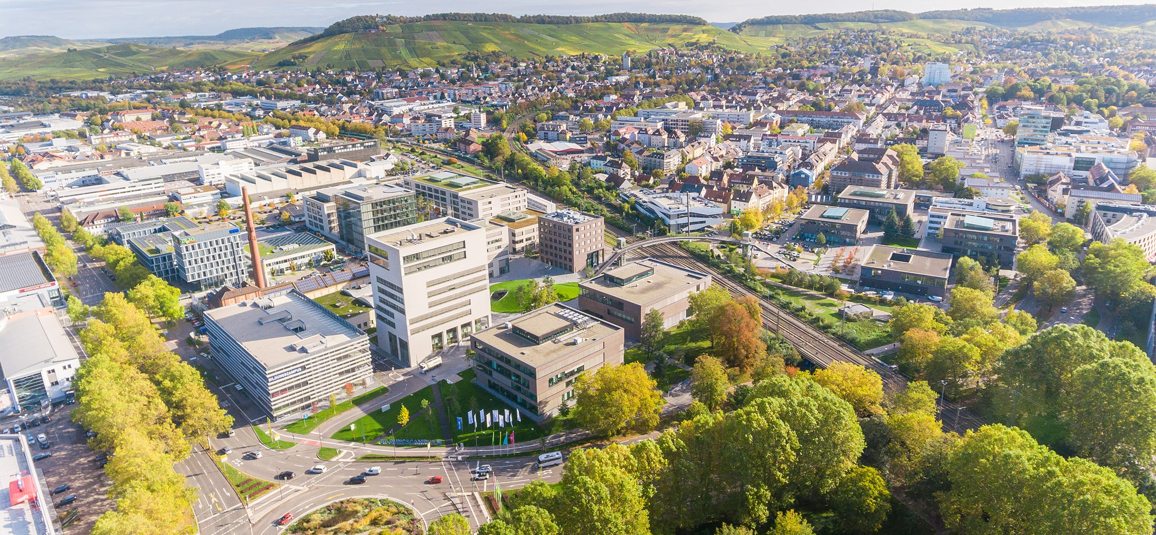
IAA LCV Hackathon
Bring-Your Own Device
External devices. Useful vehicle applications.
Chris Cheng – Ferdinand-Steinbeis-Institut
Notes:
Keyfacts Ferdinand Steinbeis Institut
Selbstverständnis: Wissenschaft/Forschung muss sowohl Gesellschaft und Wirtschaft einen Nutzen stiften (Real-World-Impact) als auch einen wissenschaftlichen Erkenntnisfortschritt bringen
Real-Welt-Phänomene sind interdisziplinär – verstehen, beschreiben und gestalten erfordert interdisziplinäres Team
Forschung mit Real-World-Impact erfordert Zusammenspiel von Kompetenzen des echten Lebens und der wissenschaftlichen Abstraktion
Erkenntisobjekt:
Zukunftsfähige Wertschöpfung
Beobachtungen:
- Globale Wettbewerb verändert sich von Leistungsangebot zu Leistungsbündeln (Ökosysteme)
- Verlagerung von Wertschöpfung aus der Realität in die Virtualität (Wertschöpfung i.S.v. Reduktion von Knappheiten)
Dualität Wissenschaft - Wirtschaft
Interdisziplinäres Team
Ganzheitlicher Ansatz
Internationale Verortung im Industrial IoT Consortium und im Digital Twin Consortium
Regionaler Impact durch Real-Welt-Implementierungen

Slide 2
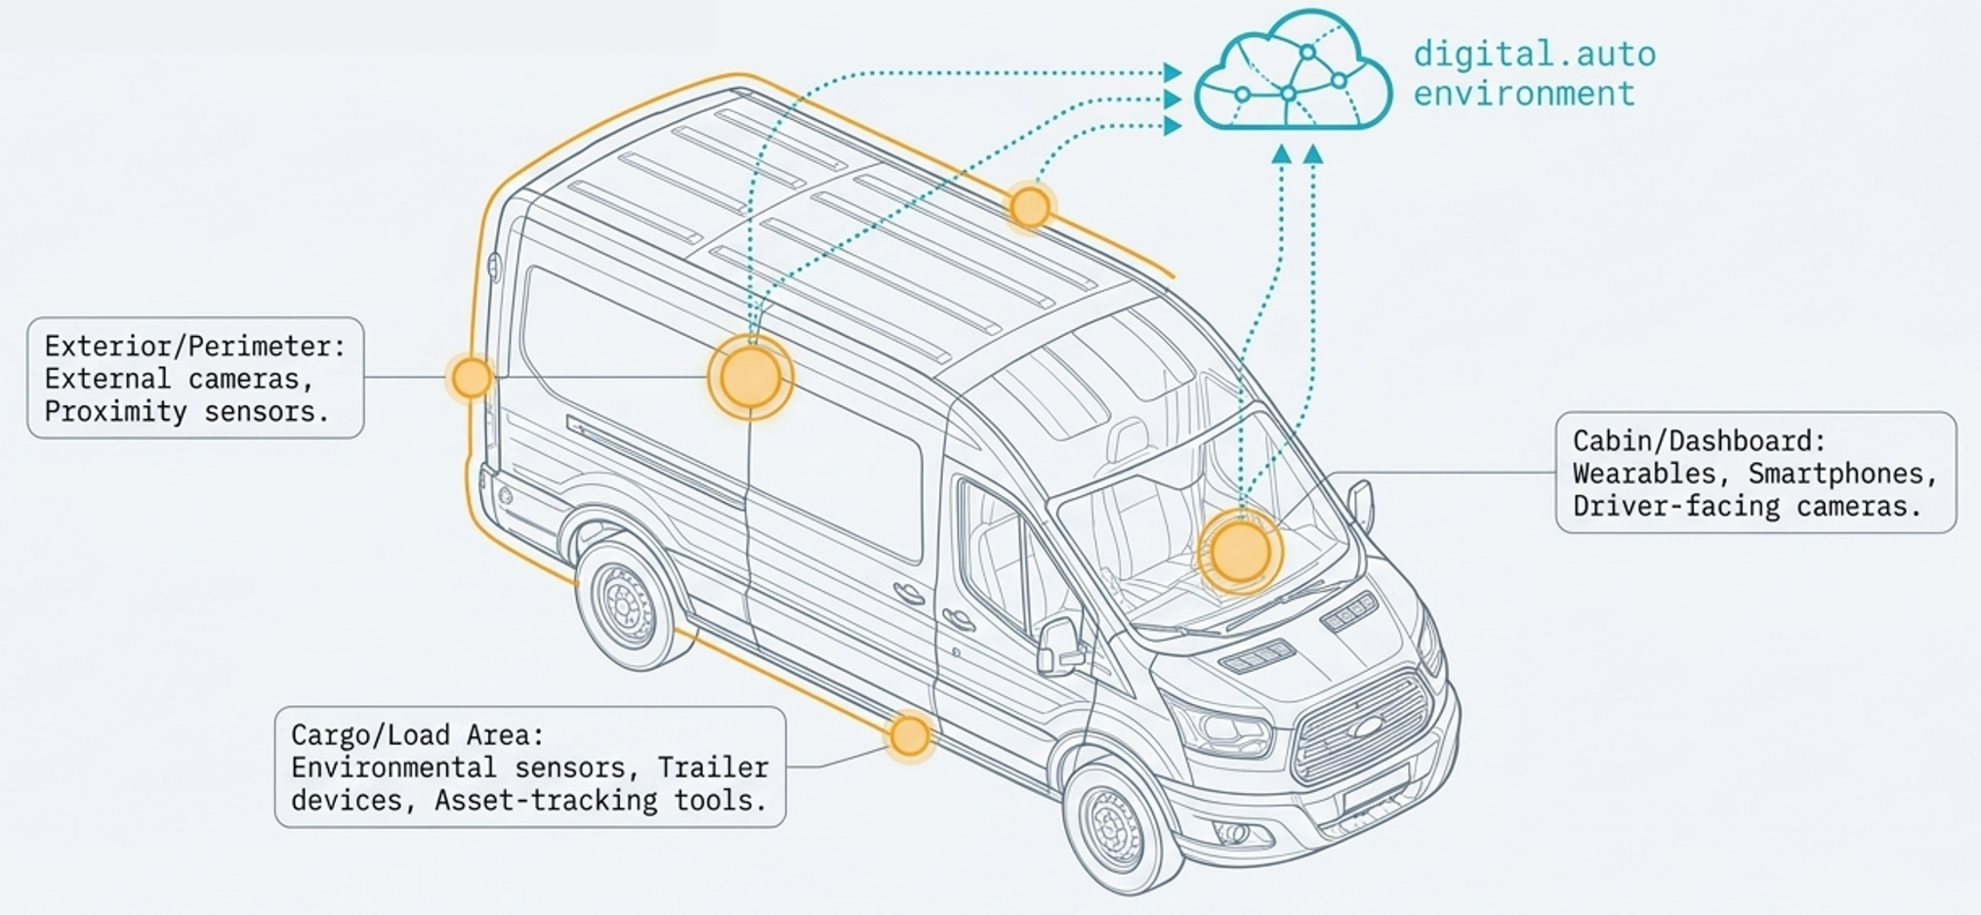
The job extends beyond the vehicle
A contractor’s tools. A sensitive load. Live cargo
Useful information often comes from outside the built-in vehicle systems.

Slide 3
BYOD in a commercial vehicle
External hardware connects with a software-defined commercial vehicle.
External devices
Application logic
Vehicle / Interface
Camera
Phone / Wearable
Tool / Sensor
Interpret the signal
Use the job context
Decide on a response
Make the result visible
Support the user’s task
The reference camera is a starting point for a broader ecosystem.

Slide 4
The Challenge
Build a prototype that connects
an external device to a useful
commercial vehicle workflow.
USER
EVENT
VALUE
RESPONSE
Who needs help?
What should the device detect ?
What should happen next?
Why does
it matter ?

Slide 5
Three starting points for your idea
Mobile workshop Equipment and operational security Tool detection Missing-item checks Loading completeness | Dangerous goods Load conditions and safety awareness Gas-cylinder detection Storage alerts Safety-equipment checks | Animal transport Live cargo and transit conditions Behavior monitoring Unusual movement Positioning indicators
Choose One User, One Observable Event, And One Useful Response.

Slide 6
A complete device-to-vehicle loop
Reference scenario: driver drowsiness
Camera input
digital.auto logic
Vehicle response
Visible evidence
Driver state
observed
Event
interpreted
Headlights
and horn
Dashboard
and logs
The audience should be able to follow the cause and effect.

Slide 7
Your technical starting point
3
Sensor Expansion
reference cameras
Radar
Bosch Gas-Sensor
Particulate-Matter sensor
Live feeds and dynamic snapshots
for computer-vision applications
*Available on request, Self-setup with mentor coordination

Slide 8
Building with digital.auto
A workspace for your code, vehicle APIs, and visible behavior.
01
02
03
04
Choose the
hackathon vehicle
Create your
team project
Build in
SDV Code
Configure The
Assigned Runtime
Dashboard plugins and API values help you inspect the device-to-vehicle loop.

Slide 9
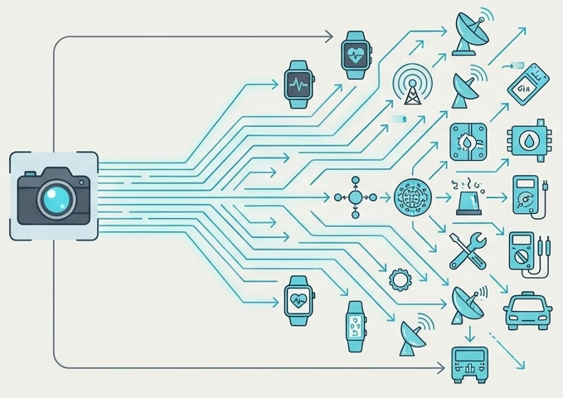
Beyond the reference camera
What other devices would
improve your application?
What vehicle data would they need?
How would discovery, onboarding,
and permissions work?
Show what works now. Explain the next integration.

Slide 10
What teams should bring back
Core outcome Working prototype / proof of concept Clear use-case description Accessible source code Functional demonstration Explanation of the BYOD integration | Useful additions Architecture diagram Extension concept Platform feedback
Make the device input, the response, and the user benefit easy to see.

Slide 11
What makes a strong outcome
Problem & value Problem relevance User value Working implementation Technical implementation Use of digital.auto Demo quality | Solution concept Creativity BYOD integration concept Future integration Scalability to additional devices

Slide 12
What would you connect?
What would you connect
to make someone’s job better?
Choose a user. Build the loop. Make the value visible
Bring your idea to the BYOD challenge.

