Slide 1
SEO
(Search Engine Optimization)
A project by Raika Singh and Aakansha Jadhav

Slide 2
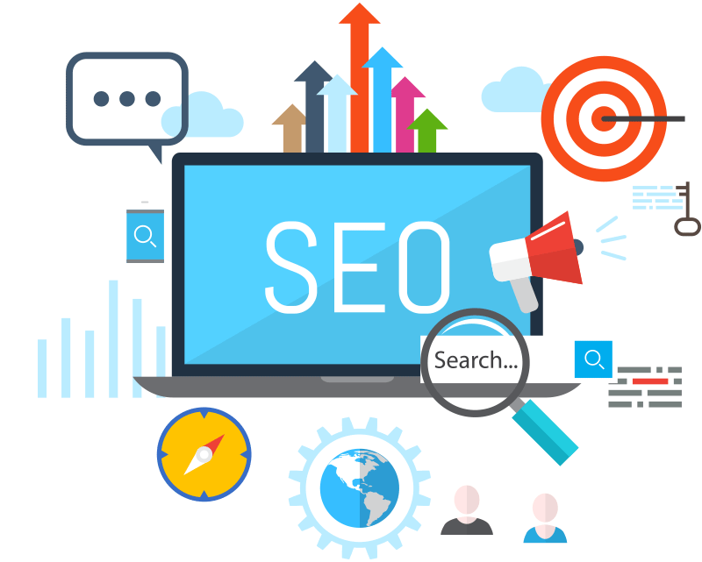
Contents
What is SEO?
Importance of SEO
Different types of SEO
Our SEO Project in brief
Python Features Used
How it Works
Conclusion
Reference

Slide 3
What is SEO ?
Search engine optimization (SEO) is the process of optimizing your online content so that a search engine likes to show it as a top result for searches of a certain keyword.
The search engine can be any web browser such as Google Chrome, Mozilla Firefox , Saffari etc.

Slide 4
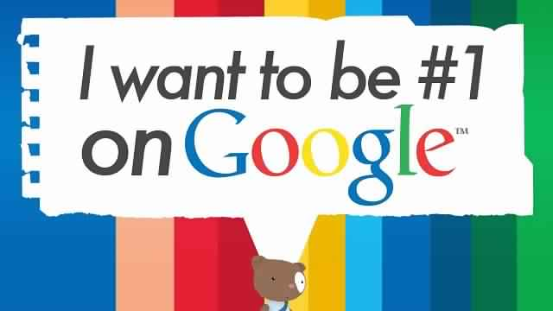
Importance of SEO
In today’s competitive market, SEO marketing is more important than ever. Search engines serve millions of users per day looking for answers to their questions or for solutions to their problems.
SEO can put you ahead of the competition. If two web sites are selling the same thing, the search engine optimized web site is more likely to have more customers and make more sales.

Slide 5
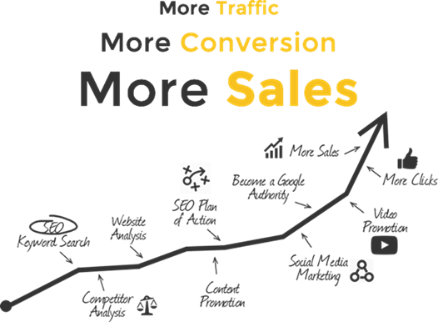

Slide 6
Different types of SEO
By check the speed and usability of your site on multiple devices
Enter a URL, and this tool will test the loading time and performance for desktop and for mobile, plus identify opportunities to improve (and pat you on the back for what you’re doing well). The mobile results also come with a user experience score, grading areas like tap targets and font sizes.

Slide 7
Keyword ideas based on a single keyword
Enter a keyword, and the Keyword Tool provides a huge handful of long-tail keyword opportunities, organized alphabetically.
Complete web stats and search insights
In addition to tracking pretty much every bit of traffic you could imagine on your website, Analytics also surfaces many keyword insights as to which terms people use to land on your pages.
Constant website analysis, alerts, and error reports
These webmaster tools help give you a taste of what the two top search engines think of your site. It’s helpful to see any bugs, alerts, and indexing issues.
Know what people search for using Keywords
Enter a keyword or group of keywords into the tool, and Google will return all sorts of helpful stats to guide your keyword strategy: monthly search volume, competition, and even suggested terms you might not have considered.

Slide 8
Our SEO Project in Brief
SEO keywords are the key words and phrases in your web content that make it possible for people to find your site via search engines. A website that is well optimized for search engines "speaks the same language" as its potential visitor base with keywords for SEO that help connect searchers to your site. Keywords are one of the main elements of SEO.
This is why developing a list of keywords is one of the first and most important steps in any SEO initiative. Keywords and SEO are directly connected when it comes to running a winning search marketing campaign. Because keywords are foundational for all your other SEO efforts, it's well worth the time and investment to ensure your SEO keywords are highly relevant to your audience and effectively organized for action.

Slide 9
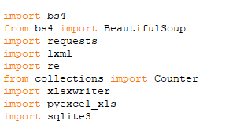
Python Features Used
This program will use the following core technologies of python:
Urllib
Requests
Beautiful soup and bs4
Regular Expression
xlsxwriter
sqlite3

Slide 10
How It Works
From this the contents of the webpage are obtained from ‘BeautifulSoup’ from bs4 and parsing is done with the help lxml (html parser can also be used).
The contents of the webpage are then opened in a text file and hence making further work offline.
The content from this text file is broken into a list , frequency of each word is calculated by using module ‘counter’ and unnecessary words are removed by creating a separate list and using ‘filter’.

Slide 11

How it works (contd..)
This list is then tronformed to Excel using ‘xlsxwriter’ module as it increases readability for the user and also always graph making.
The words obtained here must be included into user’s website title or meta description so that the search engine can easily land on this page and more customers use it.
The words and their frequency can be saved in database such as Sqlite using ‘sqlite3’ module .

Slide 12

Conclusion
With the introduction of artificial intelligence in the Google ranking algorithm, voice search and mobile first index, the structure of a website has gained more importance than ever and SEO fulfils the same requirement effectively.

Slide 13
References
https://docs.python.org/3/howto/urllib2.html
https://xlsxwriter.readthedocs.io/
https://www.tutorialspoint.com/sqlite/sqlite_python.html
https://blog.bufferapp.com/free-seo-tools
For more info on project click here (leads to documentation).

Slide 14


