Slide 1
EMA 759 Project Parallel Neural Network Process
Vinay Raikar
SR. SYSTEMS eNGINEER
HARLEY-Davidson Motor Company

Slide 2
Neural Network Process
Input Data
X 1, 2, 3……….
Y
Neural Network
Output
Model(s)

Slide 3
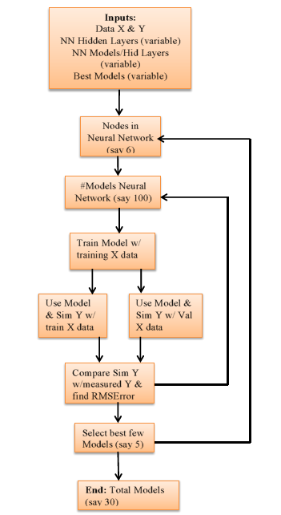
Sequential Process

Slide 4
Parallel Process
Parallel For loop
Nested Parallel For loop
Matlab doesn’t allow nested parallelism to be implemented

Slide 5
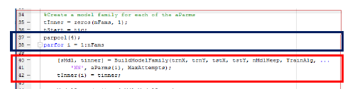
Matlab Parallel Implementation
Allocate cores to parallel for
Function call to build Neural Network Model Family Nested

Slide 6
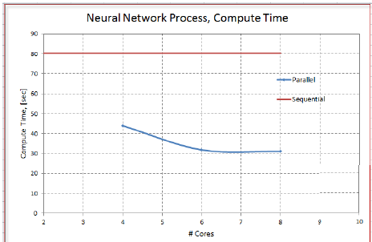
Performance Gains with Parallel
Point of diminishing returns with increase in cores

Slide 7
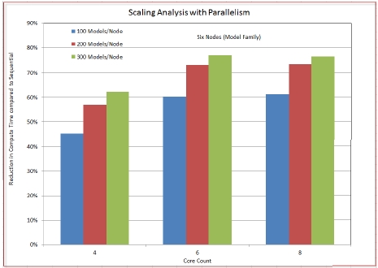
Scaling Performance with Model Family Increase

Slide 8
Conclusion & Future Scope
Conclusion
Building model family process typically takes 10-15 min based on input channels and its non-linearity with output channels. Parallelizing this process resulted in at least 50% reduction in time to execute.
Execution of each loop took 20% more time in parallel compared to sequential due to overhead associated with parallel process
Future Scope
Matlab implementation of cores with loop count couldn’t be understood. Current implementation is not robust with core count and loop count (NN nodes).
Training NN model (Matlab function) can be processed faster with fine grain parallelism (GPU) for large data sets

