Slide 1
NFC

Slide 2
What is NFC? (Brandi)
Near Field Communication
Contactless peer-to-peer communication between mobile devices
Combines the interface of a reader and a smart card into a single device
Radio frequency identification (RFID)

Slide 3
3 Modes of Operation (Brandi)
Card Emulation Mode
Device acts as a passive tag (Target)
Reader/Writer Mode
Device is a active card reader (Initiator)
Peer to Peer Mode
2 devices communicate in both active or passive mode
Initiator/master initiates and waits for slave to respond
Generates RF field
Does not generate RF field

Slide 4
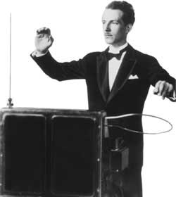
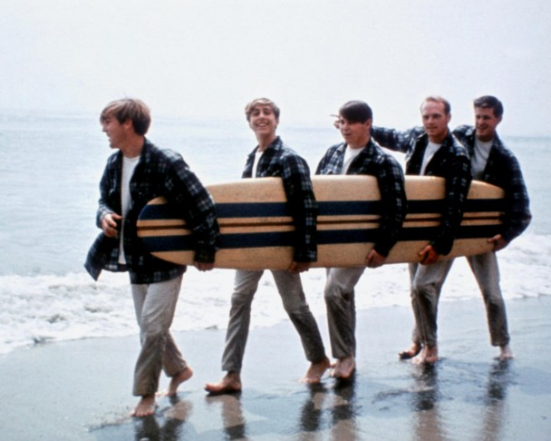
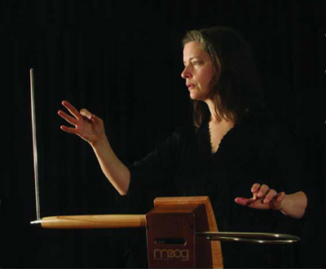
History: The Theremin
The Beach Boys’ “Good Vibrations”
Notes:
Patented in 1928 by Soviet engineer Léon Theremin, the Theremin is a contactless electronic musical instrument with two antennas. The thereminist uses one hand to control the pitch and the other to control volume.

Slide 5
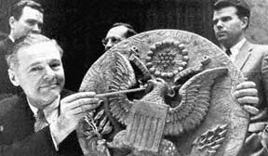
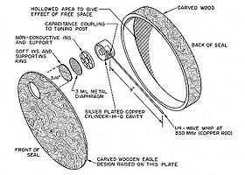
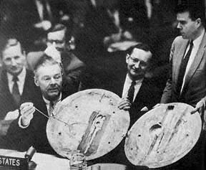
History: The Great Seal Bug
Notes:
Theremin went on to develop The Great Seal Bug in 1945, which was used by the Soviet Union for espionage. In 1946, Soviet school children presented the Bug, disguised as a two-foot wooden replica of the Great Seal of the United States to the US ambassador. It hung in the ambassador’s office in Spaso House, the ambassador’s residence in Moscow, until 1952 when it was discovered to have a microphone and a resonant cavity which could be stimulated from an outside radio signal.
A radio beam was aimed at the antenna from a source outside the building. A sound that struck the diaphragm caused variations in the amount of space (and the capacitance) between it and the tuning post plate. These variations altered the charge on the antenna, creating modulations in the reflected radio beam. These were picked up and interpreted by the receiver.
Basically, the Bug was a passive tag; the receiver was an active reader.
The Bug was presented to the United Nations in 1960, following the U-2 incident.

Slide 6
Technical Details
NFC is an outgrowth of RFID.
NFC uses electromagnetic induction to generate current and exchange information.
NFC has a maximum transmission rate of approximately 480kbs.
Absolute Maximum range: 20cm (7.5 inches).
Practical Maximum range 10cm (4 inches).
Ideal range: 4cm (1.5 inches).

Slide 7
Technical Details (II)
NFC Protocols:
ISO 14443 (already used by RFID for secure information transfer for credit-card processing).

Slide 8
NFC Uses
PAIR:
Pair two nfc-enabled devices by a simple bump (easier than by bluetooth).
Connect phone to speakers or other NFC aware devices
SHARE:
Share contact information with a simple bump of phones.
Establish a connection for playing networked games (use nfc to initiate the bluetooth / wifi adhoc connection).
TRANSACTIONS:
Use to pay at nfc-enabled payment stations (similar to swiping a transit card to pay a toll).
Eventually replace the need to carry all kinds of credit cards
IDENTIFICATION:
Could be used in place of government issued ID.
Could be used to replace corporate ID badges
Already used in passports to provide various pieces of personal information.

Slide 9
NFC vs. Bluetooth
NFC
Maximum range: 4cm (0.131234 feet)
Maximum transfer rate: 424 kbit/s
Bluetooth
Maximum range: 9.75 meters (~32 feet)
Maximum transfer rate: up to 24 Mbit/s
No authentication
PIN required
Battery consumption: 0.5% per day
Battery consumption: 4% per day
RFID
UHF radio waves
WPAN
Ad hoc

Slide 10
Security: Concerns
Eavesdropping
Complicated
Data Modification
Easy to perform
Man-in-the-Middle attacks
Short range makes MITM hard
Almost impossible to prevent
Requires proximity
Painless to detect
Notes:
Eavesdropping/Sniffing on passive devices is nearly impossible because passive devices send data using inductive coupling on the field generated by the active devices. General rule of thumb is 1 m (~3.2 feet) for passive devices and 10 m for active devices.
The only thing an NFC device can do against data modification/Denial of Service attacks is to detect them.
NFC devices are able to receive and transmit data at the same time. They can verify the radio frequency field and detect a collision if the received signal does not match with the transmitted signal to twat MITM attacks.

Slide 11

Questions?

Slide 12
References
Egan, Matt. “What is NFC? How does NFC work? For what might you use NFC? - a quick guide to NFC.” PC Advisor, Oct 9 2013. Web. 1 Apr 2014. <http://www.pcadvisor.co.uk/how-to/mobile-phone/3472879/what-is-nfc-how-nfc-works-what-it-does/>
Murray, Kevin D. “The Great Seal Bug Story.” Murray Associates, May 4 2011. Web. 27 May 2014. <http://www.spybusters.com/Great_Seal_Bug.html>
Mr. J. “Wierd but True: The Theremin.” Mr. J’s Music Room, Jan 2 2011. Web. 27 May 2014. <http://mrjsmusicroom.com/wierd%20but%20true/wierd%20but%20true%20january.html>
Peter Pringle. “THEREMIN - Over The Rainbow.” Video. Youtube, Jan 10 2009. Web. 27 May 2014. <https://www.youtube.com/watch?v=xcTPRjiCs6s#t=7>
Nosowitz, Dan. “Everything You Need to Know About Near Field Communication.” Popular Science, May 1 2011. Web. 1 Apr 2014. <http://www.popsci.com/gadgets/article/2011-02/near-field-communication-helping-your-smartphone-replace-your-wallet-2010>
Smith, Chris. “How it Works: NFC (near field communication).” Android Authority, Jun 25 2012. Web. 31 May 2014. <http://www.androidauthority.com/how-it-works-nfc-near-field-communication-97144/>
UniversalNewsreels. “UN Spy Debate, Reds 'Bugged' American Embassy 1960/5/27.” Video. Youtube, Sep 13 2006. Web. 27 May 2014. <https://www.youtube.com/watch?v=YPJjxiuyy4A>
Van Damme, Gauthier, and Karel Wouters. “Practical Experiences with NFC Security on Mobile Phones.” Katholieke Universiteit Leuven.

