Slide 1
Near Field Communication
Brandi Crawford
Donald Raikes

Slide 2
What is NFC?
Near Field Communication
Contactless peer-to-peer communication between mobile devices
Combines the interface of a reader and a smart card into a single device
Radio frequency identification (RFID)

Slide 3
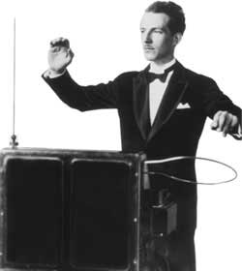
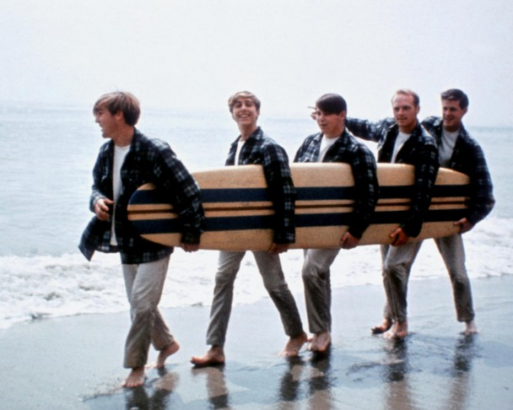
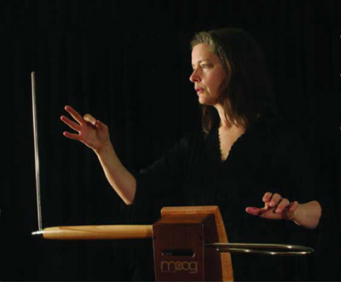
NFC History: The Theremin
The Beach Boys’ “Good Vibrations”
Notes:
Patented in 1928 by Soviet engineer Léon Theremin, the Theremin is a contactless electronic musical instrument

Slide 4
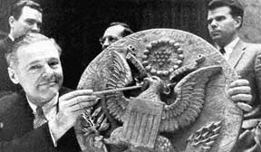
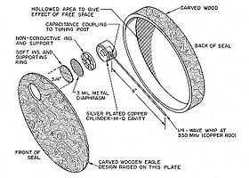
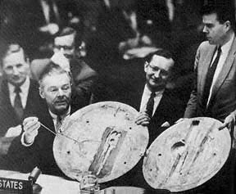
NFC History: The Great Seal Bug
Notes:
Theremin went on to develop The Great Seal Bug in 1945, which was used by the Soviet Union for espionage. In 1946, Soviet school children presented the Bug, disguised as a two-foot wooden replica of the Great Seal of the United States to the US ambassador. It hung in the ambassador’s office in Spaso House, the ambassador’s residence in Moscow, until 1952 when it was discovered to have a microphone and a resonant cavity which could be stimulated from an outside radio signal.
A radio beam was aimed at the antenna from a source outside the building. A sound that struck the diaphragm caused variations in the amount of space (and the capacitance) between it and the tuning post plate. These variations altered the charge on the antenna, creating modulations in the reflected radio beam. These were picked up and interpreted by the receiver.
Basically, the Bug was a passive tag; the receiver was an active reader.
The Bug was presented to the UN in 1960, following the U-2 incident.

Slide 5
3 Modes of Operation
Card Emulation Mode
Device acts as a passive tag
Reader/Writer Mode
Device is a active card reader
Peer to Peer Mode
2 devices communicate in both active or passive mode
Initiator/master initiates and waits for slave to respond
Generates RF field
Does not generate RF field

Slide 6
Technical Details
NFC is an outgrowth of RFID.
NFC uses electromagnetic induction to generate current and exchange information.
NFC has a maximum transmission rate of approximately 480kbs.
Absolute Maximum range: 20cm (7.5 inches).
Practical Maximum range: 10cm (4 inches).
Ideal range: 4cm (1.5 inches).

Slide 7
Technical Uses
Read/write tags
Pairing of devices
Information exchange
Transaction processing

Slide 8
Reading/Writing of Tags
Website URLs
Product details
Exhibit explanations
Notes:
NFC tags are small passive bits of circuitry embedded into things like tags on merchandise, posters in theaters, or exhibits in a museum.
Bringing the NFC-enabled device close to the tag induces electrical current in the tag which the nfc-enabled device can then read.
Data contained on the tag could be a website url, product details or exhibit explanations.
Tags can contain up to 32k of data.

Slide 9
Pairing Devices
Headphones
Speakers
Notes:
There are a number of NFC-enabled devices available on the market such as headphones, speakers and similar devices.
Typically these would be paired with smartphone using bluetooth, but with NFC, move the smartphone near the device and it will automatically pair it. The bluetooth connection is automatically initiated.

Slide 10
Information Sharing
Share contacts
Share music playlists
Notes:
Bumping phones to share contacts or music playlists can be done via NFC.
Both phones must have NFC capabilities, and have the NFC-enabled app running in the foreground for this to work.

Slide 11
Transaction Processing
Pay for tickets at a theater
Use in place of your Easypass at a toll booth
Purchase items at a store (in place of using a credit card)
Notes:
Use the NFC-enabled smartphone to:
Pay for tickets at a theater
In place of your Easypass at a toll booth
Purchase items at a store (in place of using a credit card)
Uses information stored in an app like google wallet to provide payment information.

Slide 12
Future of NFC:
Replace traditional wallets
Home automation
Complete medical history
Replace ID badges
Already embedded in passports
Notes:
* Replace traditional wallets containing a bunch of credit cards
* Home automation (simply wave your phone by a sensor to control your home automation system)
* Embed NFC tags in a person’s skin containing complete medical history and with the inclusion of sensors, track insuline levels and other physiolical information
* Replace ID badges for work places and/or governmental buildings.
* Already embedded in passports to provide personal information more quickly at ports of entry/exit.

Slide 13
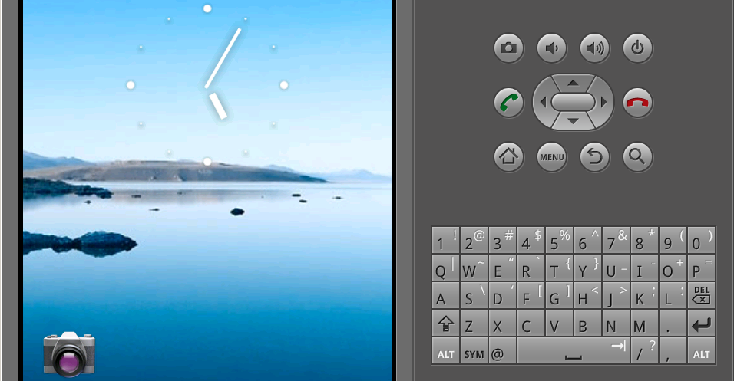
NFC Simulation Lab
Using the Open-NFC simulator and the android sdk’s emulator we were able to simulate the reading of various NFC tags. The data read from the tags was visible both in the trace logger (part of the open-nfc connection center) and in the system log from the emulated phone.
Notes:
Using the Open-nfc simulatorand an android virtual device running in the android sdk’s emulator, we were able to simulate the reding of various tags fusing an android phone running IcecreamSandwich (version 4.0.3).
We

Slide 14
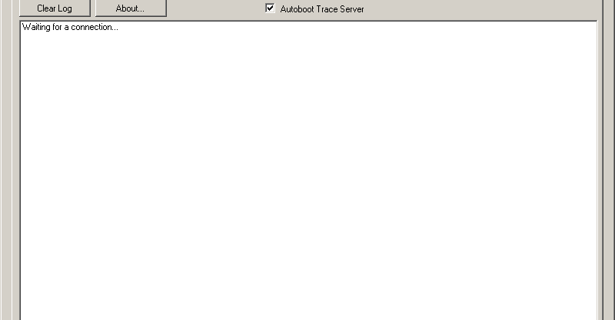
Simulation Lab (II) the ConnectionCenter
The ConnectionCenter acts as a proxy between the NFC simulator and the emulated phone. All traffic passing through the ConnectionCenter is visible in the trace log.

Slide 15
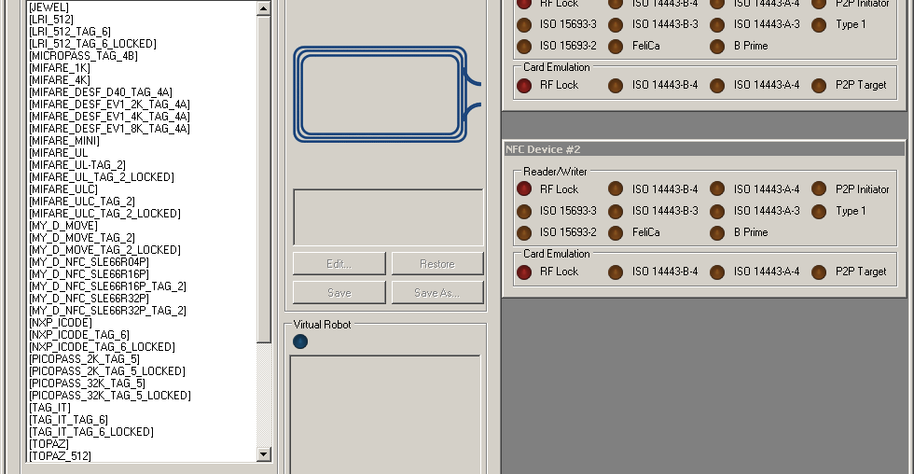
Simulation Lab (III) NFC Simulator
The NFC Simulator prior to doing andy testing.

Slide 16
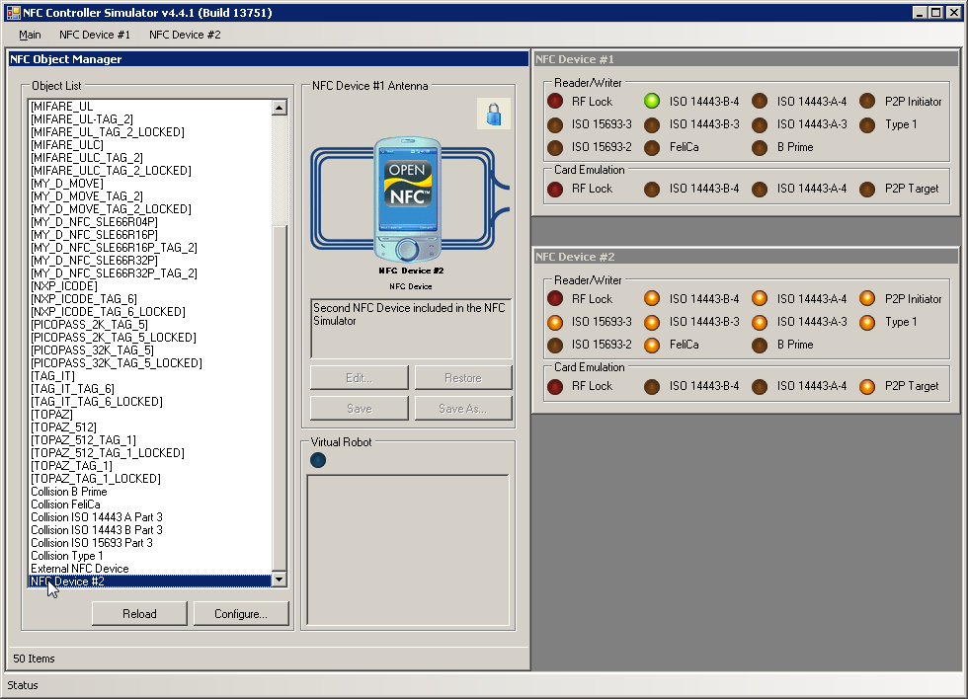
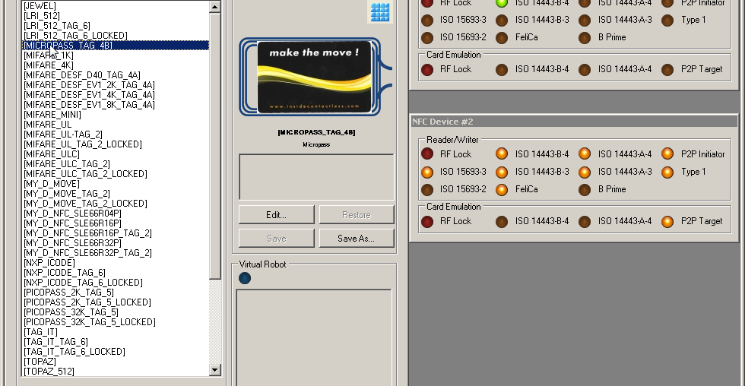
Simulator Lab (IV) Reading a MicroPass card

Slide 17
Simulator Lab (V) P2P Connection

Slide 18
NFC vs. Bluetooth
NFC
Maximum range: 4cm (0.131234 feet)
Maximum transfer rate: 424 kbit/s
Bluetooth
Maximum range: 9.75 meters (~32 feet)
Maximum transfer rate: up to 24 Mbit/s
No authentication
PIN required
Battery consumption: 0.5% per day
Battery consumption: 4% per day
RFID
UHF radio waves
WPAN
Ad hoc

Slide 19
Security: Concerns
Eavesdropping
Complicated
Data Modification
Easy to perform
Man-in-the-Middle attacks
Short range makes MITM hard
Almost impossible to prevent
Requires proximity
Painless to detect
Notes:
Eavesdropping/Sniffing on passive devices is nearly impossible because passive devices send data using inductive coupling on the field generated by the active devices. General rule of thumb is 1 m (~3.2 feet) for passive devices and 10 m for active devices.
The only thing an NFC device can do against data modification/Denial of Service attacks is to detect them.
NFC devices are able to receive and transmit data at the same time. They can verify the radio frequency field and detect a collision if the received signal does not match with the transmitted signal to twat MITM attacks.

Slide 20

Questions?

Slide 21
References
Egan, Matt. “What is NFC? How does NFC work? For what might you use NFC? - a quick guide to NFC.” PC Advisor, Oct 9 2013. Web. 1 Apr 2014. <http://www.pcadvisor.co.uk/how-to/mobile-phone/3472879/what-is-nfc-how-nfc-works-what-it-does/>
Murray, Kevin D. “The Great Seal Bug Story.” Murray Associates, May 4 2011. Web. 27 Mar 2014. <http://www.spybusters.com/Great_Seal_Bug.html>
Mr. J. “Wierd but True: The Theremin.” Mr. J’s Music Room, Jan 2 2011. Web. 27 Mar 2014. <http://mrjsmusicroom.com/wierd%20but%20true/wierd%20but%20true%20january.html>
Peter Pringle. “THEREMIN - Over The Rainbow.” Video. Youtube, Jan 10 2009. Web. 27 Mar 2014. <https://www.youtube.com/watch?v=xcTPRjiCs6s#t=7>
Nosowitz, Dan. “Everything You Need to Know About Near Field Communication.” Popular Science, May 1 2011. Web. 1 Apr 2014. <http://www.popsci.com/gadgets/article/2011-02/near-field-communication-helping-your-smartphone-replace-your-wallet-2010>
Smith, Chris. “How it Works: NFC (near field communication).” Android Authority, Jun 25 2012. Web. 31 Mar 2014. <http://www.androidauthority.com/how-it-works-nfc-near-field-communication-97144/>
UniversalNewsreels. “UN Spy Debate, Reds 'Bugged' American Embassy 1960/5/27.” Video. Youtube, Sep 13 2006. Web. 27 Mar 2014. <https://www.youtube.com/watch?v=YPJjxiuyy4A>
Van Damme, Gauthier, and Karel Wouters. “Practical Experiences with NFC Security on Mobile Phones.” Katholieke Universiteit Leuven. <http://www.cosic.esat.kuleuven.be/publications/article-1288.pdf>

