Slide 1
CRD ANOVA : Calculation for Sum of Squares
Using Least Squares Method

Slide 2
One Way ANOVA (CRD) - recap
Simplest design
Design can be used when experimental units are essentially homogeneous
not practical for field experiments
suited for small number of treatments
Randomization
Treatment are assigned to experiment units completely at random
every experiment unit has the same probability of receiving any treatment

Slide 3
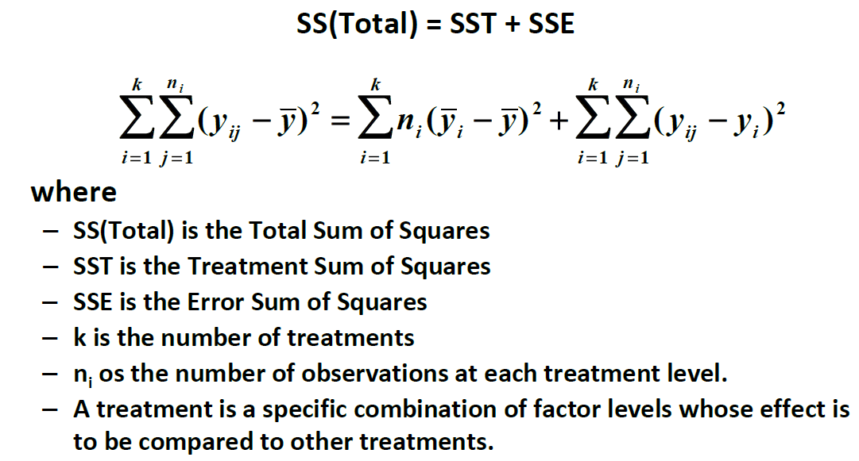
SS Equation for One Way CRD

Slide 4
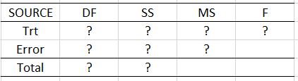

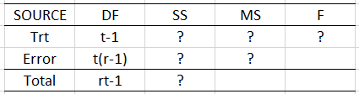
Now Let’s look at an CRD example
A | B | C | D
4.6 | 7.9 | 8.1 | 9.3
3.6 | 6.4 | 7.1 | 8.0
5.0 | 7.8 | 6.8 | 9.5
5.7 | 7.2 | 5.5 | 10.2
4 treatment levels: 4 replications each treatment level
Let’s do a bit of exercise!
=c (4.7, 7.3, 6.9, 9.2)
=7
SST=4*[(4.7-7)^2+(7.3-7)^2+(6.9-7)^2+(9.2-7)^2]=41.22
SSE=[(4.6-4.7)^2.........+(10.2-9.2)^2]=9.71

Slide 5
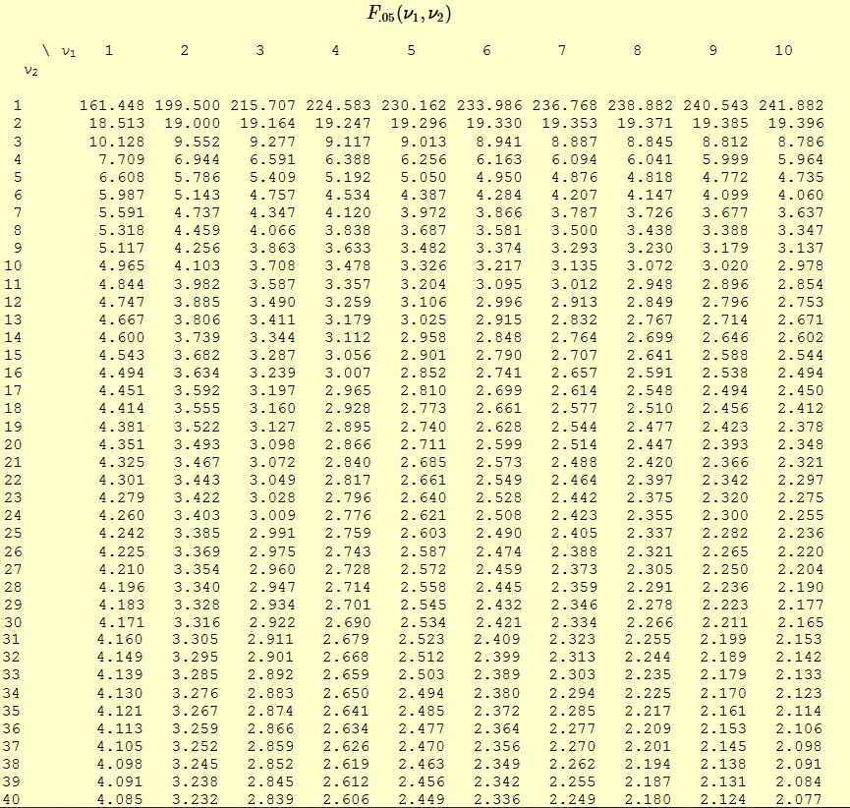
F Table

Slide 6
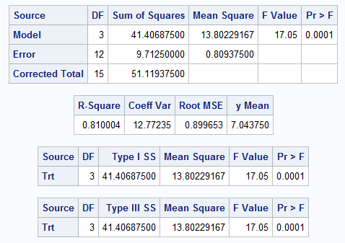
Let’s run in SAS
data example;
input Trt $ y;
datalines;
A 4.6
A 3.6
A 5.0
A 5.7
B 7.9
B 6.4
B 7.8
B 7.2
C 8.1
C 7.1
C 6.8
C 5.5
D 9.3
D 8.0
D 9.5
D 10.2
;
proc glm data=example;
class trt;
model y=trt;
contrast ‘A vs B+C+D’ trt 1 -1/3 -1/3 -1/3;
run;
Output

Slide 7
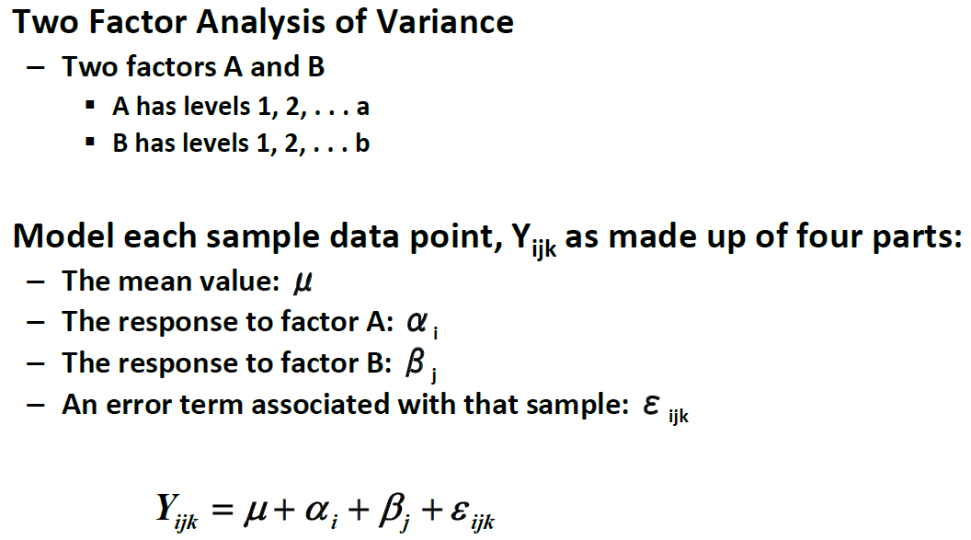
Two Way ANOVA- CRD

Slide 8
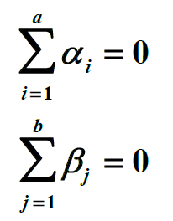
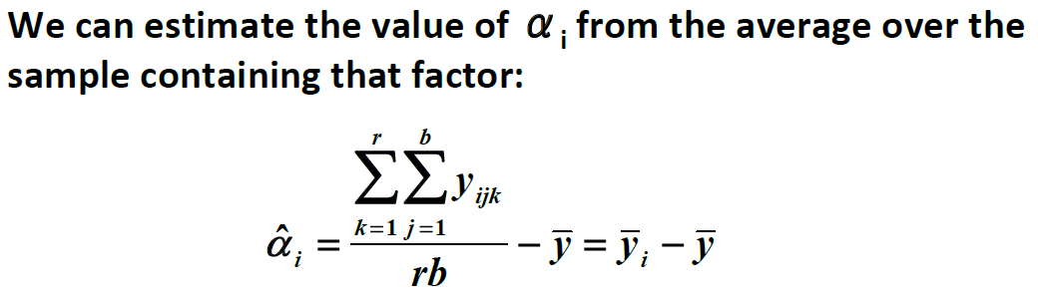

Reparameterization
Now we can break the variation down to Factor A, B and the Error

Slide 9
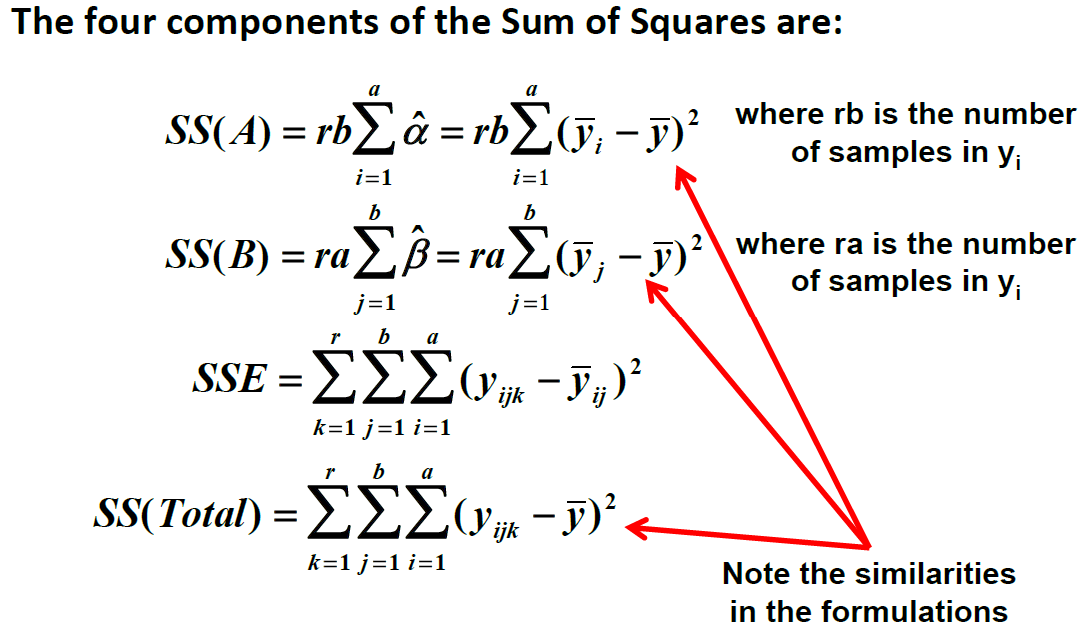
Two Way Sum of Square

Slide 10
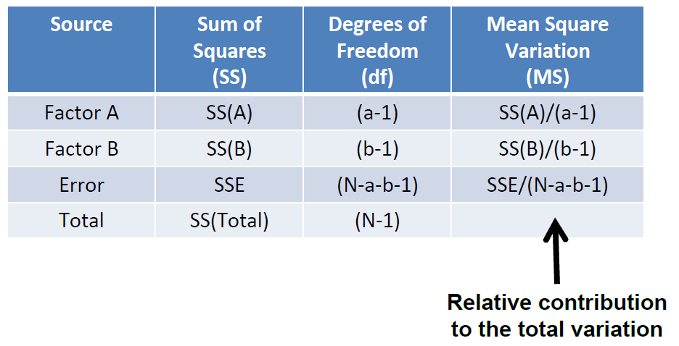
ANOVA Table for 2-Way CRD

Slide 11

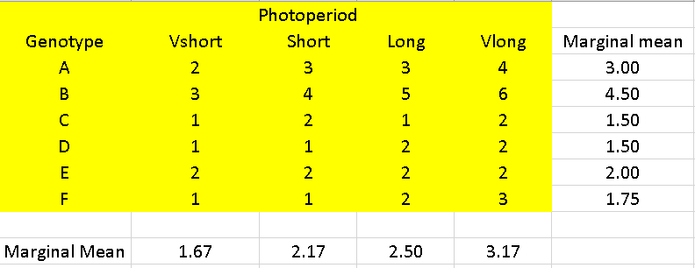

Example: Factor A: Photoperiod 4 levels; Factor B: Genotype 6 levels
=2.375
SSA=6x[(1.67-2.375)^2+(2.17-2.375)^2+(2.50-2.375)^2+(3.17-2.375)^2=7.125
SSB=4x[(3-2.375)^2+.......+(1.75-2.375)^2]=27.875
SSTotal=[(2-2.375)^2+(3-2.375)^2+.......+(3-3.17)^2]=39.625
SSE=SSTotal-SSA-SSB=39.625-7.125-27.875=4.625

Slide 12
Homework 1
options pageno=1;
data example;
input trt $ plot $ y;
datalines;
1 1 12.6
1 1 11.9
1 1 12.3
2 1 12.4
2 1 12.1
2 1 12.6
;
proc print;
run;
proc glm data=example;
class trt plot;
model y=trt plot(trt);
output out=newsoilm p=pred r=resid;
test h=trt e=plot(trt);
means trt / lsd;
means trt / lsd e=plot(trt);
contrast ’control vs others’ trt 1 1 1 -3 / e=plot(trt);
proc plot;
plot resid*pred/vref=0;
run;

Slide 13
Quiz2 – Fill in the ANOVA Table
A | B | C | D
4.6 | 7.9 | 8.1 | 9.3
3.6 | 6.4 | 7.1 | 8.0
5.0 | 7.8 | 6.8 | 9.5
4 treatment levels: 3 replications each treatment level
Q1: Fill in the ANOVA Table (7 points)
Q2: write down a contrast to compare the average effect of A and B vs. the average effect of C and D (3 points)

Slide 14
A few words about the Project-1 presentation
Be concise and keep it to be within 12 pages
Do some practice as a team before the presentation
Be prepared for trouble ☺
10 mins for each project – time it right with practice
End on time
Get excited about your results!!
Prefer figures instead of many tables
Using colors to highlight

Slide 15
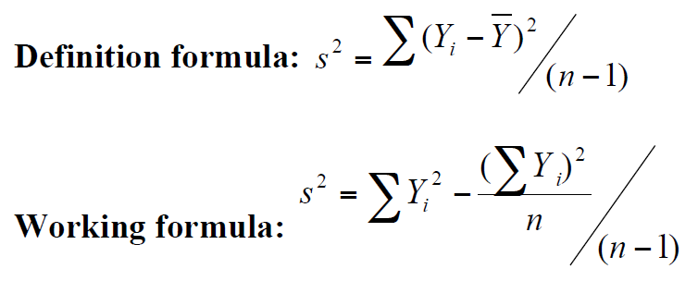

Variance of a Sample
Sum of Squares (SS)
Degree of Freedom (df)

