Slide 1

Welcome to
SSID: <wifi>
Password: <password>
Pizza is coming!!

Slide 2
Tonight's Schedule
Complete the install instructions in preparation of tomorrow
Learn about the Command Line
Hear from our wonderful sponsors
Thank our amazing TAs

Slide 3
Install Complete?
Make sure you get a sticker from a TA
Go home and rest
Breakfast arrives at <time>
Day starts at <time>

Slide 4
Install Instructions
Go to docs.railsbridgeboston.org and find installfest
Instead of downloading all the software, we have thumbdrives! TAs will be handing them out.
We'll have a presentation shortly, but for now, start going through the installfest instructions
TAs are here to help you! Please give them something to do

Slide 5





Thank you, sponsors!

Slide 6
Presentation Slides
Intro to Command Line
<bit.ly/example-link>
Intro to Ruby
<bit.ly/example-link>
What is a Web app?
<bit.ly/example-link>
Models, Scaffolding, and Migrations
<bit.ly/example-link>
The Model-View-Controller (MVC) Architecture
<bit.ly/example-link>

Slide 7
SSID: <wifi>
Password: <password>
Welcome back!
Grab some breakfast!
We’ll get started at <time>, so mingle until then!

Slide 8
Schedule
Start VirtualBox
Presentation(s)
Follow the Railsbridge curriculum
Lunch
Q&A with TAs
Follow the Railsbridge curriculum
Presentation(s)
Party!

Slide 9
Railsbridge Curriculum
Visit the docs at:
https://docs.railsbridgeboston.org/intro-to-rails/intro-to-rails
Follow the hands-on tutorial
Have a question? Raise your hand or shout out for a TA. We would love to help!

Slide 10
🌮 Lunch! 🌮

Slide 11
Q&A with TAs

Slide 12
What’s next?

Slide 13
We want your feedback! 💛
Go to the Survey link:
<bit.ly/example-link>
Send us an email: railsbridgeboston@gmail.com

Slide 14
Further your learning!
Upcase (thoughtbot.com/upcase)
The Odin Project (theodinproject.com)
freeCodeCamp (freecodecamp.org)
Resilient Coders (resilientcoders.org)
Launch Academy (launchacademy.com)
Startup Institute (startupinstitute.com)
General Assembly (generalassemb.ly)

Slide 15
Get Involved!
Girl Develop It (girldevelopit.com)
Women Who Code (womenwhocode.com/boston)
Boston Ruby Group (bostonrb.org)
Project Night is the 1st Tuesday of every month
Meetup w/ guest speakers is the the 2nd Tuesday of every month

Slide 16
Give back!
Donate
Contribute to our repo
https://github.com/railsbridge-boston/railsbridge-boston
Help us organize the next workshop!

Slide 17
Connect!
Grab your TA’s and tablemates’ contact info
Here are the lecturers:
<Presentation Name> <Speaker Name> - <email>
<Presentation Name> <Speaker Name> - <email>
<Presentation Name> <Speaker Name> - <email>

Slide 18
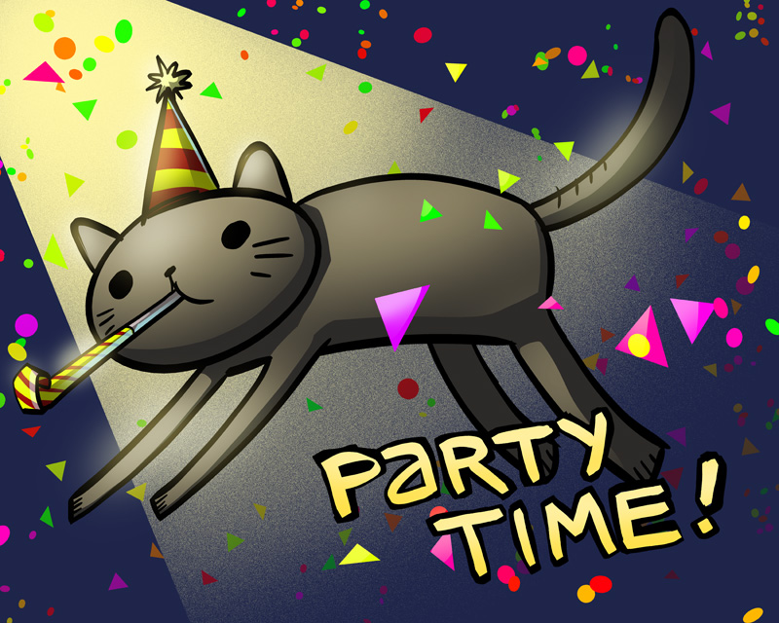
You’re done!

Slide 19
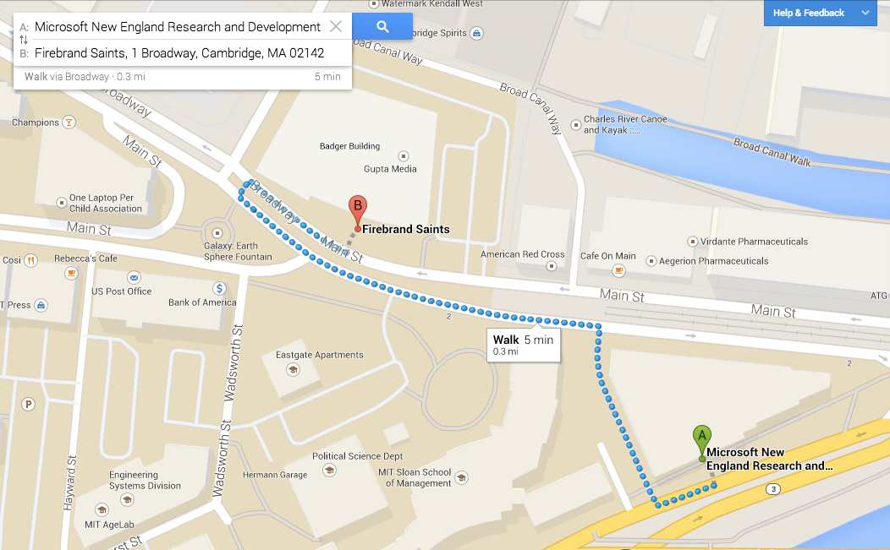
Celebrate at <name>!
(first round of drinks free)

Slide 20

On your way out...
Please throw out any trash you might have.
Grab some stickers from the check-in table!

