Slide 1


Welcome to
SSID: CAMBRIDGE
Password: rb2013
Pizza is coming!!
Thanks to our sponsor:

Slide 2
When you’re done installing...
Make sure you get a sticker from a TA
Go home and rest up
Breakfast “arrives” at 8:15 a.m.
Day starts at 9:30 a.m.
“I <3 Boston” t-shirts are first come, first serve!

Slide 3
Welcome back!
Grab some breakfast!
We’ll get started around 9:30, so mingle until then!

Slide 4

Thank you, sponsors!

Slide 5

You’re done!

Slide 6
What’s next?

Slide 7
But just a few more things...
Please throw out any trash you might have.
Grab some stickers from the check-in table!

Slide 8
Give us feedback!
Survey link at the end of the curriculum page.
Or go to: http://bit.ly/rbb1013survey
Fill it out to get your free goodies!
Send us an email: railsbridgeboston@gmail.com

Slide 9
Further your learning!
Trail Maps - learn.thoughtbot.com/trails
Launch Academy - www.launchacademy.com
Startup Institute - startupinstitute.com
General Assembly - generalassemb.ly

Slide 10
Get involved!
DevChix (http://www.devchix.com/) - mailing list for female programmers all around the world
Boston Ruby Group (http://bostonrb.org/)
  Project Night - every 1st Tuesday of the month @ thoughtbot office
Sign up for our mailing list: https://groups.google.com/forum/?fromgroups#!forum/railsbridge-boston-alumnis

Slide 11
Give back!
Donate
Contribute to our repo
  https://github.com/railsbridge-boston/railsbridge-boston
Help us organize the next workshop (January)!

Slide 12
Connect!
Grab your TA’s and tablemates’ contact info
Here’s mine: melissa@thoughtbot.com
Here are the lecturers:
  Johnny (intro to Ruby) - jboursiquot@gmail.com
  Andrew (starting a Rails app) - kookster@gmail.com
  Janet (command line & scaffolding) - jriley@janetriley.net
  Braulio (MVC) - bcarreno@yahoo.com
  Galia (routing) - galiat@gmail.com
  Alex (TA coordinator) - alxjrvs@gmail.com

Slide 13
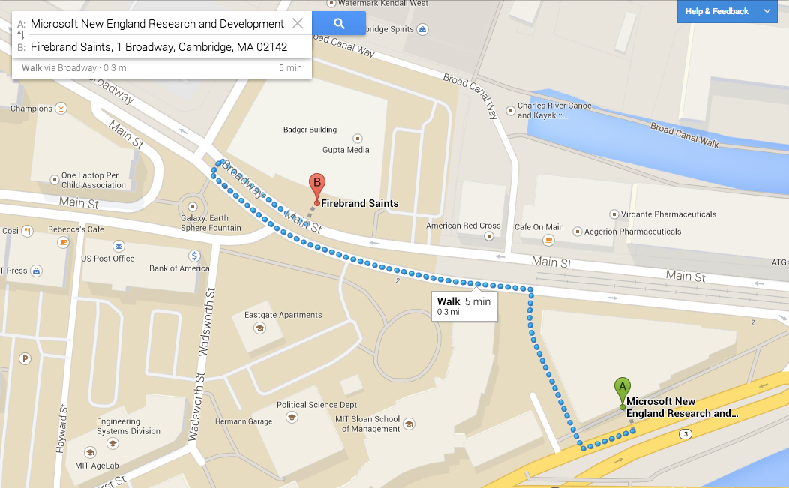
Celebrate at Fireband Saints!
(first round of drinks free)

