Slide 1
Associations
Defining the relationships between your models.

Slide 2
Imagine a Blog
Author
Post
Comment
Tag

Slide 3
A Blog Model’s Interface
user.posts
user.comments
post.author
post.comments
post.tags
comment.post
comment.author

Slide 4
Types of Associations
One-to-many
Many-to-many
One-to-one

Slide 5
One-to-many
has_many
belongs_to
Usually seen as a bi-directional pair.

Slide 6
One-to-many
has_many
Defines the relationship from the “one” side to the “many” side.
class User has_many :postsend
Some posts reference me.

Slide 7
One-to-many
belongs_to
Defines the relationship from the “many” side to the “one” side.
class Post belongs_to :userend
I reference a user.

Slide 8
One-to-many
posts
- id
- author_id
authors
- id

Slide 9
Association Methods
user.posts, user.post_ids
user.posts.find(id)
user.posts.count
user.posts.build(params)
user.posts.create(params)
user.posts.where(
:title => ‘Hello, world!’).first

Slide 10
Many-to-many
Example: Tagging posts
A post can have many tags (e.g. “programming”, “rails”, and “associations”)
A tag can have many posts (e.g. all the posts tagged with “rails”)

Slide 11
Many-to-many
You need a join table!
has_and_belongs_to_many, has_many :through

Slide 12
Many-to-many
has_and_belongs_to_many
Defines the relationship through a join table.

Slide 13
has_and_belongs_to_many
class Post has_and_belongs_to_many :tags
end
class Tag
has_and_belongs_to_many :posts
end

Slide 14
has_and_belongs_to_many
posts_tags
- post_id
- tag_id
posts
- id
tags
- id

Slide 15
Many-to-many
has_many :through
Defines the relationship through another has_many.

Slide 16
has_many :through
class Tagging
belongs_to :post
belongs_to :tag
end
class Post has_many :taggings
has_many :tags, :through => :taggingsend
class Tag
has_many :taggings
has_many :posts, :through => :taggings
end

Slide 17
has_many :through
taggings
- id
- post_id
- tag_id
posts
- id
tags
- id

Slide 18
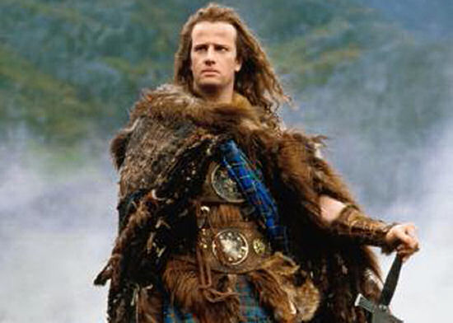
One-to-one
has_one
Like has_many, but
there can be only one.
These are relatively rare.

