Slide 1

Introduction to Ruby
Dylan Cashman
Annkissam
@dylan_cashman

Slide 2

What is Ruby?
Ruby is a programming language developed by Japanese Computer Scientist Yukihiro Matsumoto, AKA ‘Matz’ in the mid 90s
What is a programming language?
What distinguishes Ruby from other languages?

Slide 3
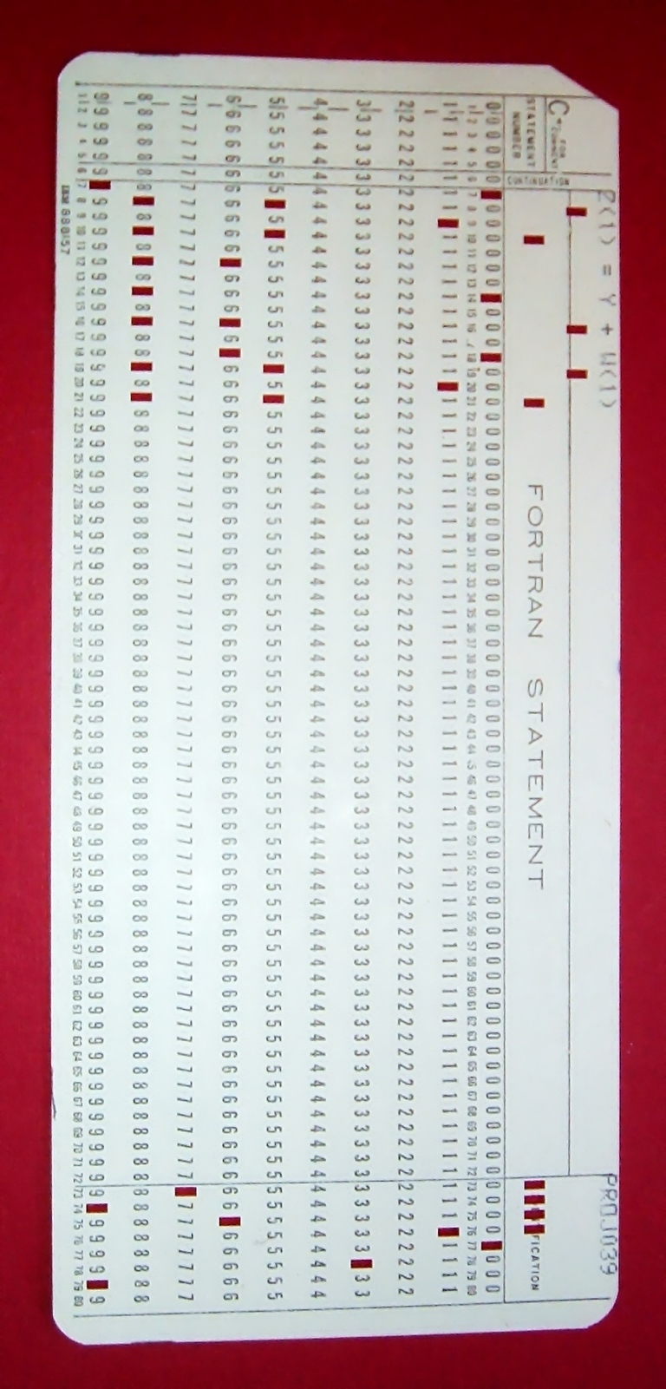

Programming
Giving a set of instructions to a computer to execute
Originally, these instructions had to be written in native language of computers
Difficult to translate Human thought into native computer language

Slide 4


Programming Language
A language we teach computers that is closer to human thinking than machine language
  C, Java, PHP, Visual Basic, Perl, Ruby
Programming Languages get compiled and assembled into machine language to get executed
http://www.publicdomainpictures.net/view-image.php?image=16520&picture=woman-with-a-thought-bubble&large=1
http://www.publicdomainpictures.net/view-image.php?image=18192&picture=computer-memory-chips

Slide 5
Ruby
An open-source, sophisticated, fully-featured modern programming language
Extremely human-readable
“I hope to see Ruby help every programmer in the world to be productive, and to enjoy programming, and to be happy. That is the primary purpose of Ruby language.” -Matz, creator of Ruby

Slide 6
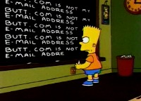
Quick Example
In Machine Code: 0s and 1s
char email_string[] = “Butt.com is not my e-mail address”;
int i;
for(i=0; i < 5; i++)
{
printf(“%s”, email_string)
}
In C:
In Ruby:
5.times { puts “Butt.com is not my e-mail address” }
http://www.simpsoncrazy.com/lists/blackboard

Slide 7
Think
Object-Oriented
Ruby is an Object-Oriented Language
Objects = Nouns, Methods = Verbs
Given a set of Nouns and Verbs, how do we describe to the computer what we want it to do?
Define your own Nouns and Verbs using those already known to the computer
Teach computer new words by importing libraries (Ruby Graph Library, Twitter API, Rails)

Slide 8
Ruby String Example
Task: given a name in the format ‘dylan_cashman’, return the last name
Noun: ‘dylan_cashman’, a String
String has the following methods:
#capitalize: changes the first character of a string to be uppercased
#split: splits the string into an array of substrings using a specified delimiter
Array has the following methods:
#first, #last: return the first and last element of array, respectively
In natural language, “Take the name, split it into first name and last name, return the last name, capitalized”
In Ruby:
‘dylan_cashman’.split(‘_’).last.capitalize

Slide 9
Ruby Literals
String - any piece of text
Array - an enumerable collection of objects
  arr = [1, 1, 2, 3, 5]
  arr[0] = 1, arr[4] = 5, arr.length = 5
Hash - a set of key-value pairs
  h = {:name => ‘Ann’, :hair_color => ‘Brown’}
  h[:name] = ‘Ann’, h[:hair_color] = ‘Brown’

Slide 10

Ruby Literals
Integer, Float, Decimal
Boolean - true or false
Date, DateTime, Time
NilClass - nil
Symbol - :options
http://www.pilatesmakesyouhappy.com/2012/10/04/thankful-thursday-or-please-stop-with-all-these-alliterations/ Accessed 01/19/2013

Slide 11
Creating Classes
Ruby lets us use existing nouns and their verbs to define new nouns with new verbs
class UtilitiesBillArray
def initialize(gas_price, electric_price)
@bill_array = [gas_price, electric_price]
end
def total_price
@bill_array.sum
end
end
november_bill = UtilitiesBillArray.new(84.55, 75.22)
november_bill.total_price # => 159.77

Slide 12

Executing Ruby
Execute Ruby in an interactive console
  irb: Interactive Ruby. Use for quick calculations and scripts
  rails console: irb shell with the Rails environment loaded - get access to all Rails classes
Write definitions and scripts into .rb file
  Run file with command: ruby my_file.rb
  File can contain class and method definitions
  File can also contain instructions to load other .rb files or libraries
  Full application is composed of dozens of .rb files, linked together

Slide 13
Open Source
Ruby is open source
  Source code is viewable online, along with documentation
  You can patch anything you don’t like about the source code
Community-created resources
  RubyGems - Injectable modules and libraries that provide extra functionality and extend classes
  Free to share and use in private projects. Includes Rails
Contribute to open source! Pay it forward!

Slide 14

In Conclusion...
Ruby is a modern, sophisticated programming language
It uses objects and methods to describe instructions to the computer
It aims to be human-readable
We can define our own objects and methods, or import libraries to pull in more objects and methods
http://blog.bounceweb.com/rapid-web-application-development-with-ruby-on-rails-and-mysql/ Accessed 01/19/2013

