Slide 1

Models, Scaffolding, & Migrations
Dylan Cashman
@dylan_cashman

Slide 2

Dynamic Vs. Static
Static - Flat HTML, content same for every user
  Old-school Geocities sites, Organization web pages with ‘About Us’
Dynamic - As website grows, content changes based on user input
  Blogs, Message Boards, Social Networks, et al
  Site takes user input, saves it, and can display it afterward

Slide 3

Persistence
POST
Today I had a good day. I found a penny on the side walk. Mood: :-)
Author: Dylan
DB
GET
Today I had a good day. I found a penny on the side walk. Mood: :-)
Author: Dylan

Slide 4
MVC - Model, View, Controller
“A software architecture pattern that separates the representation of information from the user's interaction with it.” --Wikipedia
4. Dynamic HTML returned
1. Request comes in
Controller
2. Controller gets data & calculations from Model Layer
View
Model
3. Controller passes data and calculations to View Layer to build HTML
http://en.wikipedia.org/wiki/Model%E2%80%93view%E2%80%93controller Accessed 01-18-2013

Slide 5
Databases
Separate an application into single objects
Store those objects in separate tables
Your Rails application knows how to grab data from those tables to build the page the user sees

Slide 6
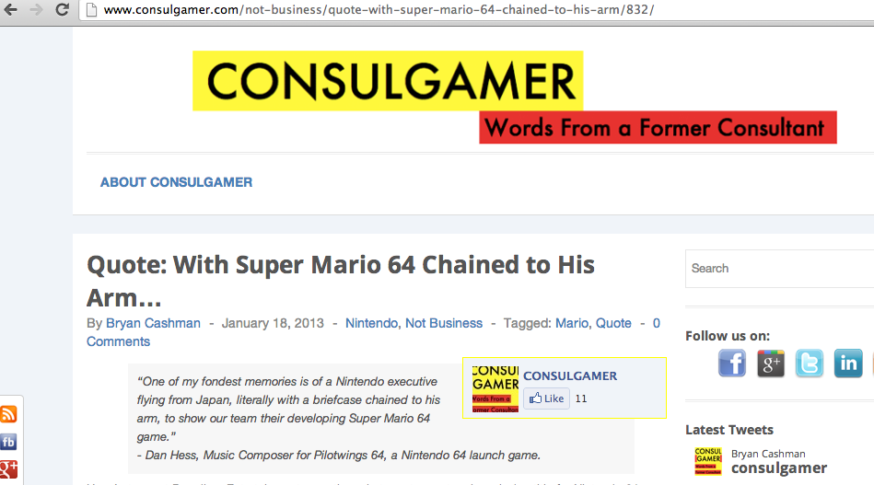
Example: A Blog
TABLES
Posts
Comments
Authors
Users
In Rails, each of these would be called a ‘Model’
You can also use ruby to write business logic on models, like a method for word_count

Slide 7
Scaffolding
Rails generates all this for you!
rails generate scaffold
  Creates model (app/models/post.rb)
  Creates controller (app/models/posts_controller.rb)
  Creates views (app/views/posts/)
  Creates migration (db/migrate/...create_posts.rb

Slide 8
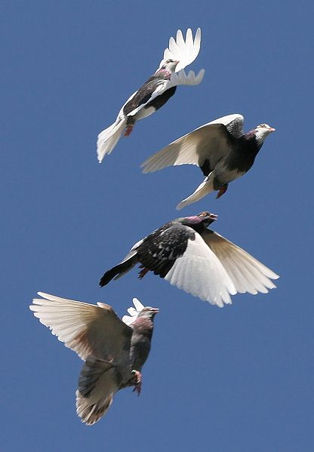
What’s a Migration?
Database tables are not supposed to change often
Each time we create a new table, or alter a table, we use a migration
Helps maintain a live database; prevents data loss
Execute migrations with rake db:migrate

Slide 9
Conclusion
Rails helps you build dynamic websites that persist data in database tables
Each object that corresponds to a table is called a Model. The model also contains business logic.
We use the generate scaffold command to have rails build us out a skeleton of models, views, controllers, and migrations
We use migrations to construct our database tables
Thanks!

