Slide 1
Updates (18.02.22)
Best layer/cluster defined using Elbow method
t-SNE and UMAP added to Shiny

Slide 2
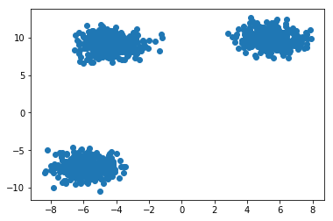
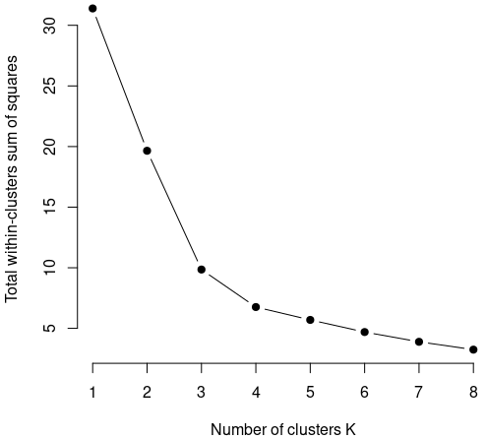
WSS scores
Within cluster Sum of Squared means how far a point is from the center of the cluster
Small number of clusters means a very high WSS
Too many clusters mean an “overfit”
Mclust uses the “Elbow” method to define optimal number of clusters

Slide 3
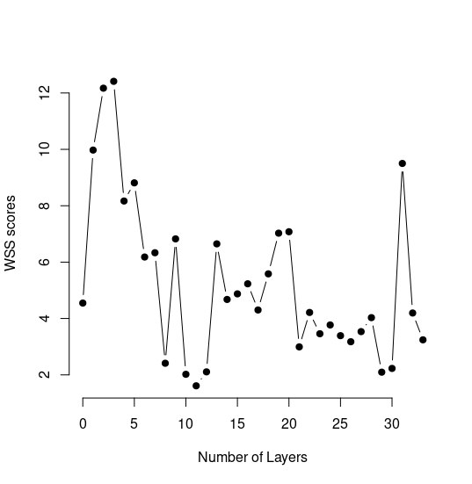
Protocol
Found optimal number of clusters for every layer using Mclust
Calculated WSS for every layer’s optimal cluster
Sorted based on WSS (lowest) to obtain the best layer

