Slide 1



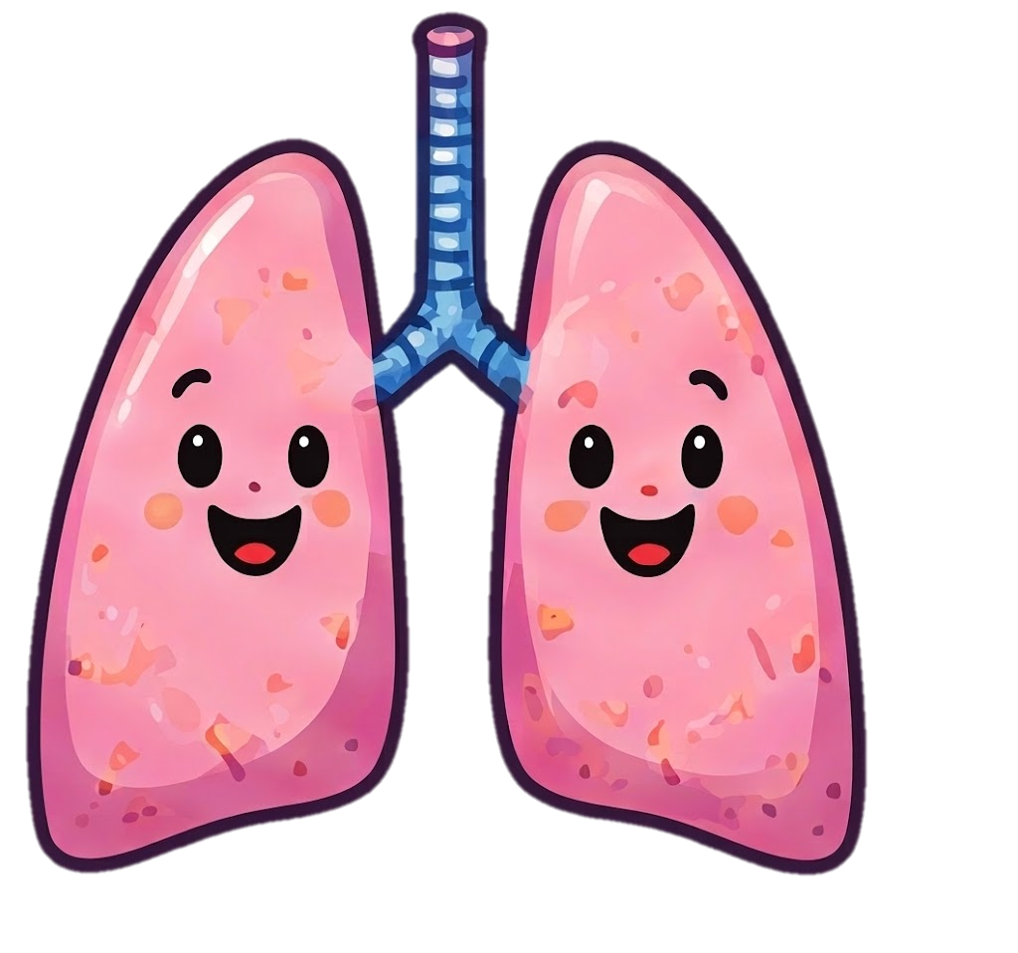
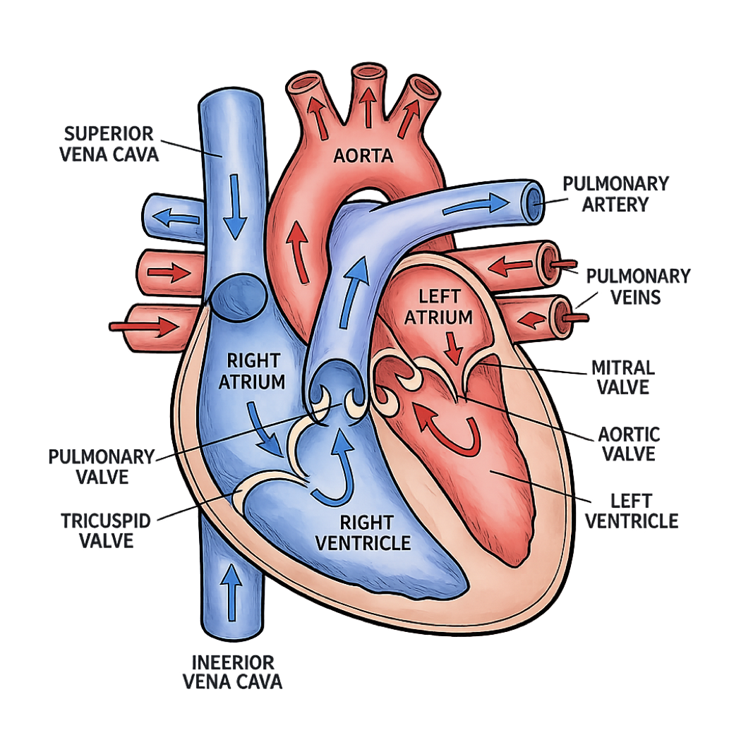
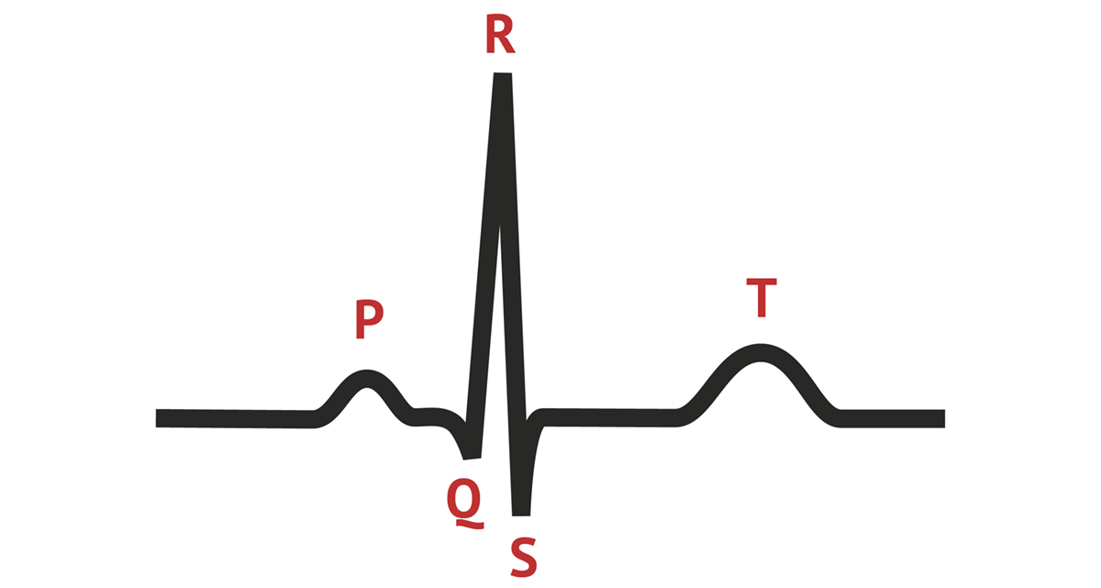

Your Heart: 4 Rooms Working as a Team!
The heart sends blood with oxygen and nutrients out through the aorta to every part of your body.
The ECG: Your Heart’s Electrical Map!
Your heart has a tiny electrical system that tells each room when to squeeze. An ECG is a machine that reads those signals.
Fun fact!
Your heart is about the size of your fist but is one of the strongest muscles in your body!
The body’s cells use oxygen and send blood back without oxygen to the heart.
At the Lungs, blood drops off carbon dioxide and picks up oxygen.
This is how one beat looks!
The valves are like doors that open one way, so blood keeps moving forward!
P
Small bump (P wave)
The atria squeeze to send blood to the ventricles.
The top 2 rooms are the ATRIA. Blood comes in and waits before going to the next room (like waiting rooms).
QRS
Big spike (QRS complex)
The ventricles squeeze hard to send blood to the body and lungs.
INFERIOR
VENA CAVA
The bottom 2 rooms are the VENTRICLES. They push the blood out to the lungs or to the rest of the body.
T
Big bump (T wave)
The heart relaxes and reset to get ready again!
The heart works non-stop, beats about 60-100 times every minute. Even when you are resting!

