Slide 1
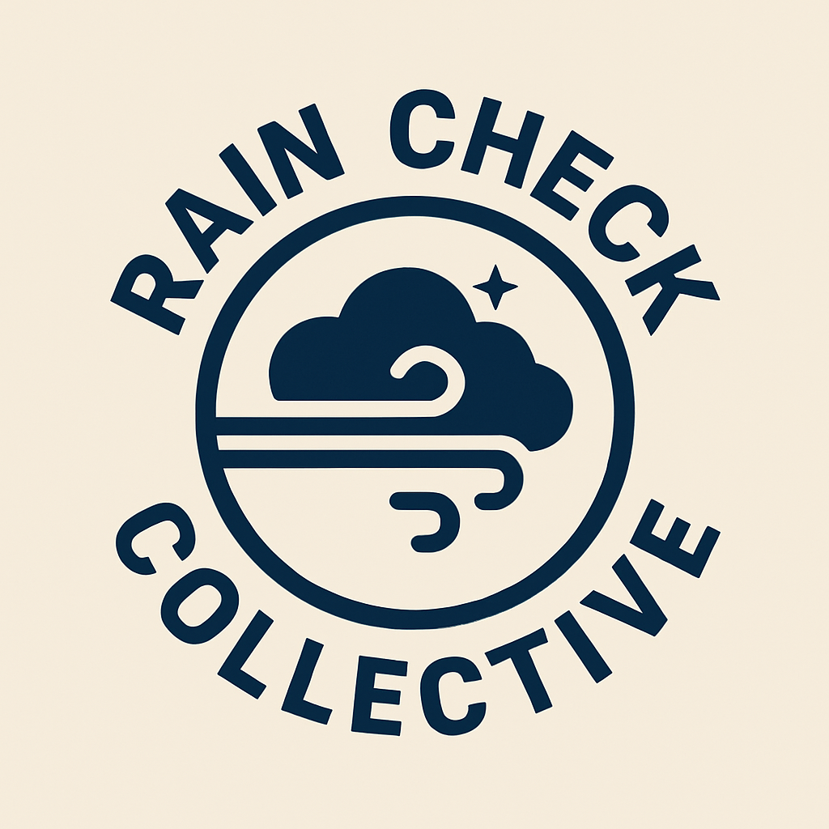
Rain Check Collective
NASA Weather App Global Challenge Pitch

Slide 2
Meet the Team
Rain Check Collective is a diverse team of programmers and a data manager who are passionate about leveraging NASA’s data to improve weather prediction and planetary resilience.
Project Manager & Technical Lead: Cindy Black
Programmer extraordinaire: Emme
Technical Documentation: Ana Shah
Project Organization & Code Review: Ahmad Mukhtar Sharify

Slide 3
Our Mission
Our mission is to revolutionize weather data analysis and prediction through global collaboration to support NASA’s ongoing planetary exploration and mission planning using historical data.

Slide 4
Introducing the Will It Rain App
Will It Rain is a cross-platform app integrating historical FAA METAR data with real-time predictive models. It offers precise, localized weather forecasts and anomaly detection through an intuitive, space-inspired interface.

Slide 5
Data Sources & Integration
The 2025 Space Apps Challenge coincided with the October 2025 federal government shutdown. During Day One of the hackathon, our attempts to retrieve data from NASA's Earthdata Harmony API endpoints consistently returned Zero granules or job failures across multiple collection IDs and query parameters.
Given time constraints and API reliability issues, the team pivoted to FAA (Federal Aviation Administration) METAR (Meteorological Aerodrome Report) data via Iowa State University's Environmental Mesonet archive. This source provides comprehensive historical aviation weather observations and is maintained independently of federal services, allowing us to proceed with implementation.

Slide 6
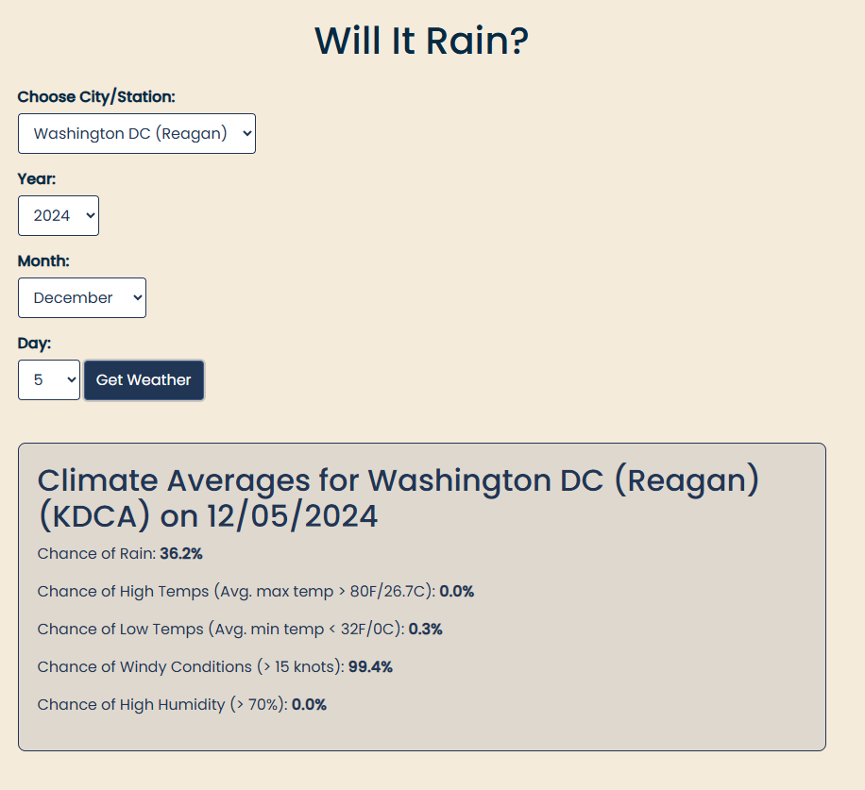
Predictive Modeling
Our predictive modeling uses five years of FAA’s METAR historical data from various US-based major cities.

Slide 7
User Interface & Accessibility
Built using Python, HTML, CSS, and JavaScript with a NASA-inspired design language emphasizing clarity, contrast, and universal accessibility.

Slide 8
System Architecture & Security
Implements encrypted data transfer and NASA-approved authentication to maintain operational security and integrity.

Slide 9
Sources & References
• Historical FAA METAR data
• NOAA National Centers for Environmental Information

