Slide 1
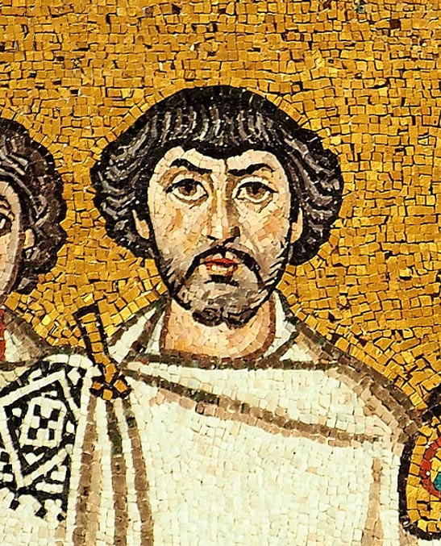

On the Round Complexity of Randomized Byzantine Agreement
Ran Cohen, Iftach Haitner, Nikolaos Makriyannis, Matan Orland & Alex Samorodnitsky To appear in DISC’19

Slide 2
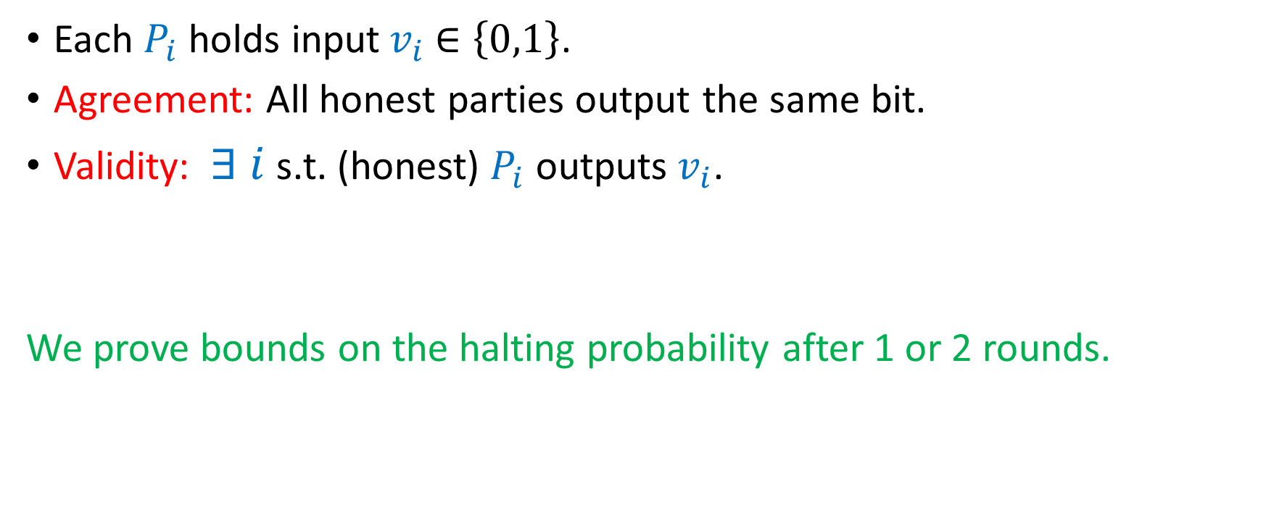
Randomized BA & Problem Statement
Each $P_{i}$ holds input${ v}_{i} ∈\left\{0,1\right\}$.
Agreement: All honest parties output the same bit.
Validity: $∃ i$ s.t. (honest) $P_{i}$ outputs${ v}_{i}$.
We prove bounds on the halting probability after 1 or 2 rounds.

Slide 3
Randomized BA & Problem Statement
Each $P_{i}$ holds input${ v}_{i} ∈\left\{0,1\right\}$.
Agreement: All honest parties output the same bit.
Validity: $∃ i$ s.t. (honest) $P_{i}$ outputs${ v}_{i}$.
We prove bounds on the halting probability after 1 or 2 rounds.
Micali’s BA (ITCS’17) halts after 3 rounds with constant probability.

Slide 4
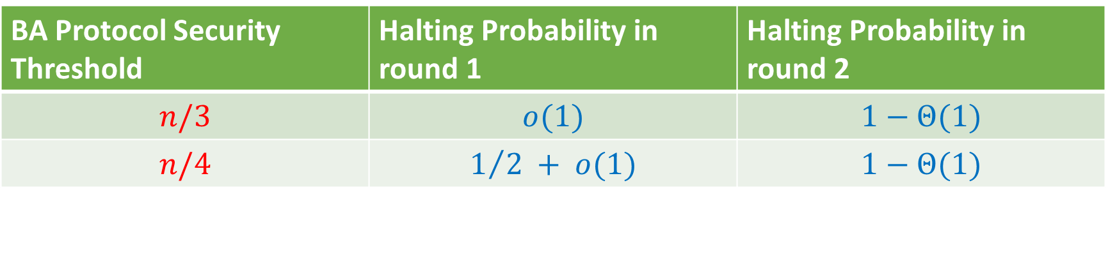
We Show
BA Protocol Security Threshold | Halting Probability in round 1 | Halting Probability in round 2
$$n/3$$ | $$o(1)$$ | $$1−Θ(1)$$
$$n/4$$ | $$1/2 + o(1)$$ | $$1−Θ(1)$$

Slide 5
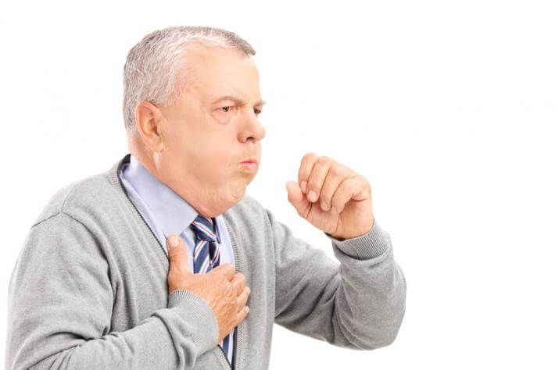
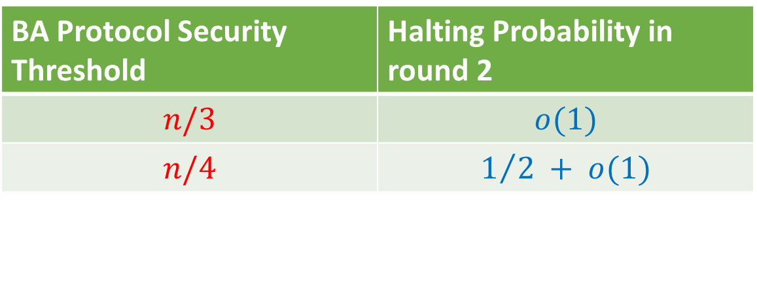
We Show
BA Protocol Security Threshold | Halting Probability in round 1 | Halting Probability in round 2
$$n/3$$ | $$o(1)$$ | $$1−Θ(1)$$
$$n/4$$ | $$1/2 + o(1)$$ | $$1−Θ(1)$$
For all* BA protocols and under plausible combinatorial assumption:
BA Protocol Security Threshold | Halting Probability in round 2
$$n/3$$ | $$o(1)$$
$$n/4$$ | $$1/2 + o(1)$$

Slide 6

Our Technique
We follow the classic blueprint for deterministic protocols:
Input=000…000
Input=000…001
…
Input=111…111

Slide 7
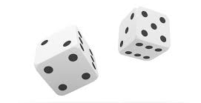
Our Technique
We follow the classic blueprint for deterministic protocols:
However, for randomized protocols, the above chain fails.
Input=000…000
Input=000…001
…
Input=111…111
The randomness can be used to distinguish adjacent executions.

Slide 8
Our Technique (cont’d)
Solution: Abort (certain) parties to uncouple randomness from output.

Slide 9
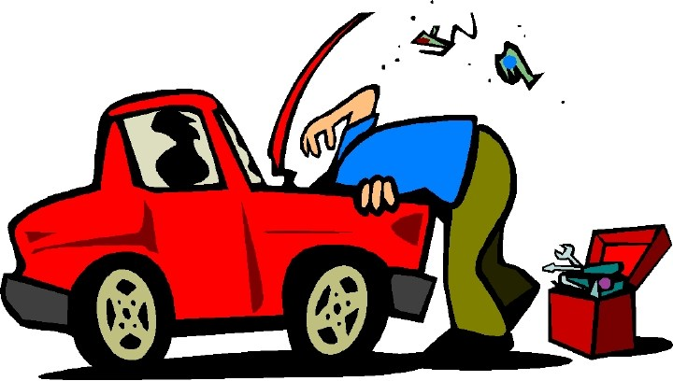
Our Technique (cont’d)
Solution: Abort (certain) parties to uncouple randomness from output.
Our attack gives rise to an isoperimetric-type inequality.
Unrealistic cases reduce to KKL & Friedgut’s junta theorem.
General case is left as open problem.

Slide 10
Thank You!
Available on eprint & arXiv:
https://eprint.iacr.org/2019/868
https://arxiv.org/abs/1907.11329

