Slide 1
Web design

Slide 2
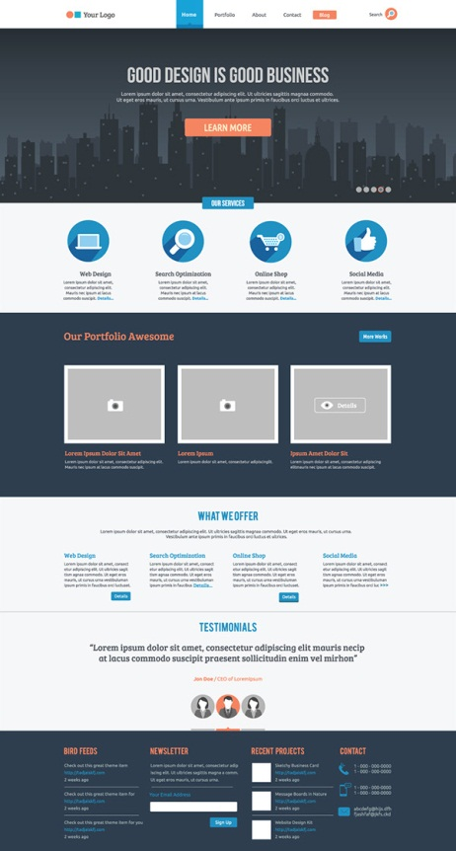
What is the web site?

Slide 3
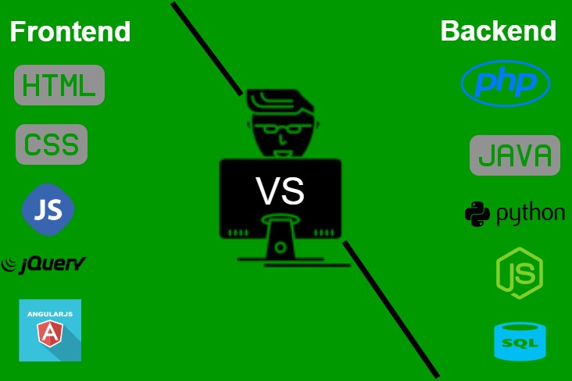
Part of web site building:
Part of web site:

Slide 4
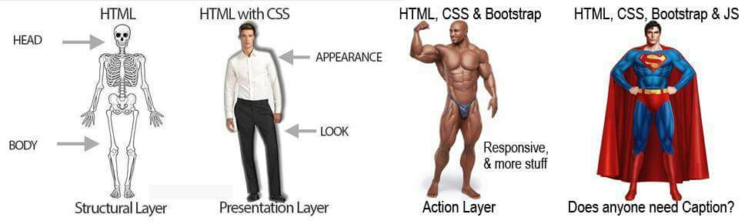

Slide 5

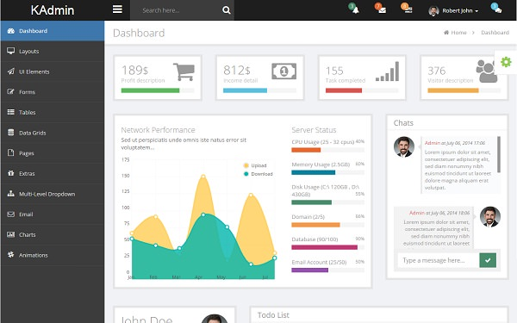

Slide 6
What you are need to start?
Notepad++
Atom
Brackets
Adobe Dreamweaver
Coda
visual studio code

