Slide 1
Lending Club Case Study
Group Members:
Raina Sharma
Rahul Madan

Slide 2


Case Study Objectives
understand the driving factors (or driver variables) behind loan default, i.e. the variables which are strong indicators of default.
identify risky loan applicants using EDA. The company can utilise this knowledge for its portfolio and risk assessment.

Slide 3
Data Cleaning Steps
Fix rows and columns
1
Fix missing values
2
Standardise values
3
Fix invalid values
4
Filter data
5

Slide 4
Pre preparatory steps
Removed columns having null values >40%
Dropped columns not required in analysis
Handled Null values and imputed the missing data
Corrected data types of columns
Created Derived Columns required for the analysis
Found outliers and removed

Slide 5
Univariate Analysis

Slide 6
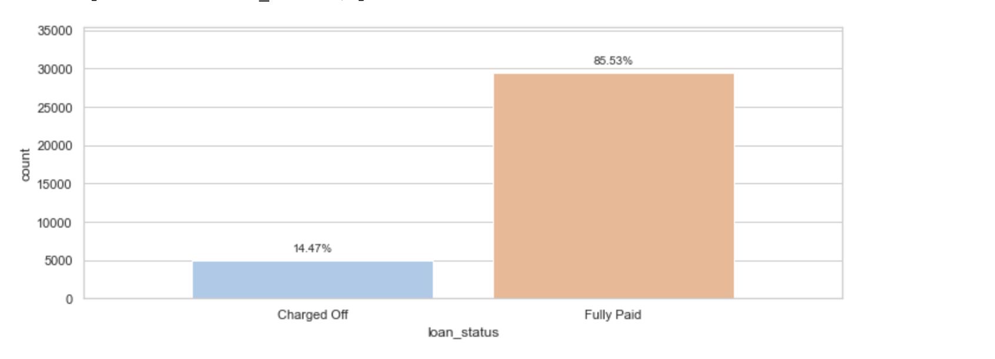
Loan Status
Observation:
85% of the loans are successfully paid and only 15% of the loans are defaulted

Slide 7
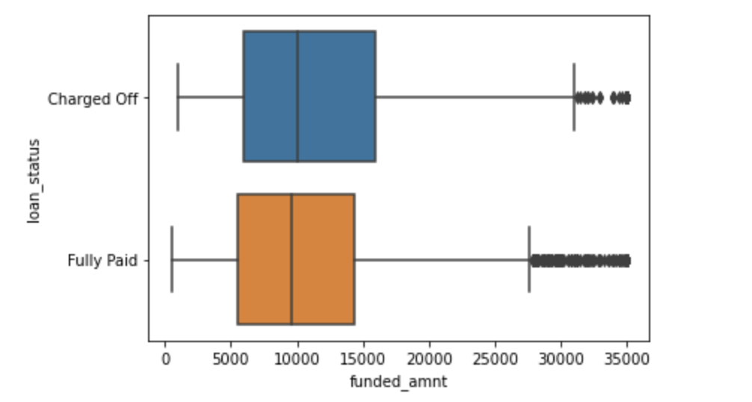
Funded Amount
**Considering Funded amount for analysis as that is the actual loan amount funded
Observation:
Overall, the funded amount distribution is slightly right-skewed with mean greater than the median. Most of the loans granted are below 16000 (75 percentile value)
Charged off loans have higher average of funded amount than the paid off loans.

Slide 8
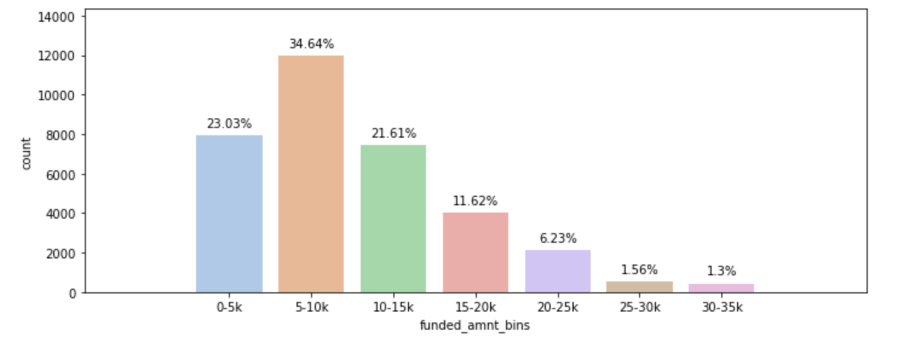
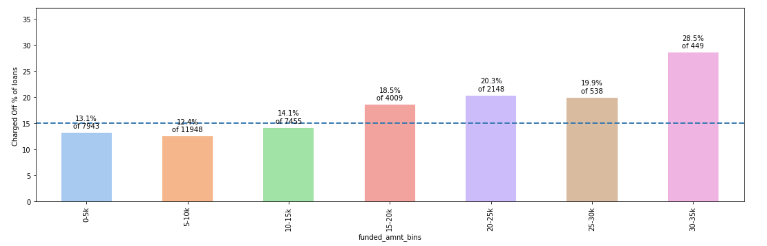
Funded Amount
Observation:
The % of charged off loans increases substantially with increase in funded amount

Slide 9
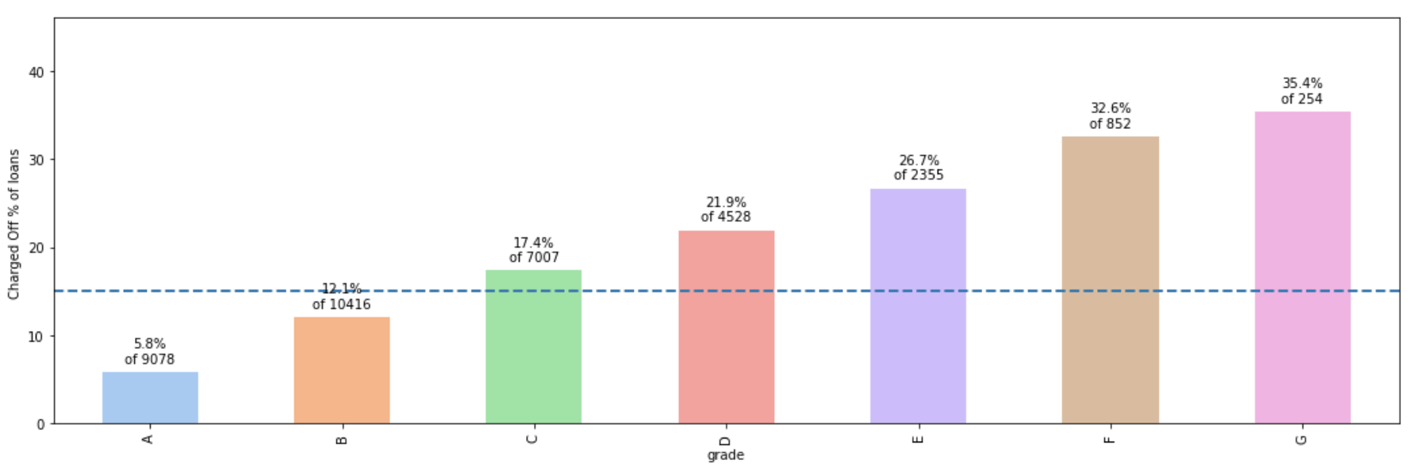
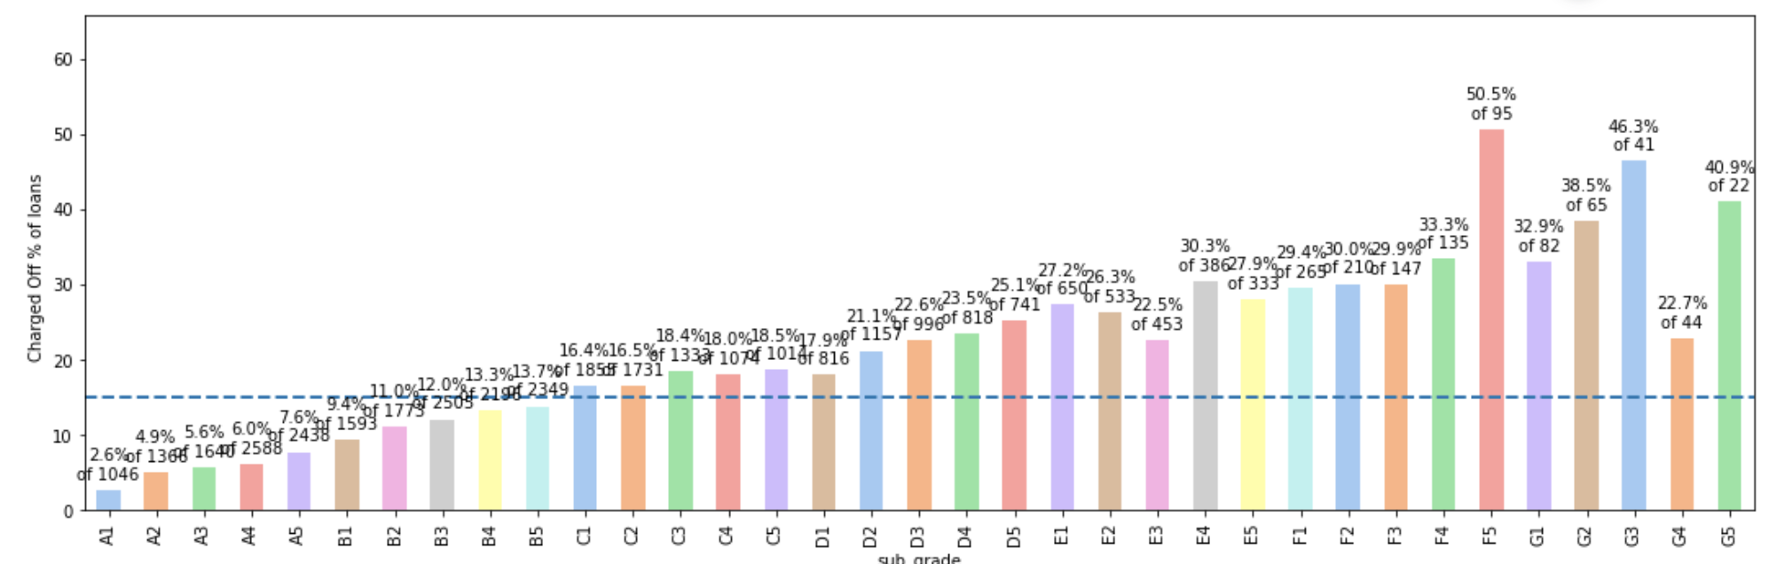
Grade & sub grade
Observation:
Chances of defaulting increases with grade from A to G and subgrade from A1-A5, B1-B5, & so forth

Slide 10
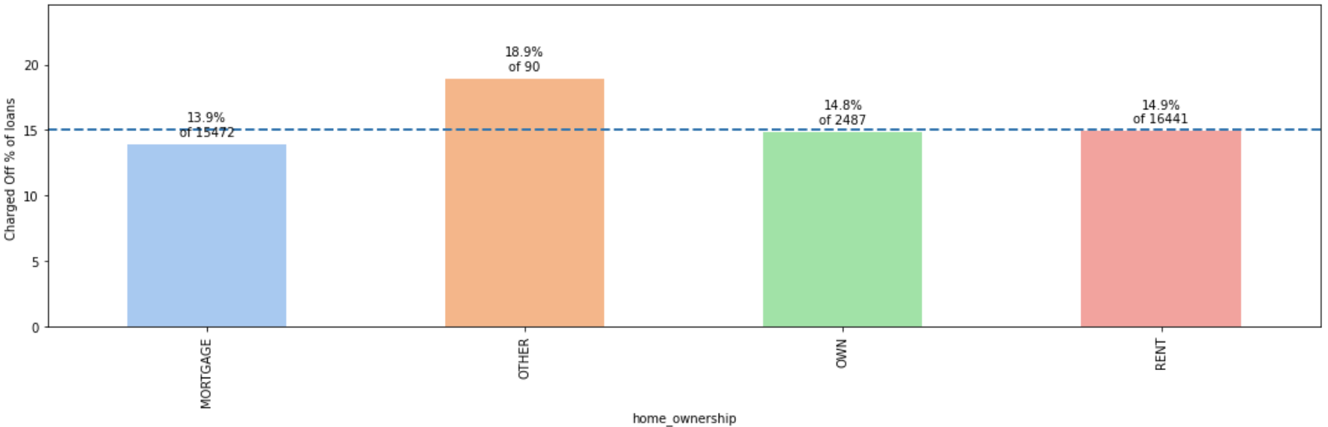
Home ownership
Observation:
People with ownership type as Mortgage and Rent are the most who take loans.
The default rate is high for people having home ownership as other.
The default rate is not significantly impacted by the home ownership status - Mortgage/Owned/Rent

Slide 11
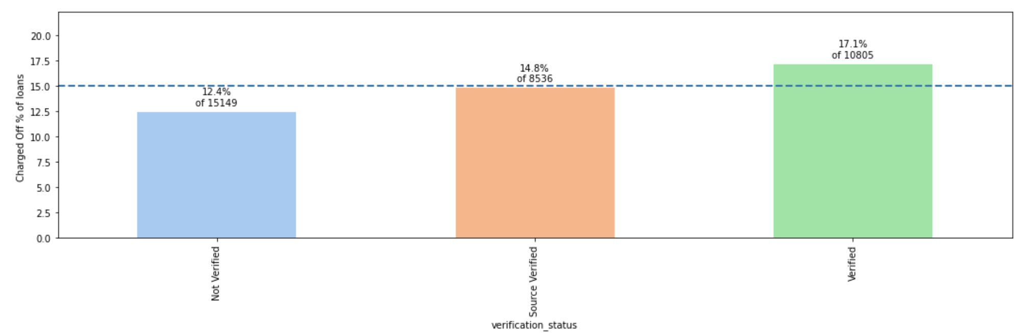
Verification status
Observation:
Majority of people taking loans are not verified.
Chances of Defaulting is higher even with the verification status as verified.

Slide 12
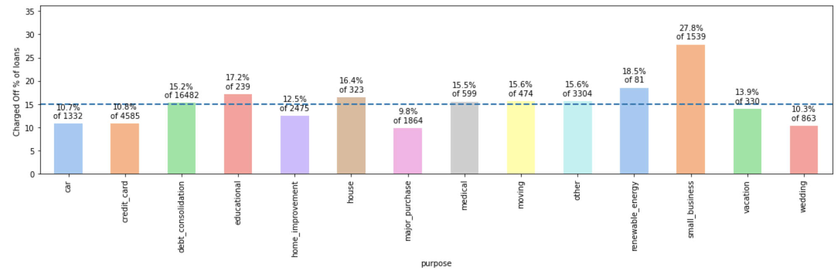
purpose
Observation:
Majority of people taking loans have credit card or debt consolidation as purpose.
Default rate is higher for small business, renewable energy, educational categories.

Slide 13
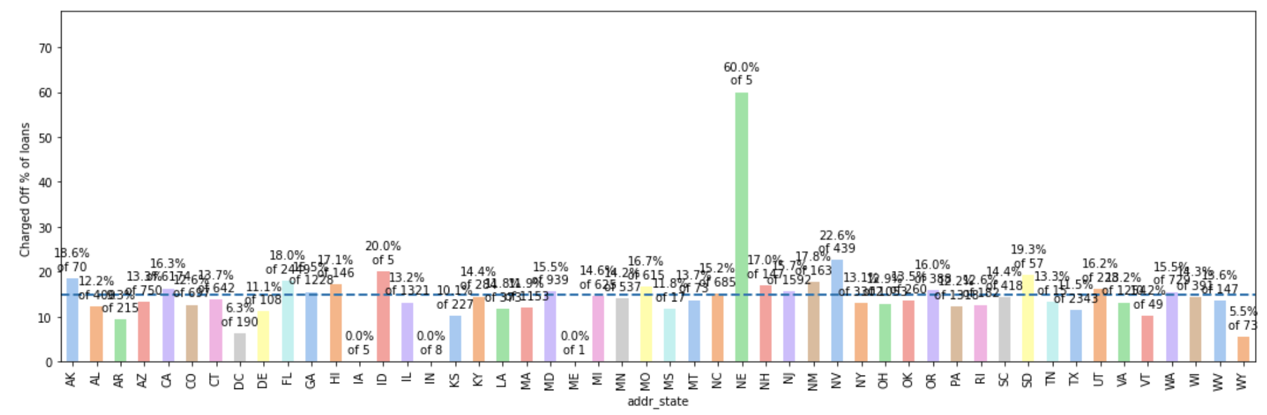
BorRower State
Observation:
Most of the borrowers are from California, New York, Florida.
Although Nebraska(NE) has high default rate but can be ignored since it had insignificant number of borrowers.
Nevada and South Dakota have high default rate and with significant % of borrowers.

Slide 14
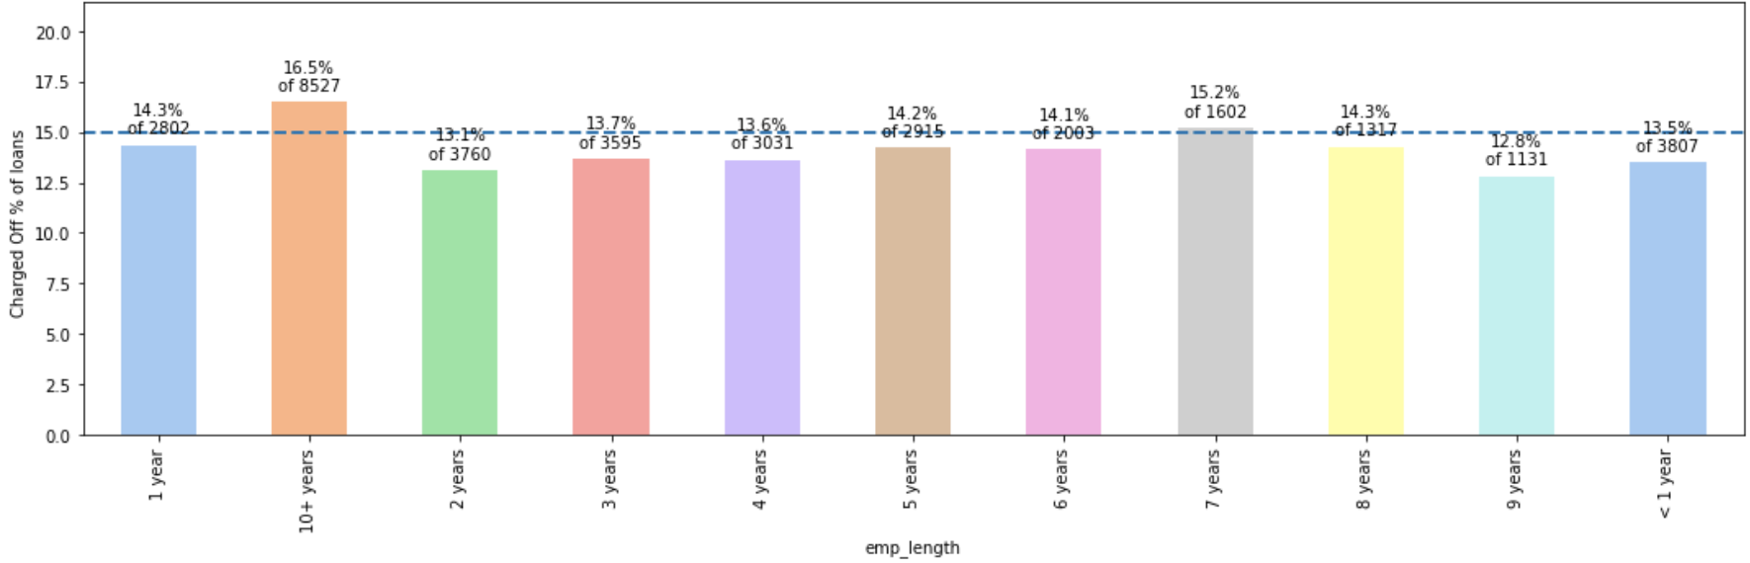
Employment length
Observation:
Most of the borrowers either have experience >10 or are freshers.
Chances of defaulting is higher for people with experience > 10 years.

Slide 15
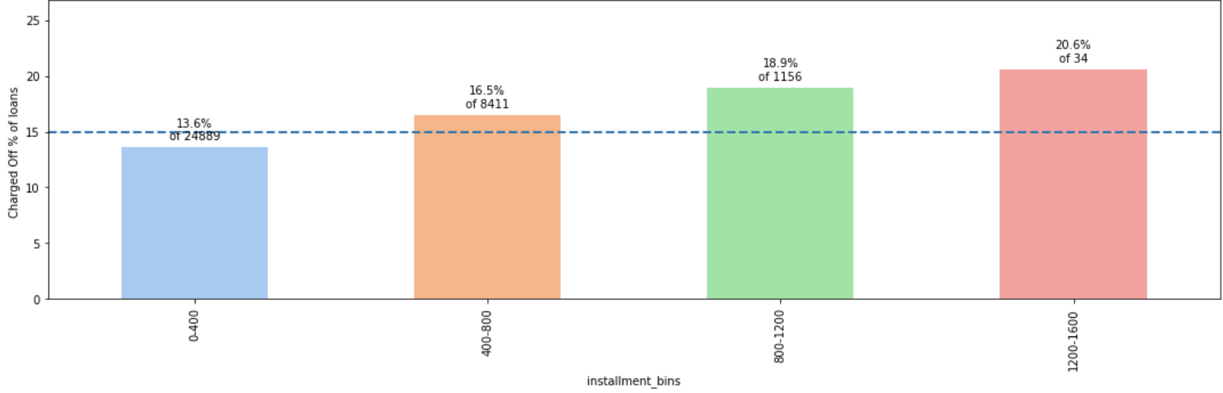
Loan Installment
Observation:
Chances of defaulting are higher for loans with higher amount of instalment

Slide 16
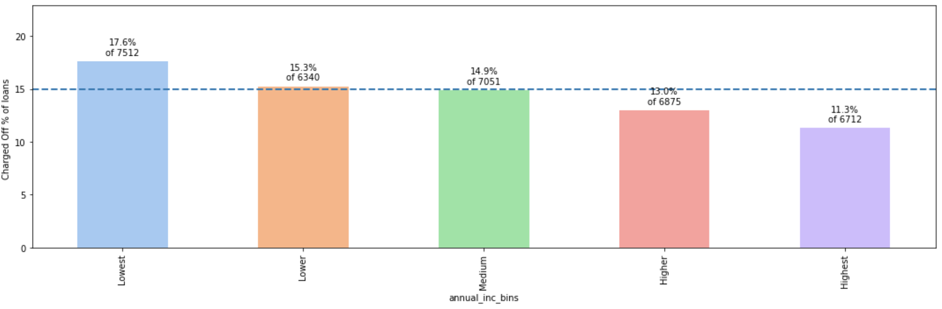
Annual income
Observation:
People with low annual income have high chances of defaulting.

Slide 17
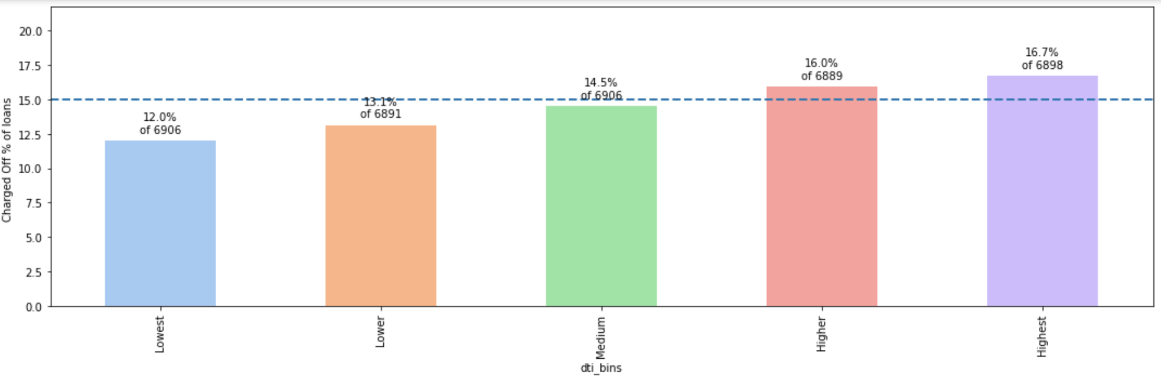
Debt to income ratio
Observation:
High DTI ( debt to income ratio) results in higher charged off % for loans.

Slide 18
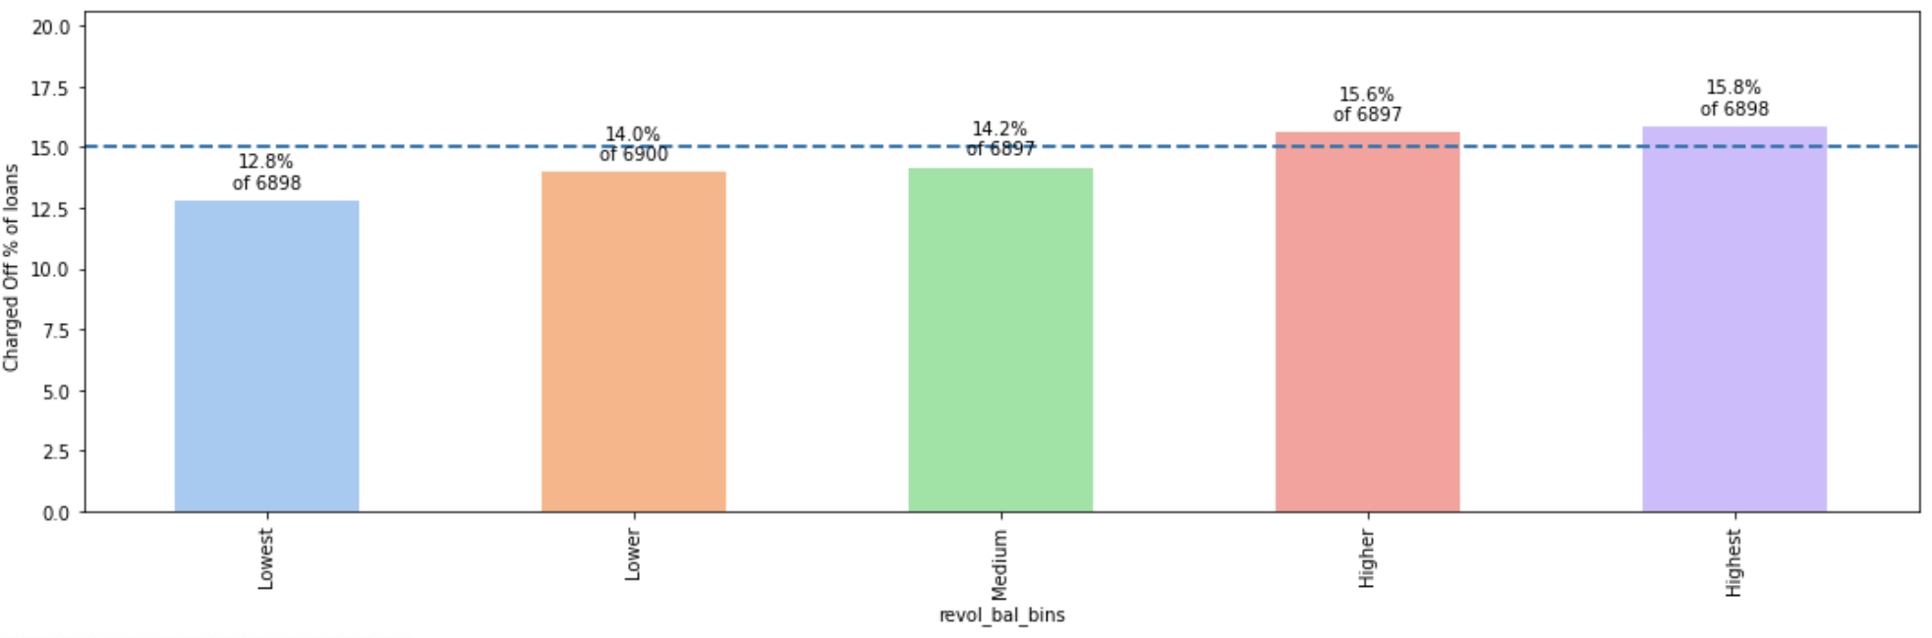
Revolving balance
Observation:
Higher the revolving balance, bigger the chance of the loan getting defaulted.

Slide 19
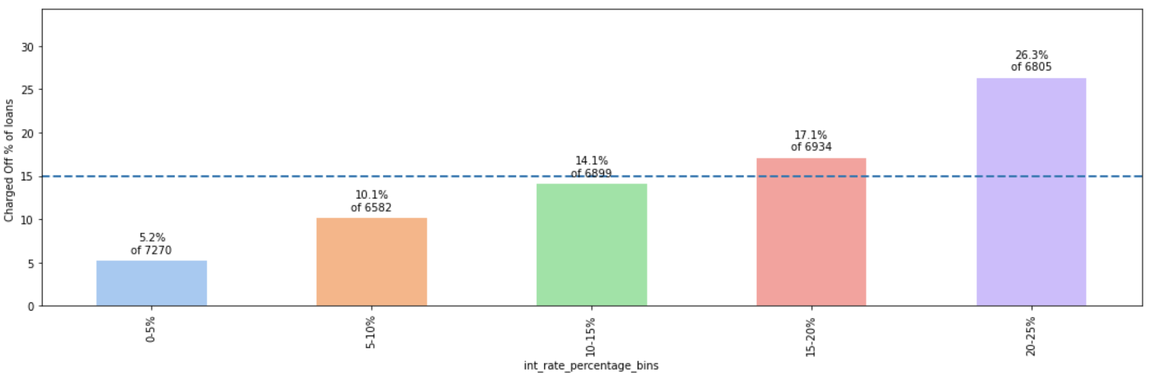
Interest rate
Observation:
Loans with high interest rates results into high default rates.

Slide 20
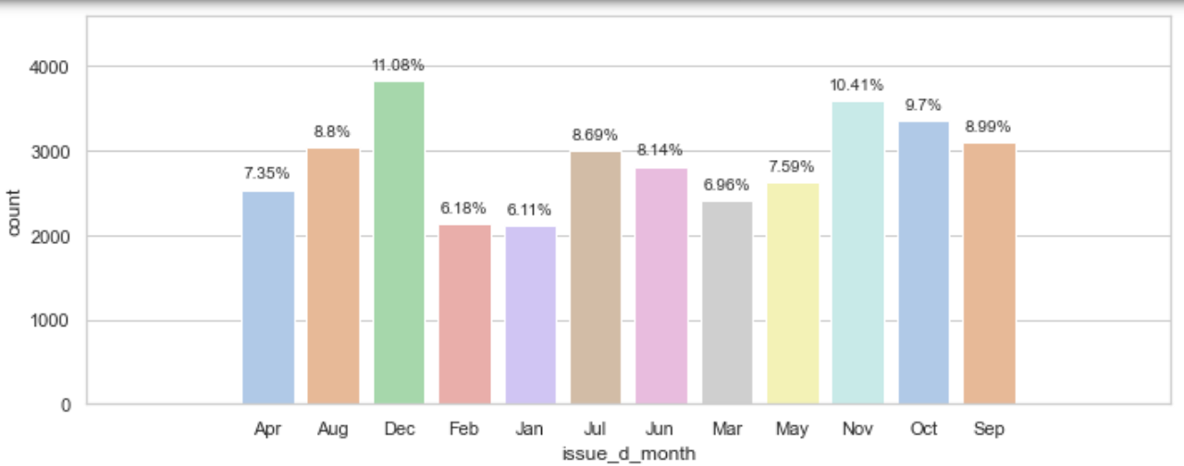
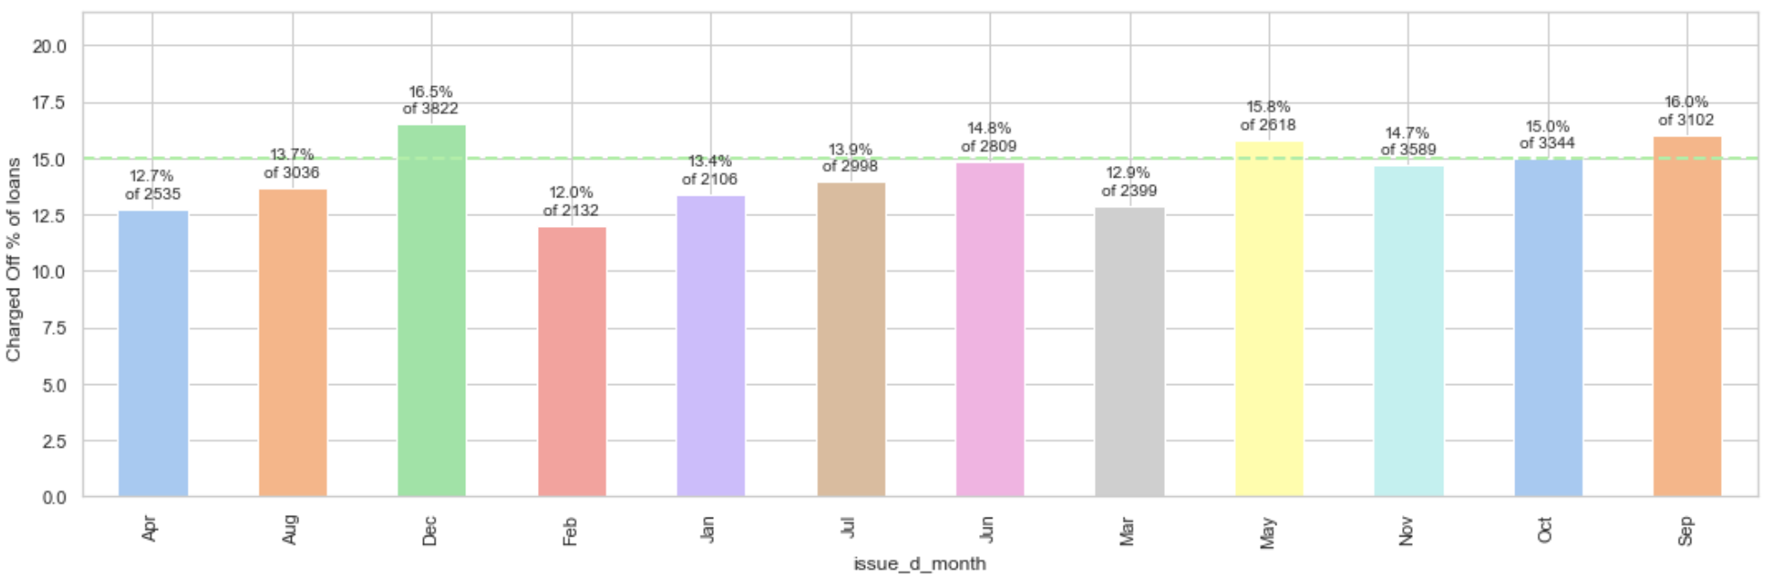
Issue date
Observation:
December has the highest charged off ratio.
Upward trend in number of borrowers from Jan to Dec.

Slide 21
BIvariate Analysis

Slide 22
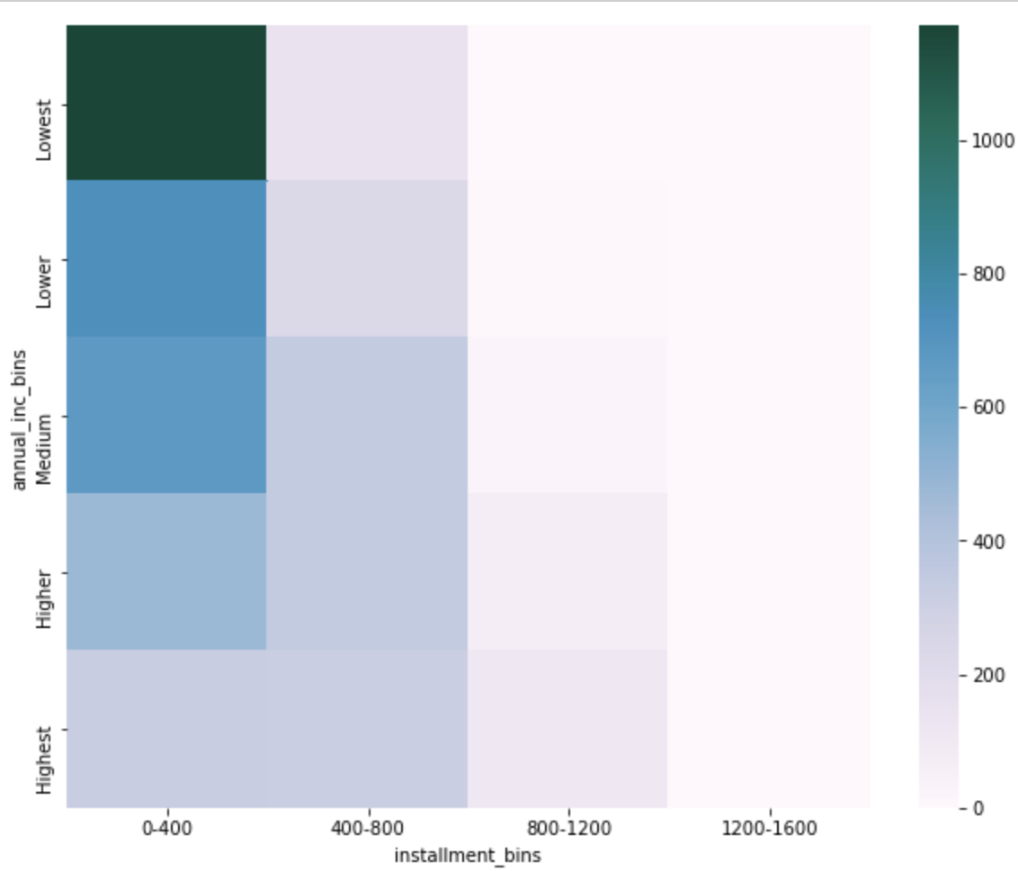
Annual Income and Instalment
Observation:
Chances of defaulting is high when the borrower has annual income in the lowest segment, even though the instalment is lowest too.

Slide 23
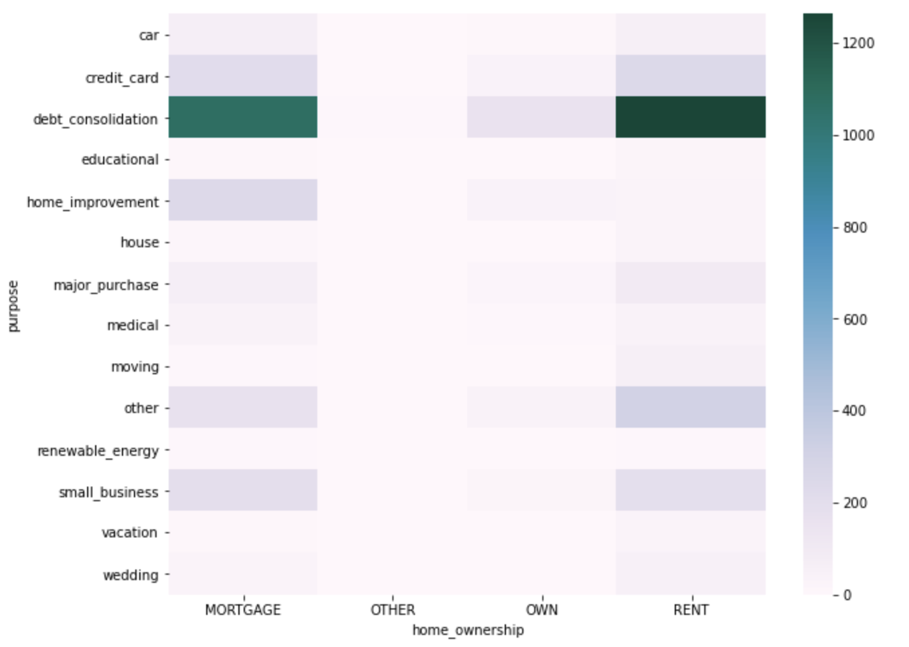
Home ownership and purpose
Observation:
Chances of defaulting is high when the borrower living in mortgage or rented home takes loan for the purpose of debt consolidation.

Slide 24
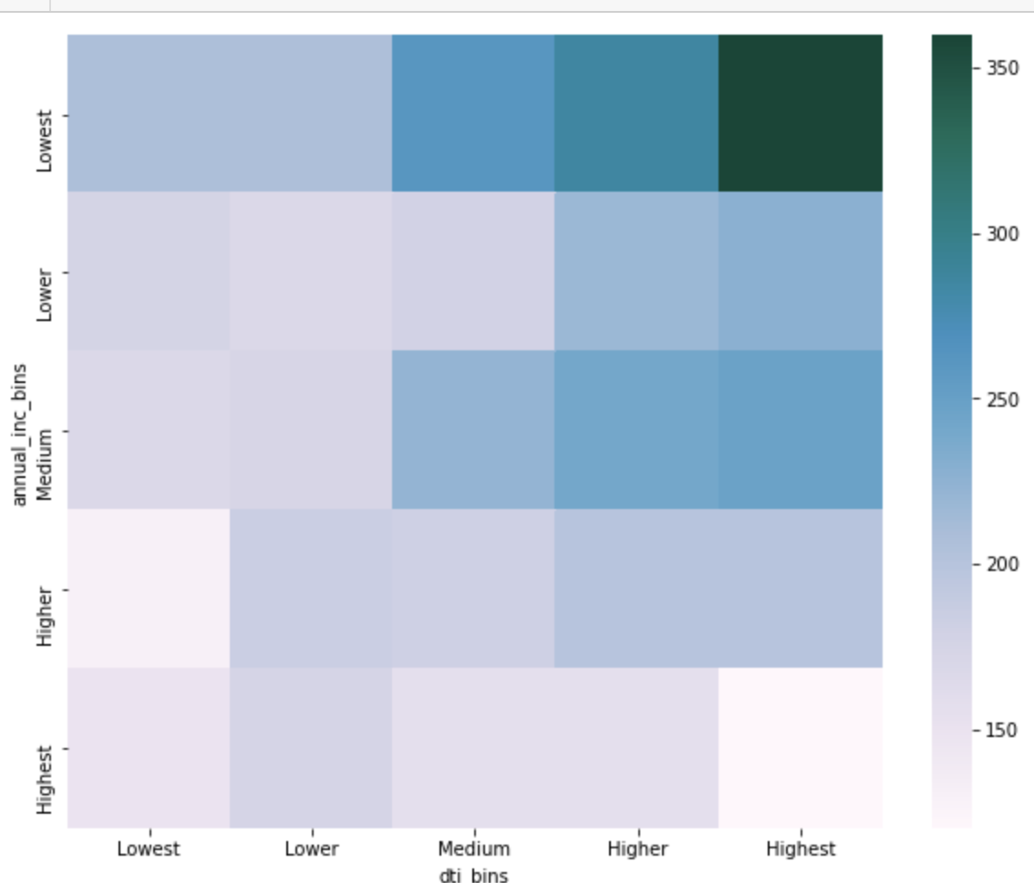
dti and annual income
Observation:
Chances of defaulting is high for the borrower with lowest income and high dti(debt to income ratio)

Slide 25
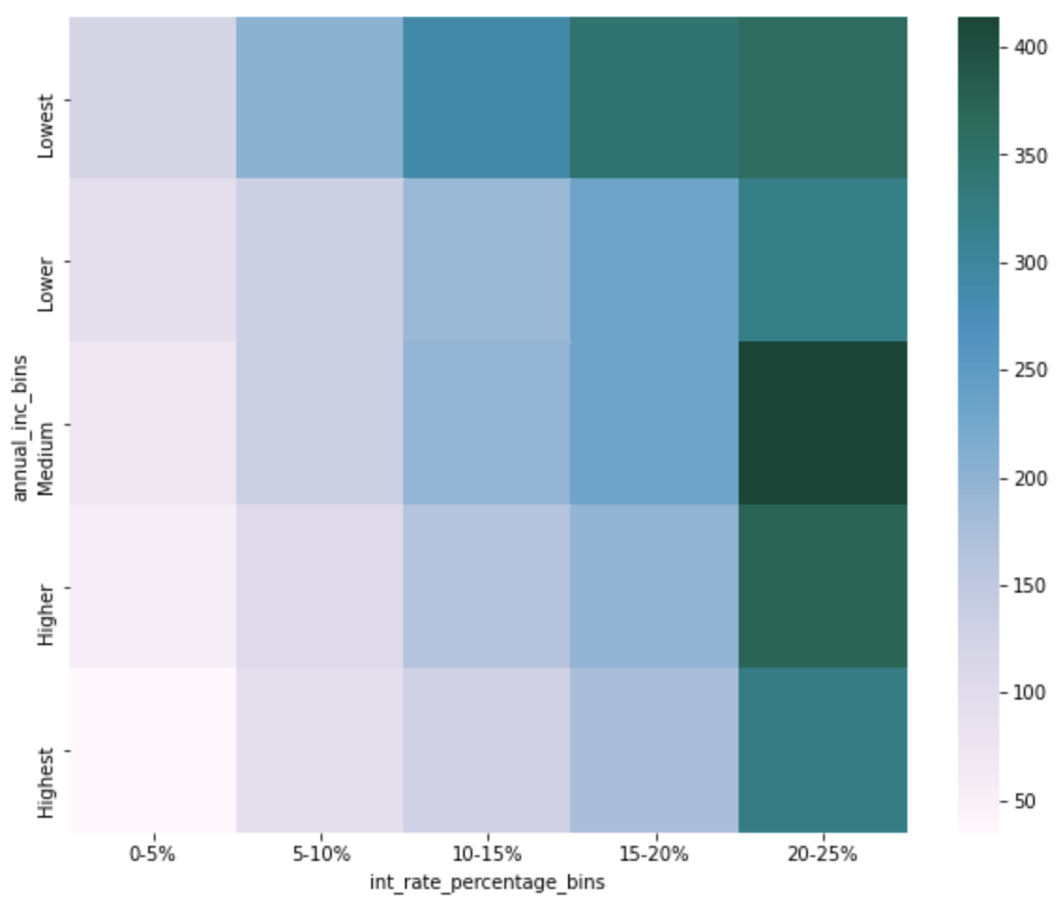
interest rate and annual income
Observation:
High interest rate for lower and medium income groups lead to high default rate

Slide 26
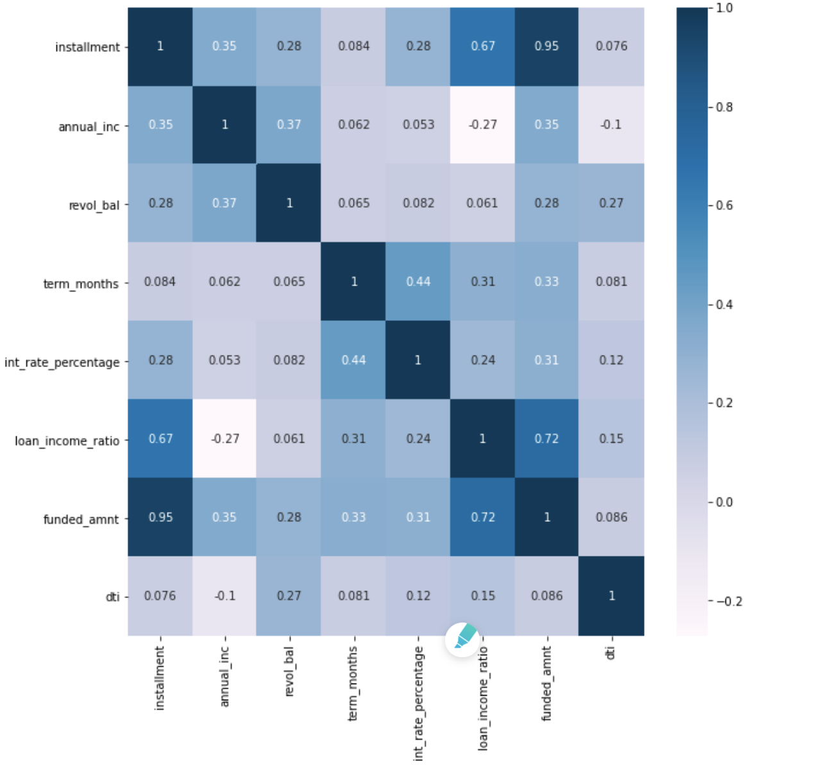
Correlation matrix
Observation:
Funded amount have very high correlation with the loan income ratio.
Term months and interest rate are positively correlated

Slide 27

conclusion
The most impactful drivers are :
Univariate Factors
Higher interest rate
Term of the loan (60 months)
Loan purpose (small business, renewable energy, educational)
Higher revolving line utilization rate
Loan grade & sub-grade
Higher loan amount
Higher instalment amount
Lower annual income
Higher debt to income ratio
Applicant’s address state
Loan issue month (Dec, May, Sep)
Bivariate Factors
High loan amount & interest rate for lower income group
Home ownership (mortgaged and rented) and loan purpose (debt consolidation)
Residential state and loan purpose
lowest income and high dti(debt to income ratio)

