Slide 1
The following spectrogram is:
burst
spectrogram
speech
formant

Slide 2
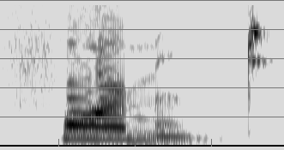

Slide 3

answer
“formant”

Slide 4
The following spectrogram is:
burst
first
bust
Bert

Slide 5
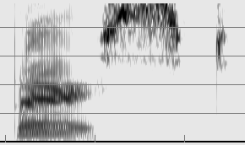

Slide 6
answer
“burst”
unaspirated labial stop
very low F3 together with F2,
vowel-like then sonorant-like
s
voiceless alveolar

Slide 7
The following spectrogram is:
intend
intone
entire
intake

Slide 8
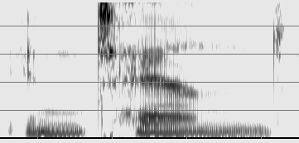

Slide 9
answer
“intend”
very short vowel
nasal
aspirated alveolar stop
lowish front vowel
nasal
alveolar

Slide 10
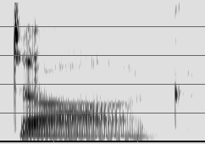
Spectrogram: pets

Slide 11
answer
“dog”

Slide 12
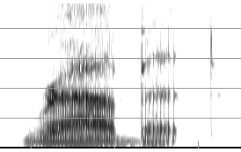
Spectrogram: pets

Slide 13
answer
“rabbit”

Slide 14
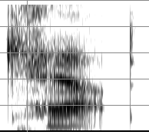
Spectrogram: pets

Slide 15
answer
“cat”

Slide 16
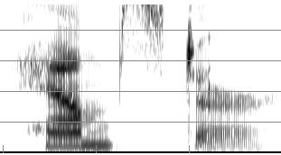
Spectrogram: pets

Slide 17

answer
“hamster”

Slide 18
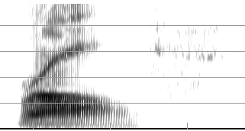
Spectrogram: UCLA

Slide 19
Answer:
“Rolfe”

Slide 20
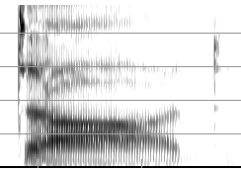
Spectrogram: UCLA

Slide 21
Answer:
“Dodd”

Slide 22
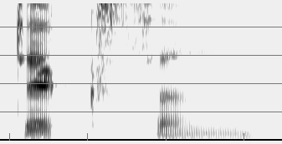
Spectrogram: UCLA

Slide 23
Answer:
“Dickson”

Slide 24
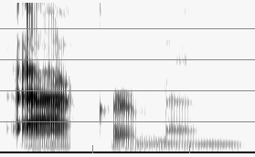
Spectrogram: UCLA

Slide 25
answer
“Ackerman”

Slide 26
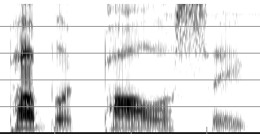
Spectrogram: UCLA

Slide 27
answer
“Public Policy”

Slide 28
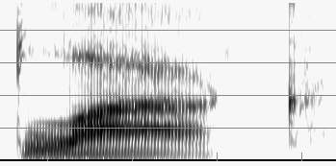
Spectrograms: colors

Slide 29
answer
“black”

Slide 30
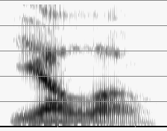
Spectrograms: colors

Slide 31
answer
“yellow”

Slide 32
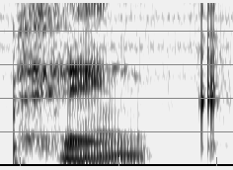
Spectrograms: colors

Slide 33
answer
“pink”

Slide 34
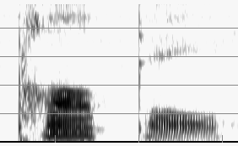
Spectrograms: colors

Slide 35
answer
“purple”

Slide 36
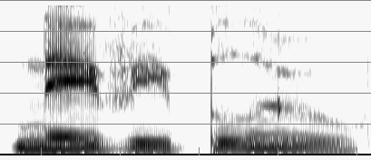
Spectrograms: colors

Slide 37
answer
“navy blue”

Slide 38
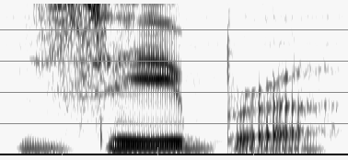
Spectrograms: animals

Slide 39
answer
“zebra”

Slide 40
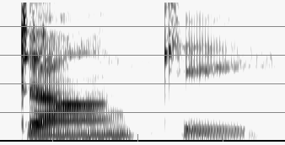
Spectrograms: animals

Slide 41
answer
“donkey”

Slide 42
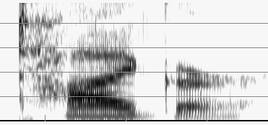
Spectrograms: animals

Slide 43
answer
“tiger”

Slide 44
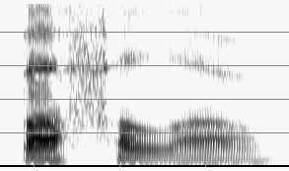
Spectrograms: animals

Slide 45
answer
“buffalo”

Slide 46
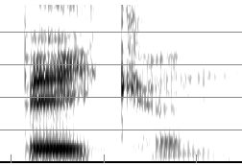
Spectrograms: foods

Slide 47
answer
“bacon”

Slide 48
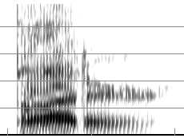
Spectrograms: foods

Slide 49
answer
“butter”

Slide 50
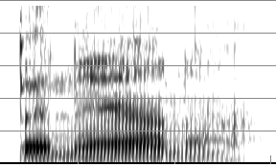
Spectrograms: foods

Slide 51
answer
“banana”

Slide 52
After those, no sound files

Slide 53
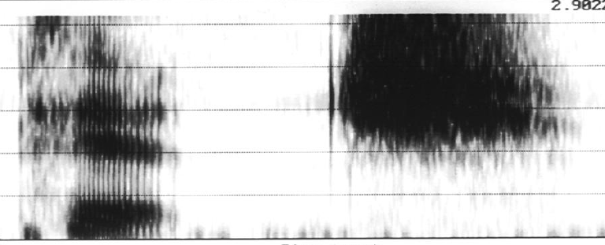
1-syllable speech word

Slide 54
answer
“pitch”
aspiration
high F2 but not lowest F1
affricate with noise at vowel F3

Slide 55
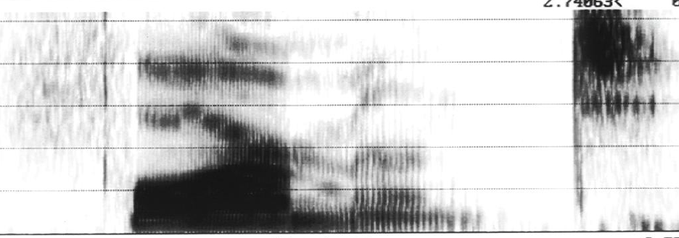
2-syllable speech word

Slide 56
answer
“formant”
weak fricative
F1 and F2 together, not a low vowel
F3 dives for /r/
nasal
another nasal or weak vowel
voiceless stop with high frequencies

Slide 57
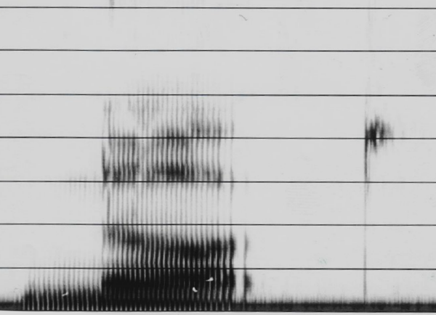
Consonant reading
clue


Slide 58
answer
“nut”
sonorant (strong voicing) with abrupt end, then falling F2 into vowel
glottalized voiceless stop with high-frequency release burst

Slide 59
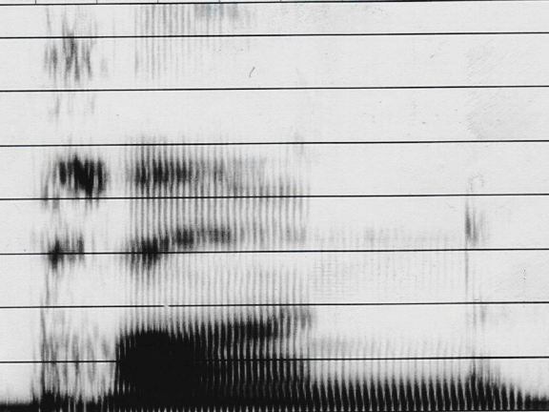
Consonant reading
clue


Slide 60
answer
“pun”
initial aspiration might look like a fricative, but note the voiceless formants
final sonorant has a voiced-stop release (a little bit of vowel after)

Slide 61
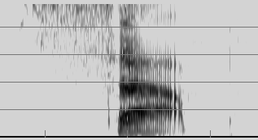
Vowel reading
s
p

Slide 62
answer
“sap”
High F1 means low vowel
F2 is also high

Slide 63
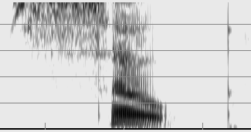
Vowel reading
s
p

Slide 64
answer
“soap”
Diphthong headed for /u/
F1 doesn’t start really high

Slide 65
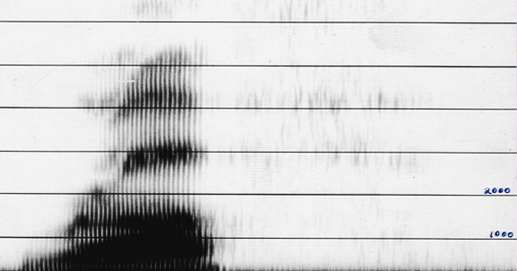
Consonant reading
lots of weak noise hard to see
clue


Slide 66
answer
“rough”

Slide 67
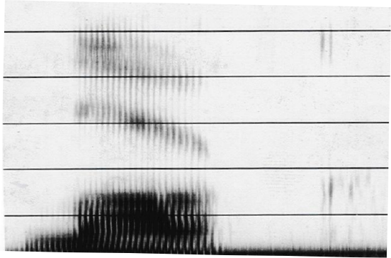
Consonant reading
clue
clue


Slide 68
answer
“luck”

Slide 69
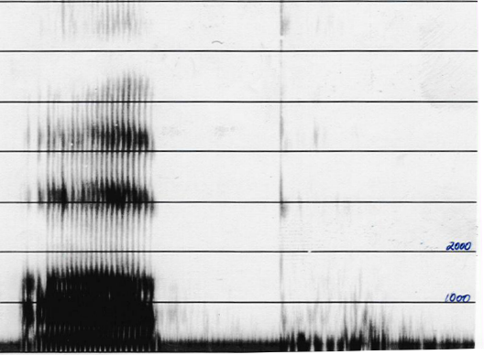
Consonant reading

Slide 70
answer
“up”
(irregular glottal vibrations at beginning is glottalization, common in vowel-initial words)

Slide 71
Consonant reading
lots of weak noise hard to see
clue


Slide 72
answer
“rough”
clue = low F3, for /r/

Slide 73
Consonant reading
clue
clue


Slide 74
answer
“luck”
clues = high F3 for /l/,
double burst for velar

Slide 75
Consonant reading
ignore

Slide 76
answer
“up”
clue = irregular glottal vibrations at beginning is glottalization, common in vowel-initial words

Slide 77
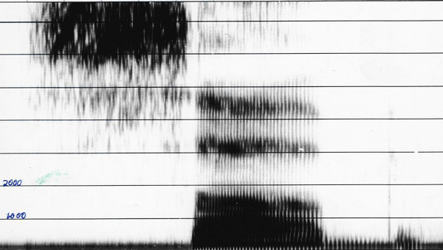
Consonant reading

clue

Slide 78
answer
“sub”
clue = closure voicing before burst

Slide 79
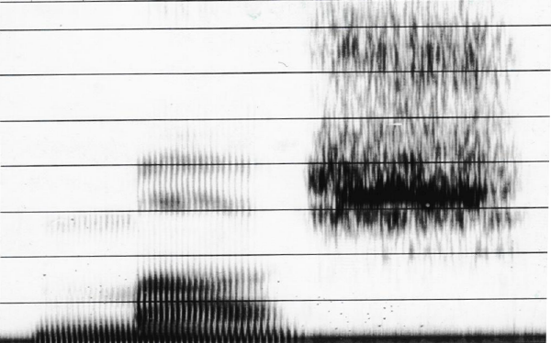
Consonant reading
clue
clue


Slide 80
answer
“mush”
clues =weak sonorant with abrupt end; fricative noise strong at F3 of vowel

Slide 81
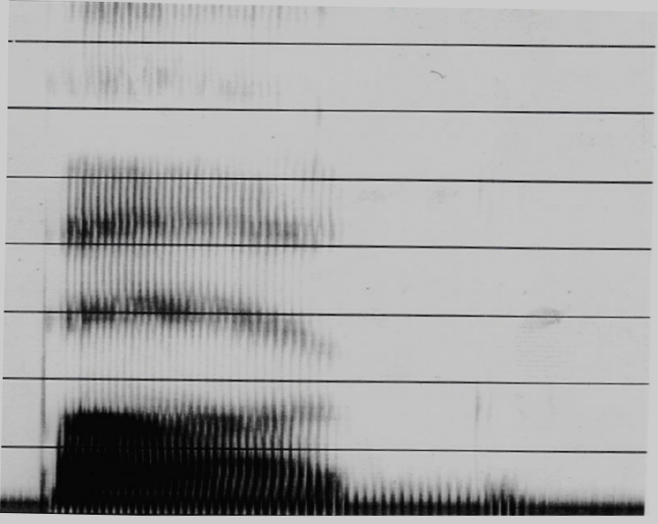
Consonant reading
clue
clue


Slide 82
answer
“bug”
clues =velar pinch; compact double burst (hard to see)

