Slide 1
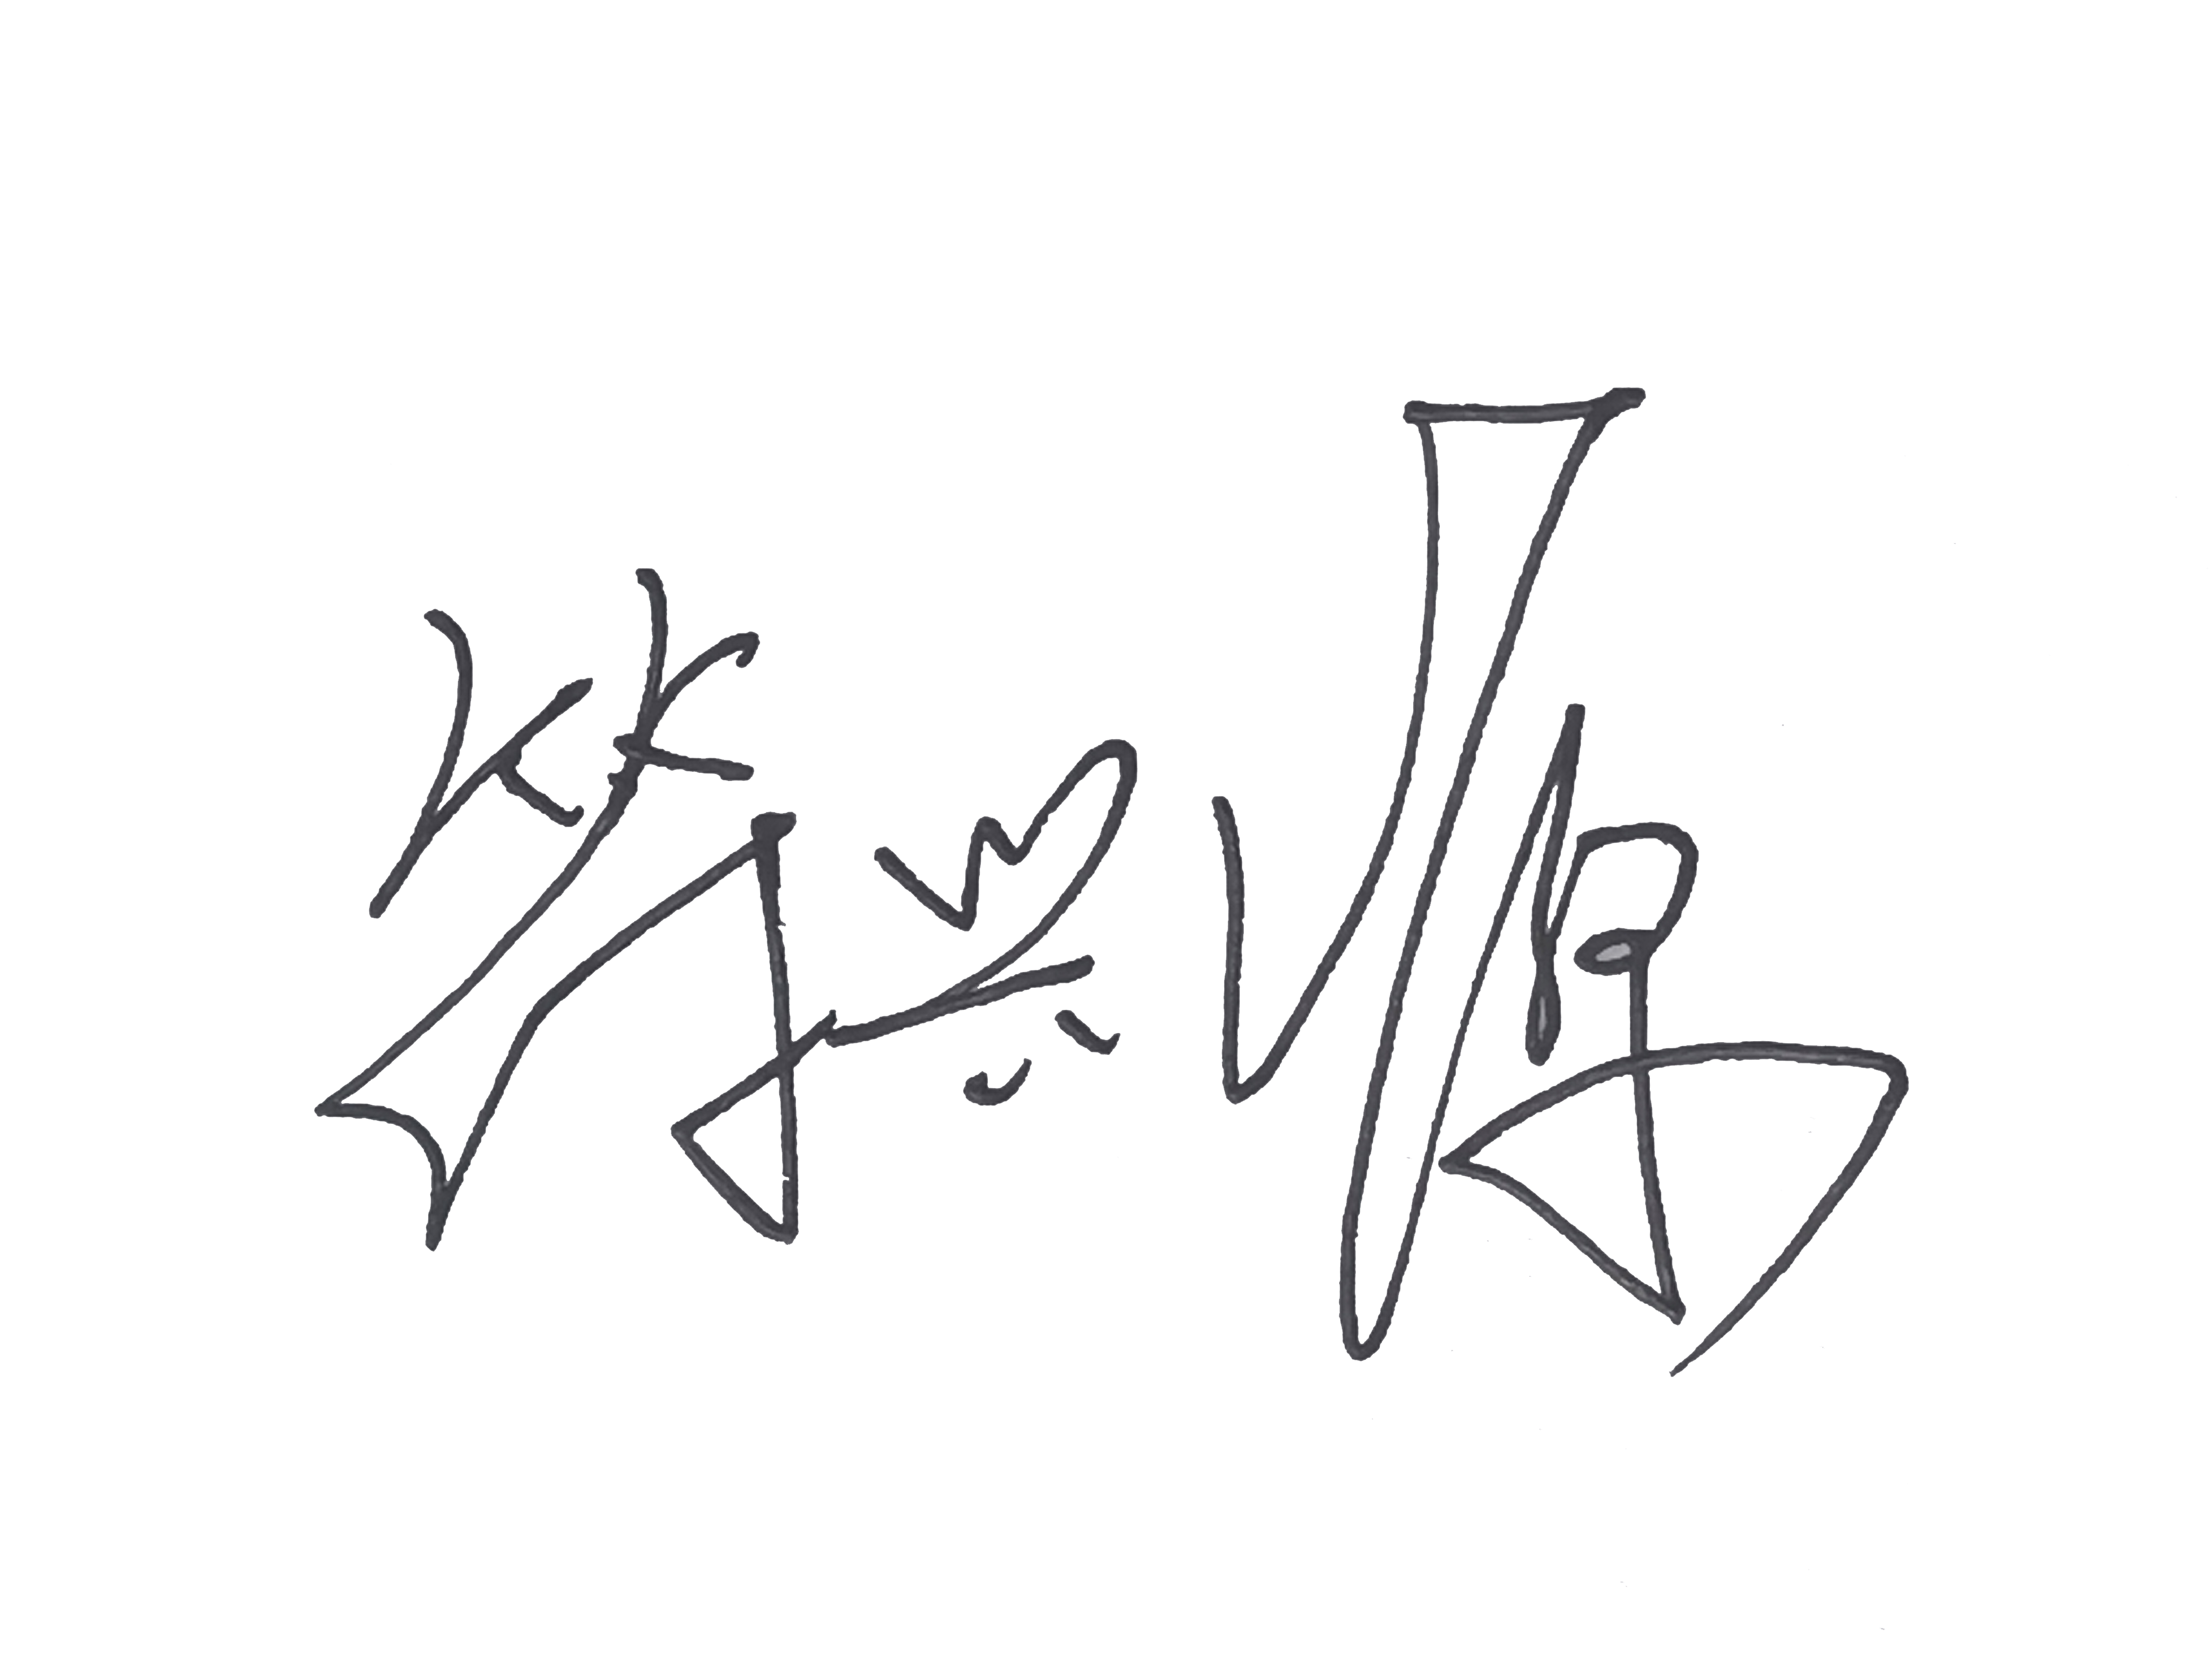
推荐信
致招生委员会 / 尊敬的相关负责人：
我很高兴推荐邢嘉欣申请人工智能伦理、人工智能治理、技术治理、数字人文及相关跨学科领域的研究生项目。
我是东北农业大学园艺学院园林系教授符兴源，于2017年至2019年担任邢嘉欣的硕士研究生导师。在她攻读硕士期间，我全程指导其研究工作，并持续关注她的学术成长与发展。
邢嘉欣本科阶段接受风景园林专业系统训练，硕士阶段进一步聚焦环境心理学与恢复性环境研究。她的硕士研究项目以中国北方医疗环境为研究对象，探讨植物景观色彩对使用者心理恢复的影响，综合运用文献研究、环境评价、实证调查与量化分析，深入考察不同人群对环境感知的差异。该研究不仅体现其扎实的研究设计能力，也展现了她将抽象理论转化为可操作研究框架的潜力。
在学期间，她参与了多项科研实践，包括：景观设计中安全感营造研究，城市公园使用者景观偏好与认知研究，观赏草在园林设计中的应用研究中。此外，她还深度参与了北方寒地村庄规划设计项目，负责人居环境中基础设施的人本化改善部分。这些经历锻炼了她的文献综合、案例收集，数据分析，实证操作和团队协作能力。
我对她最为深刻的印象是，她能够将设计项目提炼为结构清晰的研究问题，系统梳理文献，建立合理的评价维度，严谨处理实证数据，并将分析结论重新回馈至设计实践中，将风景园林空间思维与环境心理学、恢复性环境研究中的人本视角及量化工具相结合。我认为，这种跨学科研究训练为她后续进入更广阔的学术领域提供了坚实基础。
她目前对人工智能伦理、人工智能治理、技术治理及数字人文的浓厚兴趣，在我看来是其学术轨迹的自然延伸。她此前的研究始终聚焦于“人如何感知、体验并回应周围环境与系统”这一核心议题，而这一以人为中心的视角，恰恰是她未来探索人与技术、技术与社会之间复杂关系的重要基石。
综上所述，我推荐邢嘉欣申请人工智能伦理、人工智能治理、技术治理、数字人文及相关领域研究生项目。我相信她能将研究生阶段形成的研究素养进一步提升，以一贯的严谨与认真投身新的学术探索。
推荐人：
硕士研究生导师
东北农业大学园艺学院
电话：8615001308879
邮箱：fxy@neau.edu.cn

Slide 2
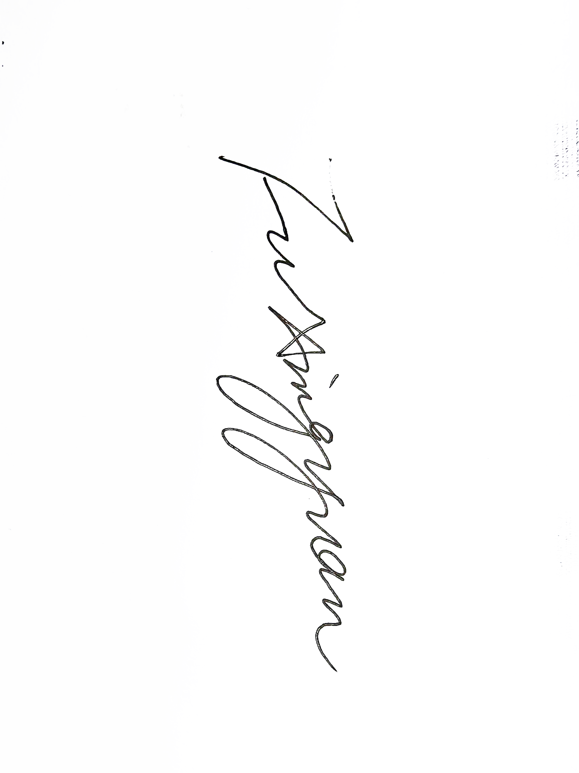
Recommendation Letter
To the Admissions Committee:
I am pleased to recommend JiaXin Xing for graduate study in AI Ethics, AI Governance, Technology Governance, Digital Humanities, and related interdisciplinary fields.
I am XingYuan Fu, a Professor in the Department of Landscape Architecture, College of Horticulture, Northeast Agricultural University, and served as JiaXin Xing’s Master’s supervisor from 2017 to 2019. During her Master’s studies, I provided continuous academic supervision of her research and closely followed her academic development.
JiaXin received systematic training in Landscape Architecture at the undergraduate level and subsequently focused on Environmental Psychology and restorative environments during her Master’s studies. Her Master’s research examined the effects of plant landscape colour on users’ psychological restoration in healthcare environments in northern China. The study integrated literature review, environmental assessment, empirical investigation, and quantitative analysis to examine differences in environmental perception among different user groups. The research demonstrated not only her sound ability in research design, but also her potential to translate abstract theoretical concepts into a structured and operational research framework.
During her graduate studies, she participated in several research projects, including studies on the creation of a sense of security in landscape design, landscape preferences and landscape cognition among urban park users, and the application of ornamental grasses in landscape design. She also made substantial contributions to a village planning and design project in northern cold-climate regions, where she was responsible for human-centred improvements to basic environmental infrastructure. These experiences strengthened her abilities in literature synthesis, case collection, data analysis, empirical research, and collaborative project work.
What impressed me most was her ability to transform design-oriented projects into clearly structured research questions, systematically review relevant literature, establish appropriate evaluation dimensions, rigorously analyse empirical data, and subsequently translate research findings back into design practice. She was able to integrate the spatial thinking of Landscape Architecture with the human-centred perspective of Environmental Psychology and restorative environment research, together with quantitative analytical approaches. I consider this interdisciplinary training a strong foundation for her subsequent academic development beyond the field of landscape architecture.
In my view, her current interest in AI Ethics, AI Governance, Technology Governance, and Digital Humanities represents a natural extension of her academic trajectory. Her previous research consistently focused on how people perceive, experience, and respond to their surrounding environments and systems. This human-centred perspective provides a valuable foundation for further examining the increasingly complex relationships between people and technology, and between technological systems and society.
On the basis of her academic performance, research training, and interdisciplinary potential, I am pleased to recommend JiaXin Xing for graduate study in AI Ethics, AI Governance, Technology Governance, Digital Humanities, and related fields. I am confident that she will build upon the research skills developed during her graduate studies and approach her future academic work with the same intellectual rigour, diligence, and commitment.
Sincerely,
Professor
Department of Landscape Architecture
College of Horticulture
Northeast Agricultural University
Master’s Supervisor of JiaXin Xing
Tel: 8615001308879
Email: fxy@neau.edu.cn

