Slide 1
FreeBalance
Transparency Portal
10 May 2021

Slide 2
Agenda
What is the FreeBalance Transparency Portal?
Benefits
How it Works?
Scope

Slide 3
Transparency Portal
The FreeBalance Transparency Portal is an E-Government application
Budget execution
Revenues
Budget and Transparency Related Information

Slide 4
Main Benefits
More transparency and accountability
More citizen participation
Increases Donors Confidence
Official source for International Support Organizations and Press
Information always available
User friendly interface

Slide 5



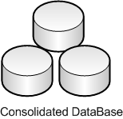
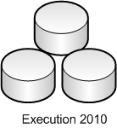
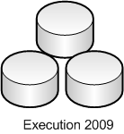
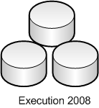
Transparency Portal
Revenue and expenditure
reports
Administrator
Commenting Blogs
…
Downloading laws,
learning about budget, etc.
…

Slide 6
Browsing the Transparency Portal
Public Section
Transparency Portal can be accessed through link http://www.budgettransparency.gov.tl/public
Basic concepts
  Homepage elements
  Data page navigation
  Chart creation

Slide 7
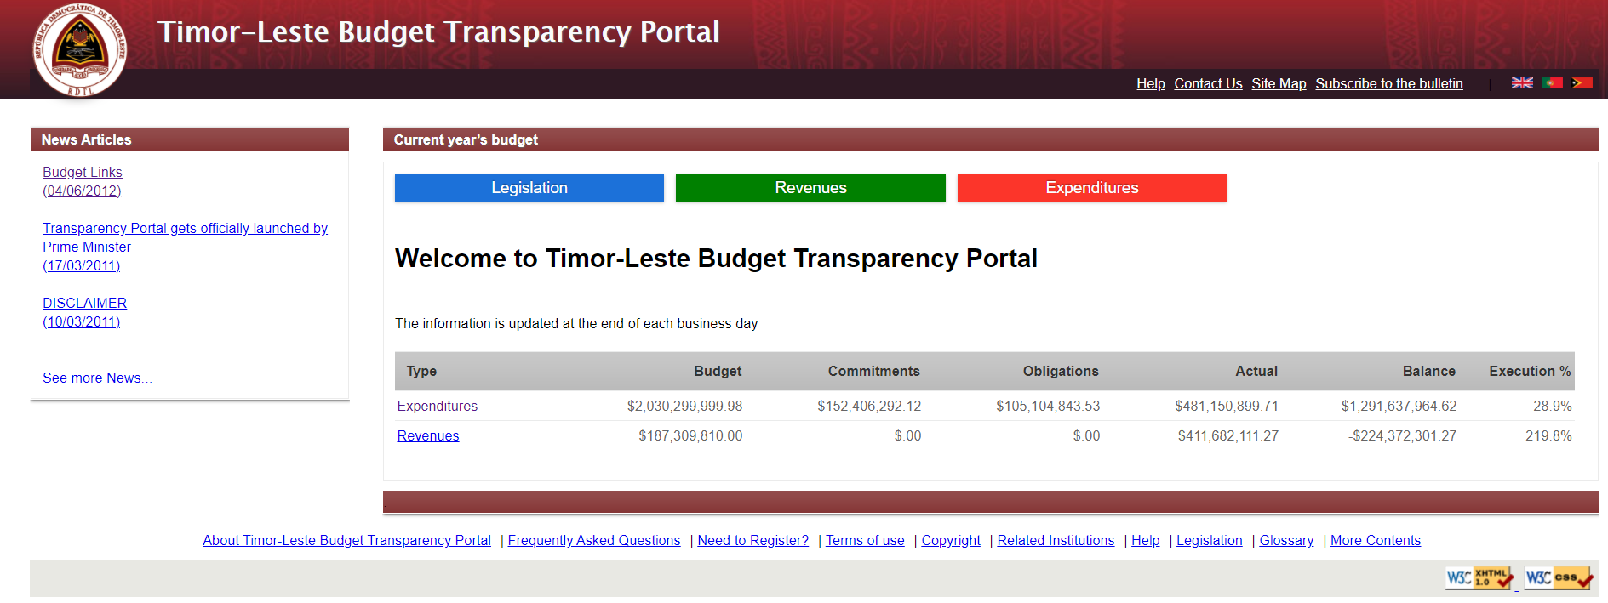
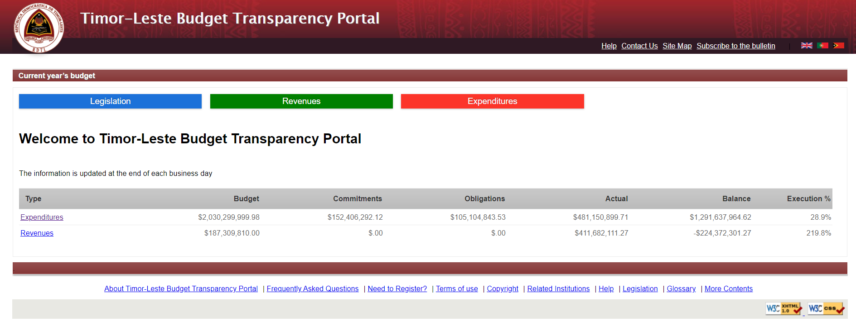

Homepage elements

Slide 8
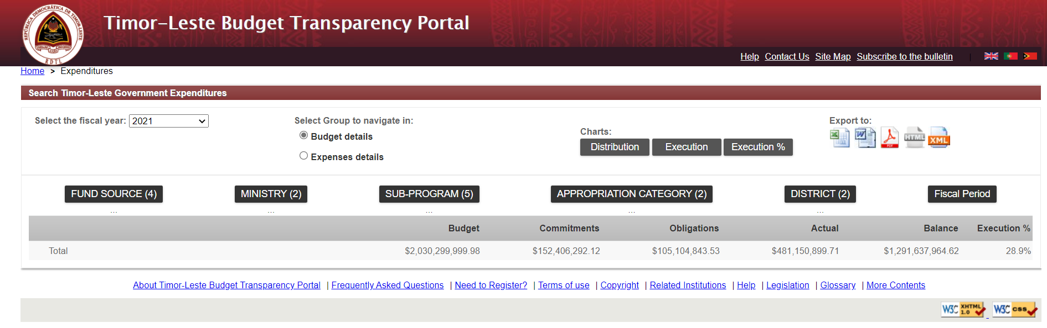






Data page - Budget
Source
Who
Activity
What
Where
When

Slide 9
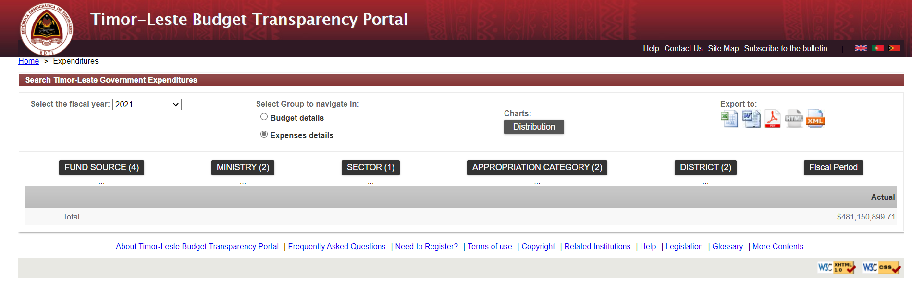

Data page - Expenses
Source
Who
Activity
What
Where
When

Slide 10


