Slide 1

Exploratory Data Analysis
Taxicab Usage Analysis
16 June 2022

Slide 2

Introduction & Background
XYZ is a private US-based firm looking to invest in the Cab Industry
In the last few years the cab industry has seen a remarkable growth in the US
We are looking to provide insights into the cab market. We will analyze by:
Profit Analysis
Share by City
Population-based Trends
Seasonal Effects
Demographic Reach

Slide 3
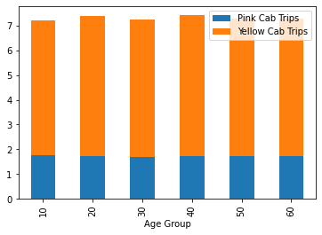
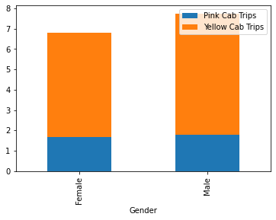
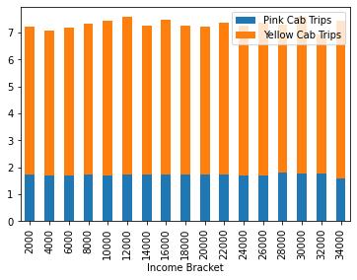
Demographic Reach
Yellow Cab and Pink Cab have widespread reach across all ages, socioeconomic status, and both genders
Men tend to use the cab services more frequently
Yellow Cab frequency is about 3x Pink Cab frequency
Chart: Average number of trips per customer in 2016-18 grouped by age (10s, 20s, 30s, etc.), and Income Bracket ($2000+, $4000+, etc.)

Slide 4
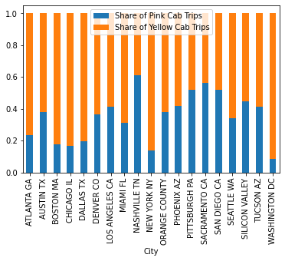
Reach by City
Chart: Share of Pink Cab and Yellow Cab Trips in each city. In most cities Yellow Cab takes up a larger share

Slide 5
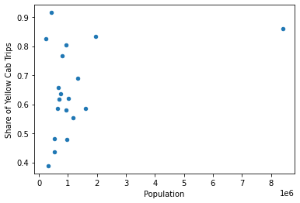
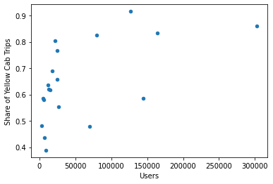
Reach by City
Yellow Cab has a larger reach compared to Pink Cab in larger cities
For a 10-fold increase in city population, share of Yellow Cab trips is 13.6% higher
Graph: Share of Yellow Cab trips against population and number of users per city.

Slide 6
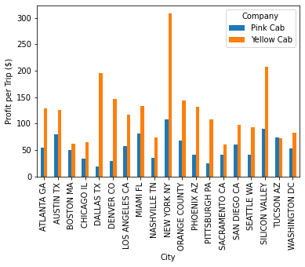
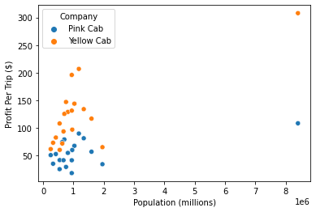
Profit Analysis by City
Average profit made per trip by city

Slide 7
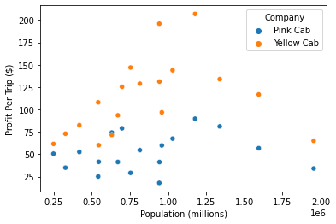
Profit Analysis by City
Average profit made per trip by city (excluding the outlier New York)

Slide 8
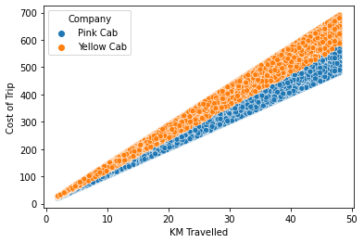
Profit Analysis of Trips
Cost of Trips based on distance (km):
Pink Cab Average: $11.00/km
Yellow Cab Average: $13.20/km

Slide 9
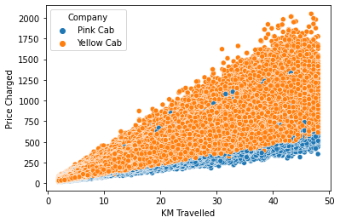
Profit Analysis of Trips
Price Charged based on distance (km):
Pink Cab Average: $13.80/km
Yellow Cab Average: $20.27/km

Slide 10
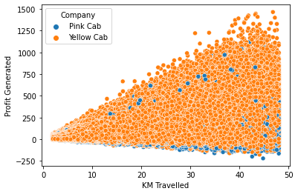
Profit Analysis of Trips
Profit based on distance (km):
Pink Cab Average: $2.81/km
Yellow Cab Average: $7.07/km
(Profit per km independent of distance)

Slide 11
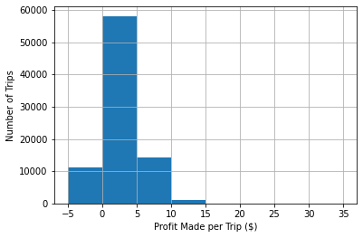
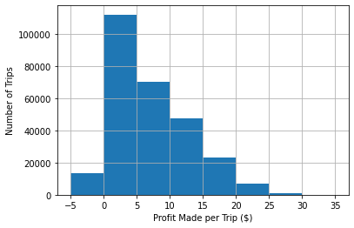
Profit Analysis of Trips
Profit Distribution of Trips
Pink Cab: 13.14% of trips ended in an overall loss
Yellow Cab: 4.98% of trips ended in an overall loss

Slide 12
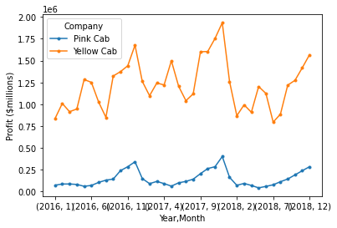
Seasonal Trends
Monthly Profit between January 2016 and December 2018

Slide 13
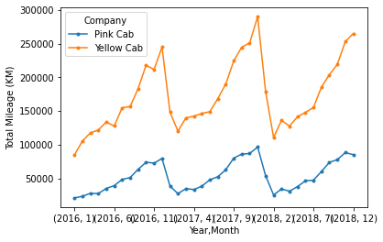
Seasonal Trends
Monthly Mileage between January 2016 and December 2018

Slide 14
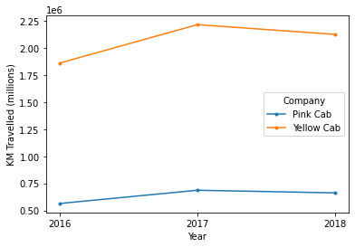
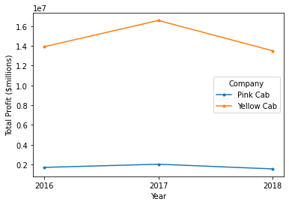
Seasonal Trends
Annual Mileage and Profit between 2016 and 2018
Although mileage has increased, profit has seen a slight decrease in both companies.

Slide 15
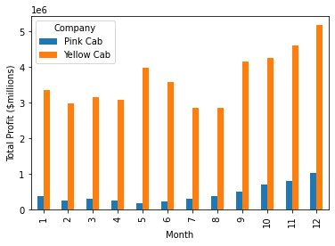
Seasonal Trends
Total profit by month, 2016-18

Slide 16
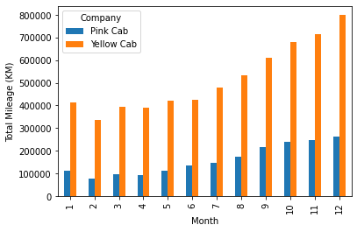
Seasonal Trends
Total mileage by month, 2016-18

Slide 17
Summary & Recommendations
Yellow Cab has consistently shown a wider reach across all demographic groups compared to Pink Cab
Yellow Cab is better at reaching more customers in larger cities, while Pink Cab is better at reaching more customers in smaller cities
Yellow Cab has better reach in every city except for four
Average profit made per trip for Yellow Cab is higher than that for Pink Cab in all but one city
On a per km basis, Yellow Cab is more profitable than Pink Cab, and is less likely to make a loss on a given trip
Seasonal Trends: Both companies have more frequent trips in the late months of the year (October, November, December)
Based on this data, we recommend to invest in Yellow Cab over Pink Cab.

Slide 18
Thank You

