Slide 1

How To Debug WebSite How to treating the elephant 6/8/2016 – Paul.Huang

Slide 2
How many steps to
put elephant in fridge?
Notes:
How many steps put elephant in fridge？
Blind men feeling an elephant
Meaning of presentation
- For myself
- For collage

Slide 3
How many steps to treat the elephant？

Slide 4
Understand the whole picture
- Subsystem / Third part plugin / Environment
Quick understand subsystem
- Build iteration environment
Find lesions
- Locate the problem
Special conditions
- Performance issue
Notes:
Understand the whole picture
How to quickly build iteration environment？Why Alpha Go won？
How to quickly locate the problem？
Special Problem

Slide 5
Understand the whole picture
- Subsystem / Third part plugin / Environment
Quick understand subsystem
- Build iteration environment
Find lesions
- Locate the problem
Special conditions
- Performance issue

Slide 6
What's the name of our system structure ?

Slide 7
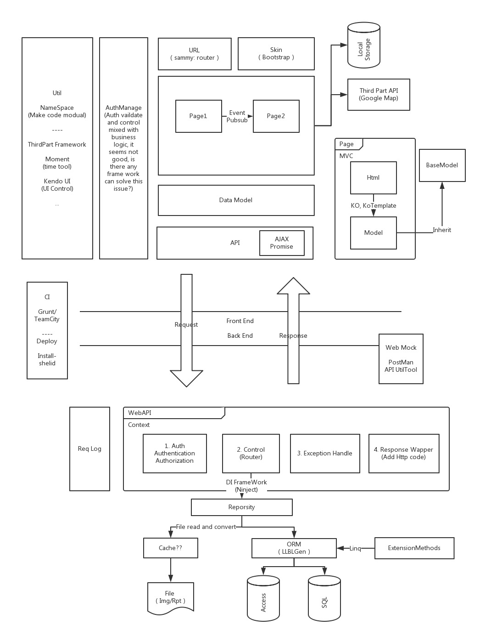
B/S Strcture
Frameworks used to buid Interface
Do you know CI ?
 | Front | Behind | Inner
Browser
Sever
DB

Slide 8
What's the meaning of CI?
- Continuous integration
CI for transfinder?
- Grunt
- TeamCity
Notes:
What's the meaning of CI?
- http://www.ruanyifeng.com/blog/2015/09/continuous-integration.html

Slide 9
Visible
Subsystem
- FrontEnd
- BackEnd
- DB
- GpsDB (Gps Real Time Data)
- MapDB (Gis Data)
- CI
Third Part PlugIn
- Controller / kendoUI
- Data Binding / knockoutJS
Invisible
Running Environment
- Chrome
- .Net
- Sql server
- Sql lite
- Nodejs

Slide 10
Understand the whole picture
- Subsystem / Third part plugin / Environment
Quick understand subsystem
- Build iteration environment
Find lesions
- Locate the problem
Special conditions
- Performance issue

Slide 11
Tools List
 | Front Mock / Monitor / Test Famework | Running Time Debug | Other
Browser | QTP | Chrome | JSfiddle
Server | Curl Fiddler Postman ApiUtility (node-webkit) | VisualStudio | Windbg (for dump)
Sql Server | Sql Profiler | Sql Management
Sql Lite |  | SQLite Expert
NodeJS | JSHint Jasmine | Node-Inspector | CMD

Slide 12
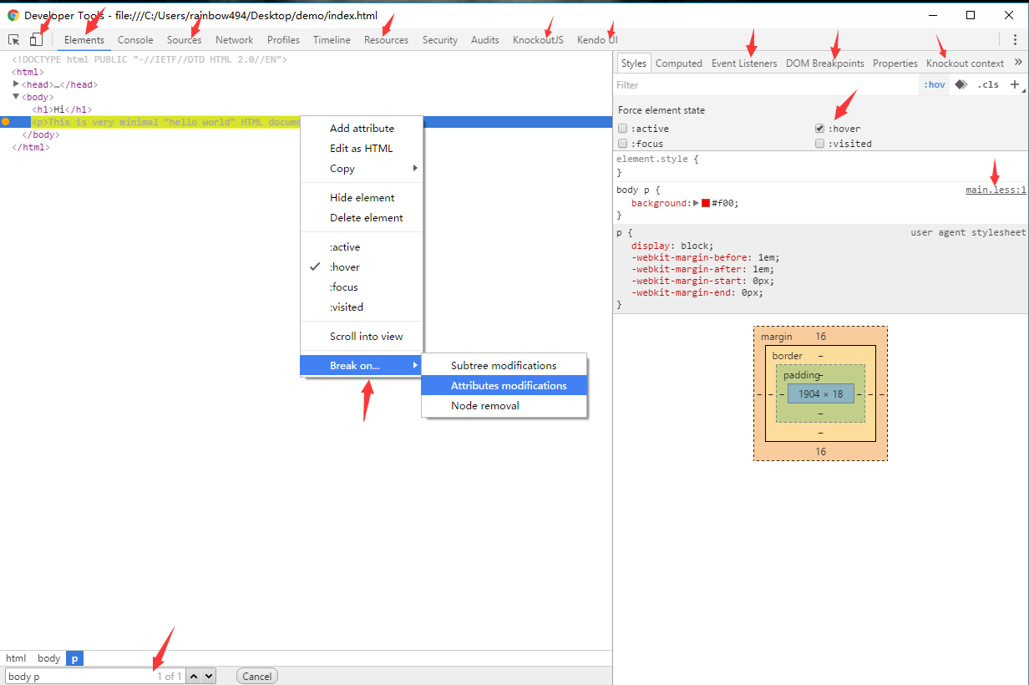
Browser
CSS / LESS
- What is LESS?
- How to Debug LESS?
- What is sourceMap?
HTML (DOM)
- Something U Must Know (1)
a. elements panel
b. resources panel
c. third part framework debug tool
JS
- Something U Must Know (2)
a. source panel
b. console panel
c. network panel
Notes:
What's LESS?
http://www.ibm.com/developerworks/cn/web/1207_zhaoch_lesscss/index.html
How to Debug LESS File?
https://github.com/rainbow494/code-reference/tree/master/examples/how-to-debug-website/demo
What's sourceMap File?
http://www.ruanyifeng.com/blog/2013/01/javascript_source_map.html
Something U Must Know (1)
- Elements Panel
- Filters (Jquery CSS Selector)
- Dom Edit
- Event Listiner
- Dom Break Point
- Responsive Design
- Resources Panel
- Local Storage
- Third Part Frame Work
- chrome-extension： kendo ui
- chrome-extension： knockoutjs context debugger
Something U Must Know (2)
- Source Panel
- pause on exception (first exception)
- add jquery.js to black box
- format min.js
- edit js file and running direct
- edit file in your computer
- Console Panel
- Newworks Panel

Slide 13
.NET
PostMan / ApiUtility64
First Throw Exception
- What is first throw exception?
WinDbg
- How to locate bug if it found in your customer's computer?
(when you cannot use vistual studio)

Slide 14
SQL Server / SQL Lite
Sql Profiler
- How to anylaize sql statement build by llbengen?
Sql Management
SQLite Expert
- How to view gis data stored in sql lite database?
Notes:
- sql lite
- [sqllite](http://www.oschina.net/news/43608/5-popular-and-free-sqlite-management-tools)

Slide 15
NodeJS
What happened when you click build.bat?
How to execute grunt by command line?
How to debug a nodejs programe?

Slide 16
Understand the whole picture
- Subsystem / Third part plugin / Environment
Quick understand subsystem
- Build iteration environment
Find lesions
- Locate the problem
Special conditions
- Performance issue

Slide 17
System Interface
- Browser - Server
- Server - GPS DB
- Server - GIS DB
- Server - SQL Server / Access
System Inside
- Presistent Data
- Running Time Envirornment
Special Enviroments
- Build Agent
- Rollback to old version
Notes:
Browser - Server
- net panel
- console log panel log xml httprequest
Server - GPS DB
- connection config: C:\acs2015\TFGPS.INI
- data related ( data db - gps db)
```
acs.vehicle.name => gps.vehicle.id
acs.vehicle.gpsid => gps.vehicle.ExternalID
```
Server - GIS DB
- db locate : C:\DevelopmentGit\RoutefinderApi\RoutefinderApi\local\sample\db7\dataSourceSpatial
- code in server : C:\DevelopmentGit\Core\Transfinder.Routefinder.Data\Spatial\SpatialConverter.cs
Server - SQL Server
- orm mapping - search PersistenceInfoProvider.cs in webapi
Build Agent
- buildagent2-dt/ViewfinderDev/
- buildagent2-dt/RoutefinderWebDev/zh-CN/html/
Rollback to old version
- git reset
- docker

Slide 18
Understand the whole picture
- Subsystem / Third part plugin / Environment
Quick understand subsystem
- Build iteration environment
Find lesions
- Locate the problem
Special conditions
- Performance issue

Slide 19
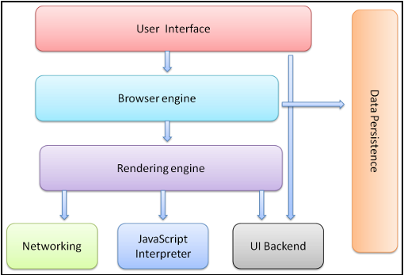
Browser
- How browsers work?
- You Must Know
- Technaicl / Skill we used(1)
Server
- Visual studio analyzer
- Technaicl / Skill we used(2)
Sql Server
- Execution Plan
Notes:
How browsers work?
- http://taligarsiel.com/Projects/howbrowserswork1.htm
- http://www.oschina.net/question/12_32766?fromerr=gAVoJWBR
You Must Know (Chrome Dev Tool)
- Profiler - Memory Leak
- Time Line - Animation Render Slowly
- Console - Console.Time
- Network -Throtting Setting
Technaicl / Skill we used(1)
- virtual Scroll Bar
- reduce response data size
Technaicl / Skill we used(2)
- gzip
- cache
- etag

Slide 20
Brain Storm
How to updated favicon.ico correctly?

