Slide 1
Need a proctor in exam ?
UESTC

Slide 2
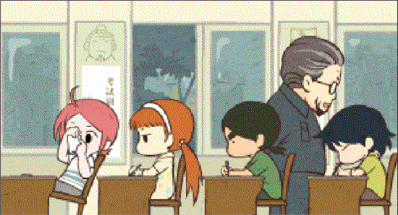
The exam is a way of assessing the student's learning status, which can truly reflect the student's knowledge level. Only a fair test environment can create a fair atmosphere.

Slide 3
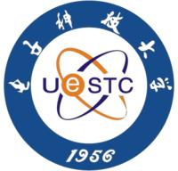
As we all know, exam cheating is almost always appearing in major universities, especially university campuses, and UESTC is no exception. At the same time, I believe that we all have encountered this kind of thing, and maybe even recently.
作弊?

Slide 4
Why need a proctor in exam ?

Slide 5
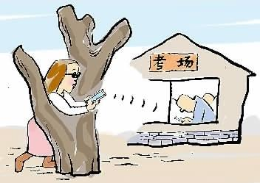
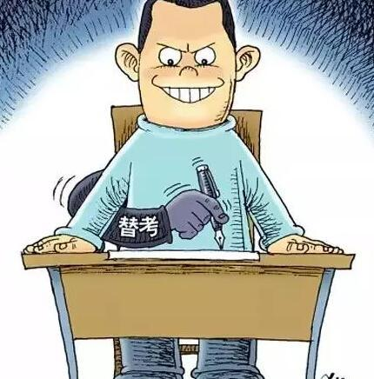
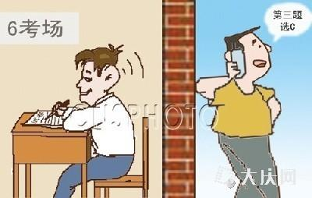
There are many forms of cheating in the exam. If there is no proctor, even if only some of the students cheated, the exam may become meaningless and may even lead to bad learning atmosphere.

Slide 6
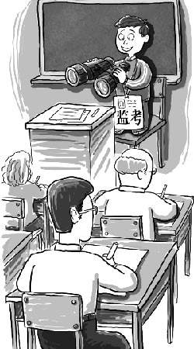
The setting of the proctor is not aimed at some students but an authority on all students and a symbol of justice.

Slide 7
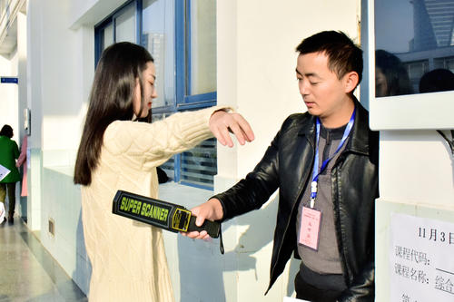
The proctor not only plays the role of supervising the students, but also serves the candidates and maintains the normal examination room order.

Slide 8
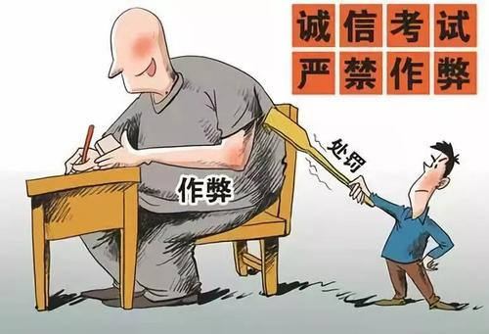
In short, at UESTC, proctors are necessary to appear in the examination room. However, that doesn't mean you don't trust your classmates because it's like a coin with both sides. For the classmates who are cheating, it is supervision, and for the students of the integrity test, it is service.

Slide 9
Thanks For Your Listening

