Slide 1
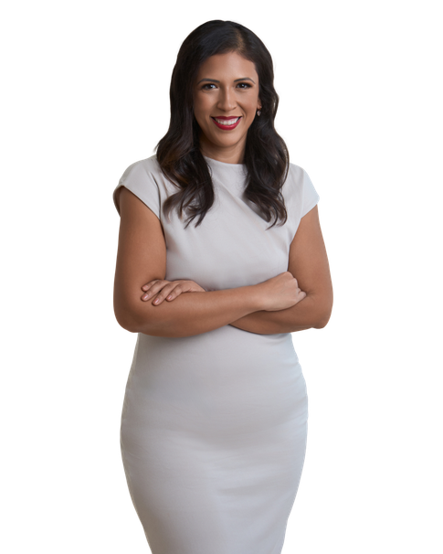

We are officially under contract!!
Congratulations!
123 Placeholder Ave.
Seattle, Washington
PURCHASE PRICE
EARNEST MONEY
$10,000,000
TBD
Here's the Timeline
Contacts
EFFECTIVE DATE
TBD
TITLE COMPANY
Lender’s Title Company
EARNEST MONEY DUE
TBD
203 Westport Drive #A
Cabot AR 72023
INSPECTION DATE
PENDING
Allison Wells/Rose Betcher
Phone: 501-843-2128
INSPECTION PERIOD ENDS
TBD
Email@company.com
APPRAISAL DATE
PENDING
LENDER
Lee Well
FINAL WALK-THROUGH
TBD
123 Street Address
City, State 12345
CLOSING DATE
TBD
Contact Name
Phone: 123-456-7890
Email@company.com
Notes
HOME INSPECTIONS
Inspection Company Name
We will wait to order appraisal until we get through the inspection period.
3
4
5
6 – test 6 – test 6 – test 6 – test 6 – test 6 – test
Contact Name
Phone: 123-456-7890
Email@company.com
SURVEY COMPANY
Kevin Beadle
Title Company will order
11111111
222
3
4
5
6
Survey Authorization needed
HOME INSURANCE
Pending
Contact Name
Phone: 123-456-7890
Please let me know if you have any questions!
Email@company.com
325.829.2839
Diana.dominguez@icloud.com
www.pcsingtolittlerock.com

