Slide 1

Quickly Hacking AI on Azure with Cognitive AI Hackathon Workshop
Gabriel Nepomuceno
Campus London, 23rd June 2017

Slide 2
What do we have to help you quickly build AI easy ?
Notes:
This is what most of our customers and ISVs do, dip their toe in the water with IaaS first as it’s perceived to be a quick win.
Let’s take a closer look and see just how quick a win this can be !

Slide 3







Different levels for AI
How fast do you want to have it on?
How much control do you want?
Notes:
Moving from cientif to engineer and business

Slide 4
Cognitive Services

Slide 5








Using Cognitive Services

Slide 6

Face Api
{
"FaceId": "42334493-d74e-40e4-9a05-50a00489ada6",
"FaceRectangle": {
"Top": 124,
"Left": 459,
"Width": 227,
"Height": 227
},
"FaceAttributes": {
"Hair": {
"Bald": 0.01,
"Invisible": false,
"HairColor": [ {
"Color": "brown",
"Confidence": 1.0
}, {
"Color": "blond",
"Confidence": 0.69
}, {
"Color": "black",
"Confidence": 0.45
}, {
"Color": "other",
"Confidence": 0.32
}, {
"Color": "gray",
"Confidence": 0.06
}
]
},
"Smile": 0.826,
"HeadPose": {
"Pitch": 0.0,
"Roll": -16.9,
"Yaw": 21.3
},
"Gender": "female",
"Age": 23.8,
"FacialHair": {
"Moustache": 0.0,
"Beard": 0.0,
"Sideburns": 0.0
},
"Glasses": "ReadingGlasses",
"Makeup": {
"EyeMakeup": true,
"LipMakeup": true
},
"Emotion": {
"Anger": 0.103,
"Contempt": 0.003,
"Disgust": 0.038,
"Fear": 0.003,
"Happiness": 0.826,
"Neutral": 0.006,
"Sadness": 0.001,
"Surprise": 0.02
},
"Occlusion": {
"ForeheadOccluded": false,
"EyeOccluded": false,
"MouthOccluded": false
},
"Accessories": [
{
"Type": "glasses",
"Confidence": 0.99
}
],
"Blur": {
"BlurLevel": "low",
"Value": 0.0
},
"Exposure": {
"ExposureLevel": "goodExposure",
"Value": 0.48
},
"Noise": {
"NoiseLevel": "low",
"Value": 0.11
}
},
"FaceLandmarks": {
"PupilLeft": {
"X": 504.4,
"Y": 202.8
},
"PupilRight": {
"X": 607.7,
"Y": 175.9
},
"NoseTip": {
"X": 598.5,
"Y": 250.9
},
"MouthLeft": {
"X": 527.7,
"Y": 298.9
},
"MouthRight": {
"X": 626.4,
"Y": 271.5
},
"EyebrowLeftOuter": {
"X": 452.3,
"Y": 191.0
},
"EyebrowLeftInner": {
"X": 531.4,
"Y": 180.2
},
"EyeLeftOuter": {
"X": 487.6,
"Y": 207.9
},
"EyeLeftTop": {
"X": 506.7,
"Y": 196.6
},
"EyeLeftBottom": {
"X": 506.8,
"Y": 212.9
},
"EyeLeftInner": {
"X": 526.5,
"Y": 204.3
},
"EyebrowRightInner": {
"X": 583.7,
"Y": 167.6
},
"EyebrowRightOuter": {
"X": 635.8,
"Y": 141.4
},
"EyeRightInner": {
"X": 592.0,
"Y": 185.0
},
"EyeRightTop": {
"X": 607.3,
"Y": 170.1
},
"EyeRightBottom": {
"X": 612.2,
"Y": 183.4
},
"EyeRightOuter": {
"X": 626.6,
"Y": 171.7
},
"NoseRootLeft": {
"X": 549.7,
"Y": 201.0
},
"NoseRootRight": {
"X": 581.7,
"Y": 192.9
},
"NoseLeftAlarTop": {
"X": 557.5,
"Y": 241.1
},
"NoseRightAlarTop": {
"X": 603.7,
"Y": 228.5
},
"NoseLeftAlarOutTip": {
"X": 549.4,
"Y": 261.8
},
"NoseRightAlarOutTip": {
"X": 616.7,
"Y": 241.7
},
"UpperLipTop": {
"X": 593.2,
"Y": 283.5
},
"UpperLipBottom": {
"X": 594.1,
"Y": 291.6
},
"UnderLipTop": {
"X": 595.6,
"Y": 307.0
},
"UnderLipBottom": {
"X": 598.0,
"Y": 320.7
}
}
}

Slide 7
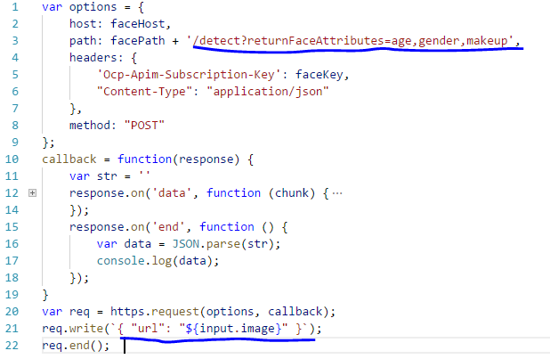
Rest Code Face Detection
JS

Slide 8
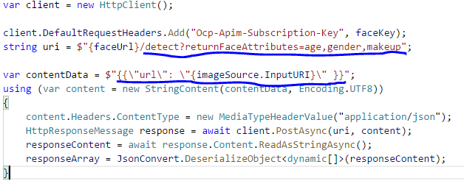
Rest Code Face Detection
C#

Slide 9
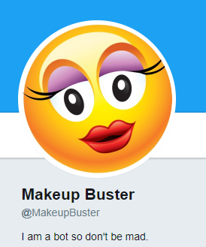
Twitter Makeup Buster
https://twitter.com/makeupbuster
#nomakeup

Slide 10



Using Logic Apps

Slide 11
Show me the CODE!

